Slide 1
Algorithm Design for Big Data Systems
Divide and conquer
Graph algorithms
Streaming algorithms

Slide 2
Embarrassingly Parallel Problems
Problems that can be easily decomposed into many independent problems.
Examples.
Word count
k-means
PageRank

Slide 3
Divide and Conquer
code at: https://www.cse.ust.hk/msbd5003/nb/DC.ipynb

Slide 4
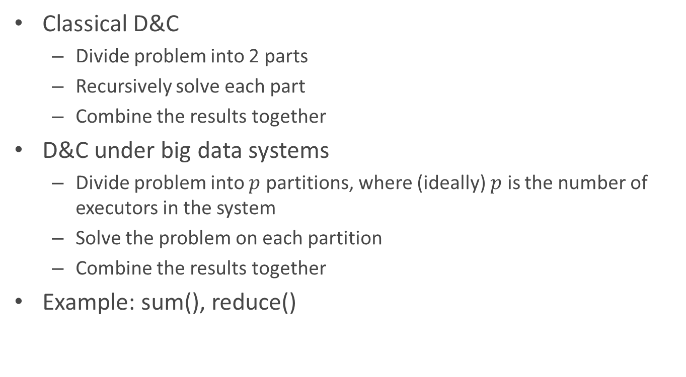
Classical Divide-and-Conquer
Classical D&C
Divide problem into 2 parts
Recursively solve each part
Combine the results together
D&C under big data systems
Divide problem into $p$ partitions, where (ideally) $p$ is the number of executors in the system
Solve the problem on each partition
Combine the results together
Example: sum(), reduce()

Slide 5
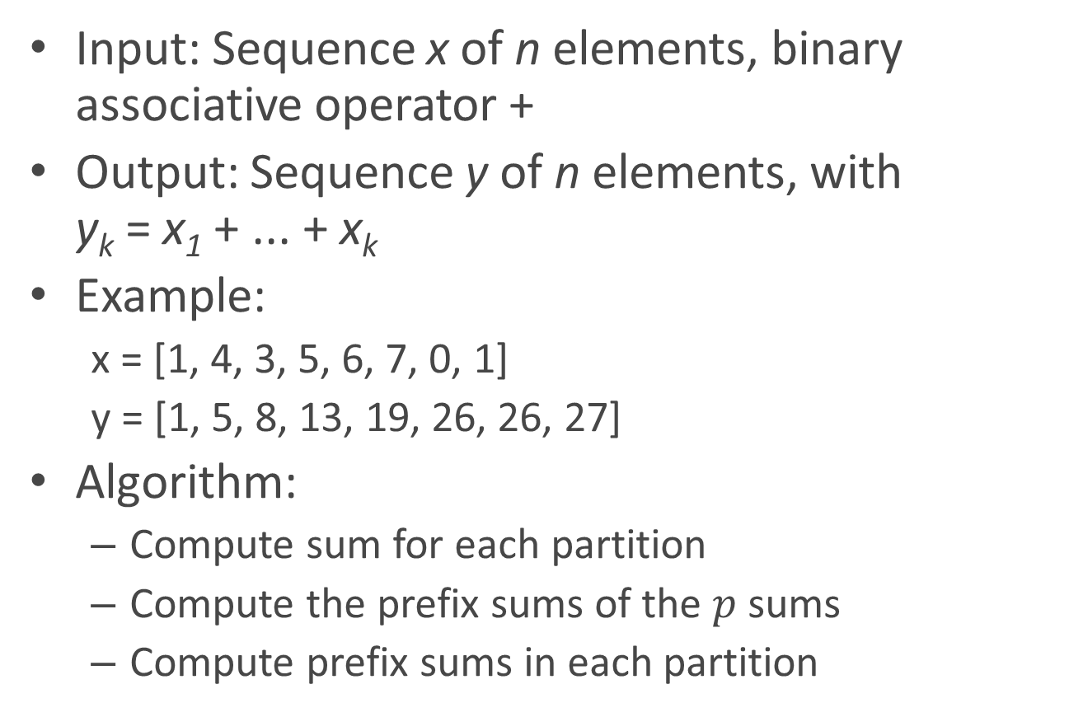
Prefix Sums
Input: Sequence x of n elements, binary associative operator +
Output: Sequence y of n elements, with y_{k} = x₁ + ... + x_{k}
Example:
x = [1, 4, 3, 5, 6, 7, 0, 1]
y = [1, 5, 8, 13, 19, 26, 26, 27]
Algorithm:
Compute sum for each partition
Compute the prefix sums of the $p$ sums
Compute prefix sums in each partition

Slide 6
Variants of Prefix Sums
Assign consecutive id’s for each element
zipWithIndex()
Given a list of words, find the first appearance of “spark”
Given two long strings, compare them lexicographically
Given a sequence of integers, check whether these numbers are monotonically decreasing.

Slide 7
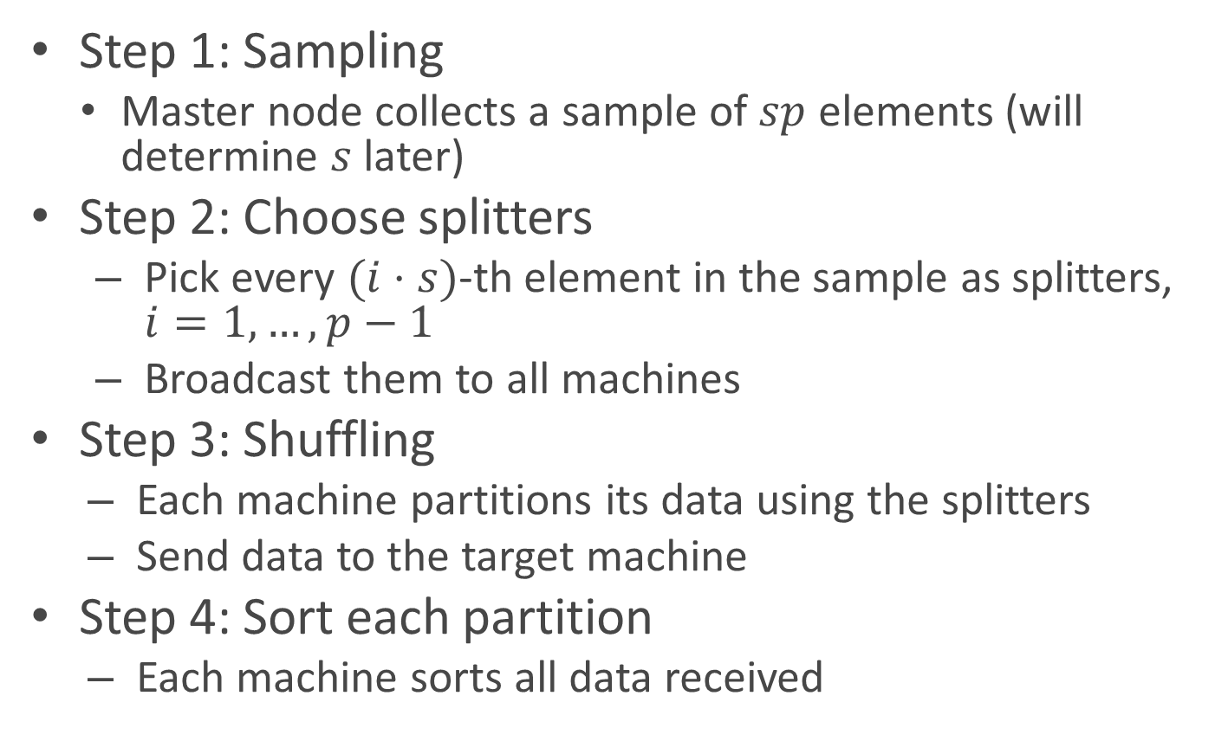
Sorting (Sample Sort)
Step 1: Sampling
Master node collects a sample of $sp$ elements (will determine $s$ later)
Step 2: Choose splitters
Pick every $(i⋅s)$-th element in the sample as splitters, $i=1,…, p−1$
Broadcast them to all machines
Step 3: Shuffling
Each machine partitions its data using the splitters
Send data to the target machine
Step 4: Sort each partition
Each machine sorts all data received

Slide 8
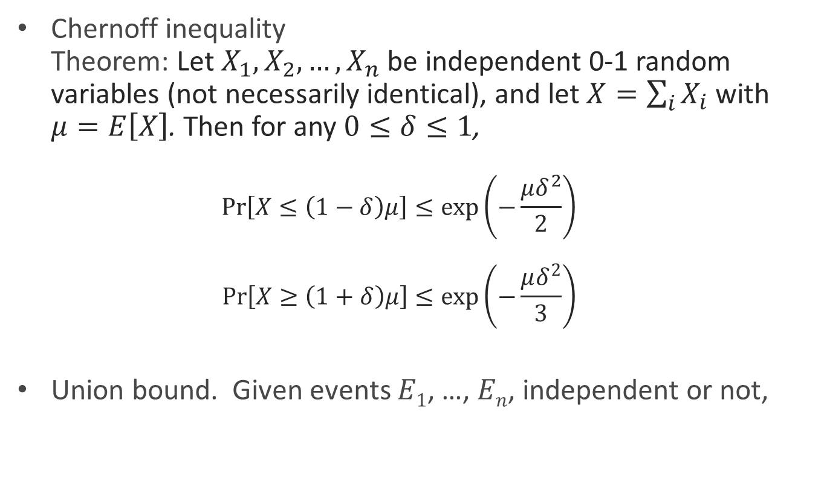
Probability Tools
Chernoff inequality Theorem: Let $X_{1},X_{2},…, X_{n}$ be independent 0-1 random variables (not necessarily identical), and let $X=\sum_{i}{X_{i}}$ with $μ=E\left[X\right]$. Then for any $0≤δ≤1$, $\operatorname{Pr}\left[X≤\left(1−δ\right)μ\right]≤\exp\left(−\frac{μδ^{2}}{2}\right)$ $\operatorname{Pr}\left[X≥\left(1+δ\right)μ\right]≤\exp\left(−\frac{μδ^{2}}{3}\right)$
Union bound. Given events $E1$, …, $En$, independent or not,

Slide 9
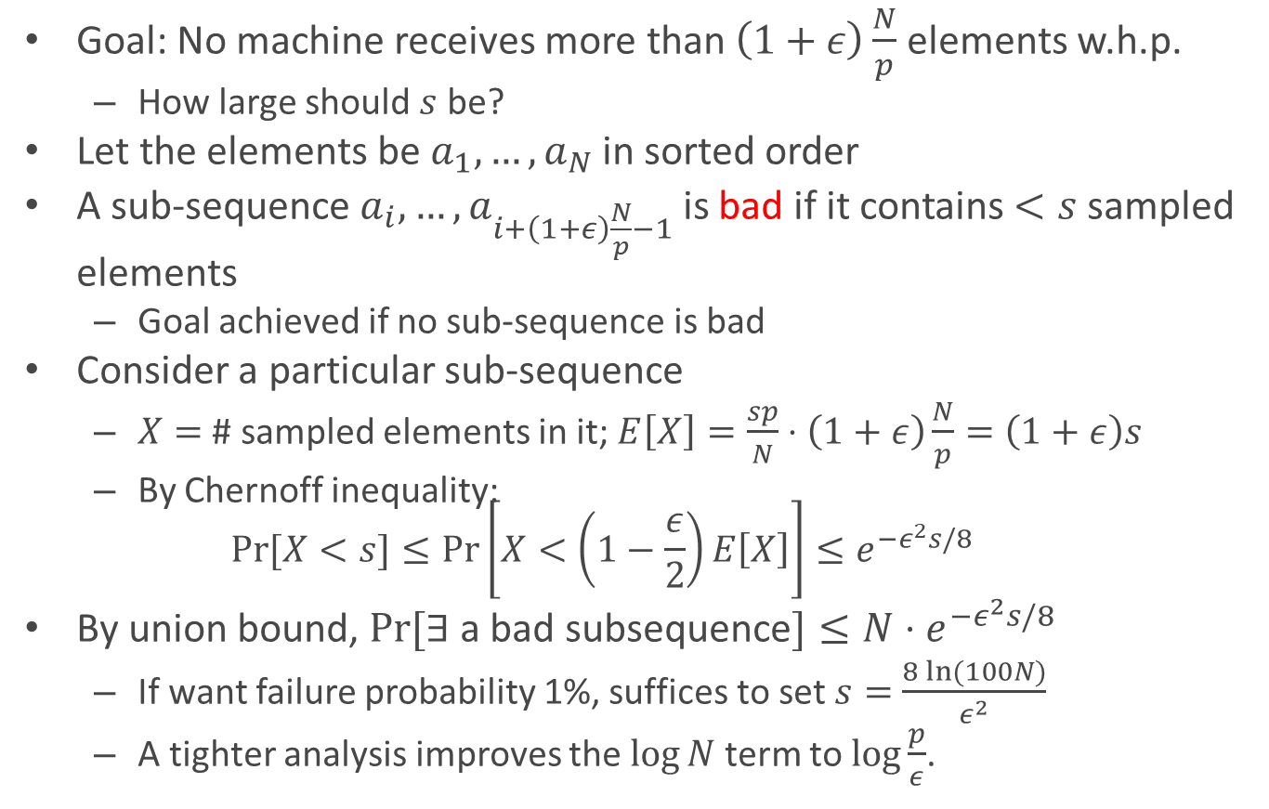
Determining Sample Size
Goal: No machine receives more than $\left(1+ε\right)\frac{N}{p}$ elements w.h.p.
How large should $s$ be?
Let the elements be $a_{1},…,a_{N}$ in sorted order
A sub-sequence $a_{i},…, a_{i+\left(1+ε\right)\frac{N}{p}−1}$ is bad if it contains $<s$ sampled elements
Goal achieved if no sub-sequence is bad
Consider a particular sub-sequence
$X=$ # sampled elements in it; $E\left[X\right]=\frac{sp}{N}⋅\left(1+ε\right)\frac{N}{p}=\left(1+ε\right)s$
By Chernoff inequality: $\operatorname{Pr}{[X<s]}≤\operatorname{Pr}\left[X<\left(1−\frac{ε}{2}\right)E\left[X\right]\right]≤e^{−ε^{2}s/8}$
By union bound, $Pr⁡[∃$ a bad subsequence$]≤N{⋅e}^{−ε^{2}s/8}$
If want failure probability 1%, suffices to set $s=$ $\frac{8 ln⁡(100N)}{ε^{2}}$
A tighter analysis improves the $\log{N}$ term to $\log{\frac{p}{ε}}$.

Slide 10
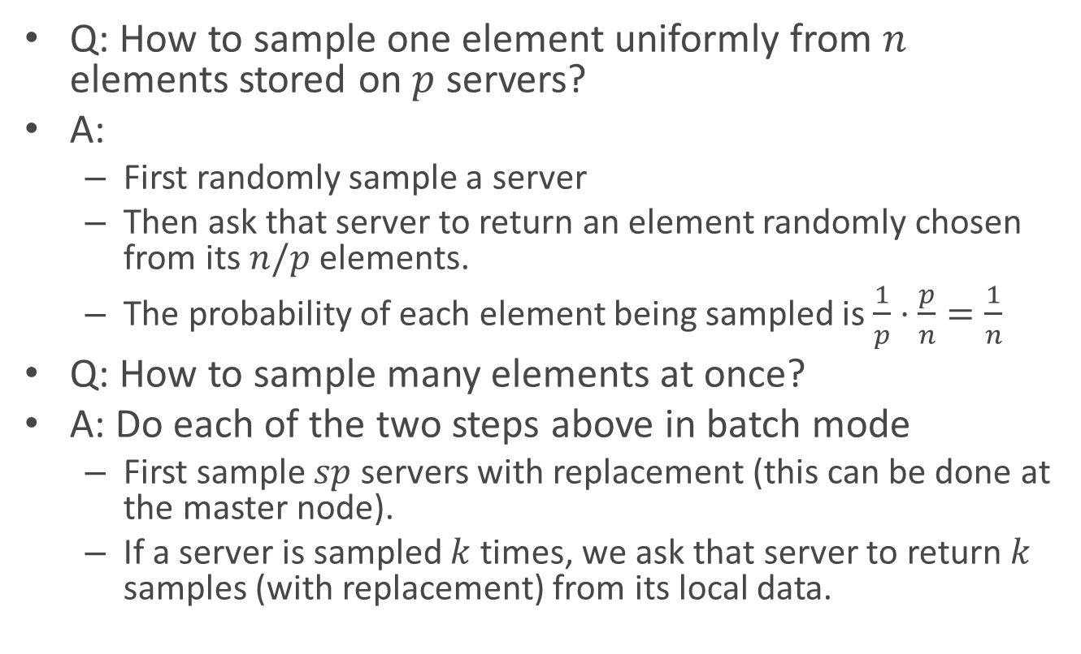
Distributed Sampling
Q: How to sample one element uniformly from $n$ elements stored on $p$ servers?
A:
First randomly sample a server
Then ask that server to return an element randomly chosen from its $n/p$ elements.
The probability of each element being sampled is$\frac{1}{p}⋅\frac{p}{n}=\frac{1}{n}$
Q: How to sample many elements at once?
A: Do each of the two steps above in batch mode
First sample $sp$ servers with replacement (this can be done at the master node).
If a server is sampled $k$ times, we ask that server to return $k$ samples (with replacement) from its local data.

Slide 11
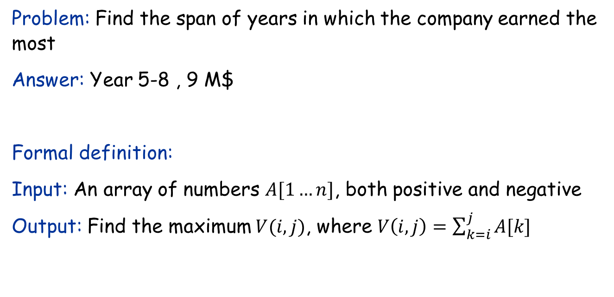
The Maximum Subarray Problem
Input: Profit history of a company of the years.
Year | 1 | 2 | 3 | 4 | 5 | 6 | 7 | 8 | 9
Profit (M$) | -3 | 2 | 1 | -4 | 5 | 2 | -1 | 3 | -1
Problem: Find the span of years in which the company earned the most
Answer: Year 5-8 , 9 M$
Formal definition:
Input: An array of numbers $A[1…n]$, both positive and negative
Output: Find the maximum $V(i,j)$, where $V\left(i,j\right)=\sum_{k=i}^{j}{A[k]}$

Slide 12
A divide-and-conquer algorithm
Year | 1 | 2 | 3 | 4 | 5 | 6 | 7 | 8 | 9
Profit (M$) | -3 | 2 | 1 | -4 | 5 | 2 | -1 | 3 | -1
Idea:
Cut the array into two halves
All subarrays can be classified into three cases:
Case 1: entirely in the first half
Case 2: entirely in the second half
Case 3: crosses the cut
Largest of three cases is final solution
The optimal solutions for case 1 and 2 can be found recursively.
Only need to consider case 3.

Slide 13
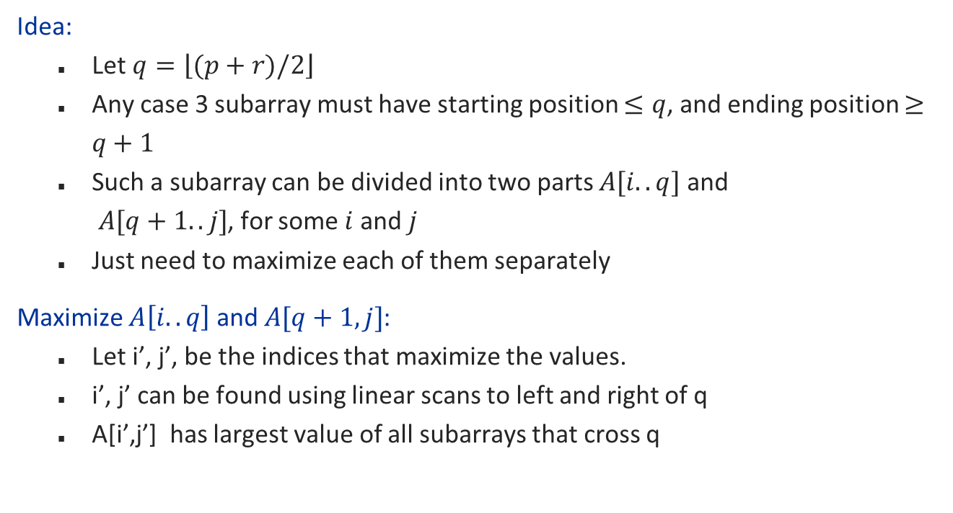
Solving case 3
Year | 1 | 2 | 3 | 4 | 5 | 6 | 7 | 8 | 9
Profit (M$) | -3 | 2 | 1 | -4 | 5 | 2 | -1 | 3 | -1
Idea:
Let $q=\left\lfloor (p+r)/2\right\rfloor$
Any case 3 subarray must have starting position $≤q$, and ending position $≥q+1$
Such a subarray can be divided into two parts $A[i..q]$ and $A[q+1..j]$, for some $i$ and $j$
Just need to maximize each of them separately
Maximize $A\left[i..q\right]$ and $A[q+1,j]$:
Let i’, j’, be the indices that maximize the values.
i’, j’ can be found using linear scans to left and right of q
A[i’,j’] has largest value of all subarrays that cross q

Slide 14
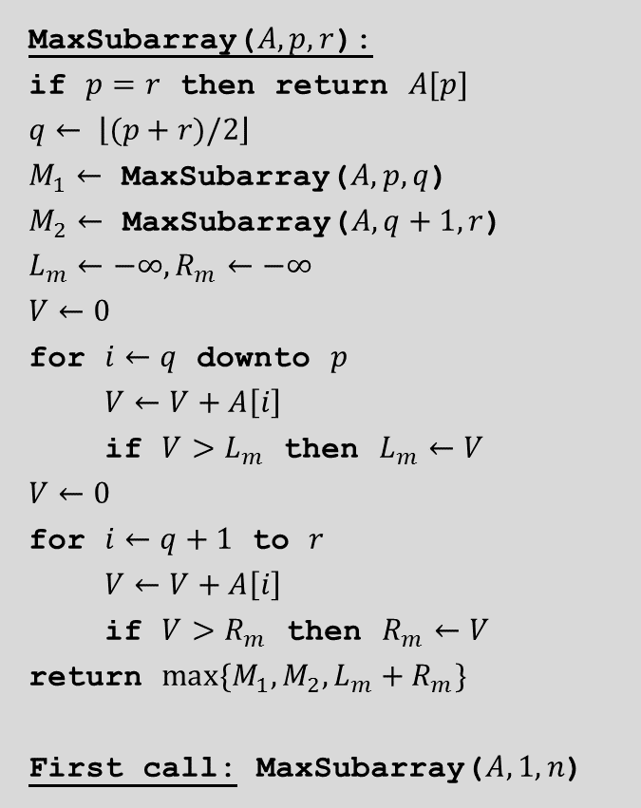
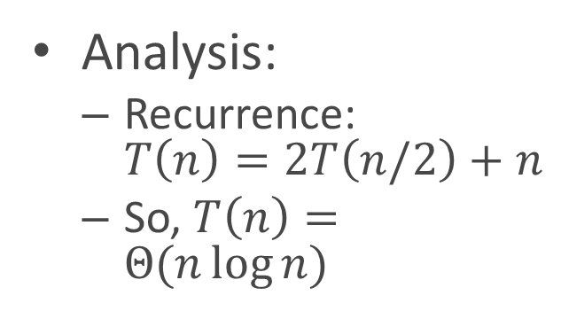
The (binary) divide-and-conquer algorithm
MaxSubarray($A, p, r$):
if $p=r$ then return $A[p]$
$$q← \left\lfloor (p+r)/2\right\rfloor$$
$M_{1}←$ MaxSubarray($A, p,q$)
$M_{2}←$ MaxSubarray($A, q+1, r$)
$$L_{m}←−∞,R_{m}←−∞$$
$$V←0$$
for $i←q$ downto $p$
$V←V+A\left[i\right]$
if $V>L_{m}$ then $L_{m}←V$
$$V←0$$
for $i←q+1$ to $r$
$V←V+A\left[i\right]$
if $V>R_{m}$ then $R_{m}←V$
return $max\{M_{1},M_{2},L_{m}+R_{m}\}$
First call: MaxSubarray($A, 1, n$)
Analysis:
Recurrence: $T\left(n\right)=2T\left(n/2\right)+n$
So, $T\left(n\right)=Θ(n\log{n)}$

Slide 15
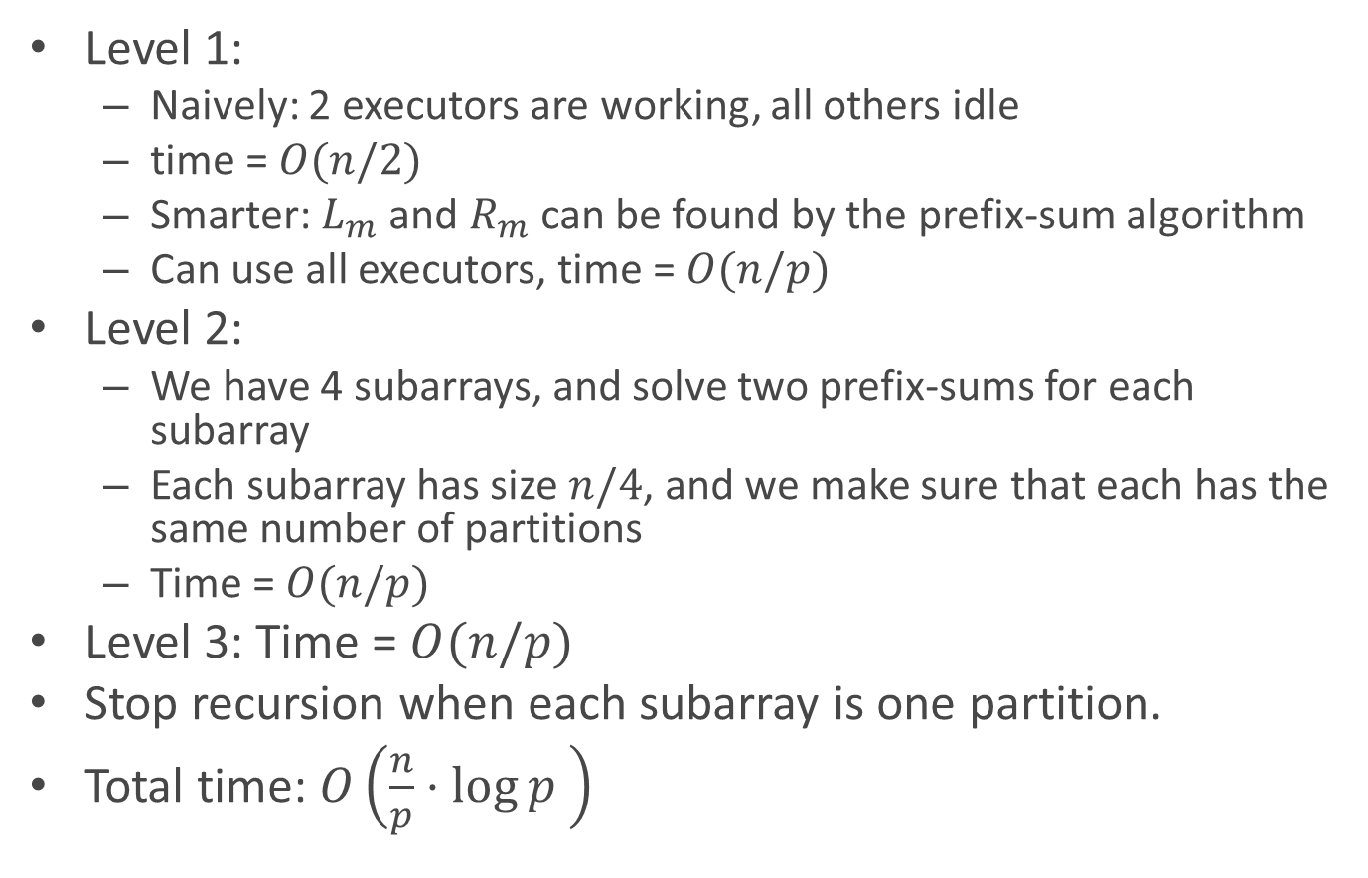
If we use the same algorithm on Spark:
Level 1:
Naively: 2 executors are working, all others idle
time = $O(n/2)$
Smarter: $L_{m}$ and $R_{m}$ can be found by the prefix-sum algorithm
Can use all executors, time = $O(n/p)$
Level 2:
We have 4 subarrays, and solve two prefix-sums for each subarray
Each subarray has size $n/4$, and we make sure that each has the same number of partitions
Time = $O(n/p)$
Level 3: Time = $O(n/p)$
Stop recursion when each subarray is one partition.
Total time: $O\left(\frac{n}{p}⋅\log{p }\right)$

Slide 16
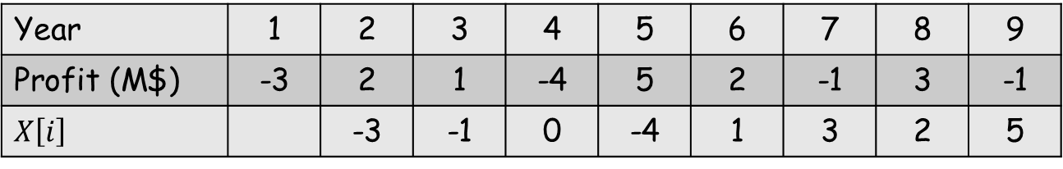

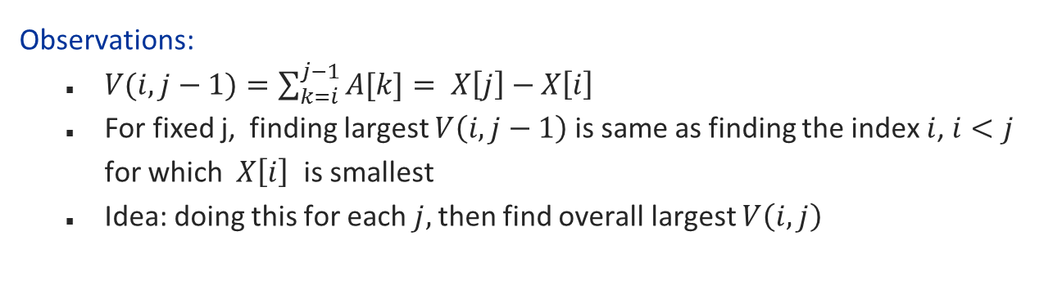
A linear-time algorithm?
Define: $X\left[i\right]=A\left[1\right]+…+A\left[i−1\right]$
Year | 1 | 2 | 3 | 4 | 5 | 6 | 7 | 8 | 9
Profit (M$) | -3 | 2 | 1 | -4 | 5 | 2 | -1 | 3 | -1
$$X\left[i\right]$$ |  | -3 | -1 | 0 | -4 | 1 | 3 | 2 | 5
Observations:
$V(i,j−1)=\sum_{k=i}^{j−1}{A[k]}= X\left[j\right]−X\left[i\right]$
For fixed j, finding largest $V\left(i,j−1\right)$is same as finding the index $i$, $i<j$ for which $X\left[i\right]$ is smallest
Idea: doing this for each $j,$then find overall largest $V\left(i,j\right)$

Slide 17
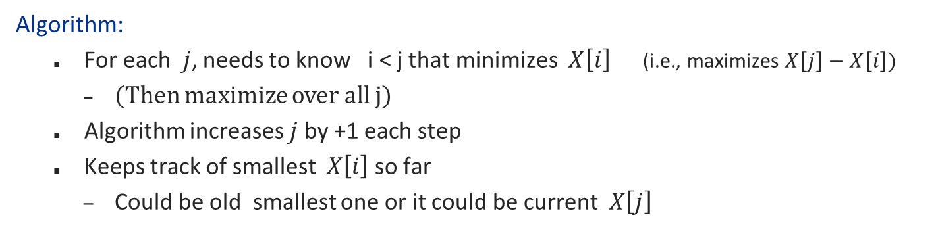

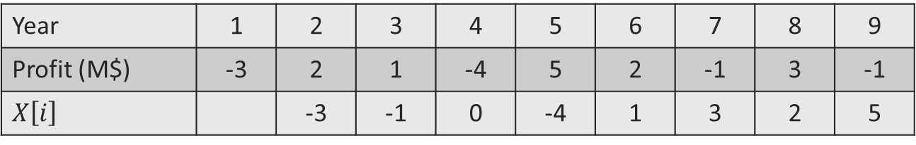
A linear-time algorithm?
Define: $X\left[i\right]=A\left[1\right]+…+A\left[i−1\right]$
Goal: Find $\max_{i<j}{(X\left[j\right]−X\left[i\right])}$
Year | 1 | 2 | 3 | 4 | 5 | 6 | 7 | 8 | 9
Profit (M$) | -3 | 2 | 1 | -4 | 5 | 2 | -1 | 3 | -1
$$X\left[i\right]$$ |  | -3 | -1 | 0 | -4 | 1 | 3 | 2 | 5
Algorithm:
For each $j$, needs to know i < j that minimizes $X\left[i\right]$ (i.e., maximizes $X\left[j\right]−X\left[i\right]$)
(Then maximize over all j)
Algorithm increases $j$ by +1 each step
Keeps track of smallest $X\left[i\right]$ so far
Could be old smallest one or it could be current $X\left[j\right]$

Slide 18
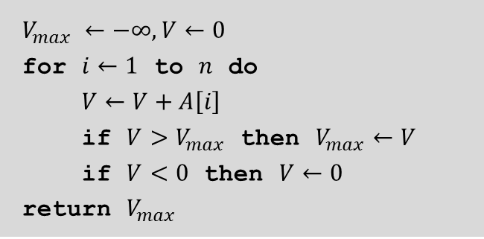
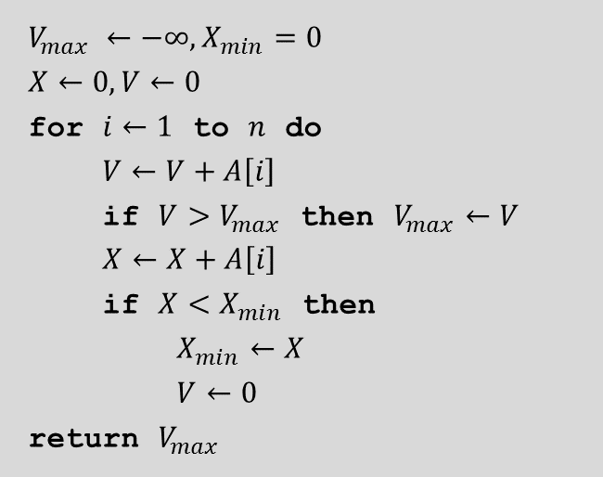
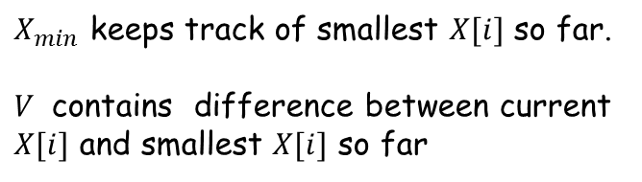
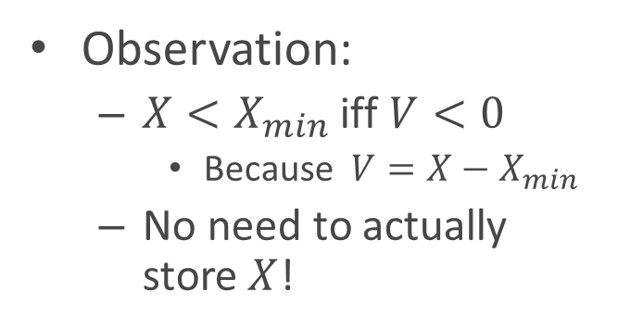
The linear-time algorithm
Even “simpler”:
$$V_{max} ←−∞,X_{min}=0$$
$$X←0,V←0$$
for $i←1$ to $n$ do
$V←V+A\left[i\right]$
if $V>V_{max}$ then $V_{max}←V$
$X←X+A\left[i\right]$
if $X<X_{min}$ then
$X_{min}←X$
$V←0$
return $V_{max}$
$$V_{max} ←−∞,V←0$$
for $i←1$ to $n$ do
$V←V+A\left[i\right]$
if $V>V_{max}$ then $V_{max}←V$
if $V<0$ then $V←0$
return $V_{max}$
Observation:
${X<X}_{min}$ iff $V<0$
Because ${V=X−X}_{min}$
No need to actually store $X$!
$X_{min}$ keeps track of smallest $X[i]$ so far.
$V$ contains difference between current $X[i]$ and smallest $X[i]$ so far

Slide 19
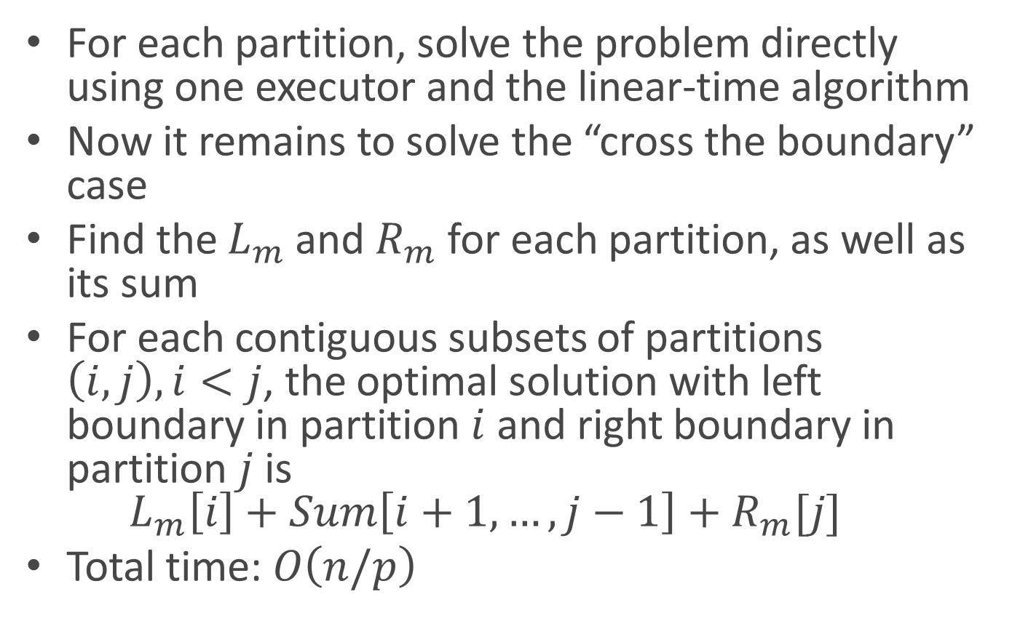
A more efficient algorithm
For each partition, solve the problem directly using one executor and the linear-time algorithm
Now it remains to solve the “cross the boundary” case
Find the $L_{m}$ and $R_{m}$ for each partition, as well as its sum
For each contiguous subsets of partitions $\left(i,j\right), i<j$, the optimal solution with left boundary in partition $i$ and right boundary in partition $j$ is $L_{m}\left[i\right]+Sum\left[i+1,…,j−1\right]+R_{m}[j]$
Total time: $O\left(n/p\right)$

