Slide 1
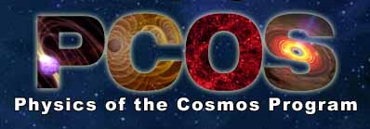
One of three NASA Astrophysics programs (PCOS, Cosmic Origins and Exoplanets)
ANN HORNSCHEMEIER
Chief Scientist, Physics of the Cosmos Program
NASA Goddard Space Flight Center

Slide 2
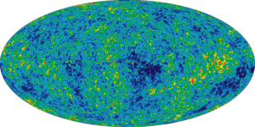
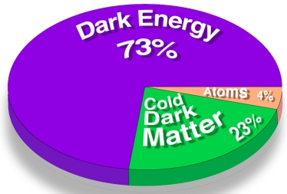
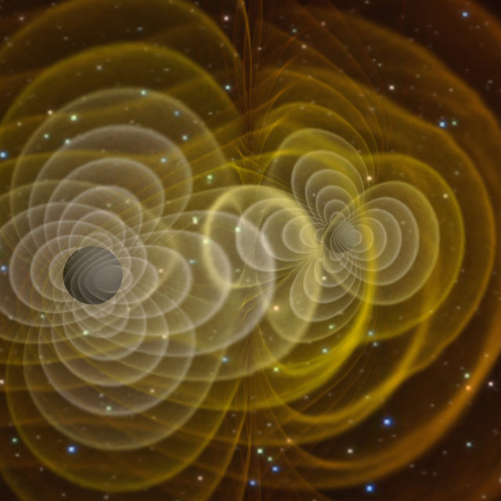
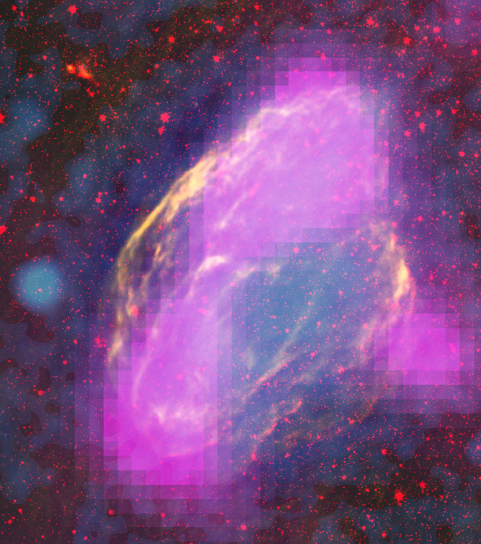
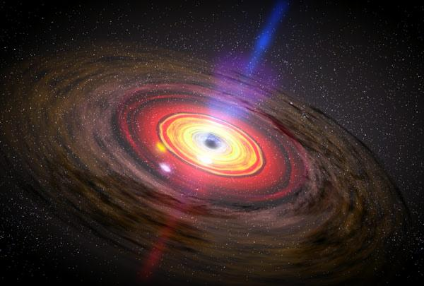
Physics of the Cosmos Science Objectives
Expand our knowledge of dark energy
Precisely measure the cosmological parameters governing the evolution of the universe and test the inflation hypothesis of the Big Bang
Test the validity of Einstein's General Theory of Relativity and investigate the nature of spacetime
Understand the formation and growth of massive black holes and their role in the evolution of galaxies
Explore the behavior of matter and energy in its most extreme environments
W44 SNR
pcos.gsfc.nasa.gov

Slide 3
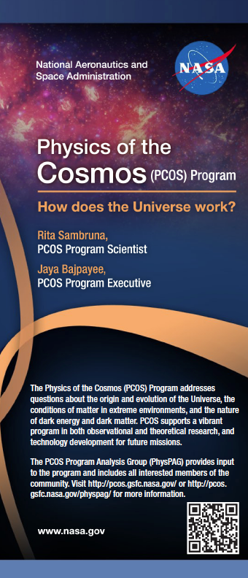
Physics of the Cosmos Science Objectives
Expand our knowledge of dark energy
Precisely measure the cosmological parameters governing the evolution of the universe and test the inflation hypothesis of the Big Bang
Test the validity of Einstein's General Theory of Relativity and investigate the nature of spacetime
Understand the formation and growth of massive black holes and their role in the evolution of galaxies
Explore the behavior of matter and energy in its most extreme environments
W44 SNR
pcos.gsfc.nasa.gov

Slide 4
Communicating with NASA Astrophysics via the Program Analysis Groups (PAGs)
The Physics of the Cosmos Program Analysis Group (PhysPAG) serves as a forum for soliciting and coordinating input and analysis from the scientific community in support of the PCOS program objectives.
PAGs report to NASA via the NAC’s Astrophysics subcommittee
PhysPAG Executive Committee (EC) members: S. Ritz (Chair), J. Bookbinder, S. Hanany, G. Mueller, E. Hays, J. Rhodes
The EC is NOT the PhysPAG, everyone here is welcome to participate in the PhysPAG!
The PhysPAG meets annually in a face-to-face meeting and plans on a presence at APS April 2013 in Denver, CO

Slide 5
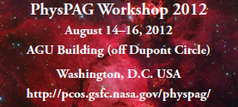
The PhysPAG and PCOS program are pleased to announce a summer 2012 workshop whose purposes will be:
Special breakout sessions:
Kick-off meetings for the XRSAG, GWSAG and GRSAG
Special session on “Dark Energy from Space”
LOCATION: WASHINGTON, D.C. AREA (DETAILS TBD)
REGISTRATION will open by the end of April 2012
FULL WEBCASTING WILL BE AVAILABLE FOR THOSE WHO CANNOT ATTEND IN PERSON,
BUT YOU MUST REGISTER (FREE!)
CONSULT: pcos.gsfc.nasa.gov/physpag for more info

