Slide 1
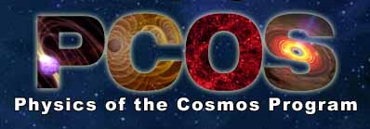
ANN HORNSCHEMEIER
Chief Scientist, Physics of the Cosmos Program
NASA Goddard Space Flight Center

Slide 2
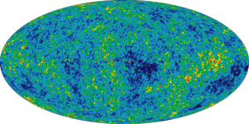
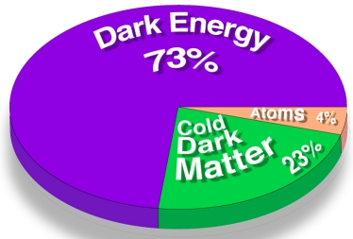
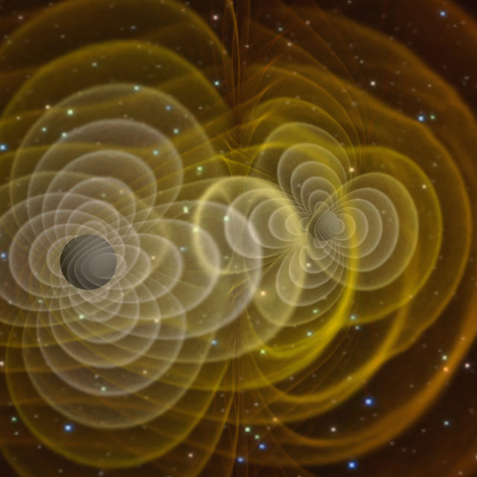
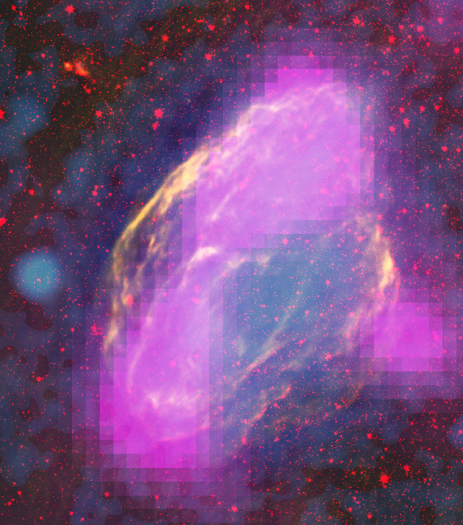
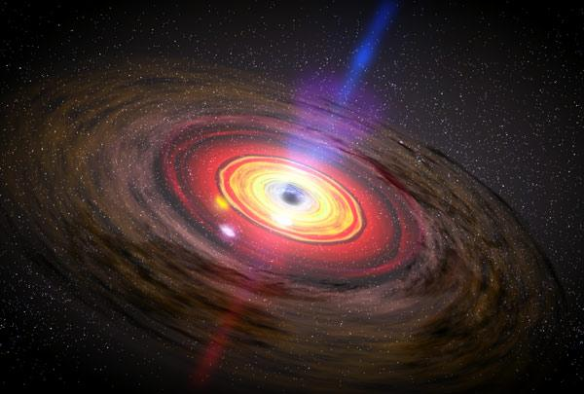
Physics of the Cosmos Science Objectives
Expand our knowledge of dark energy
Precisely measure the cosmological parameters governing the evolution of the universe and test the inflation hypothesis of the Big Bang
Test the validity of Einstein's General Theory of Relativity and investigate the nature of spacetime
Understand the formation and growth of massive black holes and their role in the evolution of galaxies
Explore the behavior of matter and energy in its most extreme environments
W44 SNR

Slide 3
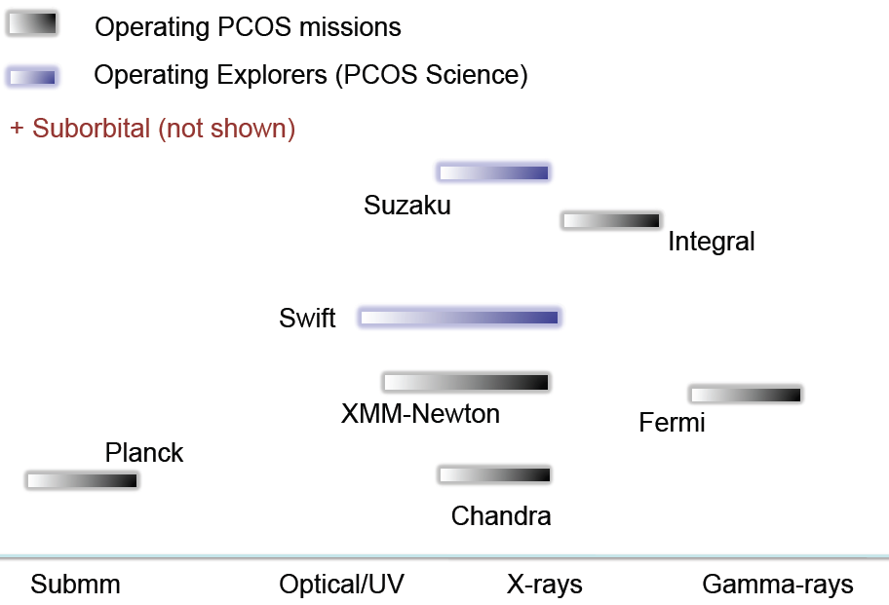
Current PCOS Portfolio Across the Electromagnetic Spectrum

Slide 4
PCOS : future missions
Provide scientific and technical stewardship for decadal-survey recommended missions:
Of the six highly-ranked medium and large-scale space-based priorities in NWNH, THREE fall within the PCOS science program:
Inflation Probe (medium-scale)
LISA
IXO
NOTE: WFIRST is located within the Exoplanet Program and the science of dark energy is within PCOS
X-ray and Gravitational Wave Mission Architecture Studies
Explore alternative mission architectures and technical solutions (e.g., instrument concepts, enabling technologies) to accomplish some or all of the LISA and IXO science objectives at lower cost points
Reports due to NASA HQ in July 2012

Slide 5
PCOS: Future Missions X-ray and Gravitational Wave Architecture Studies
GRAVITATIONAL WAVE ARCHITECTURE STUDY
Three mission concepts (+1 instrument study) under exploration at the TEAMX mission design facility at JPL:
No drag-free concept: LAGRANGE
Geocentric orbits: OMEGA
LISA-like: SGO-mid
Low-cost instrument study: OMEGA instrument
X-RAY MISSION ARCHITECTURE STUDY
Four mission concepts under exploration at Mission Design Laboratory at GSFC:
AXSIO – Cost goal: <$2B
Gratings only - Cost Goal: < $600M
Calorimeter only – Cost goal: < $1B
Wide Field only – Cost goal: < $1B

Slide 6
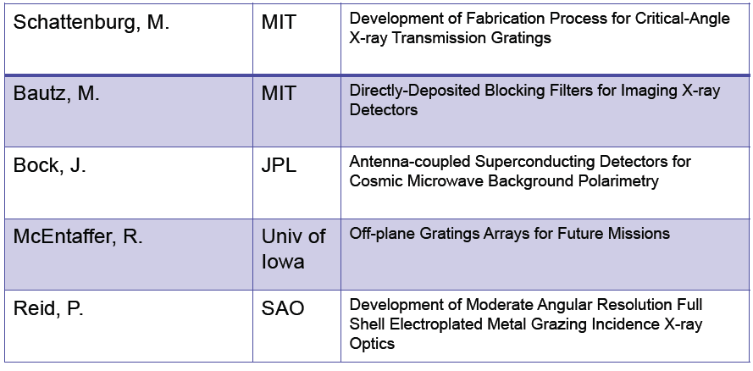
PCOS: technology development funding
NWNH priorities and NASA strategic roadmaps inform technology development funding. For example these were the projects funded by the 2010 ROSES SAT under PCOS:

Slide 7
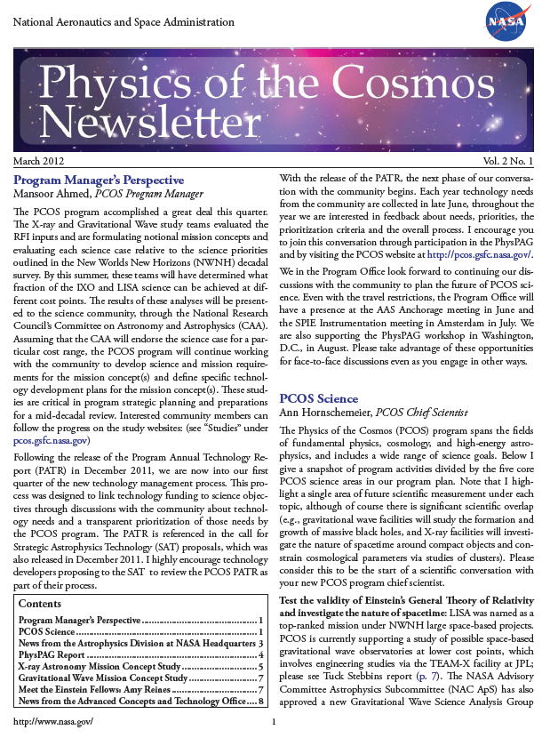
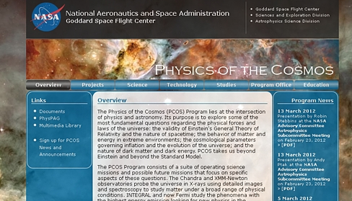
What else is going on in the PCOS program?
Three published PCOS newsletters giving updates to the community on the X-ray and GW studies, the technology management process, news from NASA HQ, science updates for operating missions
PCOS program website (pcos.gsfc.nasa.gov), continues to be the interface between all program and PhysPAG activities and the community:

Slide 8
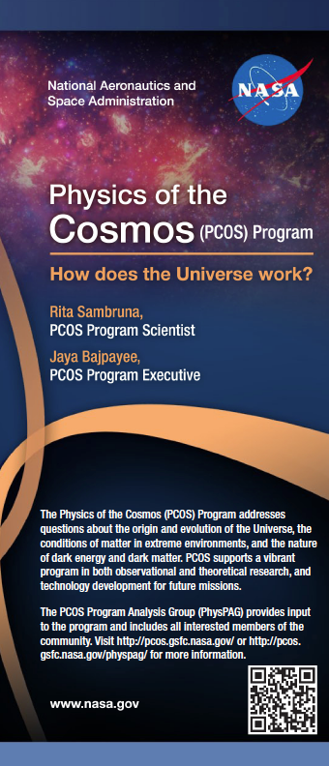

Opportunities to interface with PCOS
Personnel in the PCOS office listed on the website and in the brochure distributed here
FY12 Conference/Workshop activity yet-to-come:
PCOS/COR joint booth planned for Anchorage, AK in June 2012
August 2012 PhysPAG workshop: kick-off for GW, X-ray and Gamma Ray SAGs plus “Dark Energy from Space” session

Slide 9
Communicating with NASA Astrophysics via the Program Analysis Groups (PAGs)
The Physics of the Cosmos Program Analysis Group (PhysPAG) serves as a forum for soliciting and coordinating input and analysis from the scientific community in support of the PCOS program objectives.
The Program Analysis Groups (PAGs) include all members of the community interested in providing input to NASA on issues of strategic importance via analysis studies
PAGs hold regular public meetings to provide their members the opportunity to hear about their work and voice their input
PAGs report to NASA via the NAC’s Astrophysics subcommittee
PhysPAG Executive Committee (EC) members: S. Ritz (Chair), J. Bookbinder, S. Hanany, G. Mueller, E. Hays, J. Rhodes
The EC is NOT the PhysPAG

Slide 10
PhysPAG and SAGs
The PhysPAG identifies specific, well-defined topics for further detailed studies, and sets up taskforces of volunteers to perform the analysis – Study Analysis Groups (SAGs)
PhysPAG has four SAGs in operation or in development:
Inflation Probe SAG (Chair: Shaul Hanany)
Gravitational Wave SAG (Chair: Guido Mueller)
X-ray SAG (Chair: Jay Bookbinder)
Gamma ray SAG (Chair: Liz Hays)

Slide 11
PhysPAG Workshop August 14-16, 2012
The PhysPAG and PCOS program are pleased to announce a summer 2012 workshop whose purposes will be:
Include updates to the community from all three PAGs (PhysPAG, ExoPAG, CoPAG) in scientific and technical areas of interest to the PhysPAG community
Public presentation of the reports from the PCOS Gravitational Wave and X-ray Studies
Special breakout sessions:
Kick-off meetings for the XRSAG, GWSAG and GRSAG
“Dark Energy from Space” special one-day symposium
LOCATION: WASHINGTON, D.C. AREA (DETAILS TBD)
REGISTRATION will open by the end of April 2012
FULL WEBCASTING WILL BE AVAILABLE FOR THOSE WHO CANNOT ATTEND IN PERSON,
BUT YOU MUST REGISTER (FREE!)
CONSULT: pcos.gsfc.nasa.gov/physpag for more info

