Slide 1
Codd County Police Department
By Ryan Rendeiro

Slide 2
Table of Contents
Executive Summary page 3
Entity relation diagram page 4
Tables page 5
Views page 23
Reports page 26
Stored Procedure page 30
Trigger page 31
Security page 32
Notes page 33
Issues, and future considerations page 34

Slide 3
Executive summary
The database for the codd county police department is outlined and describe with in this documents. The purpose of this database is to keep track of employees, police officers, arrested suspects, and items and equipment related to their activities. Such related activities and items as equipment, evidence, and when they work. This database also catalogs where police officers work with in the police department premises and where they operate outside of the premises. This will empower administration of the police department to be able to analyze and extract useful and informative data about the police department. Ultimately the database should be able to provide useful control over the departments data while being normalized and elegantly serving the department’s needs.

Slide 4
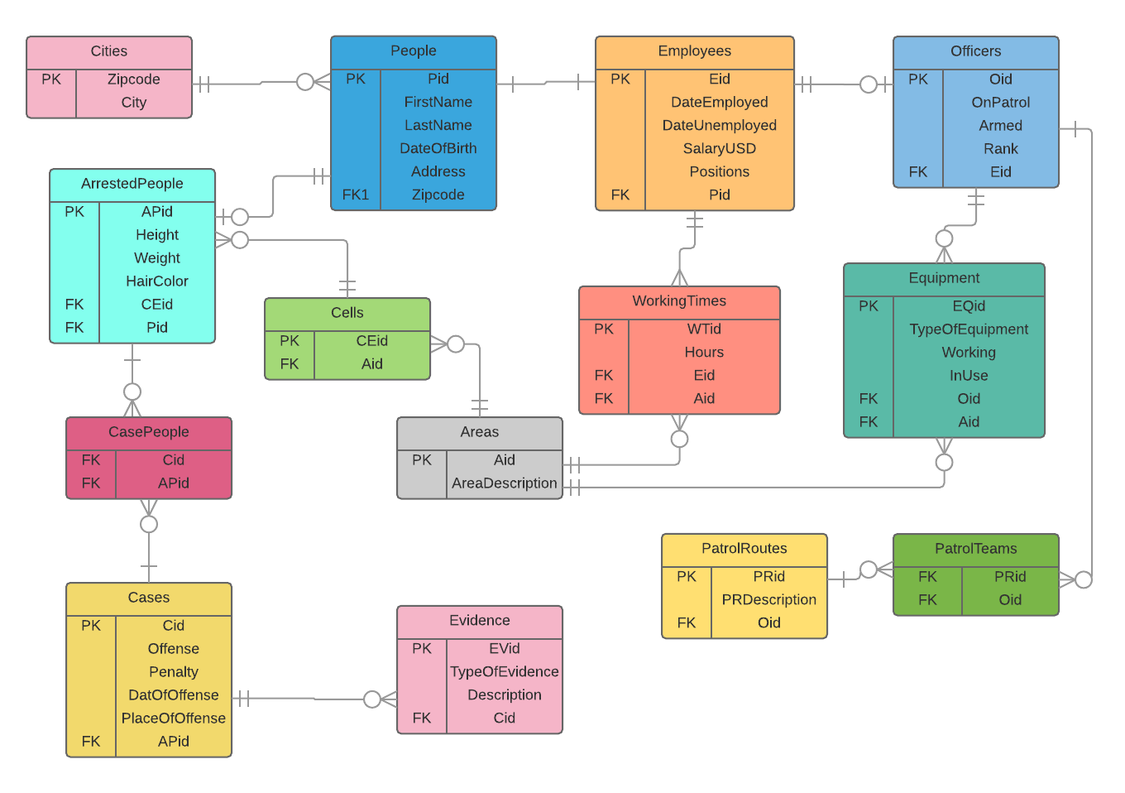
Entity Relation DIAGRAM

Slide 5
People
Lists all people with in the system with attributes and functional dependencies.
CREATE TABLE people (
Pid text NOT NULL UNIQUE,
FirstName text NOT NULL,
LastName text NOT NULL,
DateOfBirth text NOT NULL,
Address text NOT NULL,
Zipcode text NOT NULL,
FOREIGN KEY (Zipcode) REFERENCES cities(Zipcode),
PRIMARY KEY (Pid,Zipcode)
);
Functional Dependencies Pid → FirstName, LastName, DateOfBirth, Address, Zipcode
Sample data on the next page

Slide 6
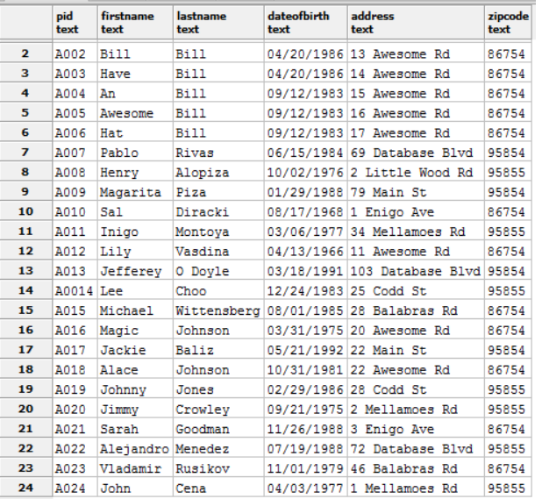

Slide 7
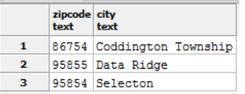
Cities
Lists all cities with in the system with their attributes and functional dependencies
CREATE TABLE cities (
Zipcode text NOT NULL UNIQUE,
City text NOT NULL,
PRIMARY KEY (Zipcode)
);
Functional Dependencies Zipcode→ City

Slide 8
Employees
Lists all employees that exist with in the system with their attributes and functional dependencies
CREATE TABLE Employees (
Eid text NOT NULL UNIQUE,
DateEmployed text NOT NULL,
DateUnemployed text,
SalaryUSD text NOT NULL,
Positions text NOT NULL,
Pid text NOT NULL,
FOREIGN KEY (Pid) REFERENCES people (Pid),
PRIMARY KEY (Eid,Pid)
);
Functional Dependencies Eid → DateEmployed, DateUnemployed, SalaryUSD, Positions, Pid
Sample data on next page

Slide 9
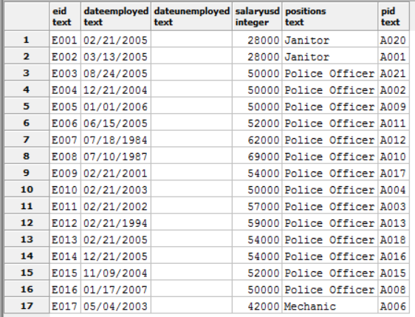

Slide 10
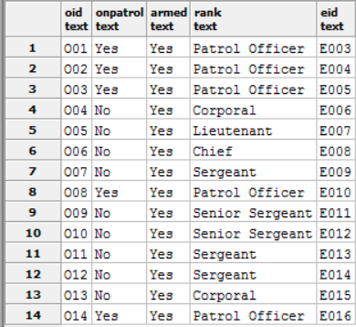
Officers
Lists all police officers in the system with their attributes and functional dependencies
CREATE TABLE Officers (
Oid text NOT NULL UNIQUE,
OnPatrol text NOT NULL,
Armed text NOT NULL,
Rank text NOT NULL,
Eid text NOT NULL,
FOREIGN KEY (Eid) REFERENCES Employees (Eid),
PRIMARY KEY (Oid,Eid)
);
Functional Dependencies Oid→ OnPatrol, Armed, Rank, Eid

Slide 11
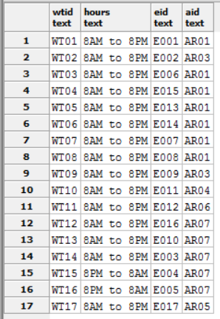
Working time
Lists all the times employees work and the attributes about those times and their functional dependencies
CREATE TABLE WorkingTimes (
WTid text NOT NULL UNIQUE,
Hours text NOT NULL,
Eid text NOT NULL,
Aid text NOT NULL,
FOREIGN KEY (Eid) REFERENCES Employees (Eid),
FOREIGN KEY (Aid) REFERENCES Areas (Aid),
PRIMARY KEY (WTid,Eid,Aid)
);
Functional Dependencies WTid→ Hours, Eid, Aid

Slide 12
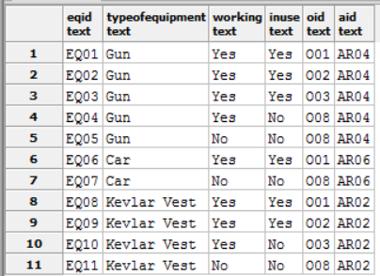
Equipment
Lists all attributes and data on equipment in the system with thei functional dependencies
CREATE TABLE Equipment (
EQid text NOT NULL UNIQUE,
TypeOfEquipment text NOT NULL,
Working text NOT NULL,
InUse text NOT NULL,
Oid text NOT NULL,
Aid text NOT NULL,
FOREIGN KEY (Oid) REFERENCES Officers (Oid),
FOREIGN KEY (Aid) REFERENCES Areas (Aid),
PRIMARY KEY (EQid,Oid,Aid)
);
Functional Dependencies EQid→ TypeOfEquipment, Working, InUse, Oid, Aid

Slide 13
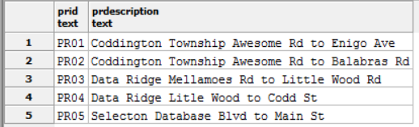
Patrol routes
Lists all attributes and functional dependencies about patrol routes
CREATE TABLE PatrolRoutes (
PRid text NOT NULL UNIQUE,
PRDescription text NOT NULL,
PRIMARY KEY (PRid)
);Functional Dependencies PRid→ PRDescription,

Slide 14
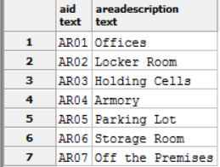
Areas
Lists all areas with their attributes and functional depedncies
CREATE TABLE Areas (
Aid text NOT NULL UNIQUE,
AreaDescription text NOT NULL,
PRIMARY KEY (Aid)
);
Functional Dependencies Aid→ AreaDescription

Slide 15
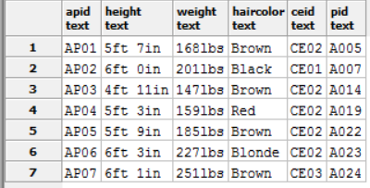
Arrested people
Lists all arrested people with their attributes and their functional dependencies
CREATE TABLE Arrestedpeople (
APid text NOT NULL UNIQUE,
Height text NOT NULL,
Weight text NOT NULL,
HairColor text NOT NULL,
CEid text NOT NULL,
Pid text NOT NULL,
FOREIGN KEY (CEid) REFERENCES cells (CEid),
FOREIGN KEY (Pid) REFERENCES people (Pid),
PRIMARY KEY (APid,Pid,CEid)
);
Functional Dependencies APid→ Height, Weight, HairColor, Ceid, Pid

Slide 16
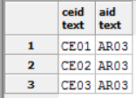
Cells
Lists all cells within the system and their attributes and functional dependencies
CREATE TABLE cells (
CEid text NOT NULL UNIQUE,
Aid text NOT NULL,
FOREIGN KEY (Aid) REFERENCES Areas (Aid),
PRIMARY KEY (CEid, Aid)
);
Functional Dependencies CEid→ Aid

Slide 17
Cases
Lists all cases within the system with their attributes and functional dependencies
CREATE TABLE Cases (
Cid text NOT NULL UNIQUE,
Offense text NOT NULL,
Penalty text NOT NULL,
DateOfOffense text NOT NULL,
PlaceOfOffense text NOT NULL,
PRIMARY KEY (Cid)
); Functional Dependencies Cid→ Offense, Penalty, DateOfOffense, PlaceOfOffense
Sample data on next page

Slide 18
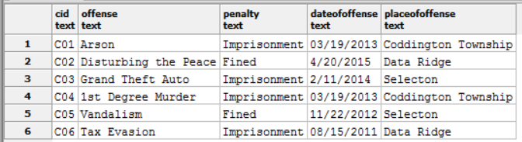

Slide 19
Evidence
Lists all pieces of evidence within the system with their attributes and functional dependencies
CREATE TABLE Evidence (
EVid text NOT NULL UNIQUE,
TypeOfEvidence text NOT NULL,
Description text NOT NULL,
Cid text NOT NULL,
FOREIGN KEY (Cid) REFERENCES Cases (Cid),
PRIMARY KEY (EVid, Cid)
);
Functional Dependencies EVid→ TypeOfEvidence, Description, Cid
Sample data on next page

Slide 20
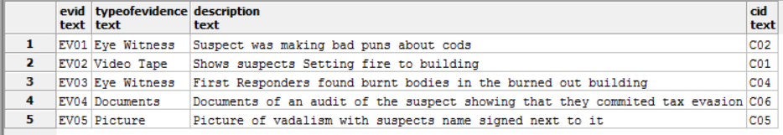

Slide 21
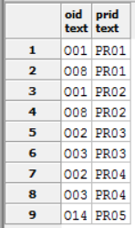
Patrol teams
Lists all patrol teams and their attributes within the database and their functional dependencies
CREATE TABLE PatrolTeams (
Oid text NOT NULL,
PRid text NOT NULL,
FOREIGN KEY (Oid) REFERENCES Officers (Oid),
FOREIGN KEY (PRid) REFERENCES PatrolRoutes(PRid),
PRIMARY KEY (Oid, PRid)
);
Functional Dependencies PRid→Oid

Slide 22
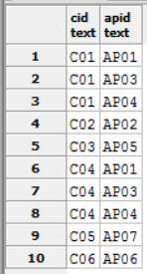
Case People
Lists all case people and their attributes and functional dependencies
CREATE TABLE CasePeople (
Cid text NOT NULL,
APid text NOT NULL,
FOREIGN KEY (Cid) REFERENCES Cases (Cid),
FOREIGN KEY (APid) REFERENCES ArresedPeople (APid),
PRIMARY KEY (Cid, APid)
);
Functional Dependencies Cid→APid

Slide 23
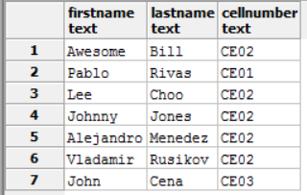
View Arrested Suspects
This view creates a table that puts the names of arrested people with their cell numbers making it easy keep track of arrested people
Create View ArrestedSuspects AS
Select FirstName, LastName, ArrestedPeople.Ceid as Cell Number
From people
Inner join ArrestedPeople
ON people.pid = ArrestedPeople.pid
Inner join Cells
ON Cells.Ceid = ArrestedPeople.Ceid;

Slide 24
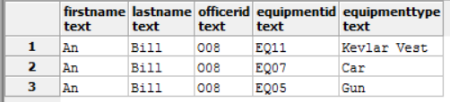
View Who Broke IT
This view will create a table that will show which police officer broke which piece of equipment allowing the user to determine both what needs to be repaired and if the offending officer should get new equipment
Create View WhoBrokeIt as
Select FirstName, LastName, Officer.Oid as OfficerID, Equipment.Eqid as EquipmentID, Equipment.TypeOfEquipment as EquipmentType
From People
Inner Join Employees
On people.pid = employees.pid
inner join Officer
On employees.eid = Officer.eid
inner join equipment
On officer.Oid = Equipment.oid
Order by Officer.Oid;

Slide 25
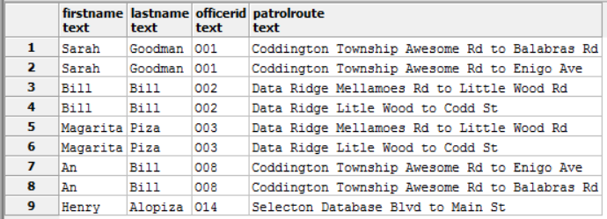
View Who Patrols WHAT
This view create a table that shows the user every police officers name, id and patrol route, for police officers who have patrol routes, allowing the user to keep track of on duty officers that aren’t at the police department.
Create View WhoPatrolsWhat as
Select FirstName, LastName, Officer.Oid as OfficerID, PatrolRoutes.PRDescription as PatrolRoute
from people
inner join employees
ON people.pid = employees.pid
inner join officers
ON employees.eid = officers.eid
inner join PatrolRoutes
ON officers.Oid = PatrolRoutes.Oid
Order by Officers.Oid;

Slide 26
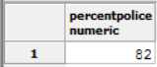
reports
The following query counts the amounts of police officers then employees and divides them to get the percentage of employees who are police officers.
Select TRUNC (
CAST((SELECT COUNT(Eid) as PoliceCount
FROM Employees
WHERE positions = 'Police Officer') as DECIMAL(5,2)
) /
(SELECT COUNT(Eid) as EmployeeCount
FROM Employees) * 100) as PercentPolice

Slide 27

Reports
This query will get the user a percentage amount of how many people live in the town of Data Ridge.
Select TRUNC (
CAST((SELECT COUNT(Pid) as WherePeopleLive
FROM People
INNER JOIN Cities ON
People.Zipcode = Cities.Zipcode
WHERE city = 'Data Ridge') as DECIMAL(5,2)
) /
(SELECT COUNT(Pid) as People
FROM People) * 100) as DataRidgePeople

Slide 28

Reports
This query will give the user a percentage of how many people live in coddington township.
Select TRUNC (
CAST((SELECT COUNT(Pid) as WherePeopleLive
FROM People
INNER JOIN Cities ON
People.Zipcode = Cities.Zipcode
WHERE city = 'Coddington Township') as DECIMAL(5,2)
) /
(SELECT COUNT(Pid) as People
FROM People) * 100) as CoddingtonPeople

Slide 29

Reports
This query gives the user a percentage amount of how many people live in the town of Selecton
Select TRUNC (
CAST((SELECT COUNT(Pid) as WherePeopleLive
FROM People
INNER JOIN Cities ON
People.Zipcode = Cities.Zipcode
WHERE city = 'Selecton') as DECIMAL(5,2)
) /
(SELECT COUNT(Pid) as People
FROM People) * 100) as SelectonPeople

Slide 30
Stored procedure
This stored procedure gets called by the trigger that waits for new police officers then assigns then working times in the working times relation.
Create Or Replace Function AddWorkHours(refcursor) Returns refcursor AS $$
Declare
p refcursor = $1;
Begin
IF NEW.Positions = ‘Police Officer’ THEN
Insert Into WorkingTimes (Eid) VALUES (NEW.Eid);
END IF;
RETURN p;
END;
$$
Language plpgsql;

Slide 31
trigger
This Trigger waits for a new police officers to be added to the employees relation and then assigns them a spot in the working times table to ensure that they have times to work in the police department.
Create Trigger AddPoliceOfficer
After Insert on Employees
For Each Row
Execute Procedure AddWorkHours();

Slide 32
security
The following roles would be used by authorized personnel to get access to certain parts of the database to update, insert, or lookup data and to give/revoke privileges as necessary.
Admin Role
Create Role Admin;
Grant all on all tables
In schema public
To Admin;
Employees Role
Create Role Employees;
Grants Select On People, Employees, Officers, ArrestedPeople, Cells, Equipment, PatrolRoutes, WorkingTimes, Areas, Cases, and Evidence
To Employees;
Grants Insert On ArrestedPeople, Cases, Evidence, and Equipment
To Employees;
Grants Update On ArrestedPeople, PatrolRoutes, WorkingTimes, People, Officers, and Employees
To Employees;

Slide 33
Notes
This Database is populated with a small amount of data compared to the size of actual police departments and to reach such the queries and database presented in this document would need to grow and become much more complex. This would include many more tables, people arrested people, and other relation data entries to be completely comprehensive and usable for an actual police department

Slide 34
Issues, Future Considerations
This database doesn’t have the capabilities to address criminals who aren’t arrested nor cases or evidence that lack an arrested person in the system. This system also lacks ways of keeping long term records of criminals who were arrested then moved to other facilities or released criminals from the department’s holding.
To address these concerns future versions of this database should have changes made to the cases table that allow for cases to not need to be linked directly to criminals arrested and being held in police custody, and to allow for those criminal’s record to be updated so when they are released or moved to new facilities that errors do not occur in the database.

