Slide 1
GRADUATE LECTURE SERIES · FOUNDATIONS OF MACHINE LEARNING
Machine Learning Models
From First Principles to Supervised & Unsupervised Algorithms —
intuition, mechanics, and the mathematics that drives them
Lecturer: Desmond Onam · Senior Instructor, Machine Learning & Data Engineering
Companion reading: “Machine Learning Models” — medium.com/@desmondonam

Slide 2
COURSE ORIENTATION
What you will be able to do after this lecture
1
Define
2
Classify
Explain what machine learning is, how it differs from traditional programming, and where it fits in modern data science.
Distinguish supervised from unsupervised learning, and regression from classification from clustering tasks.
3
Explain
4
Derive
Describe how ten core models work — Linear & Logistic Regression, SVM, Decision Trees, KNN, Naive Bayes, ANNs, AdaBoost, K-Means, and PCA.
Read and interpret the objective functions and update rules behind each model — cost functions, margins, impurity, likelihoods, eigen-decompositions.
5
Diagnose
6
Select
Recognise overfitting, underfitting and bias, and apply regularisation, preprocessing and sound evaluation to fix them.
Choose an appropriate model for a given real-world problem and justify the choice like a practitioner.
Machine Learning Models — Lecture Series · Desmond Onam
2

Slide 3
FOUNDATIONS
What is Machine Learning?
Two classic definitions
Why machine learning matters now
“The field of study that gives computers the ability to learn without being explicitly programmed.”
— Arthur Samuel, 1959
◆
Data at unprecedented scale
Every industry now generates more data than humans can inspect by hand — models extract the signal.
◆
Models learn and improve
“A program learns from experience E with respect to task T and performance measure P, if its performance on T, measured by P, improves with E.”
— Tom Mitchell, 1997 (the formal definition)
Accuracy improves over time as new data arrives, without rewriting the program.
◆
Prediction and decision-making
The same toolkit powers medical diagnosis, fraud detection, recommendation, forecasting and autonomous systems.
Worked example — spam filtering
T (task): flag incoming email as spam or not. E (experience): thousands of emails already labelled by users. P (performance): % of emails classified correctly. The model improves P automatically as E grows.
◆
A general-purpose skill
Classification, regression, clustering and dimensionality reduction cover most applied problems you will meet.
Machine Learning Models — Lecture Series · Desmond Onam
3

Slide 4
FOUNDATIONS
The paradigm shift: rules are learned, not written
Traditional programming — a human writes the rules
Brittle: every edge case must be anticipated and coded by hand.
DATA
RULES
(hand-coded)
COMPUTER
ANSWERS
+
→
→
Machine learning — the computer infers the rules
Adaptive: the mapping f : X → y is estimated from examples, and improves as more data arrives.
DATA
ANSWERS
(labels)
LEARNING
ALGORITHM
MODEL
(learned rules)
+
→
→
Professor’s note: the learned model is then deployed exactly like a traditional program — new data in, predictions out. What changed is who wrote the rules: the optimiser did, by minimising a loss function on historical examples.
Machine Learning Models — Lecture Series · Desmond Onam
4

Slide 5
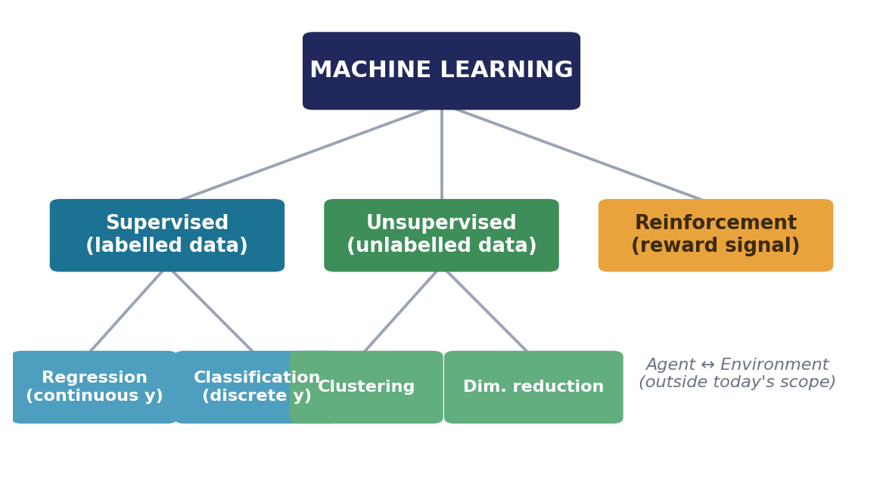
FOUNDATIONS
The machine learning landscape
Supervised
Learn f : X → y from labelled pairs (xᵢ, yᵢ). Regression predicts numbers; classification predicts categories.
Unsupervised
No labels — discover hidden structure: clusters, low-dimensional representations, anomalies.
Reinforcement
An agent learns by acting and receiving rewards. Mentioned for completeness; beyond today’s scope.
Today we cover 8 supervised models and 2 unsupervised models — the canonical toolkit of applied ML.
Machine Learning Models — Lecture Series · Desmond Onam
5

Slide 6
FOUNDATIONS
Supervised vs unsupervised learning at a glance
 | SUPERVISED LEARNING | UNSUPERVISED LEARNING
Training data | Labelled pairs (xᵢ, yᵢ) — every example has a known answer | Unlabelled — only the inputs xᵢ are observed
Goal | Learn a mapping f : X → y that generalises to unseen inputs | Discover latent structure: groups, directions of variation, densities
Canonical tasks | Regression (continuous y) · Classification (discrete y) | Clustering · Dimensionality reduction · Anomaly detection
Feedback signal | Direct — the loss compares predictions ŷ with true labels y | Indirect — objectives like compactness (WCSS) or variance explained
Models today | Linear/Logistic Regression, SVM, Decision Tree, KNN, Naive Bayes, ANN, AdaBoost | K-Means, Principal Component Analysis (PCA)
Typical uses | Price prediction, churn, diagnosis, spam, credit scoring | Customer segmentation, compression, visualisation, preprocessing
Machine Learning Models — Lecture Series · Desmond Onam
6

Slide 7
PART I · EIGHT ALGORITHMS
Supervised Learning Models
1
Linear Regression
5
K-Nearest Neighbours
2
Logistic Regression
6
Naive Bayes
3
Support Vector Machines
7
Artificial Neural Networks
4
Decision Trees
8
AdaBoost (Boosting)
Machine Learning Models — Lecture Series · Desmond Onam
7

Slide 8
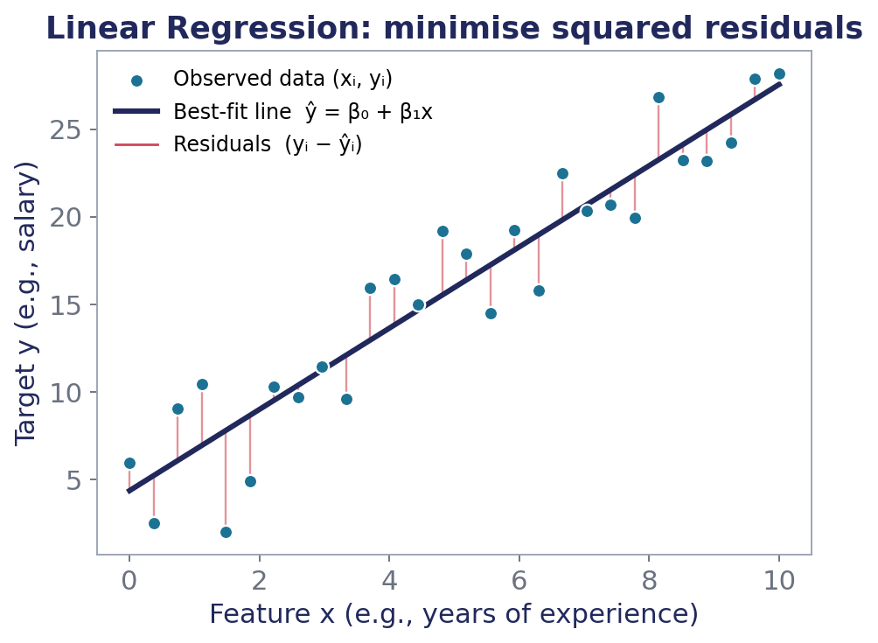
SUPERVISED · REGRESSION
1. Linear Regression
What it is
The workhorse of predictive modelling: fit a straight line (a hyperplane, in many dimensions) through the data so that predictions of a continuous target are as close as possible to the observed values.
How it works
1
Assume a linear relationship: the target y is a weighted sum of the features plus an intercept.
2
Measure error as the sum of squared residuals — the vertical gaps between points and the line.
3
Solve for the coefficients that minimise this error, via Ordinary Least Squares (closed form) or gradient descent.
4
Predict on new data by plugging feature values into the fitted equation.
Problems it solves
House-price and salary prediction · sales and demand forecasting · trend estimation · any problem with a continuous numeric target and (roughly) linear structure.
Each red segment is a residual (yᵢ − ŷᵢ). OLS chooses the line that minimises the sum of their squares.
Machine Learning Models — Lecture Series · Desmond Onam
8

Slide 9
SUPERVISED · REGRESSION
1. Linear Regression — the mathematics
THE MODEL (HYPOTHESIS)
COST FUNCTION (MSE)
ŷ = β₀ + β₁x₁ + β₂x₂ + … + βₙxₙ
J(β) = (1/2m) Σᵢ (ŷᵢ − yᵢ)²
β₀ is the intercept; β₁…βₙ are learned weights — each βⱼ is the change in ŷ for a one-unit change in xⱼ, holding all else constant.
The average squared residual over m training examples. Squaring penalises large errors and makes J smooth and convex.
CLOSED-FORM OLS SOLUTION
GRADIENT DESCENT UPDATE
β̂ = (XᵀX)⁻¹ Xᵀy
βⱼ := βⱼ − α · ∂J/∂βⱼ
The Normal Equation: one linear-algebra step gives the global minimum. Practical when the number of features is modest.
For large data, iteratively step downhill on J with learning rate α until convergence — the same engine that trains neural networks.
✓ STRENGTHS
! LIMITATIONS
Highly interpretable coefficients · fast to train and predict · a strong baseline and the foundation of many advanced models (Ridge, Lasso, GLMs).
Assumes linearity between features and target · sensitive to outliers (squared loss) · correlated features destabilise the coefficients; can underfit complex patterns.
Machine Learning Models — Lecture Series · Desmond Onam
9

Slide 10
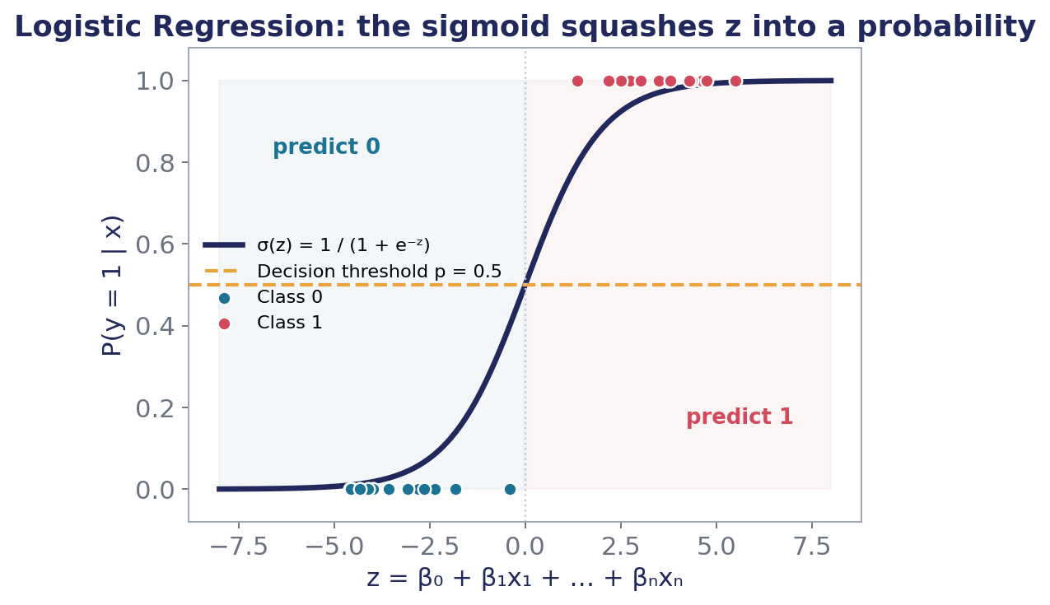
SUPERVISED · CLASSIFICATION
2. Logistic Regression
What it is
Despite the name, a classification model: it estimates the probability that an example belongs to the positive class by passing a linear score through the sigmoid (logistic) function.
How it works
1
Compute a linear score z = β₀ + β₁x₁ + … + βₙxₙ from the features.
2
Squash z through the S-shaped sigmoid σ(z) to get a probability between 0 and 1.
3
Learn the coefficients by Maximum Likelihood Estimation — make the predicted probabilities match observed outcomes.
4
Classify: predict class 1 if p ≥ threshold (typically 0.5), else class 0.
Problems it solves
Medical diagnosis (disease / no disease) · fraud detection · spam filtering · churn and credit-default prediction — any binary (or, via extensions, multi-class) decision.
The sigmoid maps any real score z to a probability; the 0.5 line is the default decision threshold.
Machine Learning Models — Lecture Series · Desmond Onam
10

Slide 11
SUPERVISED · CLASSIFICATION
2. Logistic Regression — the mathematics
SIGMOID (LOGISTIC) FUNCTION
LOG-ODDS INTERPRETATION
P(y=1|x) = σ(z) = 1 / (1 + e⁻ᶻ)
ln[ p / (1 − p) ] = β₀ + β₁x₁ + … + βₙxₙ
With z = β₀ + β₁x₁ + … + βₙxₙ. Outputs a calibrated probability, not just a hard label.
The model is linear in the log-odds: each βⱼ shifts the odds multiplicatively by e^βⱼ — the key to its interpretability.
LOSS: BINARY CROSS-ENTROPY
LEARNING RULE
J(β) = −(1/m) Σᵢ [ yᵢ ln ŷᵢ + (1−yᵢ) ln(1−ŷᵢ) ]
β := β − α ∇J(β), ∂J/∂βⱼ = (1/m) Σᵢ (ŷᵢ − yᵢ) xᵢⱼ
Equivalent to Maximum Likelihood Estimation: confident wrong predictions are punished severely. Convex, so optimisation is well-behaved.
Remarkably, the gradient has the same elegant form as linear regression’s — error times input.
✓ STRENGTHS
! LIMITATIONS
Simple, fast, well-calibrated probabilities · coefficients read as odds ratios · robust baseline for tabular classification and the output layer of neural networks.
Decision boundary is linear in the features · assumes linearity in the log-odds · struggles with heavily imbalanced classes without re-weighting or resampling.
Machine Learning Models — Lecture Series · Desmond Onam
11

Slide 12
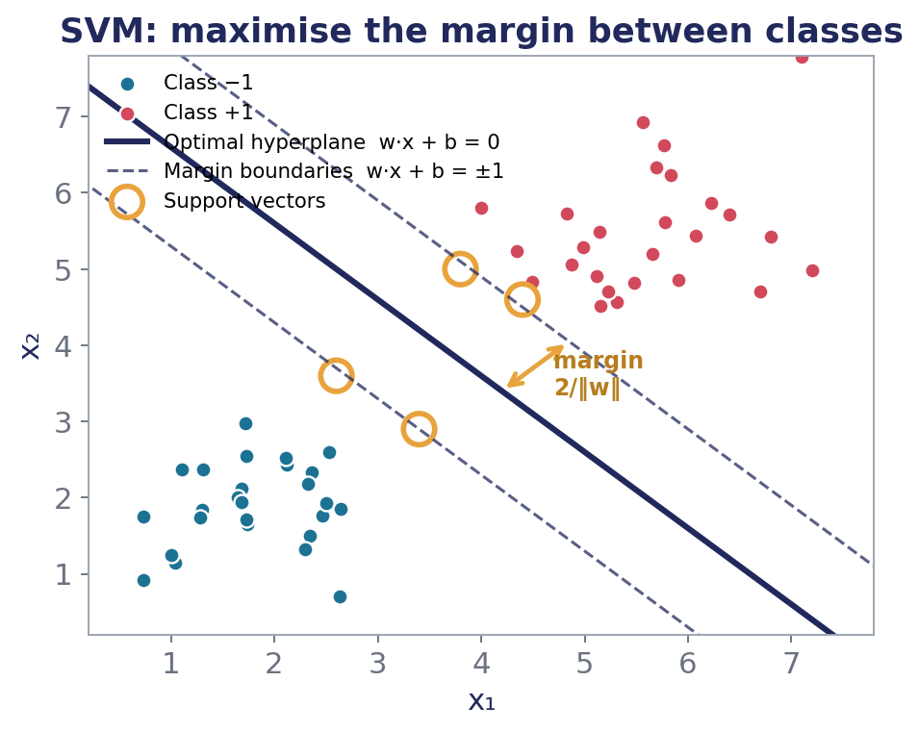
SUPERVISED · CLASSIFICATION & REGRESSION
3. Support Vector Machine (SVM)
What it is
Find the separating hyperplane that maximises the margin — the distance to the closest training points of each class. Those closest points, the support vectors, alone define the boundary.
How it works
1
Search for the hyperplane w·x + b = 0 that separates the classes with the widest possible margin.
2
Only the support vectors (points on the margin) constrain the solution; all other points are irrelevant.
3
Allow some violations with a soft margin (parameter C) to handle noisy, overlapping data.
4
For non-linear boundaries, apply the kernel trick: implicitly map data to a higher-dimensional space where it becomes separable.
Problems it solves
Text and document classification · image recognition · bioinformatics (gene classification) · high-dimensional problems where the number of features rivals the number of samples.
The solid line is the optimal hyperplane; circled points are support vectors sitting on the dashed margin boundaries.
Machine Learning Models — Lecture Series · Desmond Onam
12

Slide 13
SUPERVISED · CLASSIFICATION & REGRESSION
3. Support Vector Machine (SVM) — the mathematics
HARD-MARGIN OBJECTIVE
SOFT MARGIN (REGULARISED)
min ½‖w‖² s.t. yᵢ(w·xᵢ + b) ≥ 1 ∀i
min ½‖w‖² + C Σᵢ ξᵢ, ξᵢ ≥ 0
Maximising the margin 2/‖w‖ is equivalent to minimising ‖w‖² — a convex quadratic programme with a unique optimum.
Slack variables ξᵢ permit margin violations; C trades margin width against training errors (small C = wider, more tolerant margin).
HINGE LOSS VIEW
THE KERNEL TRICK
L = Σᵢ max(0, 1 − yᵢ(w·xᵢ + b)) + λ‖w‖²
K(x, x′) = φ(x)·φ(x′), e.g. RBF: K = exp(−γ‖x − x′‖²)
Points beyond the margin contribute zero loss — which is exactly why only support vectors matter.
Compute inner products in a high-dimensional feature space without ever constructing φ(x) explicitly — non-linear power at linear cost.
✓ STRENGTHS
! LIMITATIONS
Excellent in high dimensions · memory-efficient (only support vectors stored) · kernels give flexible non-linear boundaries · strong theoretical guarantees.
Training scales poorly to very large datasets · performance hinges on kernel and C, γ choices · no direct probability outputs · less interpretable than linear models.
Machine Learning Models — Lecture Series · Desmond Onam
13

Slide 14
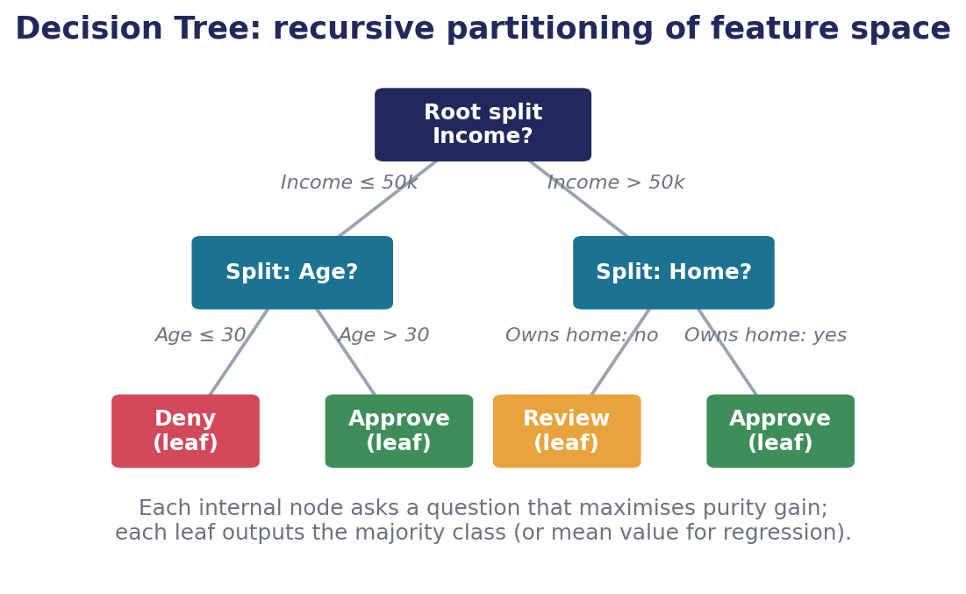
SUPERVISED · CLASSIFICATION & REGRESSION
4. Decision Tree
What it is
A flowchart learned from data: recursively split the feature space with simple if/else questions until the resulting regions (leaves) are pure enough to make a prediction.
How it works
1
At the root, evaluate every candidate feature-and-threshold split.
2
Choose the split that most reduces impurity (Gini or entropy) in the children.
3
Recurse on each child until a stopping rule fires — max depth, min samples, or minimum impurity gain.
4
Predict by routing a new example down the tree: leaves output the majority class (classification) or the mean value (regression).
Problems it solves
Credit approval and risk rules · medical triage · churn analysis · any setting that values transparent, explainable decision logic with mixed numeric/categorical features.
A loan-approval tree: internal nodes ask questions; leaves carry decisions. The whole model is human-readable.
Machine Learning Models — Lecture Series · Desmond Onam
14

Slide 15
SUPERVISED · CLASSIFICATION & REGRESSION
4. Decision Tree — the mathematics
GINI IMPURITY
ENTROPY
G(node) = 1 − Σₖ pₖ²
H(node) = − Σₖ pₖ log₂ pₖ
pₖ = proportion of class k in the node. G = 0 for a pure node; maximal when classes are evenly mixed. CART’s default criterion.
Information-theoretic impurity in bits: 0 for pure nodes, 1 for a 50/50 binary split. Used by the ID3/C4.5 family.
INFORMATION GAIN (THE SPLIT RULE)
REGRESSION VARIANT
IG = H(parent) − Σⱼ (nⱼ/n) · H(childⱼ)
Split minimises Σⱼ Σᵢ∈childⱼ (yᵢ − ȳⱼ)²
The impurity reduction achieved by a split, weighting each child by its share of samples. The tree greedily takes the split with the largest IG.
For continuous targets, impurity becomes within-node variance; leaves predict the node mean ȳ.
✓ STRENGTHS
! LIMITATIONS
Fully interpretable · handles non-linearities, mixed feature types, missing values · no feature scaling needed · the building block of Random Forests and Gradient Boosting.
High variance — small data changes can reshape the tree · prone to overfitting without pruning/depth limits · greedy splits are locally, not globally, optimal.
Machine Learning Models — Lecture Series · Desmond Onam
15

Slide 16
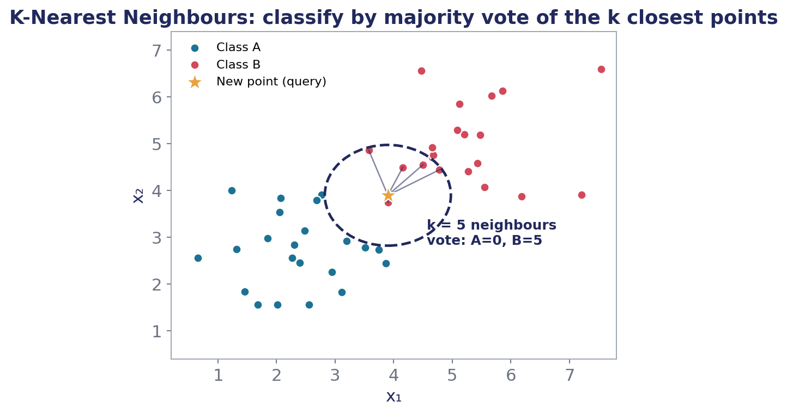
SUPERVISED · CLASSIFICATION & REGRESSION
5. K-Nearest Neighbours (KNN)
What it is
A lazy, instance-based learner: no training phase at all. To predict, find the k most similar examples in the training set and let them vote (classification) or average (regression).
How it works
1
Store the entire training set — that is the whole “training” step.
2
For a query point, compute its distance to every stored example (Euclidean, Manhattan, or cosine).
3
Select the k nearest neighbours; small k gives flexible, noisy boundaries, large k gives smooth ones.
4
Output the majority class among the neighbours, or the mean of their target values for regression.
Problems it solves
Recommender systems (similar users/items) · pattern and handwriting recognition · imputation of missing values · quick non-parametric baselines when decision boundaries are complex.
The starred query takes the majority vote of its k = 5 nearest neighbours inside the dashed circle.
Machine Learning Models — Lecture Series · Desmond Onam
16

Slide 17
SUPERVISED · CLASSIFICATION & REGRESSION
5. K-Nearest Neighbours (KNN) — the mathematics
EUCLIDEAN DISTANCE
MANHATTAN DISTANCE
d(x, x′) = √ Σⱼ (xⱼ − x′ⱼ)²
d(x, x′) = Σⱼ |xⱼ − x′ⱼ|
The default metric — straight-line distance in feature space. Features must be scaled first, or large-range features dominate.
City-block distance; more robust to outliers, often better in high dimensions. Cosine similarity suits text/frequency vectors.
CLASSIFICATION RULE
REGRESSION RULE
ŷ = mode{ yᵢ : xᵢ ∈ Nₖ(x) }
ŷ = (1/k) Σᵢ∈Nₖ(x) yᵢ
Majority vote of the k nearest neighbours Nₖ(x); ties broken by distance weighting wᵢ = 1/d(x, xᵢ).
The neighbours’ average. Choose k by cross-validation — the single most important hyperparameter.
✓ STRENGTHS
! LIMITATIONS
No training time · naturally non-linear and multi-class · adapts instantly as new data is added · a strong, honest baseline.
Prediction is slow on large datasets (distance to every point) · the curse of dimensionality erodes distances in high dimensions · sensitive to feature scaling and irrelevant features.
Machine Learning Models — Lecture Series · Desmond Onam
17

Slide 18
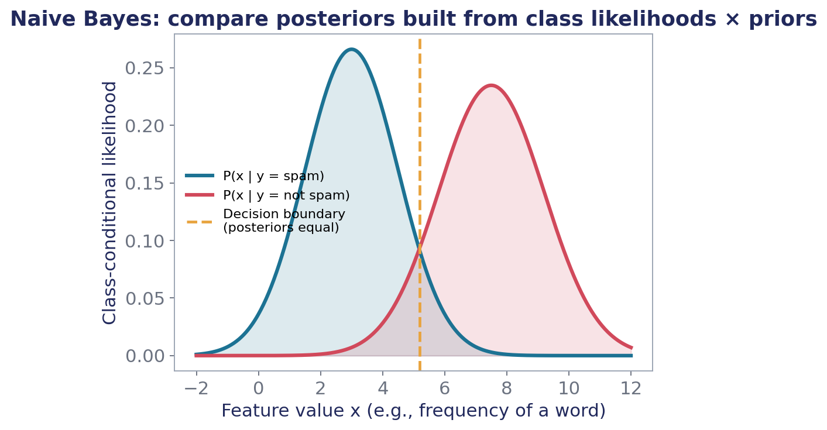
SUPERVISED · CLASSIFICATION
6. Naive Bayes
What it is
A probabilistic classifier built on Bayes’ theorem with one bold (“naive”) simplification: features are assumed conditionally independent given the class. Simple, fast, surprisingly effective.
How it works
1
Estimate the prior P(y) of each class from label frequencies in the training data.
2
Estimate each feature’s likelihood P(xⱼ|y) per class — counts for discrete features, a Gaussian for continuous ones.
3
For a new example, multiply prior × likelihoods to score each class (Bayes’ theorem).
4
Predict the class with the highest posterior probability.
Problems it solves
Spam filtering (its classic triumph) · sentiment analysis and document classification · real-time prediction where speed matters · problems with small training sets and many features.
Each class induces a likelihood curve over a feature; the boundary sits where the posteriors are equal.
Machine Learning Models — Lecture Series · Desmond Onam
18

Slide 19
SUPERVISED · CLASSIFICATION
6. Naive Bayes — the mathematics
BAYES’ THEOREM
THE NAIVE ASSUMPTION
P(y|x) = P(x|y) · P(y) / P(x)
P(x₁,…,xₙ | y) = Πⱼ P(xⱼ | y)
Posterior = likelihood × prior, normalised by the evidence. P(x) is constant across classes, so it can be ignored when comparing.
Conditional independence lets us estimate each feature’s distribution separately — collapsing an intractable joint into n easy one-dimensional problems.
DECISION RULE
GAUSSIAN LIKELIHOOD (CONTINUOUS X)
ŷ = argmaxᵧ P(y) · Πⱼ P(xⱼ | y)
P(xⱼ|y) = (1/√(2πσ²ᵧ)) · exp(−(xⱼ−μᵧ)²/2σ²ᵧ)
In practice we sum logs instead of multiplying probabilities to avoid numerical underflow: argmax [ln P(y) + Σⱼ ln P(xⱼ|y)].
Gaussian NB fits a mean and variance per feature per class. Laplace smoothing (add-one counts) protects against zero probabilities.
✓ STRENGTHS
! LIMITATIONS
Extremely fast to train and predict · works with small data and high dimensions · handles missing features gracefully · naturally multi-class.
Independence rarely holds exactly, so probabilities are poorly calibrated (though rankings often survive) · correlated features get double-counted · zero-frequency problem without smoothing.
Machine Learning Models — Lecture Series · Desmond Onam
19

Slide 20
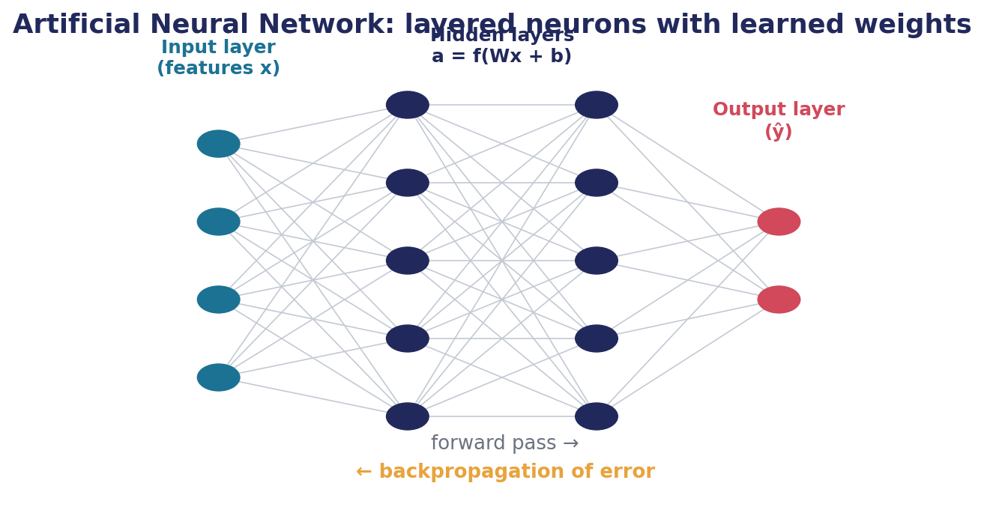
SUPERVISED · CLASSIFICATION, REGRESSION & BEYOND
7. Artificial Neural Networks (ANN)
What it is
Layers of simple computational units (“neurons”) inspired by the brain: each neuron computes a weighted sum of its inputs and applies a non-linear activation. Stacked layers can approximate virtually any function.
How it works
1
Forward pass: inputs flow through hidden layers; each layer computes a = f(Wx + b).
2
Compare the output ŷ to the true label with a loss function (MSE or cross-entropy).
3
Backpropagation: use the chain rule to compute how the loss changes with every weight.
4
Gradient descent nudges all weights downhill; repeat over many epochs until the loss converges.
Problems it solves
Image and speech recognition · natural language processing · time-series forecasting · any large-scale problem with complex non-linear structure. CNNs and RNNs/Transformers are specialised descendants.
Information flows forward through weighted connections; error gradients flow backward to update every weight.
Machine Learning Models — Lecture Series · Desmond Onam
20

Slide 21
SUPERVISED · CLASSIFICATION, REGRESSION & BEYOND
7. Artificial Neural Networks (ANN) — the mathematics
A SINGLE NEURON
ACTIVATION FUNCTIONS
a = f( Σⱼ wⱼxⱼ + b )
σ(z) = 1/(1+e⁻ᶻ) · ReLU(z) = max(0, z)
A weighted sum plus bias, passed through a non-linear activation f — without non-linearity, stacked layers would collapse into one linear model.
ReLU dominates hidden layers (fast, mitigates vanishing gradients); sigmoid/softmax convert output-layer scores into probabilities.
LOSS FUNCTIONS
BACKPROPAGATION UPDATE
MSE = (1/m)Σ(ŷ−y)² · CE = −Σ y ln ŷ
w := w − η · ∂L/∂w (chain rule, layer by layer)
Mean squared error for regression; cross-entropy for classification. The loss defines the landscape the optimiser descends.
η is the learning rate. Gradients are computed efficiently backward from output to input — the algorithm that makes deep learning feasible.
✓ STRENGTHS
! LIMITATIONS
Universal approximators of non-linear functions · state-of-the-art on vision, speech and language · scales with data and compute · flexible architectures for any modality.
Data- and compute-hungry · many hyperparameters (depth, width, η, regularisation) · a black box compared with trees or linear models · risk of overfitting without dropout/early stopping.
Machine Learning Models — Lecture Series · Desmond Onam
21

Slide 22
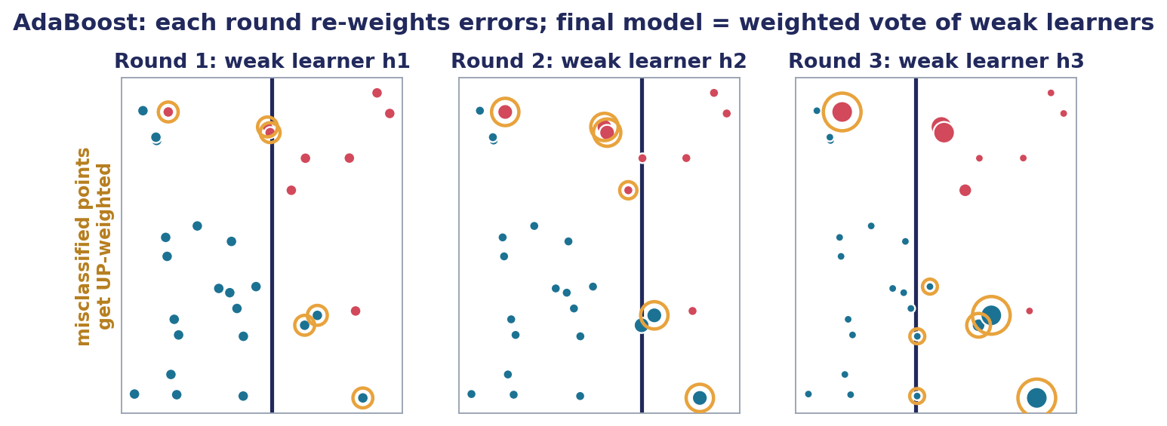
SUPERVISED · ENSEMBLE (BOOSTING)
8. AdaBoost
What it is
Adaptive Boosting: build a strong classifier from many weak ones (typically decision stumps) trained in sequence, where each new learner concentrates on the examples its predecessors got wrong.
How it works
1
Start with equal weights on all training examples.
2
Train a weak learner; measure its weighted error rate εₜ.
3
Up-weight the misclassified points and down-weight the correct ones, so the next learner must focus on the hard cases.
4
Repeat T rounds; the final prediction is a weighted vote where accurate learners speak louder.
Problems it solves
Face detection (the classic Viola–Jones detector) · tabular classification with noisy features · squeezing strong performance from very simple base models. Ancestor of Gradient Boosting and XGBoost.
Circled points were misclassified and grow in weight; each round’s stump attacks its predecessor’s mistakes.
Machine Learning Models — Lecture Series · Desmond Onam
22

Slide 23
SUPERVISED · ENSEMBLE (BOOSTING)
8. AdaBoost — the mathematics
WEIGHTED ERROR OF ROUND T
LEARNER’S VOTING WEIGHT
εₜ = Σᵢ wᵢ · 1(hₜ(xᵢ) ≠ yᵢ)
αₜ = ½ ln( (1 − εₜ) / εₜ )
The fraction of the current weight mass that learner hₜ misclassifies. A weak learner only needs εₜ < 0.5 — barely better than chance.
Accurate learners (small εₜ) receive large α; a coin-flip learner (εₜ = 0.5) gets α = 0 and no vote.
EXAMPLE RE-WEIGHTING
FINAL STRONG CLASSIFIER
wᵢ ← wᵢ · exp(−αₜ yᵢ hₜ(xᵢ)) / Zₜ
H(x) = sign( Σₜ αₜ hₜ(x) )
Misclassified points (yᵢhₜ = −1) are multiplied up; correct ones shrink. Zₜ renormalises weights to sum to 1.
A confidence-weighted majority vote across all T rounds — provably driving training error down exponentially fast.
✓ STRENGTHS
! LIMITATIONS
Turns weak learners into a strong one · few hyperparameters · resistant to overfitting in many practical regimes · foundation of the modern boosting family.
Sensitive to noisy labels and outliers (they keep getting up-weighted) · sequential, so harder to parallelise · needs enough rounds T tuned by validation.
Machine Learning Models — Lecture Series · Desmond Onam
23

Slide 24
PART II · FINDING STRUCTURE WITHOUT LABELS
Unsupervised Learning Models
1
K-Means Clustering
2
Principal Component Analysis (PCA)
Machine Learning Models — Lecture Series · Desmond Onam
24

Slide 25
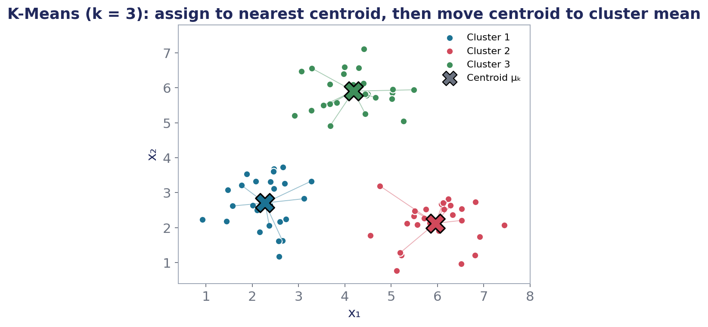
UNSUPERVISED · CLUSTERING
9. K-Means Clustering
What it is
Partition unlabelled data into k clusters so that points within a cluster are similar and clusters are well separated. The archetypal “discover the groups” algorithm.
How it works
1
Choose k and initialise k centroids (randomly, or smartly with k-means++).
2
Assignment step: attach every point to its nearest centroid (Euclidean distance).
3
Update step: move each centroid to the mean of the points assigned to it.
4
Iterate assignment ↔ update until centroids stop moving (convergence) or a max-iteration cap is hit.
Problems it solves
Customer and market segmentation · image colour compression · document grouping · anomaly detection (points far from every centroid) · pre-clustering for downstream supervised models.
Points join their nearest ✕ centroid; centroids then relocate to their cluster means until stable.
Machine Learning Models — Lecture Series · Desmond Onam
25

Slide 26
UNSUPERVISED · CLUSTERING
9. K-Means Clustering — the mathematics
OBJECTIVE (WCSS / INERTIA)
ASSIGNMENT STEP
J = Σₖ Σᵢ∈Cₖ ‖xᵢ − μₖ‖²
Cₖ = { xᵢ : ‖xᵢ − μₖ‖ ≤ ‖xᵢ − μⱼ‖ ∀j }
Within-Cluster Sum of Squares: total squared distance from points to their centroids. K-Means is coordinate descent on J.
Each point joins its nearest centroid — this step can only decrease J, holding centroids fixed.
UPDATE STEP
CHOOSING K
μₖ = (1/|Cₖ|) Σᵢ∈Cₖ xᵢ
Elbow on J(k) · Silhouette s = (b − a)/max(a, b)
The mean minimises squared distance within a cluster — this step also only decreases J, guaranteeing convergence (to a local optimum).
Plot J against k and look for the bend; or maximise the silhouette, where a = mean intra-cluster distance and b = distance to the nearest other cluster.
✓ STRENGTHS
! LIMITATIONS
Simple, fast, scales to large datasets · easy to interpret centroids as cluster “profiles” · a building block for GMMs and hierarchical methods.
k must be chosen in advance · sensitive to initialisation (use k-means++, multiple restarts) · assumes roughly spherical, equal-sized clusters · outliers drag centroids.
Machine Learning Models — Lecture Series · Desmond Onam
26

Slide 27
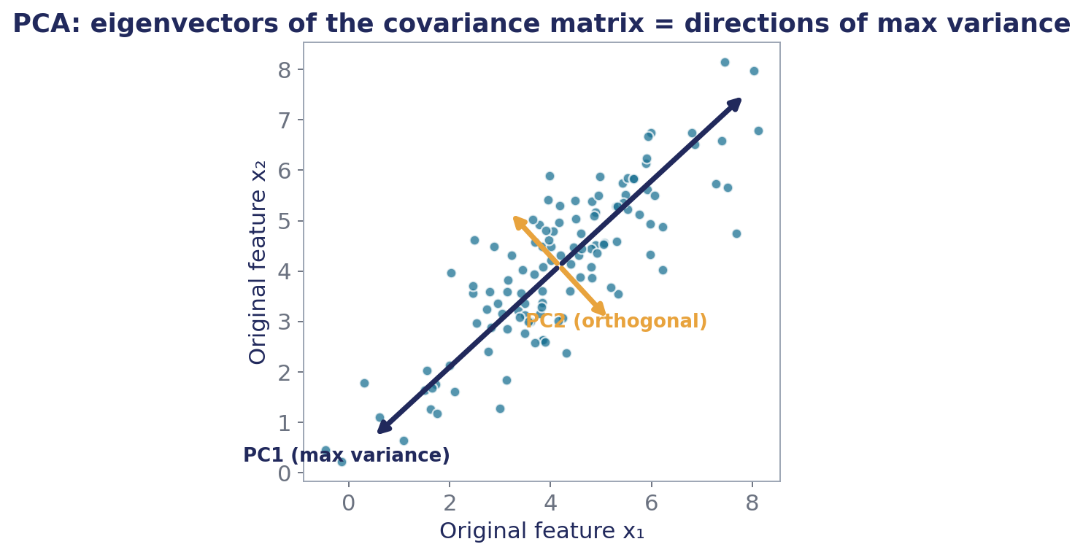
UNSUPERVISED · DIMENSIONALITY REDUCTION
10. Principal Component Analysis (PCA)
What it is
Rotate the coordinate system to align with the directions of greatest variance in the data, then keep only the top few directions — compressing many correlated features into a handful of uncorrelated principal components.
How it works
1
Standardise the features (zero mean, unit variance) — PCA is scale-sensitive.
2
Compute the covariance matrix capturing how features vary together.
3
Extract its eigenvectors (directions) and eigenvalues (variance along each direction).
4
Project the data onto the top-d eigenvectors, chosen to retain e.g. 95% of total variance.
Problems it solves
Visualising high-dimensional data in 2-D/3-D · de-noising and compression · removing multicollinearity before regression · speeding up downstream models (SVMs, ANNs) as a preprocessing step.
PC1 points along maximum variance; PC2 is orthogonal. Dropping later components loses little information.
Machine Learning Models — Lecture Series · Desmond Onam
27

Slide 28
UNSUPERVISED · DIMENSIONALITY REDUCTION
10. Principal Component Analysis (PCA) — the mathematics
COVARIANCE MATRIX
EIGEN-DECOMPOSITION
Σ = (1/m) X̃ᵀX̃ (X̃ = centred data)
Σ v = λ v
Entry Σⱼₗ measures how features j and l co-vary. Symmetric and positive semi-definite — so its eigenvectors are orthogonal.
Eigenvectors v are the principal components; each eigenvalue λ is the variance the data exhibits along that direction. Sort by λ, largest first.
EXPLAINED VARIANCE RATIO
PROJECTION (THE REDUCTION)
EVRᵢ = λᵢ / Σⱼ λⱼ
Z = X̃ W_d (W_d = top-d eigenvectors)
The share of total variance captured by component i. Keep the smallest d with cumulative EVR above your threshold (commonly 90–95%).
Z is the compressed dataset: m examples × d uncorrelated features. Reconstruction X̂ = ZW_dᵀ quantifies information lost.
✓ STRENGTHS
! LIMITATIONS
Removes redundancy and noise · uncorrelated outputs stabilise downstream models · dramatic compression with minimal variance loss · closed-form and deterministic.
Strictly linear — cannot unfold curved manifolds (see kernel PCA, t-SNE, UMAP) · components are combinations of features, hurting interpretability · sensitive to outliers and scaling.
Machine Learning Models — Lecture Series · Desmond Onam
28

Slide 29
SYNTHESIS
Choosing the right model — a practitioner’s cheat sheet
Model | Learning | Task | Core idea | Reach for it when…
Linear Regression | Supervised | Regression | Best-fit hyperplane via least squares | You need an interpretable numeric baseline
Logistic Regression | Supervised | Classification | Sigmoid over a linear score; MLE | You need probabilities and odds-ratio insight
SVM | Supervised | Both | Maximum-margin hyperplane + kernels | Features are many, data is modest, boundaries non-linear
Decision Tree | Supervised | Both | Recursive impurity-reducing splits | Stakeholders must read the decision logic
KNN | Supervised | Both | Vote/average of k nearest points | Data is small and the boundary is complex
Naive Bayes | Supervised | Classification | Bayes’ rule + feature independence | Text data, tight compute budgets, small samples
ANN | Supervised | Both | Layered neurons trained by backprop | Data is large and patterns are highly non-linear
AdaBoost | Supervised | Classification | Re-weighted sequence of weak learners | Simple learners underperform on tabular data
K-Means | Unsupervised | Clustering | Alternate assign-to-centroid / recompute mean | You must discover natural groups, k roughly known
PCA | Unsupervised | Dim. reduction | Project onto top eigenvectors of covariance | Features are many and correlated; need compression
Machine Learning Models — Lecture Series · Desmond Onam
29

Slide 30
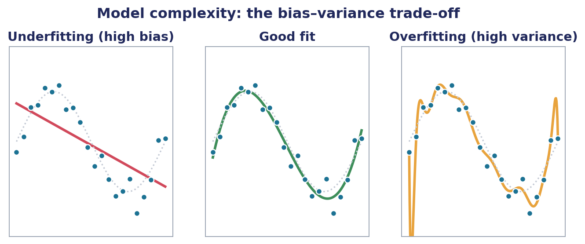
CHALLENGES IN PRACTICE
The central tension: bias vs variance
UNDERFITTING = HIGH BIAS
THE SWEET SPOT
OVERFITTING = HIGH VARIANCE
The model is too simple to capture the signal — poor on training AND test data. Remedies: richer features, higher-capacity models, less regularisation.
Capacity matched to the data: captures the pattern, ignores the noise. Found empirically via validation curves and cross-validation.
The model memorises noise — excellent on training data, poor on unseen data. Remedies: more data, L1/L2 regularisation, dropout, early stopping, pruning.
Machine Learning Models — Lecture Series · Desmond Onam
30

Slide 31
CHALLENGES IN PRACTICE
Building robust models: regularisation & data preparation
Taming overfitting — regularisation
Data preprocessing — where models are won
L2 (Ridge) — J + λ Σ βⱼ² — shrinks all weights smoothly toward zero; stabilises correlated features.
1
Cleaning. Handle missing values (impute or drop), fix inconsistencies, deduplicate — garbage in, garbage out.
L1 (Lasso) — J + λ Σ |βⱼ| — drives some weights exactly to zero, performing automatic feature selection.
2
Outlier treatment. Detect via IQR or z-scores; cap, transform, or remove. Squared-loss models are especially vulnerable.
Dropout (ANNs) — Randomly silence a fraction of neurons each step, forcing redundant, robust representations.
Scaling. Standardise (z-score) or normalise (min–max). Mandatory for KNN, SVM, PCA and neural networks.
3
Early stopping — Halt training when validation loss stops improving — the cheapest regulariser of all.
4
Encoding. One-hot or ordinal encoding turns categorical variables into numbers models can consume.
Fighting bias (underfitting)
Increase model capacity (deeper trees, more layers, kernels) · engineer better features · reduce λ · train longer. Bias and variance trade off — tune with a held-out validation set, never the test set.
5
Class imbalance. Resample (SMOTE, under-sampling) or re-weight classes so minority patterns are not ignored.
6
Feature selection. Drop redundant/irrelevant features via correlation analysis, Lasso, or tree importances.
Machine Learning Models — Lecture Series · Desmond Onam
31

Slide 32
CHALLENGES IN PRACTICE
How do we know a model is good? Evaluation metrics
CLASSIFICATION
REGRESSION
CLUSTERING
Accuracy
MSE / RMSE
WCSS / inertia
(TP+TN) / all
(1/m)Σ(ŷ−y)² , √MSE
Σₖ Σ ‖x − μₖ‖²
Fraction correct — misleading on imbalanced classes.
Average squared error; RMSE returns to the target’s units.
Compactness of clusters — the K-Means objective itself.
Precision
MAE
Silhouette
TP / (TP + FP)
(1/m)Σ|ŷ − y|
s = (b − a)/max(a,b)
Of predicted positives, how many were real? Cost of false alarms.
Mean absolute error — robust to outliers, easy to explain.
Compares cohesion a with separation b; s → 1 is ideal.
Recall (sensitivity)
R² (coefficient of determination)
Elbow method
TP / (TP + FN)
1 − SS_res / SS_tot
plot J(k) vs k
Of real positives, how many did we catch? Cost of misses.
Share of variance explained; 1 is perfect, 0 is the mean baseline.
Choose k at the bend where gains flatten out.
F1-score
Validation protocol
Reconstruction error (PCA)
2·P·R / (P + R)
k-fold cross-validation
‖X − X̂‖²
Harmonic mean of precision and recall — one balanced number.
Rotate train/validation folds; report mean ± std of the metric.
Information lost when projecting to d components.
Machine Learning Models — Lecture Series · Desmond Onam
32

Slide 33
LECTURE SUMMARY
Ten models, one discipline
1
Machine learning = generalisation — Every model estimates a function from data and is judged on unseen examples — never on the data it memorised.
2
Supervised models map X → y — Linear & logistic regression, SVM, trees, KNN, Naive Bayes, ANNs and AdaBoost differ in the shape of that map and the loss they minimise.
3
Unsupervised models reveal structure — K-Means compresses data into groups; PCA compresses it into directions. Both optimise explicit, interpretable objectives.
4
The mathematics is the model — Cost functions, margins, impurities, likelihoods, eigenvalues — understand the objective and the algorithm follows.
5
Practice is a discipline — Preprocess carefully, regularise deliberately, validate honestly, and match the model to the problem — not the fashion.
Companion reading: D. Onam, “Machine Learning Models”, Medium — medium.com/@desmondonam/machine-learning-models-2c7b707a2ce8
Machine Learning Models — Lecture Series · Desmond Onam
33

