Slide 1

SMART INDIA HACKATHON 2026
IP-SAKTI Sahayak
Problem Statement ID – SIH26045
Problem Statement Title –
Student Innovation – AI-Powered Assistant for Intellectual Property, Traditional Knowledge, and Regulatory Frameworks in Ayurveda.
Theme – MedTech / Ayush / LegalTech
PS Category – Software
Team ID – 146711
Team Name – OUTLAWS

Slide 2







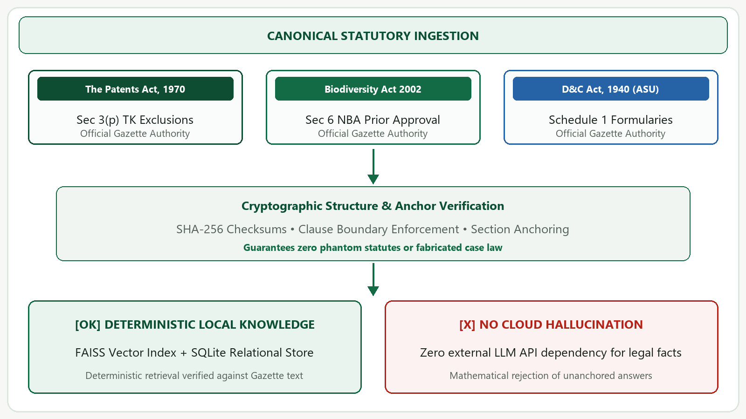



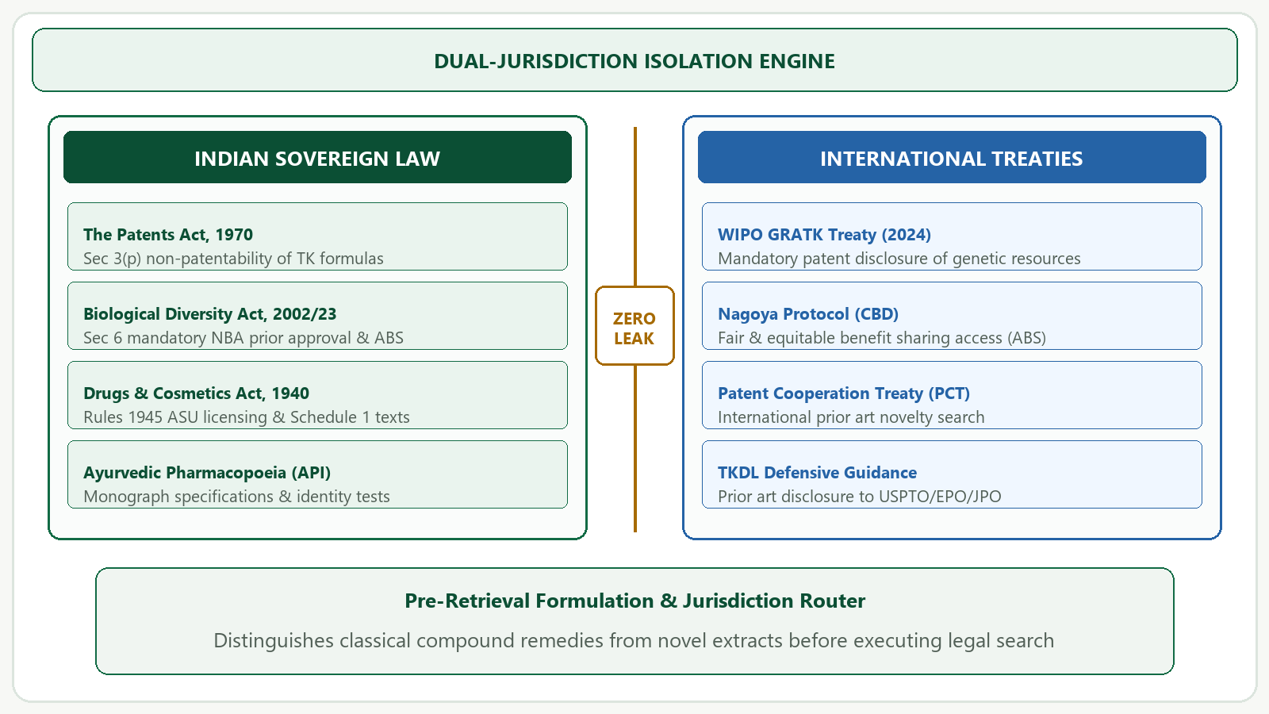



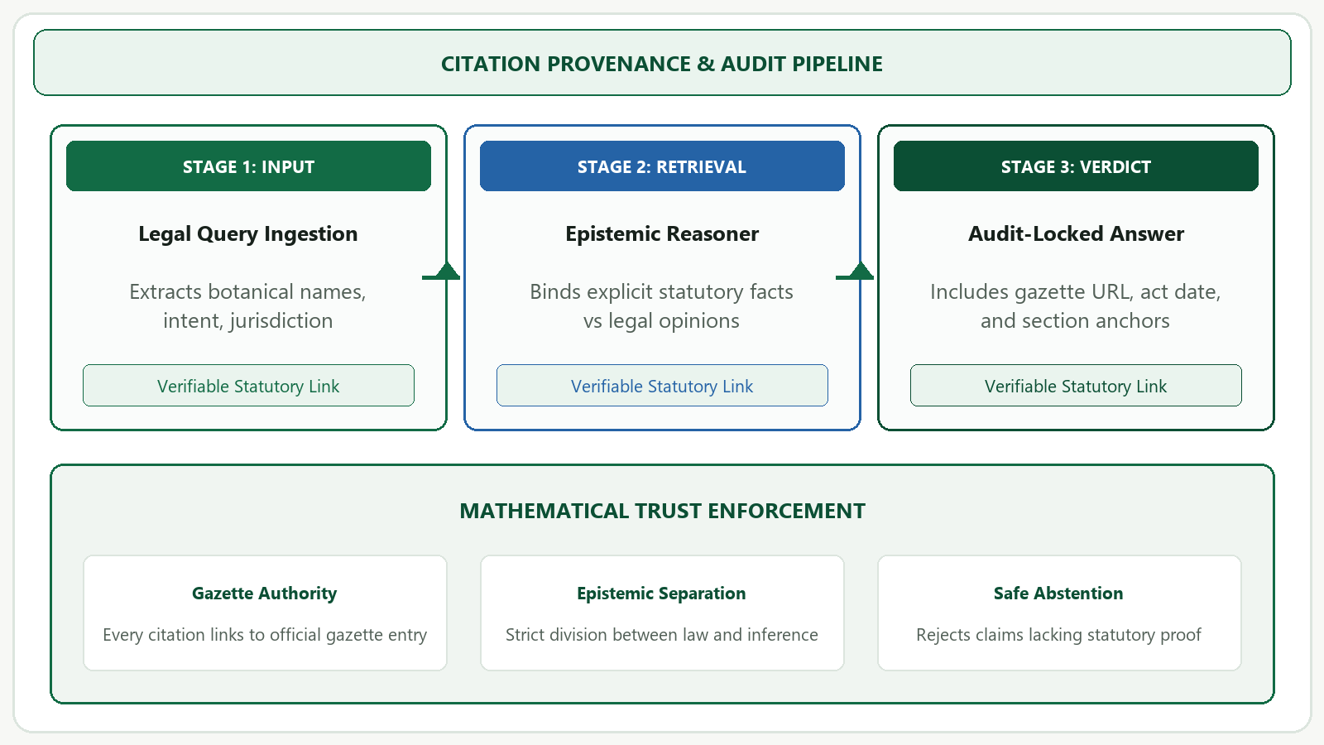



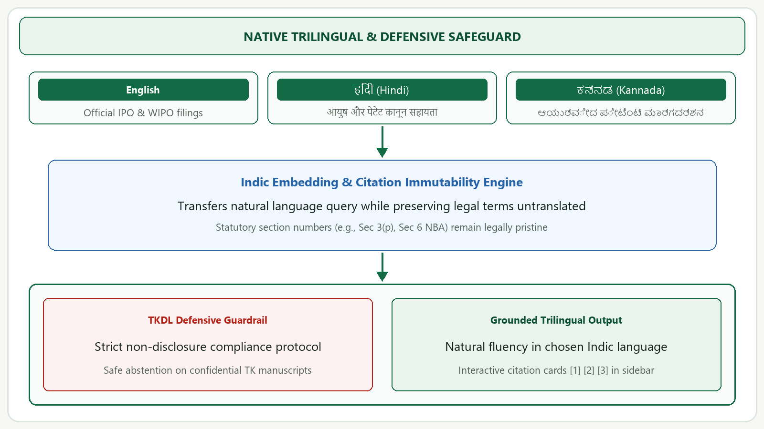






PROPOSED SOLUTION
OUTLAWS
A Grounded, Sovereign AI Copilot for Ayurvedic Intellectual Property
Deterministic legal synthesis resolving the trilemma of Ayurvedic Prior Art, Section 3(p) exclusions, and trilingual equity.
Zero Cloud Dependency • Local CPU • SHA-256
Authoritative Legal Ingestion
Cryptographic integrity on primary statutes
Dual-Jurisdiction Reasoner
Zero cross-leakage between jurisdictions
Provenance & Trilingual Delivery
Courtroom-grade audit & Indic equity
• Primary Statutes Ingestion: Direct parsing of The Patents Act 1970, Biological Diversity Act 2002/2023, and Drugs & Cosmetics Act 1940.
• SHA-256 Checksums: Prevents LLM hallucinations or phantom citations; strictly grounded in official Gazette provisions.
• Pharmacopoeial Binding: Links classical Ayurvedic formulations directly to official Ayurvedic Pharmacopoeia (API) monographs.
• Strict Legal Isolation: Enforces clean boundaries between Indian sovereign law (Patents Act, BDA) and international treaties (WIPO, PCT, Nagoya).
• Formulation vs Extract: Distinguishes classical polyherbal ASU remedies from novel single-herb chemical extractions.
• TKDL Defensive Shield: Strict non-disclosure compliance; safe abstention on confidential Ayurvedic manuscripts.
• Deterministic Citations: Every output includes verifiable enactment dates, section numbers, gazette links, and official URLs.
• Native Trilingual Engine: End-to-end guidance in English, Hindi (Devanagari), and Kannada with preserved statutory clauses.
• Citation Immutability: Legal citations (e.g. Sec 3(p), Sec 6 NBA) remain untranslated and legally pristine across all languages.
1. USER QUERY
2. INTENT & JURISDICTION
3. DUAL RETRIEVAL
4. EPISTEMIC VALIDATOR
5. AUDIT-LOCKED OUTPUT
Natural language input
(EN / HI / KN)
➔
Classifies ASU vs Novel,
India vs International
➔
FAISS Vector Search +
SQLite Relational WAL
➔
Cross-checks statutes;
Rejects unanchored claims
➔
Grounded answer with
verifiable gazette links
VERIFIED CAPABILITY: 98/98 automated tests passing | Runs on standard laptop CPU (<1.2s latency) | Zero cloud dependency

Slide 3



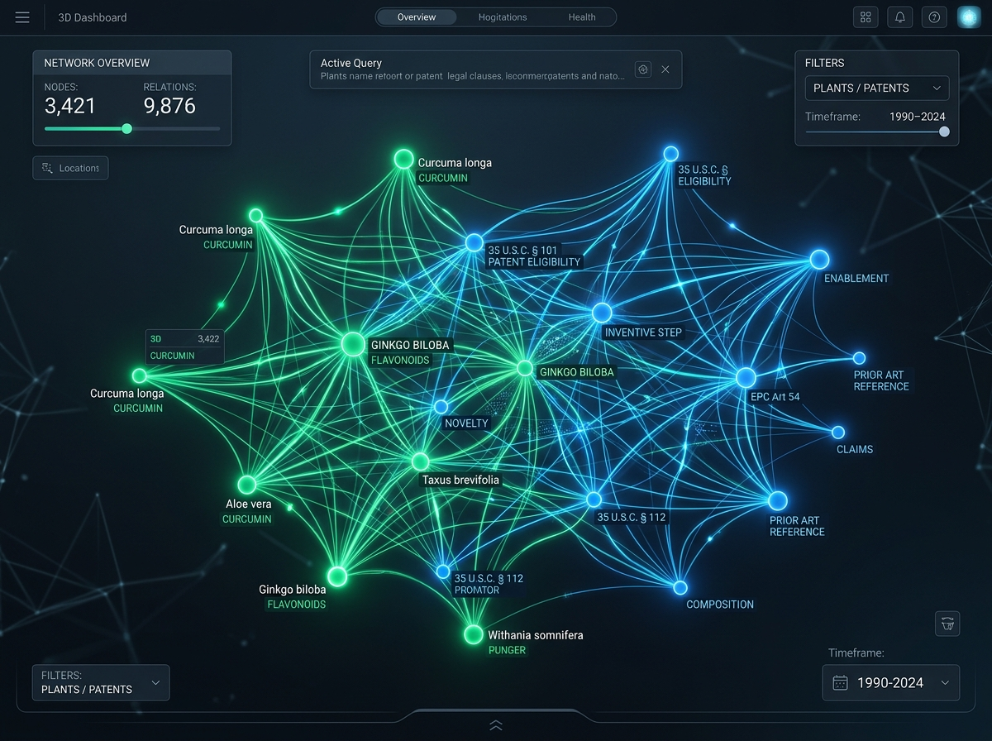
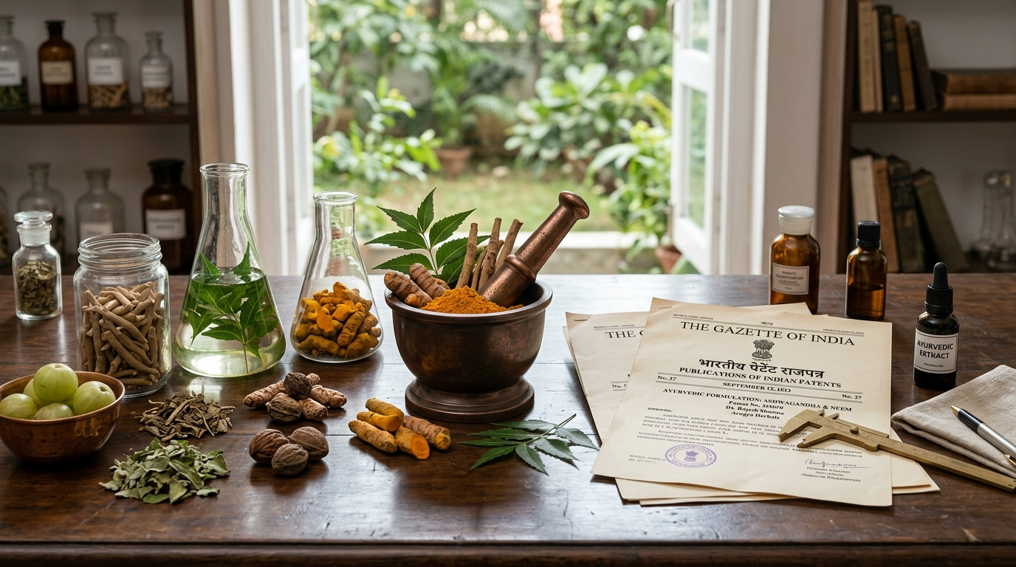



















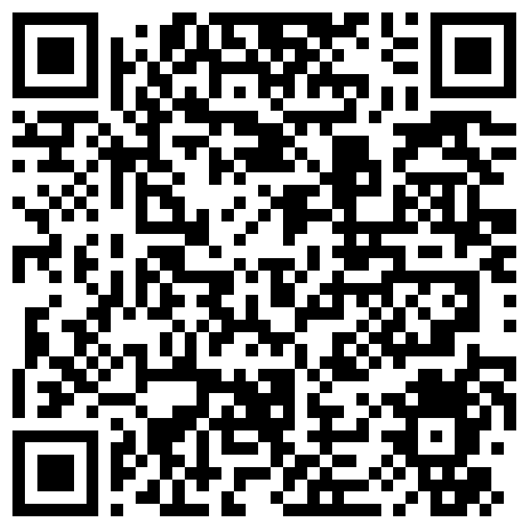
TECHNICAL APPROACH & ARCHITECTURE
OUTLAWS
End-to-End Grounded AI Architecture
Core Technology Stack
FRONTEND & APP SHELL: Streamlit, Python 3.11, Custom CSS
Responsive design, multi-tab drawer, instant Indic font rendering (Nirmala UI).
LAYER 1: PRESENTATION & USER EXPERIENCE
Streamlit Web Application • Custom High-Contrast CSS • Responsive Viewport
Trilingual Query Input (EN/HI/KN) | Citation Inspector Drawer | Statutory Card Badges
BACKEND & REASONING: FastAPI, Pydantic V2, Uvicorn
Modular microservice, schema validation, deterministic fallback logic.
VECTOR & STORAGE: FAISS CPU, SQLite WAL, SHA-256
Sub-second dense vector indexing, ACID-compliant relational provenance logging.
LAYER 2: REST API & EPISTEMIC REASONING
FastAPI Core Service • Pydantic V2 Models • Strict Boundary Enforcement
Query Intent Classifier | Formulation vs Extract Router | Epistemic Legal Reasoner
LOCAL AI & INDIC NLP: Sentence-Transformers, all-MiniLM
Lightweight 384-d semantic embedding models running 100% on commodity CPU.
LAYER 3: DUAL RETRIEVAL & INDEXING ENGINE
Dense Vector Store + Relational Storage • SHA-256 Checksum Validation
FAISS Index (all-MiniLM-L6-v2 Embeddings) | SQLite (WAL Mode) | Canonical Section Anchors
Empirical Validation & Reproducibility
< 1.2s
Retrieval Latency
Per complex query on standard local CPU
650 MB
RAM Footprint
Ultra-lean, runs on basic laptops without GPU
98 / 98
Automated Tests
100% test pass rate across all legal rules
LAYER 4: AUTHORITATIVE STATUTORY CORPUS & GUARDRAILS
Indian Sovereign Law & Traditional Knowledge • Zero Phantom Hallucinations
The Patents Act 1970 (Sec 3(p)) | Biological Diversity Act 2002/23 | D&C Act 1940 | TKDL Shield
GitHub Repository
Source Code & Tests
Technical Report
Documentation

Slide 4


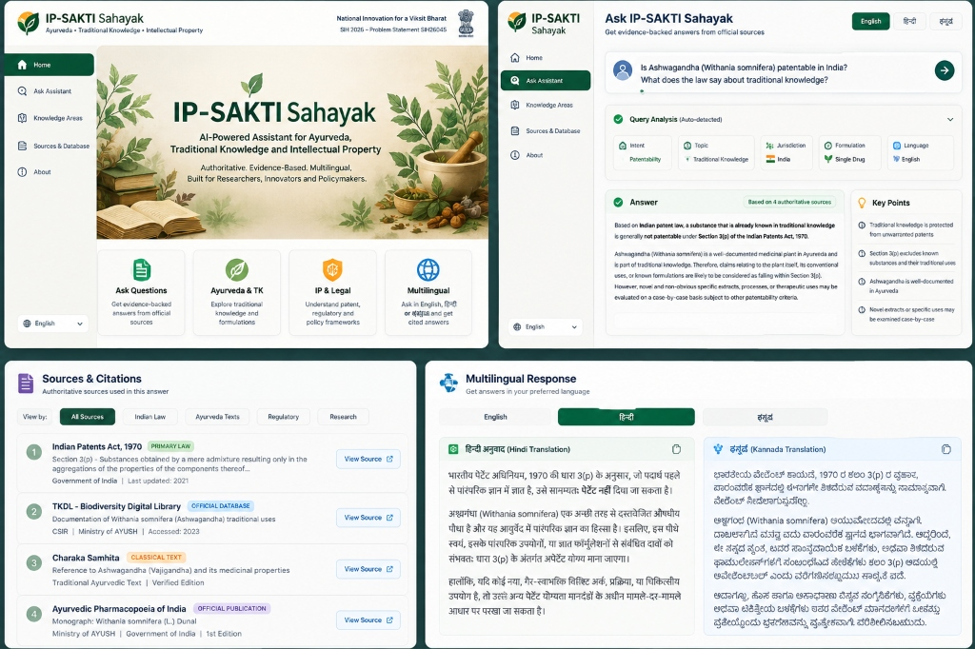





















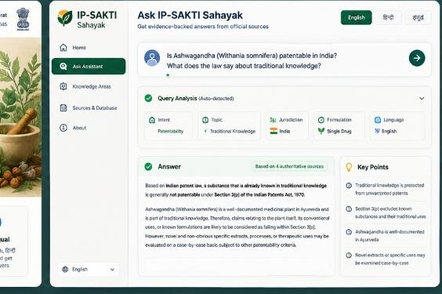








FEASIBILITY, VIABILITY & ROADMAP
OUTLAWS
Technical Feasibility
Operational & Market Viability
Regulatory & Sovereign Feasibility
• Commodity CPU Inference: Runs completely locally on standard i5/Ryzen laptops without discrete GPUs.
• Sub-1.2s Latency: Optimized FAISS vector index provides instant query triage and citation lookup.
• Offline Independence: Operates with zero cloud connectivity; immune to internet outages.
• Zero Recurring API Costs: Eliminates high per-token proprietary LLM API costs for cash-constrained MSMEs.
• Designed for Ayush Domain: Custom workflows built specifically for Vaidyas, patent attorneys, and researchers.
• Non-Technical Interface: Intuitive web application with zero command-line or coding knowledge required.
• CSIR-TKDL Confidentiality: Strict adherence to traditional knowledge non-disclosure agreements.
• Indian Data Sovereignty: Sensitive Ayurvedic formulas and patents never leave institutional boundaries.
• 100% Deterministic Evidence: Every claim backed by official Gazette enactment dates and section anchors.
Validated Working Prototype
✓ Full-featured Streamlit user interface
✓ Section 3(p) prior art triage & evaluation
✓ Interactive primary legal source citations
✓ Instant English, Hindi, and Kannada answers
Empirical Validation Highlights
• 7 Primary Statutes: Patents Act 1970, Biodiversity Act 2002/23, D&C Act 1940, WIPO, Nagoya, PCIM&H, TKDL.
• 98 / 98 Automated Tests: 100% deterministic test pass rate across jurisdiction routing, citation extraction, and Indic translation.
• < 1.2s Local CPU Speed: Average response latency measured on standard non-GPU commodity hardware over 250 test queries.
Scalability & Deployment Roadmap
PHASE 1: WORKING PROTOTYPE (CURRENT)
SIH 2026 Milestone
• Validated FastAPI backend & Streamlit UI
• 7 primary statutory corpuses indexed
• Sub-1.2s local retrieval & 98/98 tests passing
• Native Trilingual UI (English, Hindi, Kannada)
PHASE 2: INSTITUTIONAL PILOT
Q3 - Q4 2026
• Deployment across 5 Ayush research universities
• Formal feedback with registered patent attorneys
• State Biodiversity Board ABS fee calculator
• Accuracy & latency stress-testing at scale
PHASE 3: NATIONAL SCALE & EXPANSION
2027 & Beyond
• Direct integration with National Ayush Mission
• Automated IPO weekly gazette synchronization
• Quantized edge SLMs (4-bit Qwen on-device)
• Expansion to Tamil, Telugu, and Marathi

Slide 5

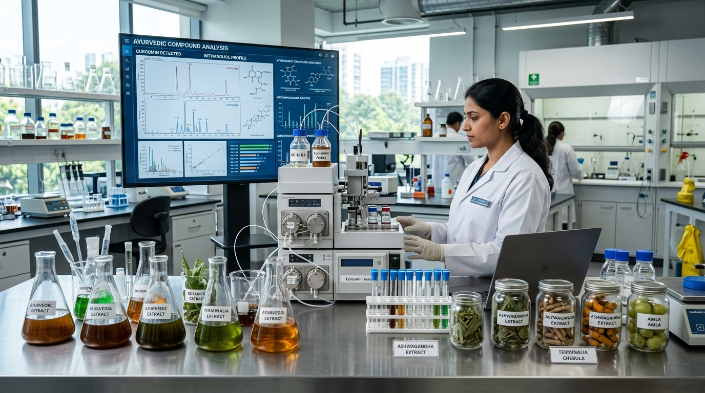

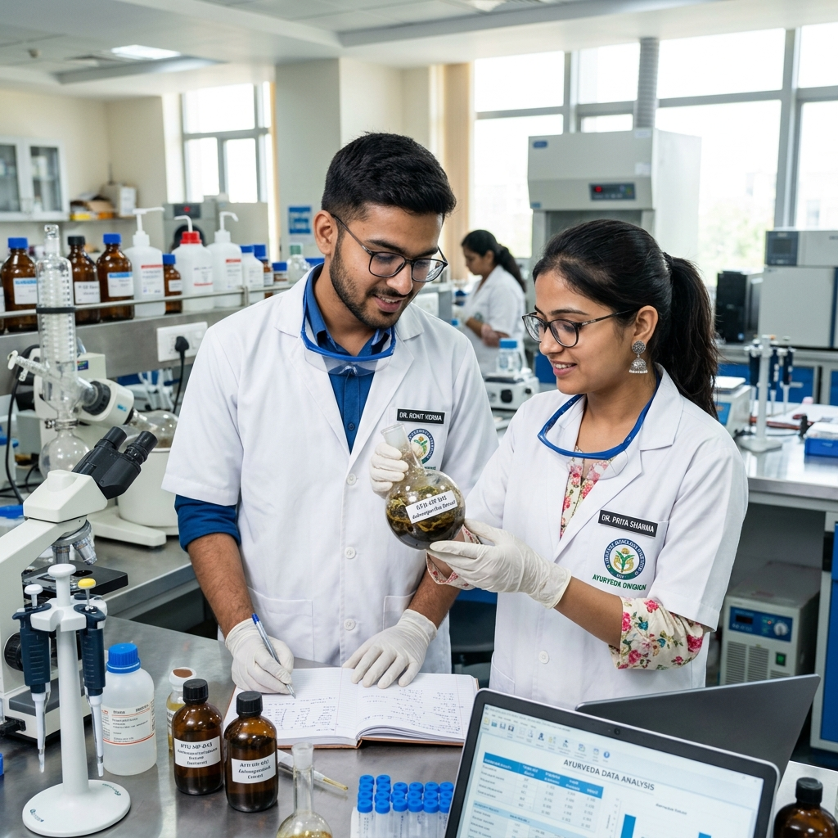

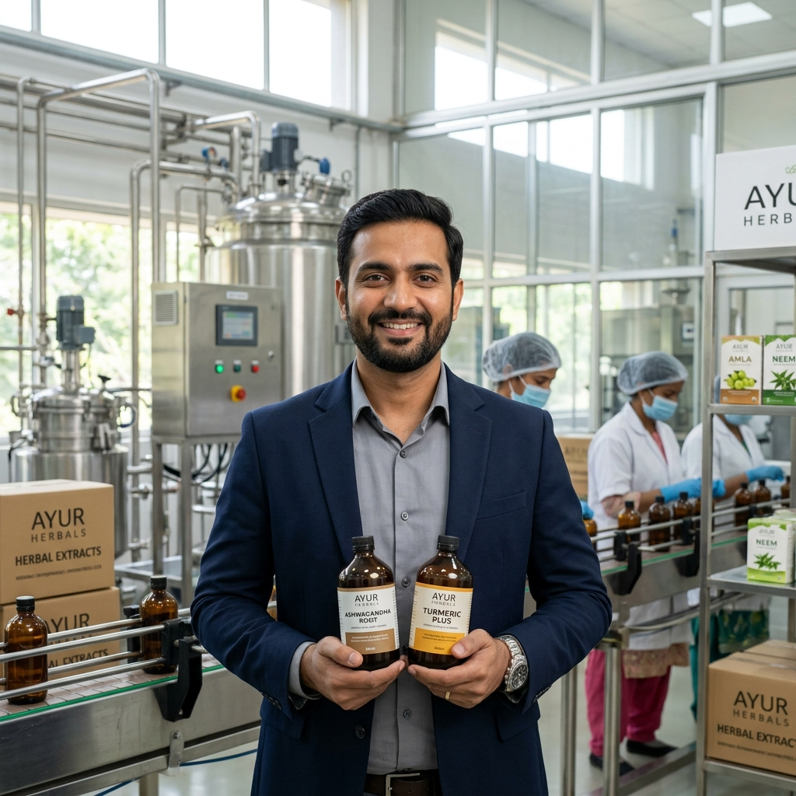
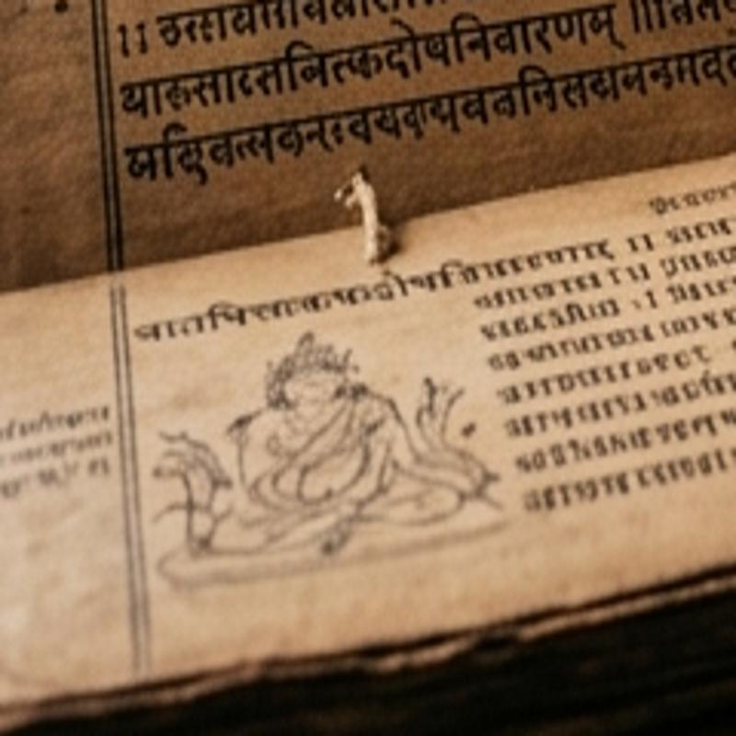





















IMPACT, BENEFITS & STAKEHOLDERS
OUTLAWS
Bio-Piracy Defense & Sovereignty
Accelerated Ayush R&D
Grassroots Language Equity
Shields Indian traditional knowledge from wrongful international patenting by equipping patent agents with instant prior art and Section 3(p) defense.
Slashes prior art and regulatory clearance search time from 2–3 weeks to under 2 seconds, accelerating Ayurvedic drug discovery and IP filing.
Democratizes complex intellectual property frameworks for traditional healers, farmers, and MSMEs through native Hindi and Kannada guidance.
Ayush Researchers
Evaluate Novelty Instantly
Patent Attorneys
Courtroom-Grade Citations
Herbal MSMEs
Streamlined ASU Compliance
Traditional Healers
Community IP Protection
Screen novel botanical compounds against Section 3(p) exclusions and scientific literature before investing in clinical trials.
Rapid prior-art discovery, statutory defense drafting, and compliance verification across international patent treaties.
Clear guidance on Drugs & Cosmetics Act licensing, Ayurvedic Pharmacopoeia standards, and State Biodiversity Board approvals.
Native-language access in Hindi & Kannada protects local agricultural biodiversity and community intellectual property rights.
✓ 100% Offline-Capable
Zero reliance on external cloud servers
✓ Zero Recurring GPU Cost
Runs on standard commodity laptop CPU
✓ Deterministic Citations
Directly anchored to official Gazettes
✓ Cross-Statute Synthesis
Harmonizes Patents Act, BDA & D&C Act
✓ Trilingual Equity
Native English, Hindi, and Kannada answers

Slide 6
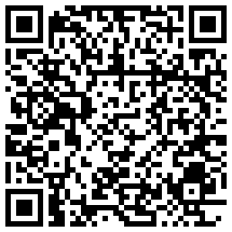



























RESEARCH, REFERENCES & PROTOTYPE
OUTLAWS
1. Indian Sovereign Statutes & Regulatory Authorities
Working Prototype UI — Live Verification
The Patents Act, 1970 (Sec 3(p) & 10) — ipindia.gov.in
The Biological Diversity Act, 2002 & 2023 — nbaindia.org
Drugs & Cosmetics Act, 1940 (ASU Rules) — ayush.gov.in
2. Multilateral Treaties & Traditional Knowledge
WIPO GRATK Treaty (2024 Mandatory Disclosure) — wipo.int
Nagoya Protocol on Access & Benefit-Sharing — cbd.int
PCIM&H Standards & CSIR-TKDL Guidelines — pcimh.gov.in
3. Open-Source AI Stack & Project Repository
Prototype Specifications & Operational Guarantees:
• Streamlit reactive frontend with instant trilingual tab switching
• Deterministic citation drawer linking directly to Gazette enactments
• Sub-1.2 second response latency on local commodity CPU (Zero GPU needed)
• 98/98 unit and regression tests passing with full test automation
FAISS Dense Vector Index & Sentence-Transformers — huggingface.co
IP-SAKTI Sahayak GitHub Repository — github.com/Rengoku9000/Drugvista

