Slide 1

SMART INDIA HACKATHON 2026
IP-SAKTI Sahayak
Problem Statement ID – SIH26045
Problem Statement Title –
Student Innovation – AI-Powered Assistant for Intellectual Property, Traditional Knowledge, and Regulatory Frameworks in Ayurveda.
Theme – MedTech / Ayush / LegalTech
PS Category – Software
Team ID – 146711
Team Name – OUTLAWS

Slide 2



PROPOSED SOLUTION
OUTLAWS
An Offline-First Assistant for Ayurveda IP & Regulation
Brings source-linked patent, traditional-knowledge, and ASU regulatory references into one trilingual workflow.
Offline-First • Local CPU • SHA-256 Source Checks
Authoritative Legal Ingestion
Indexed sources with file-integrity checks
Jurisdiction-Aware Retrieval
Keeps domestic statutes and treaty sources distinct
Trilingual, Source-Linked Answers
English, Hindi, and Kannada interface
• Source Corpus: Indian acts and rules plus selected treaties and reference sources.
• SHA-256 Checks: Detect changes to indexed files; they do not establish legal correctness.
• Source Links: Connect retrieved passages to section anchors and source records.
• Source Routing: Separates Indian statutes from treaty materials (WIPO, PCT, Nagoya).
• Formulation Triage: Flags traditional-knowledge issues for expert review; it does not decide patentability.
• TKDL Safeguards: Avoids exposing restricted TKDL content and relies on accessible sources.
• Source Trail: Shows retrieved sources and section anchors where available.
• Language Support: Provides guidance in English, Hindi (Devanagari), and Kannada.
• Citation Preservation: Keeps source names and legal section labels unchanged across languages.
1. USER QUERY
2. INTENT & JURISDICTION
3. DUAL RETRIEVAL
4. EPISTEMIC VALIDATOR
5. SOURCE-LINKED OUTPUT
Natural language input
(EN / HI / KN)
➔
Query type and source scope
India vs. international
➔
FAISS Vector Search +
SQLite Relational WAL
➔
Checks retrieved evidence;
abstains when support is insufficient
➔
Answer with source links
citations shown where available
PROJECT REPORT: 106/106 tests passing | <1.2s query benchmark on i5 CPU | Offline-first mode

Slide 3

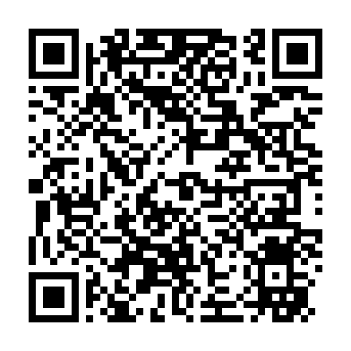
TECHNICAL APPROACH & ARCHITECTURE
OUTLAWS
End-to-End Grounded AI Architecture
Core Technology Stack
FRONTEND & APP SHELL: Streamlit, Python 3.11, Custom CSS
Responsive interface, multi-tab navigation, and Indic-script support.
LAYER 1: PRESENTATION & USER EXPERIENCE
Streamlit Web Application • Custom High-Contrast CSS • Responsive Viewport
Trilingual Query Input (EN/HI/KN) | Citation Inspector Drawer | Statutory Card Badges
BACKEND & REASONING: FastAPI, Pydantic V2, Uvicorn
Modular API, schema validation, and a rules-based fallback.
VECTOR & STORAGE: FAISS CPU, SQLite WAL, SHA-256
Local vector retrieval, source records, and file-integrity checks.
LAYER 2: REST API & EPISTEMIC REASONING
FastAPI Core Service • Pydantic V2 Models • Strict Boundary Enforcement
Query Intent Classifier | Formulation vs Extract Router | Epistemic Legal Reasoner
LOCAL AI & INDIC NLP: Sentence-Transformers, all-MiniLM
384-dimensional embeddings; external model endpoints are optional.
LAYER 3: DUAL RETRIEVAL & INDEXING ENGINE
Vector retrieval and relational source records • SHA-256 file checks
FAISS CPU | SQLite WAL | Citation and section anchors
Empirical Validation & Reproducibility
< 1.2s
End-to-End Query
Project report benchmark (Intel i5-1135G7)
~650 MB
Measured RAM
Project report; 8 GB test system
106 / 106
Automated Tests
Project report lists all tests passing
LAYER 4: AUTHORITATIVE SOURCES & GUARDRAILS
Indian statutes and ASU rules • WIPO / Nagoya treaty materials
Pharmacopoeial references • Public traditional-knowledge sources
GitHub Repository
Open repository
Project Report
Open report folder

Slide 4


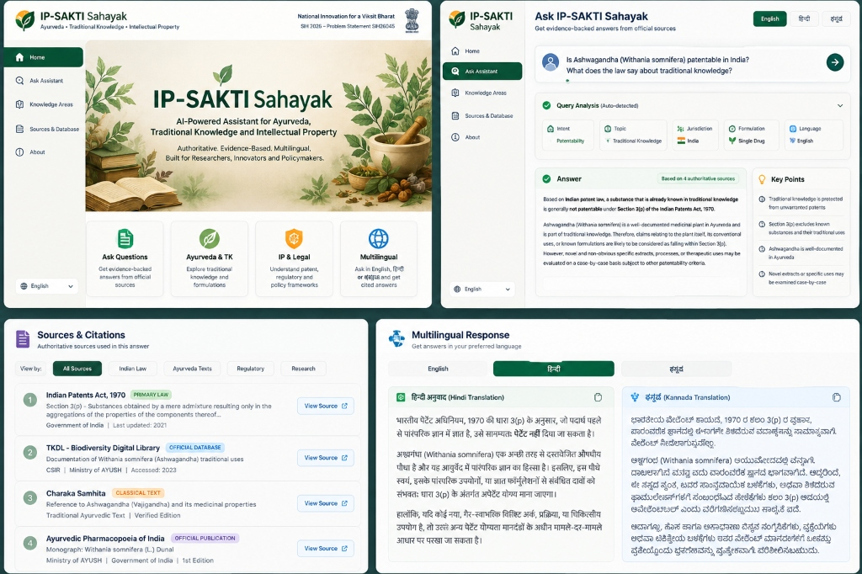
FEASIBILITY, VIABILITY & ROADMAP
OUTLAWS
Technical Feasibility
Operational & Market Viability
Regulatory & Sovereign Feasibility
• CPU Benchmark: Measured on an Intel Core i5-1135G7; no discrete GPU.
• Query Latency: Project report records end-to-end responses under 1.2 seconds.
• Offline Mode: Local corpus and rules-based fallback; external model service is optional.
• No API Cost in Local Mode: Runs without an external model service.
• Ayush-Focused Workflow: Built for researchers, Vaidyas, and patent professionals.
• Browser-Based Interface: Designed for users without command-line experience.
• TKDL Safeguards: The prototype does not reproduce content from the restricted TKDL database.
• Local Deployment: Data stays on the host when offline mode is used.
• Evidence Controls: Shows available source anchors and abstains when support is insufficient.
Validated Working Prototype
✓ Streamlit web interface
✓ Section 3(p) and biodiversity-law source triage
✓ Interactive source citations
✓ English, Hindi, and Kannada interface
Empirical Validation Highlights
• 7 Indexed Corpora: Acts, rules, treaty materials, pharmacopoeial and traditional-knowledge references.
• 106 / 106 Tests: Project report lists all tests as passing.
• < 1.2s Benchmark: Reported on Intel Core i5-1135G7 with 8 GB RAM.
Scalability & Deployment Roadmap
PHASE 1: WORKING PROTOTYPE (CURRENT)
SIH 2026 Milestone
• FastAPI backend and Streamlit UI
• 7 legal and reference corpora indexed
• <1.2s benchmark; 106/106 tests reported
• English, Hindi, and Kannada interface
PHASE 2: INSTITUTIONAL PILOT
Q4 2026 (PLANNED)
• Proposed pilot at 5 Ayush research universities
• Feedback from patent professionals
• Prototype State Biodiversity Board ABS calculator
• Accuracy and latency testing at scale
PHASE 3: NATIONAL SCALE & EXPANSION
2027 & Beyond (PLANNED)
• Explore National Ayush Mission integration
• Prototype IP India Gazette updates
• Evaluate 4-bit on-device model options
• Consider Tamil, Telugu, Marathi, and Bengali

Slide 5

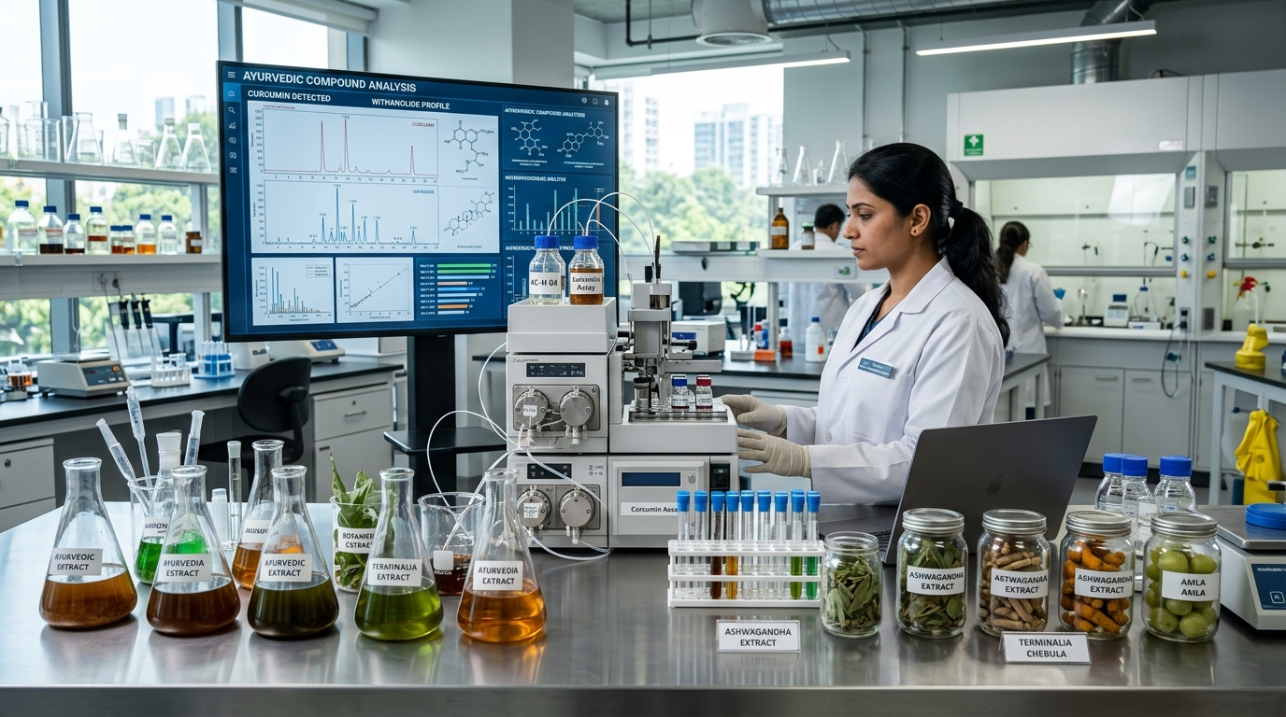

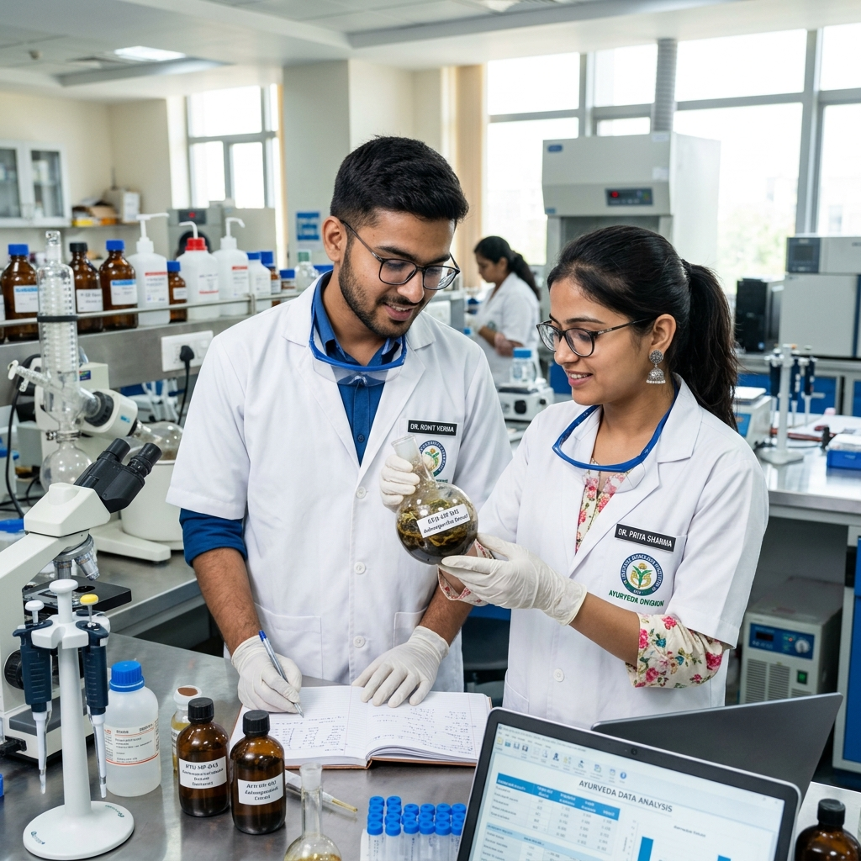

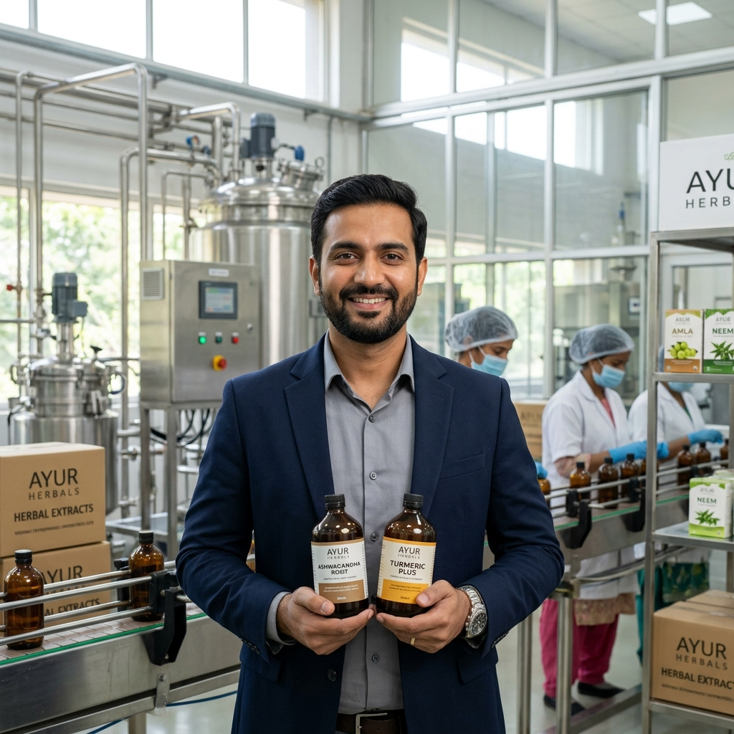
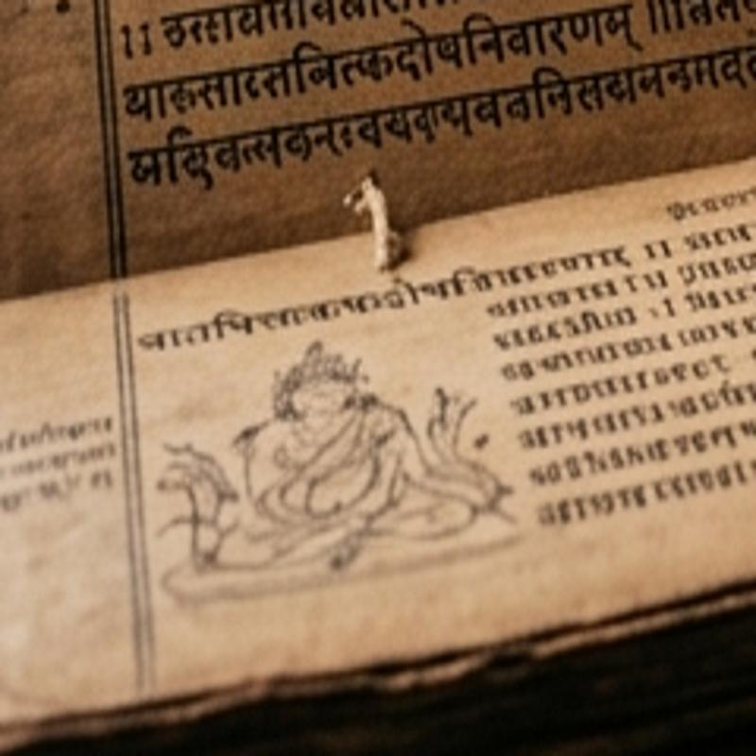
IMPACT, BENEFITS & STAKEHOLDERS
OUTLAWS
Bio-Piracy Defense & Sovereignty
Accelerated Ayush R&D
Grassroots Language Equity
Surfaces public traditional-knowledge references and Section 3(p) material to support expert patent review.
Brings patent, biodiversity, and ASU references into one searchable workflow, reducing time spent across source portals.
Offers source-linked guidance in English, Hindi, and Kannada to make legal and regulatory references easier to navigate.
Ayush Researchers
Source Discovery
Patent Attorneys
Citation-Led Research
Herbal MSMEs
ASU Reference Guidance
Traditional Healers
Public Information Access
Find relevant indexed sources early in formulation research; verify cited text before clinical or filing decisions.
Review linked statutory provisions and technical references while preparing a patent or compliance analysis.
Find references on ASU licensing, pharmacopoeial standards, and biodiversity approvals; confirm requirements with the relevant authority.
Access public Hindi and Kannada information about traditional knowledge and related intellectual-property frameworks.
✓ Offline-First Option
No external model call in local mode
✓ CPU-Only Operation
Benchmarked without a discrete GPU
✓ Source-Linked Responses
Citations connect to indexed references
✓ Cross-Domain Retrieval
Connects patent, biodiversity, and ASU sources
✓ Three Supported Languages
English, Hindi, and Kannada

Slide 6
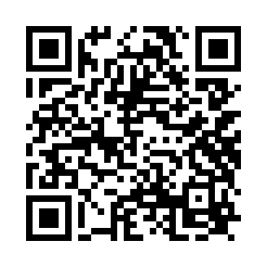

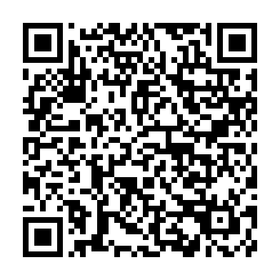
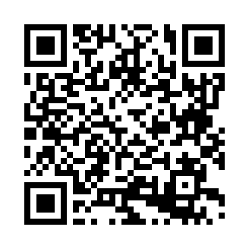


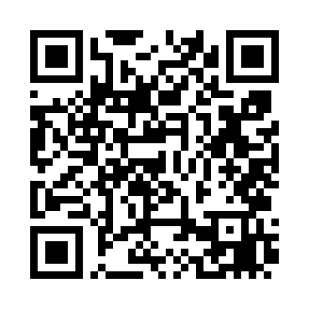
RESEARCH, REFERENCES & PROTOTYPE
OUTLAWS
1. Indian Acts & Regulatory Sources
Prototype UI — Interface Preview
Patents Act, 1970 (Sections 3(p), 10(4)) — ipindia.gov.in
Biological Diversity Act, 2002 (as amended 2023) — nbaindia.nic.in
Drugs & Cosmetics Act, 1940 and Rules (ASU) — ayush.gov.in
2. Treaties & Traditional-Knowledge Resources
WIPO GRATK Treaty — adopted 2024; not yet in force — wipo.int
Nagoya Protocol on Access & Benefit-Sharing — cbd.int
PCIM&H Pharmacopoeial Standards — pcimh.gov.in
TKDL public information — tkdl.res.in
3. Technical Resources & Project Files
all-MiniLM-L6-v2 Embedding Model — huggingface.co
Prototype Scope & Safe Use:
• Streamlit interface for English, Hindi, and Kannada
• Displays retrieved sources and available citation anchors
• Offline rules-based mode; external model endpoint is optional
• Research support only; not legal advice
IP-SAKTI Sahayak GitHub Repository — github.com/Rengoku9000/ip-shakti
Project Report & Evidence Dossier — drive.google.com (SIH 2026)

