Slide 1
Path of least Violations

Slide 2
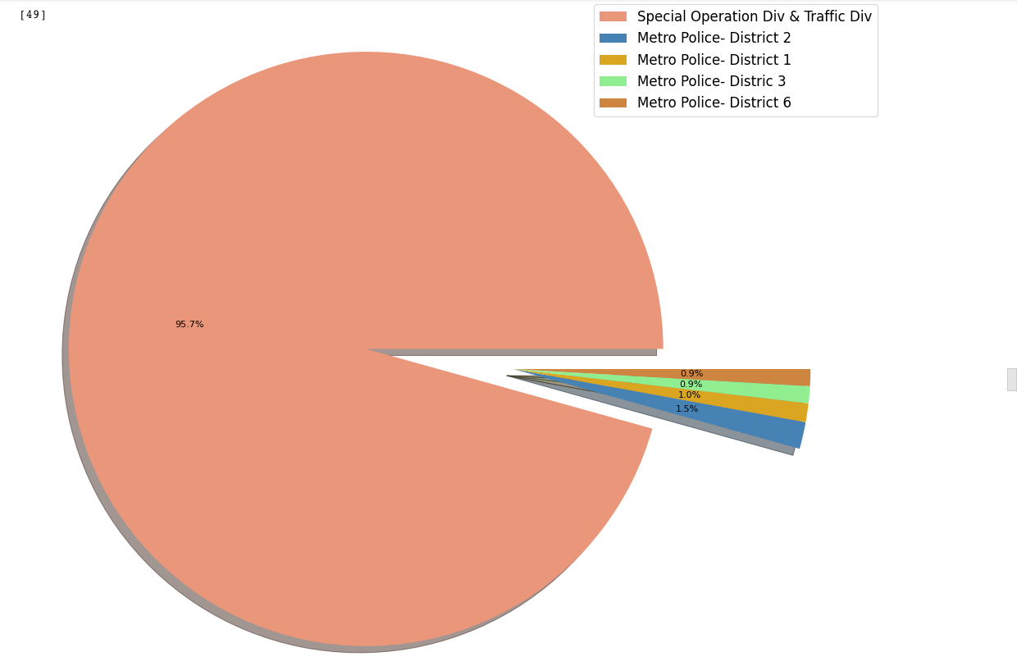
WHICH AGENCY ISSUES THE MOST VIOLATIONS?
Notes:
Special Operations Division and Traffic Division issued the most violations while facilities management issued the least violations.
Traffic violations are the most common types of violations

Slide 3
ARE MORE VIOLATIONS ISSUED IN A PARTICULAR QUADRANT OF THE CITY?
Notes:
DC 295 .4mi s/o PA Ave SE sw/b is where the most violations were issued in 2019

Slide 4
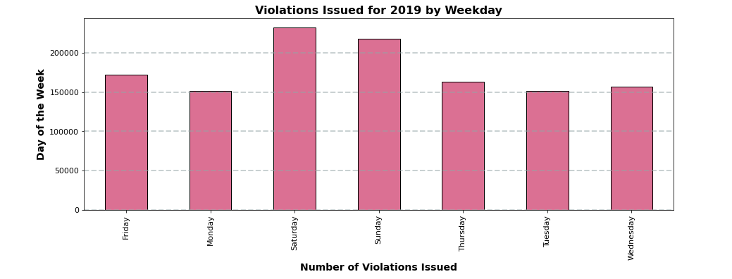
VIOLATIONS BY DAY OF THE WEEK
Notes:
When the data for the entire year was combined, Monday was the day of the week with the least violations while Saturday was the day of the week with the highest number of violations

Slide 5
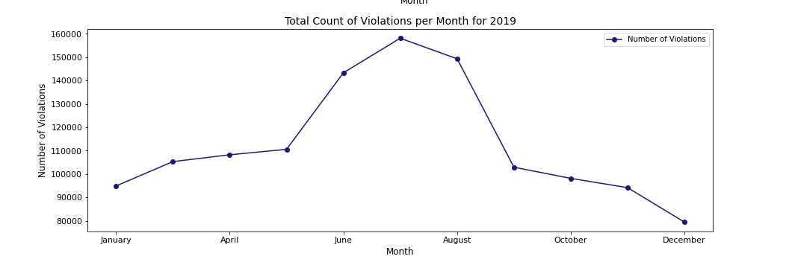
VIOLATIONS BY MONTH
Notes:
Highest number of violations occurred in July, and lowest occurred in December

Slide 6
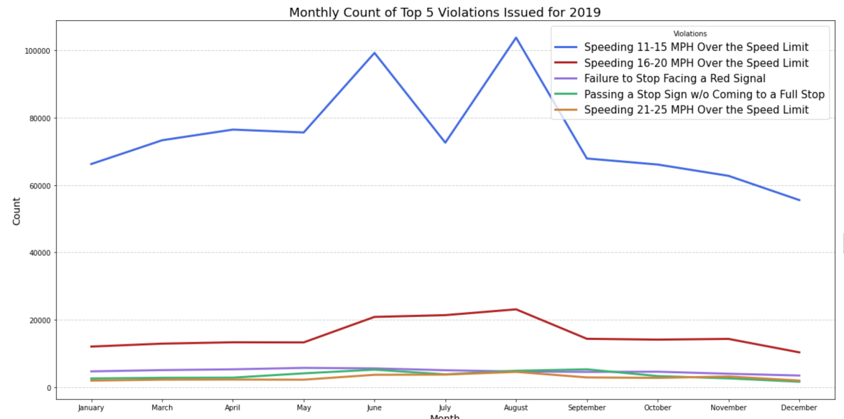
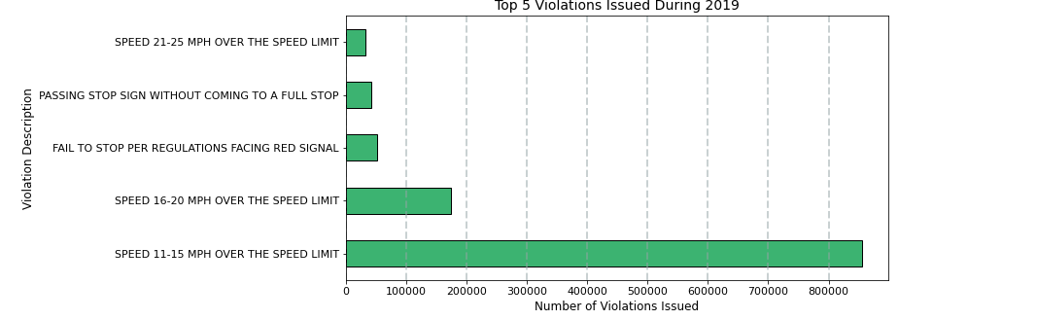
MOST COMMON VIOLATIONS
Notes:
Top 5 most common violations:
Speeding 11-15 MPH over speed limit
Speeding 16-20 MPH over speed limit
Failure to stop at red light
Passing a stop sign without coming to a full stop
Speeding 21-25 MPH over the speed limit

Slide 7
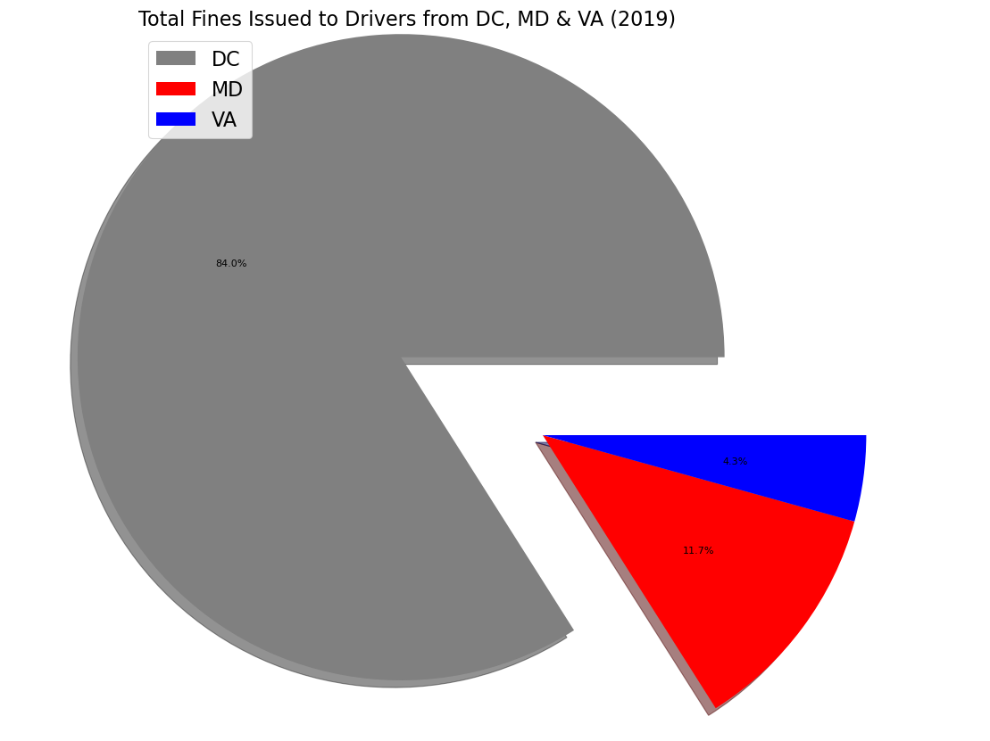
$ GENERATED

Slide 8
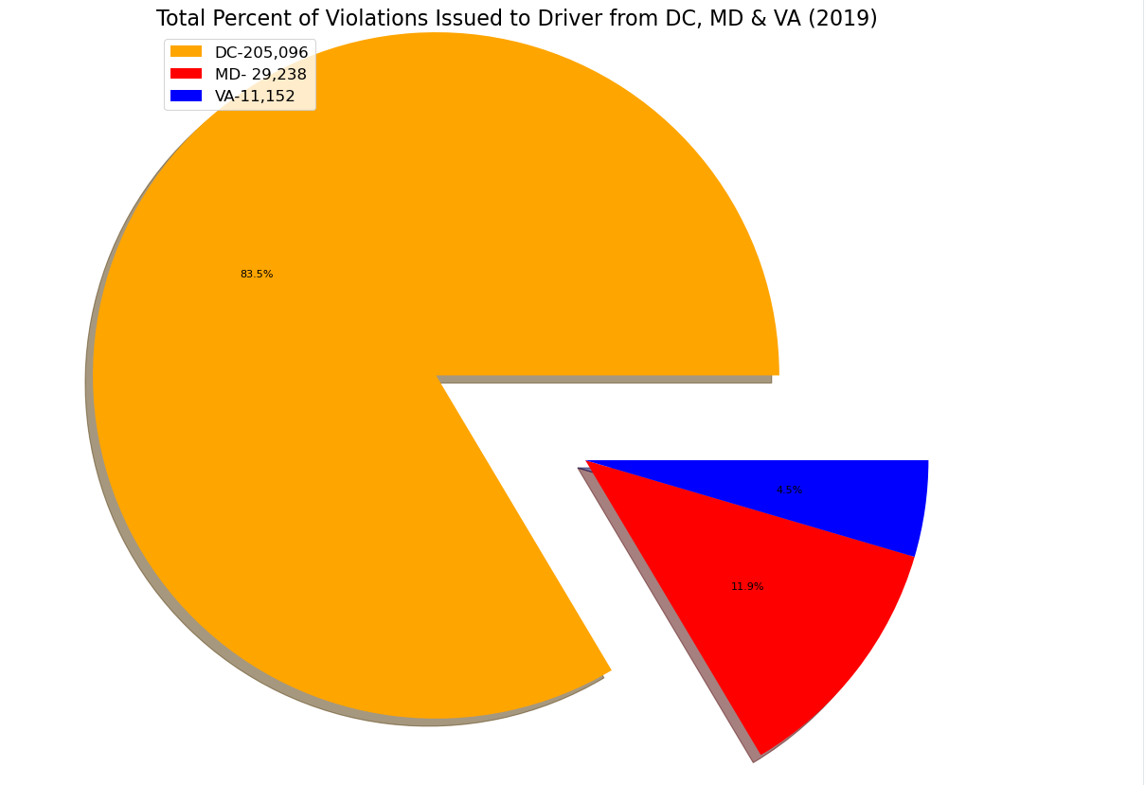
VIOLATIONS BY DRIVER STATE

Slide 9
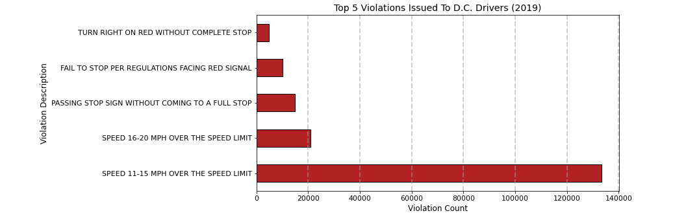
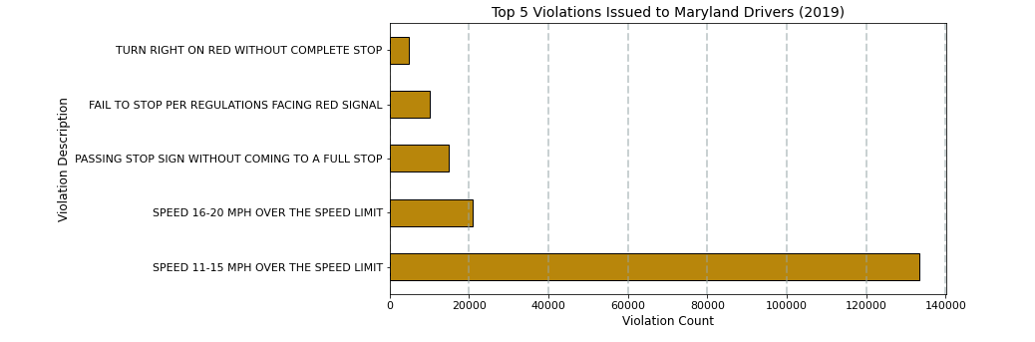
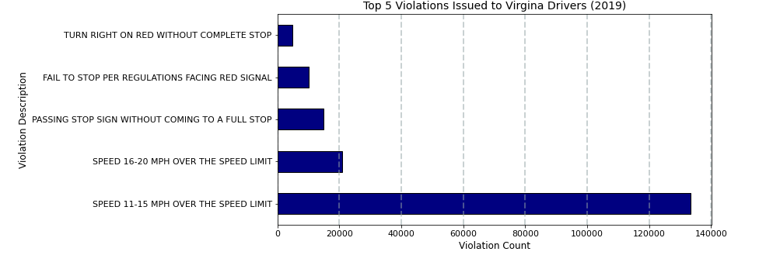
VIOLATION TYPE BY DRIVER STATE
Notes:
Top 5 Violations in:
D.C.: (RED)
Speed 11-15 MPH over speed limit
Speed 16-20 MPH over speed limit
Passing stop sign without coming to a full stop
Fail to stop per regulations facing red signal
Turn right on red without complete stop
Maryland (Gold):
Same top 5
Virginia (Dark Blue):
Same Top 5

Slide 10
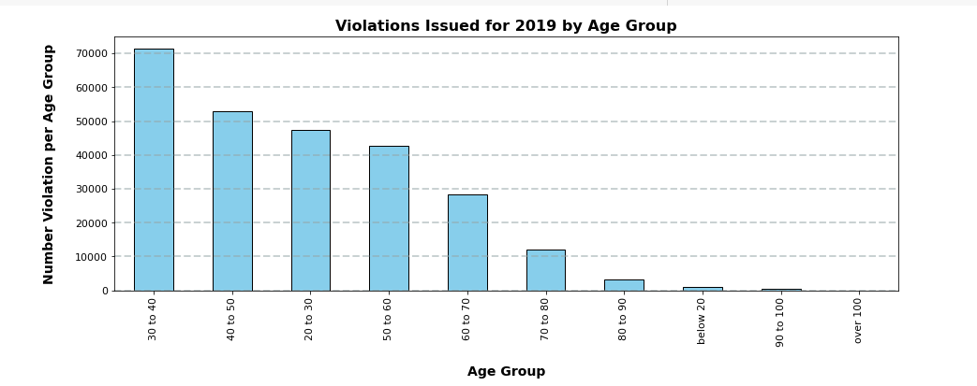
VIOLATIONS BY AGE

