Slide 1
Renil Shaji
Final Project

Slide 2
Chatbot With Python
This is a Python chatbot employing Neural Network, TensorFlow, Flask, and React for interactive and dynamic conversational experiences.

Slide 3


AGENDA
Problem Statement
Project Overview
Who Are The End Users
Your Solution And Its Value Proposition
Wow Factor
Modelling
Result
3/21/2024 Annual Review

Slide 4

PROBLEM STATEMENT
Design and develop a neural Python chatbot capable of processing natural language input, engaging in contextually relevant conversations, and providing meaningful responses. The chatbot should encompass tasks such as answering queries, providing guidance, and routing users to relevant resources, ensuring it addresses diverse user needs. Utilize neural network models and natural language processing techniques to create a user-friendly and interactive interface, allowing seamless integration within a chosen platform. The objective is to create an innovative chatbot solution that improves various applications, such as customer support and virtual assistants, by providing adaptive, human-like conversational experiences.

Slide 5
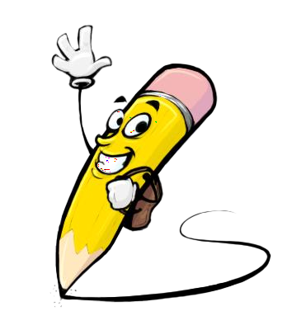
PROJECT OVERVIEW
Objective: Develop a neural Python chatbot with robust natural language processing capabilities.
Scope: Answer queries, provide guidance, and cater to diverse user needs through contextually relevant conversations.
Integration: Seamlessly integrate within chosen platform (e.g., website, app) with an intuitive user interface.
Technologies: Utilize TensorFlow and NLTK for neural ML model building and NLP techniques.
Responses: Provide comprehensive responses tailored to user queries using advanced neural techniques.
Testing & Improvement: Iteratively test, collect feedback, and enhance performance for user satisfaction.
Dataset Preprocessing: Clean and preprocess dataset using Pandas, Matplotlib, and Seaborn.
Chatbot Interaction: Develop API endpoints for querying and receiving responses; implement chat user interface using Flask and React JS.
Innovation: Incorporate advanced features like attention mechanisms for improved context awareness and response quality.
Outcome: Deliver a versatile neural Python chatbot for enhanced user engagement and satisfaction.

Slide 6
WHO ARE THE END USERS?
General Public: Individuals seeking information, assistance, or entertainment.
Customers: Users engaging with businesses for support, inquiries, or transactions.
Students and Researchers: Academic or research communities seeking information or assistance.
Professionals: Individuals in various industries seeking quick access to relevant information or assistance.
Developers: Those interested in exploring chatbot development techniques or integrating the chatbot into their own projects or platforms.
Any entity with a need for automated assistance or information retrieval: This includes both individuals and organizations across diverse sectors.

Slide 7
YOUR SOLUTION AND ITS VALUE PROPOSITION
Solution: A highly adaptable and scalable neural Python chatbot designed to cater to diverse user needs. Leveraging cutting-edge natural language processing (NLP) techniques and advanced neural network models, our chatbot provides intelligent responses and engaging conversations. With seamless integration capabilities and user-friendly interfaces, our solution empowers businesses and individuals to streamline customer support, enhance user engagement, and deliver personalized assistance.
Value Proposition:
Enhanced User Experience: Human-like conversational experience, providing accurate responses and proactive assistance.
Efficient Customer Support: Automates responses, reduces response times, and improves customer satisfaction.
Scalability and Adaptability: Meets growing demands and adaptable to various industries and use cases.
Cost Savings: Automates repetitive tasks, reduces need for human intervention, and improves operational efficiency.
Innovative Technology: Leverages state-of-the-art NLP techniques and neural network models for technological innovation.
Seamless Integration: Integrates with existing platforms, ensuring smooth user experience and accessibility.
Continuous Improvement: Iterative testing and feedback mechanisms ensure ongoing user satisfaction and efficiency gains.

Slide 8

THE WOW IN YOUR SOLUTION
Experience the future of conversational technology with our revolutionary neural Python chatbot. Our solution employs state-of-the-art natural language processing (NLP) techniques and advanced neural network models to create an unparalleled user experience. Here's what makes our chatbot stand out:
Human-like Conversations: Our chatbot engages users with conversations that feel natural and intuitive, thanks to its advanced NLP capabilities.
Intelligent Responses: Witness the power of AI as our chatbot provides intelligent, contextually relevant responses tailored to each user's query.
Adaptive Learning: Our chatbot continuously learns and adapts, ensuring that it evolves with user interactions and becomes even smarter over time.
Seamless Integration: Easily integrate our chatbot into your existing platforms, providing users with a seamless and intuitive experience across all touchpoints.
Unmatched Efficiency: Streamline your operations and delight customers with faster response times and efficient problem resolution, all powered by our innovative chatbot technology.
Embrace the future of communication and elevate your user experience with our groundbreaking neural Python chatbot solution.
8

Slide 9
MODELLING
Encoder-Decoder Architecture:
The core architecture of the chatbot model is based on an encoder-decoder framework.
The encoder processes input sequences and generates meaningful representations.
The decoder utilizes these representations to generate output sequences, i.e., responses.
Encoder Implementation:
Implemented using a GRU (Gated Recurrent Unit) layer.
GRU is a type of recurrent neural network (RNN) layer known for its ability to capture temporal dependencies in sequential data.
Converts input sequences into fixed-length representations, capturing context and semantics.
Decoder Implementation:
Also utilizes a GRU layer for sequence processing.
Integrates an attention mechanism to focus on relevant parts of the input sequence during decoding.
Generates output sequences based on the encoded representations and attention weights.
Attention Mechanism:
Enhances the model's ability to capture context and improve translation quality.
Implemented as a separate layer that computes attention weights based on the current decoder state and encoder output.
Dynamically adjusts the importance of different parts of the input sequence during decoding
9

Slide 10
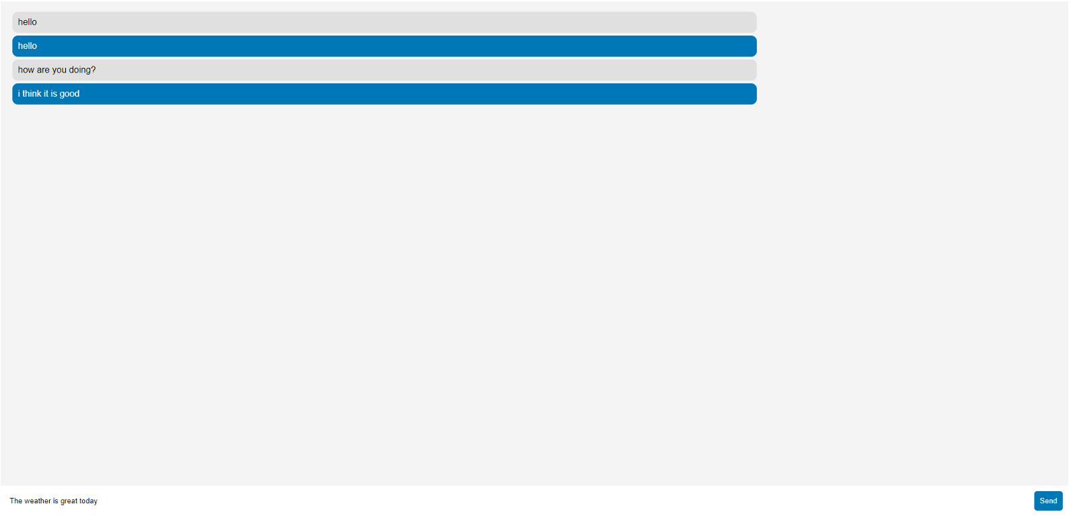
RESULTS
10

