Slide 1


Group: 03
Stadium Seat Booking Management System
Meet Sheladiya : 19BIT076
Renish Jagani : 19BIT108
Rishit Samariya : 19BIT109
Rishabh Patel : 19BIT141
Ujash Thakkar : 19BIT142
Ananya Khandelwal : 19BIT144

Slide 2
Project Description
Stadium is the place where get together to watch the matches of cricket, football, hockey, and many more. But to watch these matches one need to book a seat for that matter. To get a seat in the stadium to watch the matches sometimes it will be a difficult job. Many of you might have experienced it! But what if the seats in the stadium can be booked through online mode. Yes it's possible. The stadium seat booking system will help in booking the tickets of the matches through the online mode. The people can get the tickets through the online mode at ease.
It is a process in which customers can order, pay for, receive and confirm tickets from anywhere anytime using mobile phones or other mobile phones. Mobile tickets reduce the cost of production and distribution linked to traditional paper-based tickets channels and increase customer usability by providing new and easier ways to purchase tickets.
Stadium seat booking management system is a smart system and a platform from which any person can book a ticket and details of users are stored into database to track the information and to reduce the complexity.

Slide 3
Feature Table
Sr No. | Features (Bold Text – Unique Features) | Tables Associated
1. | Each person access to a system through self-identification and authentication. | Login
2. | The System has a feature of booking tickets for spectators and displaying, managing data of spectators. | Seat_details, Seat_booking
3. | The System has inbuilt tracking system function where using GPS sensor to determine seat location. | Seat_location
4. | Harmonic Search algorithm and graph colouring algorithm used to allocate seats for each person. | Seat_arrangement

Slide 4
Sr No. | Features (Bold Text – Unique Features) | Tables Associated
5. | Home team details and away team details is stored and managed easily | home_team, away_team
6. | The system has a feature of providing details of the upcoming matches which will identify the detailed information about fixtures and venue of the match. | fixtures , venue

Slide 5
Features
1. Number of Seats: The details related to the seats in our database is mentioned properly .
2. Seat Availability: The people will be to check the availability of the seats in the stadium for a particular
match just at one click.
3. Temperature: The people will have to be checked their body temperature due to COVID concern.
4. Updates of Different matches: The details of the upcoming matches should be also present in the
application which will provide the exact date of the match.
5. Stadiums: The matches that take place in different stadiums must be mentioned properly and should be
updated on regular basis.
6. Category: The seats in the stadium can be categorized based on prize.

Slide 6
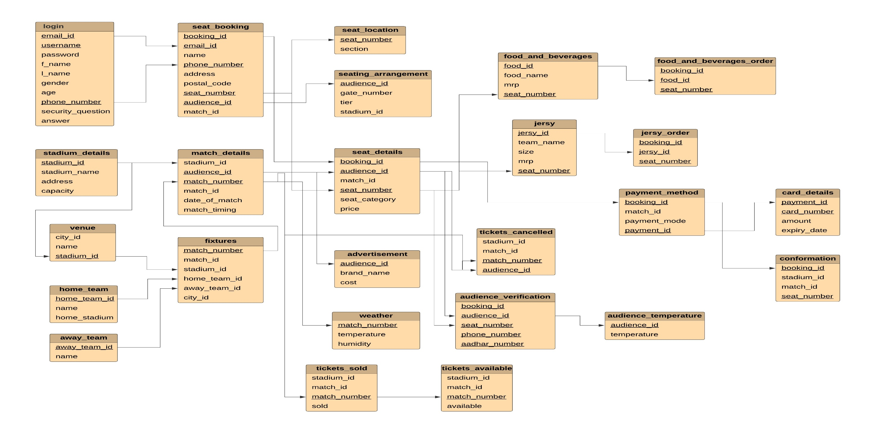
Relational Model for Stadium Seat Booking Management System

