Slide 1
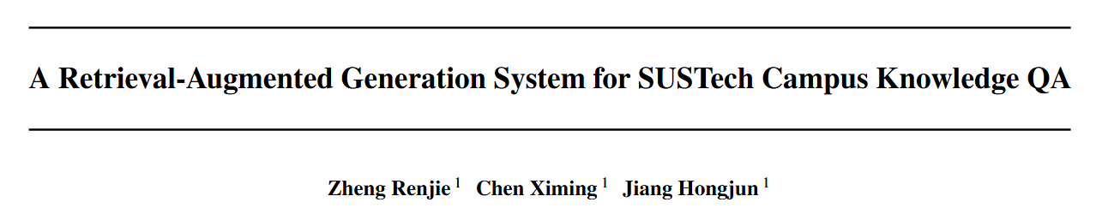



COE201 2026

Slide 2
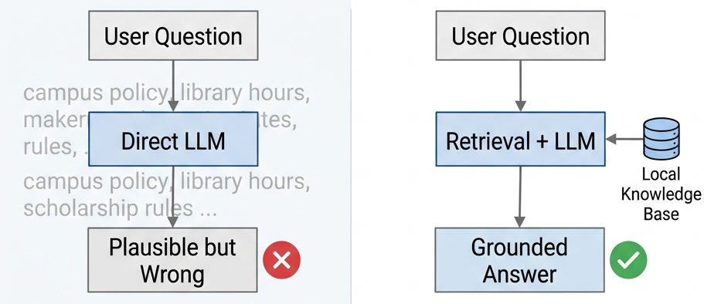
Motivation: Local Knowledge Breaks Direct LLM QA
Campus QA depends on local documents
Why direct LLM is risky
Goal
Housing and dormitory rules, Course selection procedures, Library opening hours, Student card and scholarship policies, Examination discipline,
Regulations...
Plausible but generic answers; Outdated or non-SUSTech facts; No reliable source traceability; Weak refusal when evidence is absent...
Ground answers in SUSTech documents via RAG

Slide 3
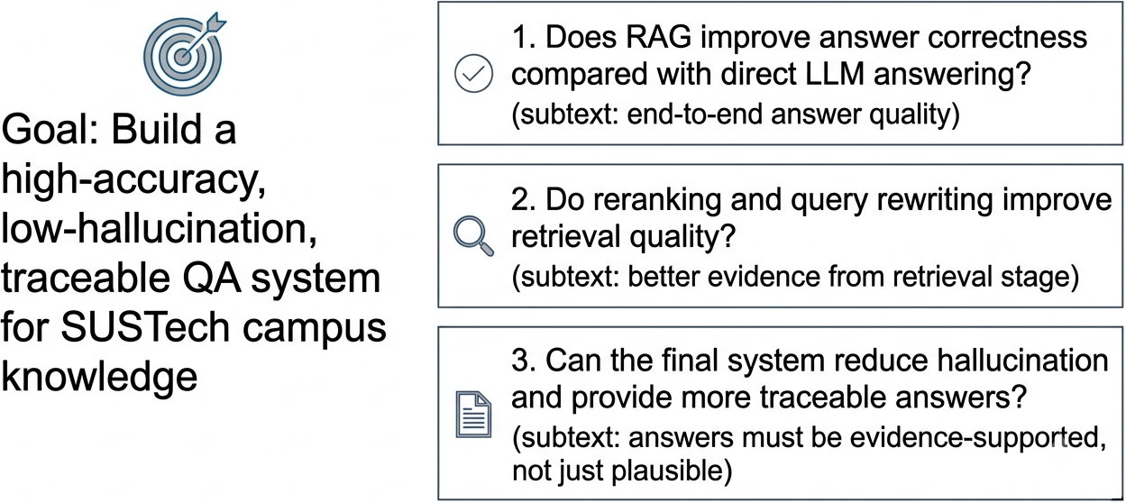
Project Goal and Research Questions
30
1700
4
evaluation questions
indexed QA records
systems compared

Slide 4
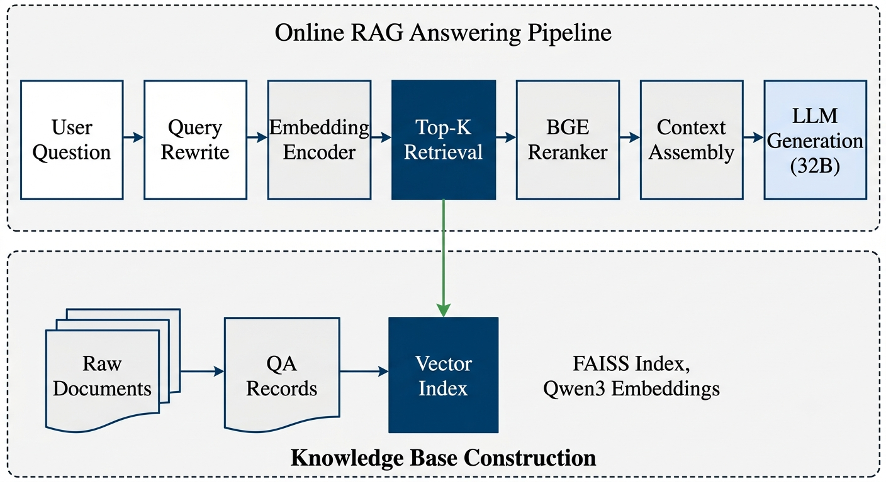
System Architecture

Slide 5

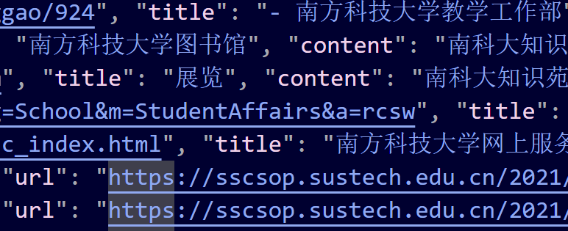
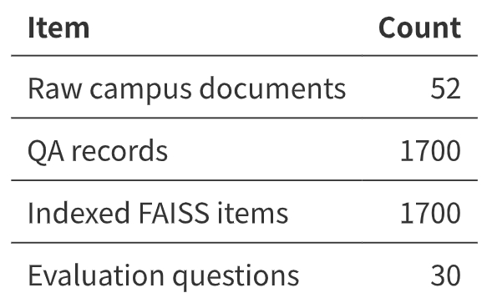


Knowledge Base Construction
Data pipeline: Crawl SUSTech-related official pages → Clean and normalize web content → Convert content into QA-style records → Store source title and URL → Build dense FAISS index
Row data from websides
Save clean and normalized content & meta data
Get QA pairs and FAISS

Slide 6

AI QA Collector
Quality control
Append-only crawl state normalized Document content-hash deduplication
Failed/skipped URL recording
Coverage discovery
Evident QA
High-value SUSTech seed URLs AI-generated/given search keywords Official-domain whitelist Web search plus internal links 1 to 2 depth recursive crawling
Documents → overlapping chunks
Generate realistic student-style QA pairs
Attach title, URL, category, evidence

Slide 7
Model and Deployment Configuration
Generator
Qwen3-32B served by vLLM as qwen3-32b
Embedding
Qwen3-Embedding-0.6B
Vector index
FAISS dense index
Retriever
TOP K = 30 candidates
Reranker
bge-reranker-v2-m3
Context
top 5 chunks after reranking
Interface
Gradio web application
Runtime
tmux sessions for long-running server and evaluation jobs
7

Slide 8
Four Compared Systems
Direct
Basic RAG
Qwen3-32B answers without retrieval
FAISS retrieval plus generation
Reranking
Query rewriting
retrieve top 30 candidates BGE reranker selects top 5 chunks for the prompt
use LLM to rewrite the query for retrieval

Slide 9
Evaluation Metrics
Retrieval
Generation
Trust and system
Recall@K Precision@K MRR@K nDCG@K evidence rank
answer correctness relevance completeness faithfulness groundedness
citation accuracy hallucination rate latency
Scoring
An LLM-as-a-judge evaluator scores answer quality from 0 to 3. Scores >= 2 are counted as acceptable.

Slide 10
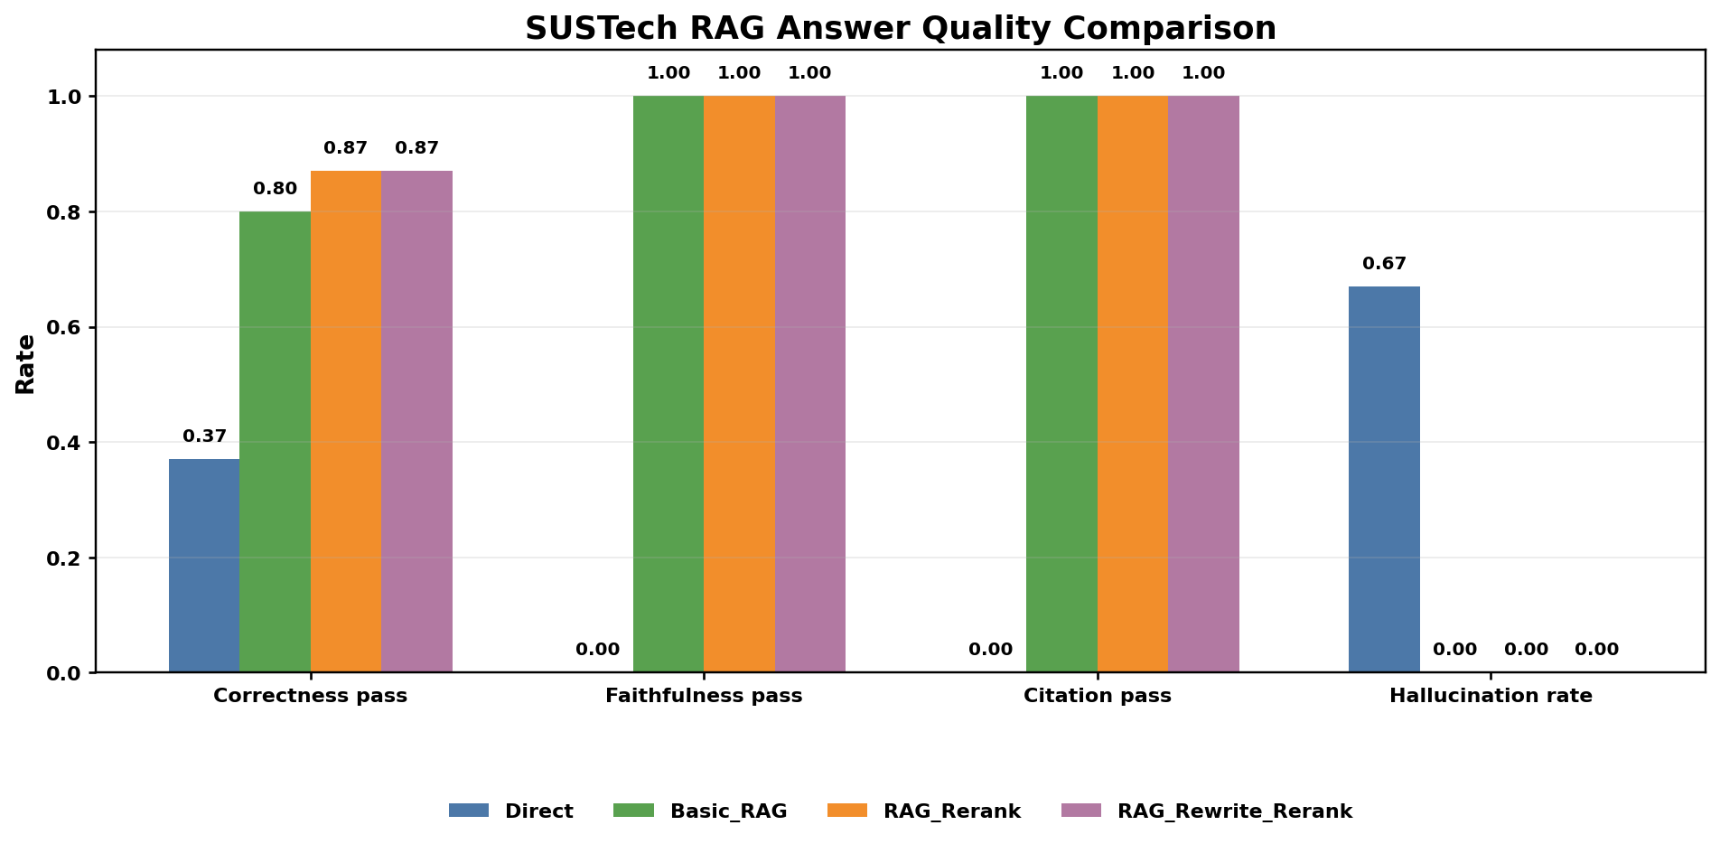
Answer Quality: RAG Improves Correctness and Removes Hallucination
Correctness pass
Direct: 36.67% Best RAG: 86.67%
Hallucination rate
Direct: 66.67% RAG systems: 0.00%
Interpretation
Direct LLM answers are fluent but often unsupported. RAG grounds answers in retrieved evidence.

Slide 11
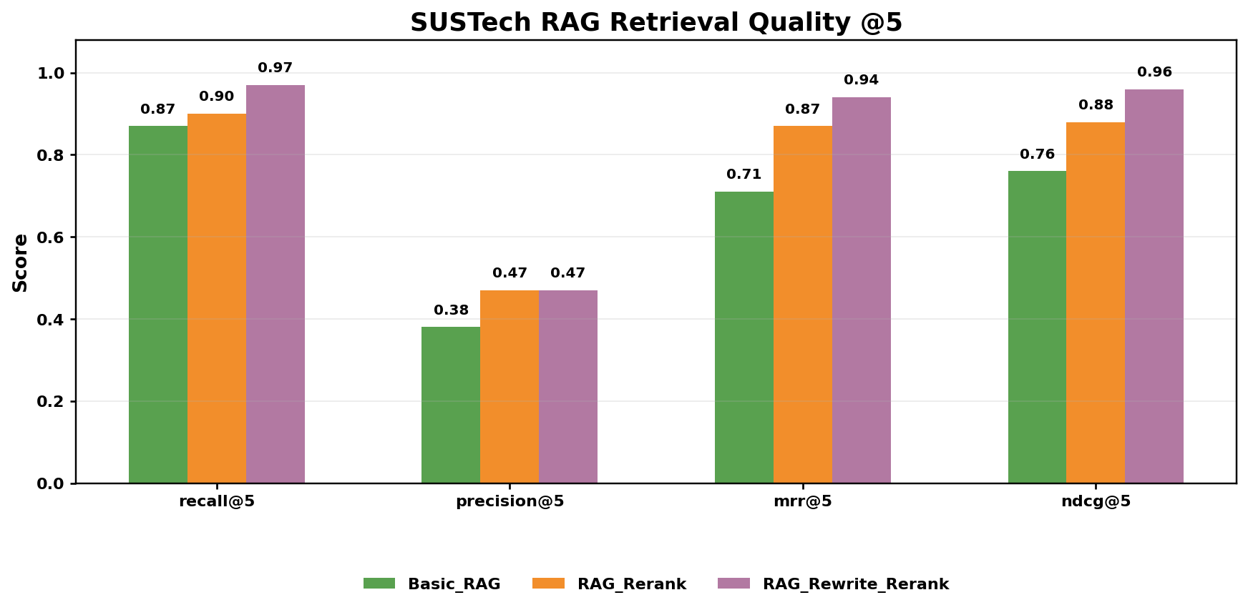
Retrieval Result: Rewrite and Rerank Improve Evidence Quality
Basic RAG
R@5 86.67% | P@5 38.00% MRR 70.56% | nDCG 76.23%
RAG + Rerank
R@5 90.00% | P@5 47.33% MRR 87.33% | nDCG 88.30%
Rewrite + Rerank
R@5 96.67% | P@5 46.67% MRR 94.44% | nDCG 95.86%
Takeaway
Rewrite improves recall and rank quality. Reranking improves evidence ordering.

Slide 12
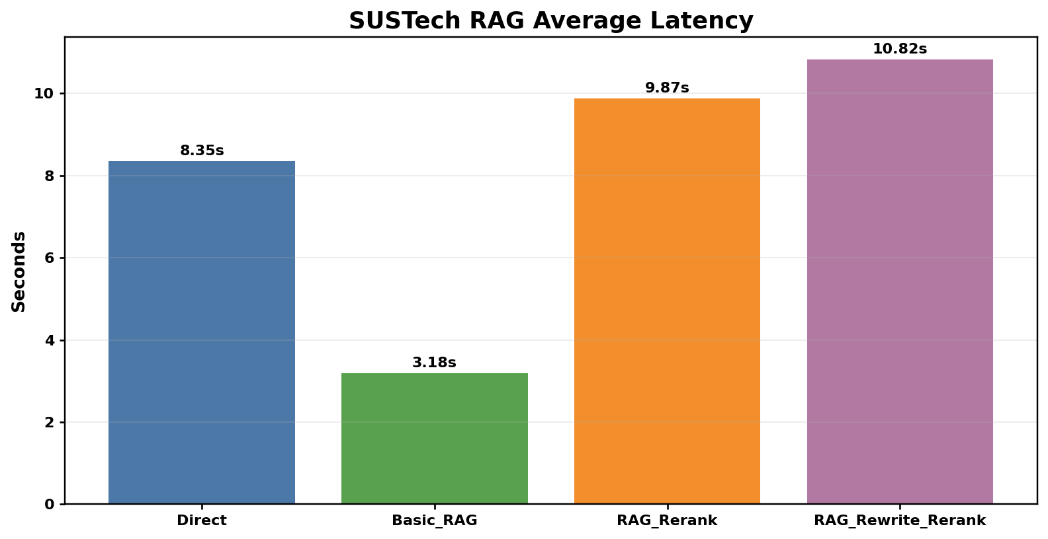
Latency Trade-off
Fastest RAG
Basic RAG: 3.18 s average latency
Higher quality cost
Reranking adds CPU cost.
Best retrieval
Rewrite + Rerank: 10.82 s average latency
Practical choice
Basic RAG for speed. Rewrite + Rerank for reliability.

Slide 13

Limitations and Future Work

Slide 14
Current limitations
Future improvements
only 30 evaluation questions
LLM-as-a-judge may introduce scoring variance
limited unanswerable-question coverage
rewrite and rerank
increase latency
knowledge base quality limits system ceiling
expand test set by category and difficulty
add stronger evidence annotations
cache rewritten queries and rerank results
improve conflict-aware answer generation
......

Slide 15
Conclusion
Main conclusion
RAG is effective for SUSTech-specific campus QA because it turns local documents into explicit evidence for the LLM.
36.67% → 86.67%
66.67% → 0.00%
96.67%
correctness pass rate
hallucination rate
best Recall@5
Best quality setting
RAG + query rewrite + rerank gives the strongest retrieval metrics; RAG + rerank gives the same final correctness with slightly lower latency.

