Slide 1
DEEP LEARNING-BASED CLASSIFICATION OF DENTAL PATHOLOGIES FROM RADIOGRAPHIC IMAGES
Done by
RENJISH K S
Reg No: MAC23MCA-2046
Under the guidance of
Prof. Manu John

Slide 2
CONTENTS
1.INTRODUCTION
2.LITERATURE REVIEW
3.COMPARISION
4.PROPOSED SYSTEM
5.DATASET DESCRIPTION

Slide 3
INTRODUCTON

Slide 4
Detecting Dental Conditions Using Deep Learning Models
Accurately classify dental conditions from radiographic images, supporting automated diagnosis.
8,030 annotated dental radiographic images from Kaggle.
NAS Net architecture, Convolutional Neural Networks (CNNs).

Slide 5
LITERATURE REVIEW

Slide 6
PAPER-1
TITLE | ABOUT | DATASET | ALGORITHM | ACCURACY
“Detection of Dental Diseases through X‐Ray Images Using Neural Search Architecture Network” | AUTHOR: Abdullah S. AL-Malaise AL-Ghamdi PUBLISHER: Proceedings of the Fifth International Conference on Communication and Electronics Systems (ICCES 2020) | Clinical dataset consist of 5000 records with 3 classes | NAS Net-based CNN. | Greater than 96%.

Slide 7
PAPER-2
TITLE | METHODS | DATASET | ALGORITHM | ACCURACY
Michael G. Endres,Florian Hillen,Marios Salloumis, ”Development of a Deep Learning Algorithm for Periapical Disease Detection in Dental Radiographs” |  | The dataset consists of 2,902 de-identified panoramic radiographic images | U Net-based CNN. | 67.2%.

Slide 8
PAPER-3
TITLE | METHODS | DATASET | ALGORITHM | ACCURACY
Hu Chen,Hong Li7,Yijiao Zhao,Jianjiang Zha,Yong Wang , ”Dental disease detection on periapical radiographs based on deep convolutional neural networks” | The Faster R-CNN model was trained and validated using several strategies. Training with all annotated images (baseline) | In total, 2900 digital dental periapical radiographs were collected | R-CNN | 71%.

Slide 9
COMPARISION

Slide 10
TITLE | DATASET | ALGORITHM | ACCURACY
Detection of Dental Diseases through X‐Ray Images Using Neural Search Architecture Network | Clinical dataset consist of 5000 records with 3 classes | NAS Net-based CNN. | Greater than 96%.
Development of a Deep Learning Algorithm for Periapical Disease Detection in Dental Radiographs | The dataset consists of 2,902 de-identified panoramic radiographic images | U Net-based CNN. | Greater than 67%.
Dental disease detection on periapical radiographs based on deep convolutional neural networks | In total, 2900 digital dental periapical radiographs were collected | R-CNN | Greater than 71%.

Slide 11
PROPOSED SYSTEM

Slide 12
Deep Learning-Based Classification of Dental Pathologies from Radiographic Images
Building on the findings from the reviewed literature, the proposed project aims to develop an advanced deep learning model using the NAS Net architecture for predicting dental diseases.
The model will be trained on a comprehensive dataset of over 8000 radiographic images, each annotated for four distinct dental conditions: cavity, implant, filling, and impacted tooth.
The cavity class will identify areas of decay in the tooth structure, while the implant class will detect the presence of dental implants.
The filling class will classify regions where dental restorations have been applied, and the impacted tooth class will identify teeth that have not erupted properly or are misaligned.

Slide 13
PIPELINE DIAGRAM

Slide 14
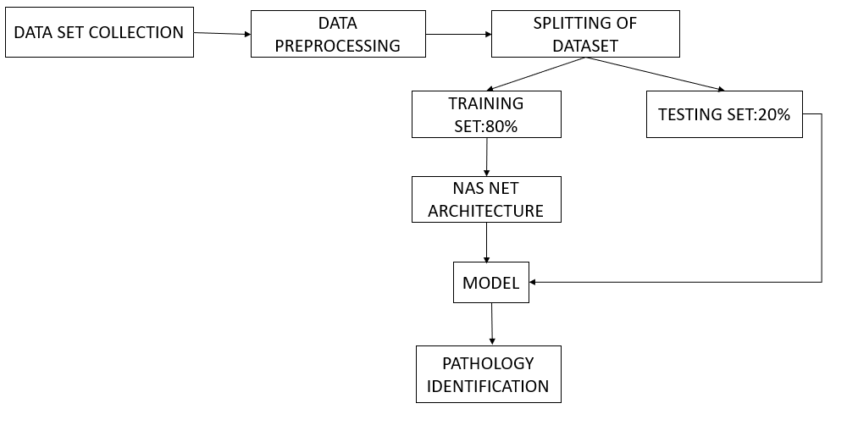

Slide 15
DATASET DESCRIPTION

Slide 16
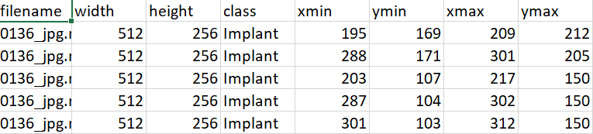
The dataset comprises 8,030 entries, each corresponding to a dental radiographic image with detailed annotations.
These annotations are crucial for identifying and classifying dental conditions, primarily focusing on four categories: cavity, implant, filling, and impacted tooth.
Width: The width of the image in pixels, indicating the resolution and aspect ratio. Height: The height of the image in pixels, providing additional information about the image's dimensions. Class: The category of the dental condition present in the image.

Slide 17
Class Labels:
The dataset includes images classified into the following categories:
Cavity: (576 images) Identifies areas of tooth decay, crucial for early diagnosis and treatment planning.
Implant: (1,784 images) Detects dental implants used as replacements for missing teeth, assisting in monitoring and follow-up.
Fillings: (5,242 images) Recognizes dental restorations, helping to assess the state and quality of the fillings.
Impacted Tooth: (428 images) Identifies teeth that have not erupted properly or are misaligned, often requiring surgical intervention.

Slide 18
THANK YOU

