Slide 1


LIMU-BERT: Unleashing the Potential of Unlabeled Data for IMU Sensing Applications
Huatao Xu, Pengfei Zhou, Rui Tan, Mo Li, Guobin (Jacky) Shen

Slide 2


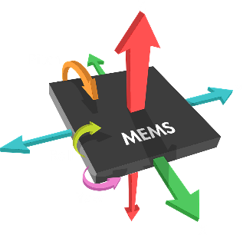
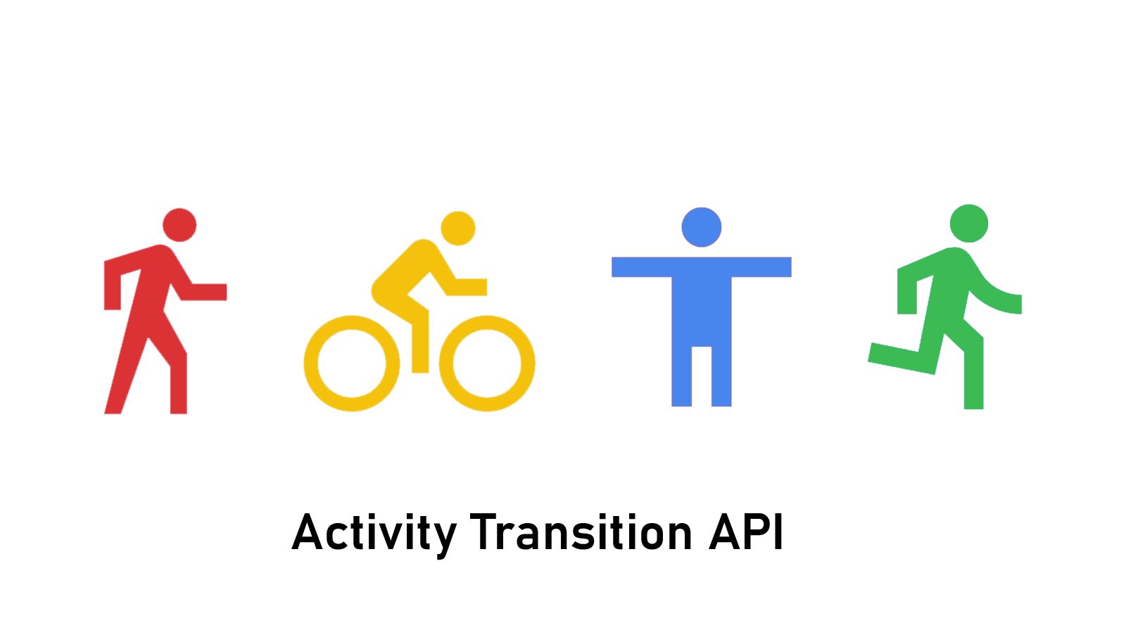


IMU sensing
IMU sensors in mobile devices:
Accelerometer
Gyroscope
Magnetometer
Potential applications:
Human activity recognition
Human computer interaction
Indoor localization

Slide 3
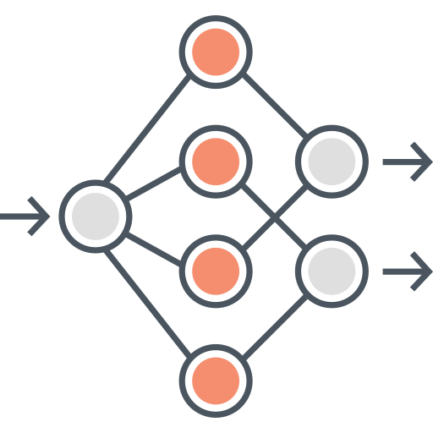

IMU sensing
Supervised representation learning for IMU sensing
Limitation: it requires a large amount of labeled data!

Slide 4
IMU sensing - Features
Features with information loss
Most signal processing-based features
Overfitted features
Supervised learning (CNNs, etc.)
Lack of sufficient high-quality labels

Slide 5
IMU sensing - Data
Can unlabeled data help?

Slide 6
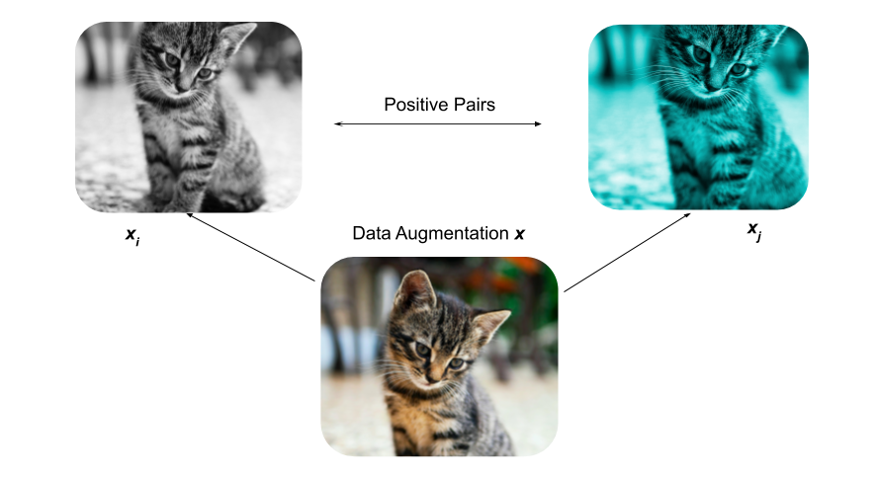
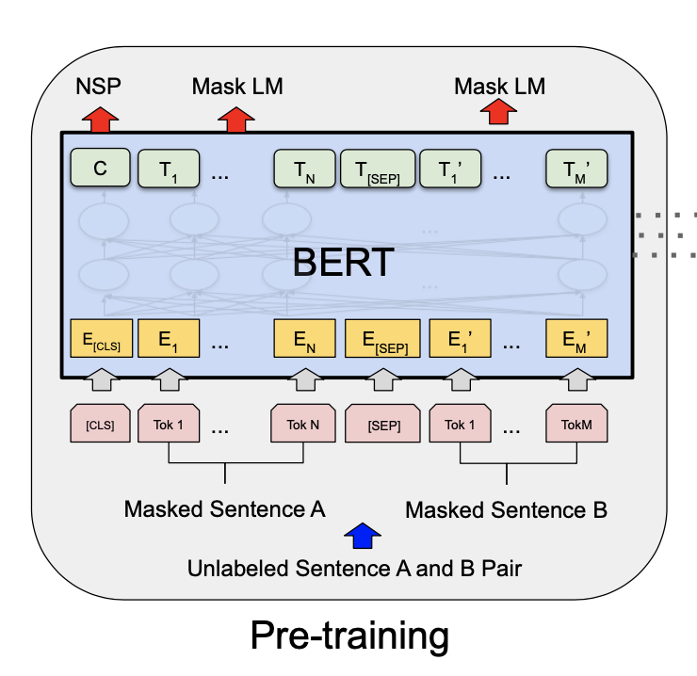
IMU sensing with unlabeled data
Self-supervised learning methods:
Contrastive-based
Autoencoder-based: BERT [1]
[1] Devlin, Jacob, et al. "Bert: Pre-training of deep bidirectional transformers for language understanding." arXiv preprint arXiv:1810.04805 (2018).

Slide 7
IMU sensing with unlabeled data
2001
Neural Language models
2008
Multi-task learning
2013
Word embeddings
2013
Neural networks for NLP
2014
Sequence-to-sequence models
2015
Memory-based networks
2017
Attention
2018
Pretrained language models

Slide 8
IMU sensing with unlabeled data
2001
Neural Language models
2008
Multi-task learning
2013
Word embeddings
2013
Neural networks for NLP
IMU sensing
2014
Sequence-to-sequence models
2015
Memory-based networks
2017
Attention
2018
Pretrained language models

Slide 9
IMU sensing with unlabeled data
2001
Neural Language models
2008
Multi-task learning
2013
Word embeddings
2013
Neural networks for NLP
IMU sensing
2014
Sequence-to-sequence models
2015
Memory-based networks
2017
Attention
2018
Pretrained language models
IMU sensing

Slide 10
BERT: From text IMU data
BERT for text
Large amounts of text without labels (e.g., Wikipedia, news, books).
Specific patterns in text (e.g., grammar, context, phrases).
The patterns can help many NLP applications.
BERT for IMU data
Abundant real world IMU data without labels.
Specific features in IMU data (e.g., periodical changes).
The features can help sensing applications (e.g., activity recognition).

Slide 11
BERT - Training
Pre-training phase: learn representations from unlabeled text data.
MLM
Classifier
BERT
Welcome To ACM SenSys
Mask
Welcome [MASK] ACM SenSys
Dictionary

Slide 12
BERT - Training
Pre-training phase: learn representations from unlabeled text data.
MLM
Classifier
NSP
Classifier
BERT
Sentence-A
Sentence-B
Connect
[CLS] Sentence-A [SEP] Sentence-B…
Dictionary

Slide 13
BERT - Usage
Fine-tuning phase: learn to accomplish a task with labeled data.
Feature space
Task
Classifier
Sentence-level task:
Input: sentence
Output: class
Application: sentiment analysis
BERT
(Fine-tuned)
Positive / Negative
[CLS] I like this T-shirt…
Dictionary

Slide 14
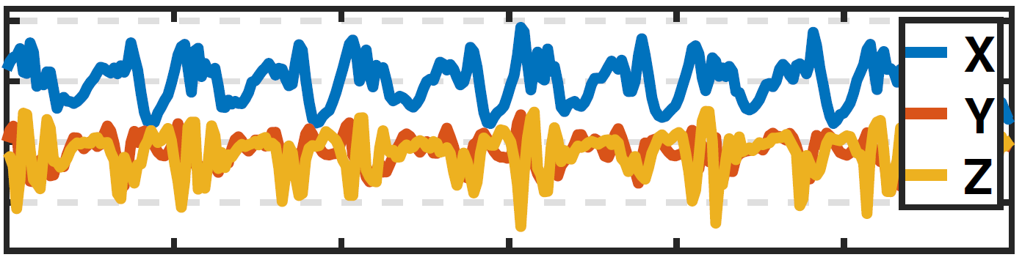
Challenges
From text to IMU data.
MLM
Classifier
NSP
Classifier
Text
IMU
A B C D E F
BERT
Welcome To ACM SenSys
Sentence-A
Sentence-B
1. Continuous variables
Mask
Connect
Welcome [MASK] ACM SenSys
[CLS] Sentence-A [SEP] Sentence-B…
Dictionary

Slide 15
Challenges
From text to IMU data.
MLM
Classifier
NSP
Classifier
Text
IMU
A B C D E F
BERT
Welcome To ACM SenSys
Sentence-A
Sentence-B
1. Continuous variables
2. Multi-modal
Mask
Connect
Welcome [MASK] ACM SenSys
[CLS] Sentence-A [SEP] Sentence-B…
Dictionary

Slide 16
Challenges
From text to IMU data.
MLM
Classifier
NSP
Classifier
Text
IMU
A B C D E F
BERT
Welcome To ACM SenSys
Sentence-A
Sentence-B
1. Continuous variables
2. Multi-modal
Mask
Connect
3. Motion features
Welcome [MASK] ACM SenSys
[CLS] Sentence-A [SEP] Sentence-B…
Dictionary

Slide 17
Challenges
From text to IMU data.
MLM
Classifier
NSP
Classifier
Text
IMU
A B C D E F
BERT
Welcome To ACM SenSys
Sentence-A
Sentence-B
1. Continuous variables
2. Multi-modal
Mask
Connect
3. Motion features
Welcome [MASK] ACM SenSys
4. Efficiency
[CLS] Sentence-A [SEP] Sentence-B…
Dictionary

Slide 18
Design
Adapt BERT to IMU data.
MLM
Classifier
1. Continuous variables
2. Multi-modal
BERT
Normalization
3. Motion features
Mask
4. Efficiency

Slide 19
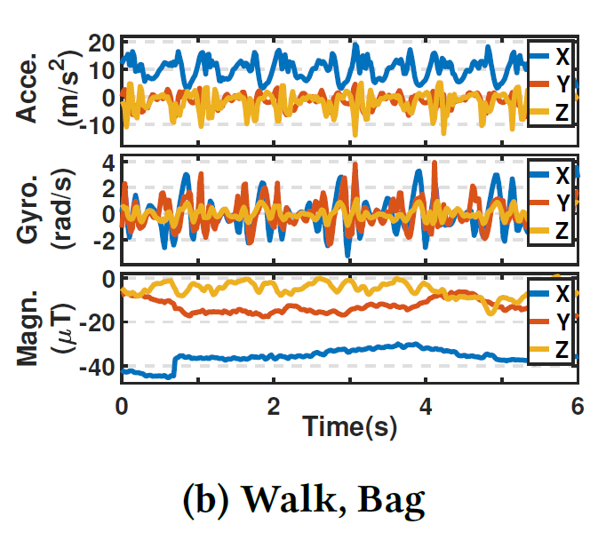
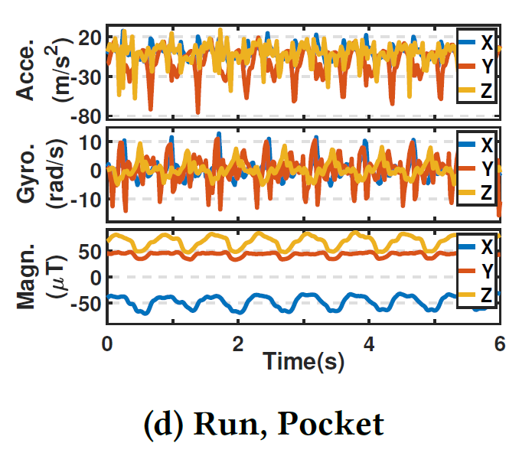
Normalization
IMU sensors have varied distributions:
Previous solutions: mean-variance, min-max, magnitude, FFT

Slide 20
Normalization
IMU sensors have varied distributions:
Previous solutions: mean-variance, min-max, magnitude, FFT

Slide 21
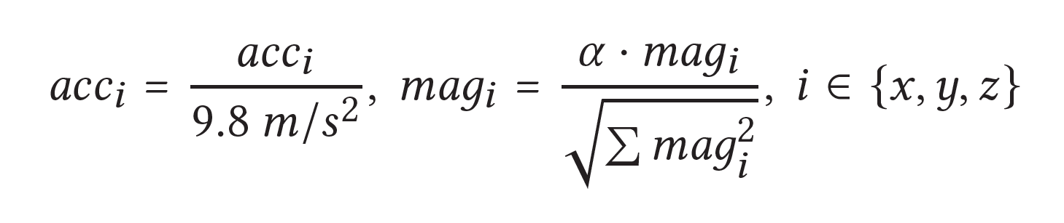
Normalization
IMU sensors have varied distributions:
Previous solutions: mean-variance, min-max, magnitude, FFT

Slide 22
Design
Adapt BERT to IMU data.
MLM
Classifier
1. Continuous variables
Fusion
2. Multi-modal
BERT
3. Motion features
Mask
4. Efficiency

Slide 23
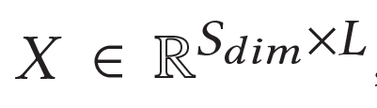
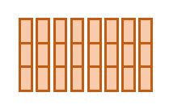
Fusion
Align data: IMU readings are naturally well-aligned.
Accelerometer
Gyroscope
Magnetometer
Time Index

Slide 24
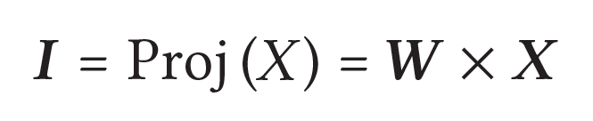


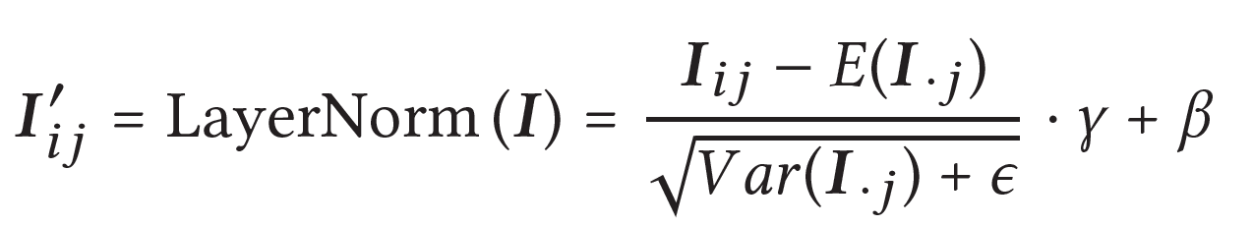
Fusion
Fuse data: expand feature space.
Fuse data: normalize expanded features.

Slide 25
Design
Adapt BERT to IMU data.
MLM
Classifier
1. Continuous variables
Training
Method
2. Multi-modal
BERT
3. Motion features
Mask
4. Efficiency

Slide 26
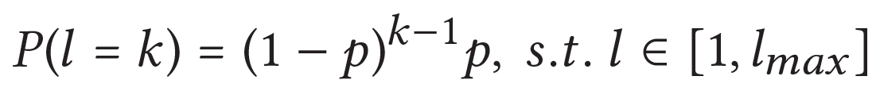
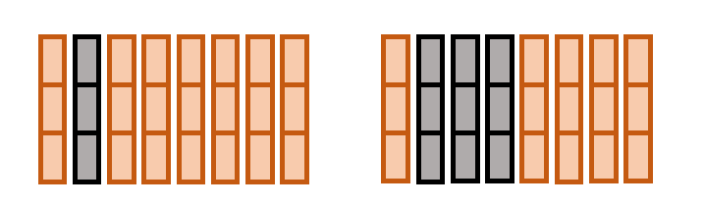
Training method
LIMU-BERT:
Adopt MLM and skip NSP.
Reconstruction task is treated as a regression problem.
Mask N continuous readings, which is sampled from a geometric distribution.
BERT
LIMU-BERT

Slide 27
Design
Adapt BERT to IMU data.
MLM
Classifier
1. Continuous variables
2. Multi-modal
BERT
3. Motion features
Mask
Lightweight
Model
4. Efficiency

Slide 28
Lightweight Model
LIMU-BERT should run on mobile devices:
Down-sample to reduce the sequence length. [20Hz]
Reduce feature dimension. 1024 -> 72
Adopt cross-layer parameter sharing. 4 blocks -> 1 block
Block-1
Block-2
Block-3
Block-4
Share parameters

Slide 29
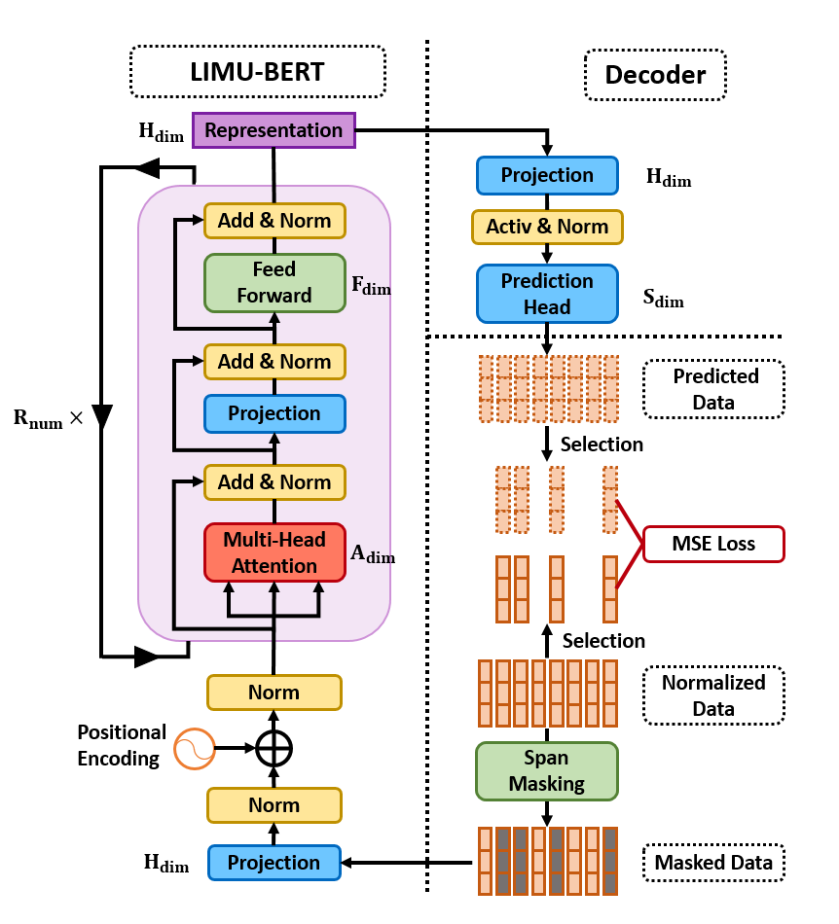
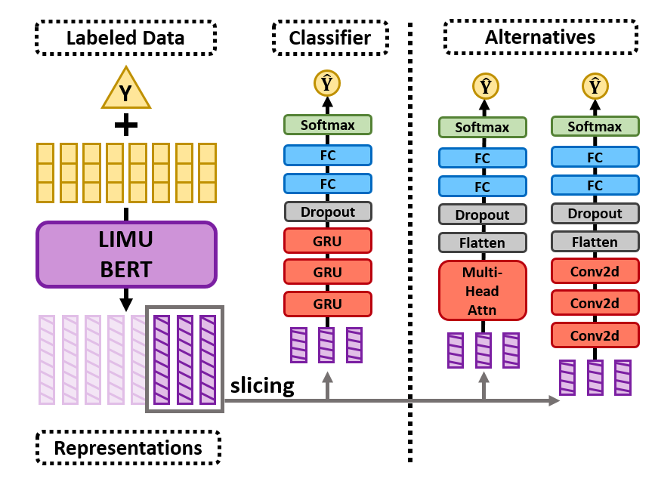
Design - Workflow
Self-supervised learning phase: Learn representations.
Supervised learning phase: Learn to accomplish task.

Slide 30
Evaluation
Dataset | Sensor | Activity | User # | Placement | Sample #
HHAR | A,G | 6 | 9 | - | 9166
UCI | A,G | 6 | 30 | - | 2088
MotionSense | A,G | 6 | 24 | - | 4534
Shoaib | A,G,M | 7 | 10 | 5 | 10500
Dataset Partition:
Training set (80%): train LIMU-BERT
Labeling set (1%): train classifier
Validation set (10%): select model
Test set (10%): evaluate model

Slide 31
Evaluation
Models in comparison:
LIMU-GRU: LIMU-BERT + GRU classifier
DCNN [IJCAI’15]
DeepSense [WWW’17]
TPN [Ubicomp’19]
R-GRU: raw data + GRU classifier
Applications:
Human activity recognition (HAR).
Device placement classification (DPC).
Metric: Accuracy and F1-score

Slide 32
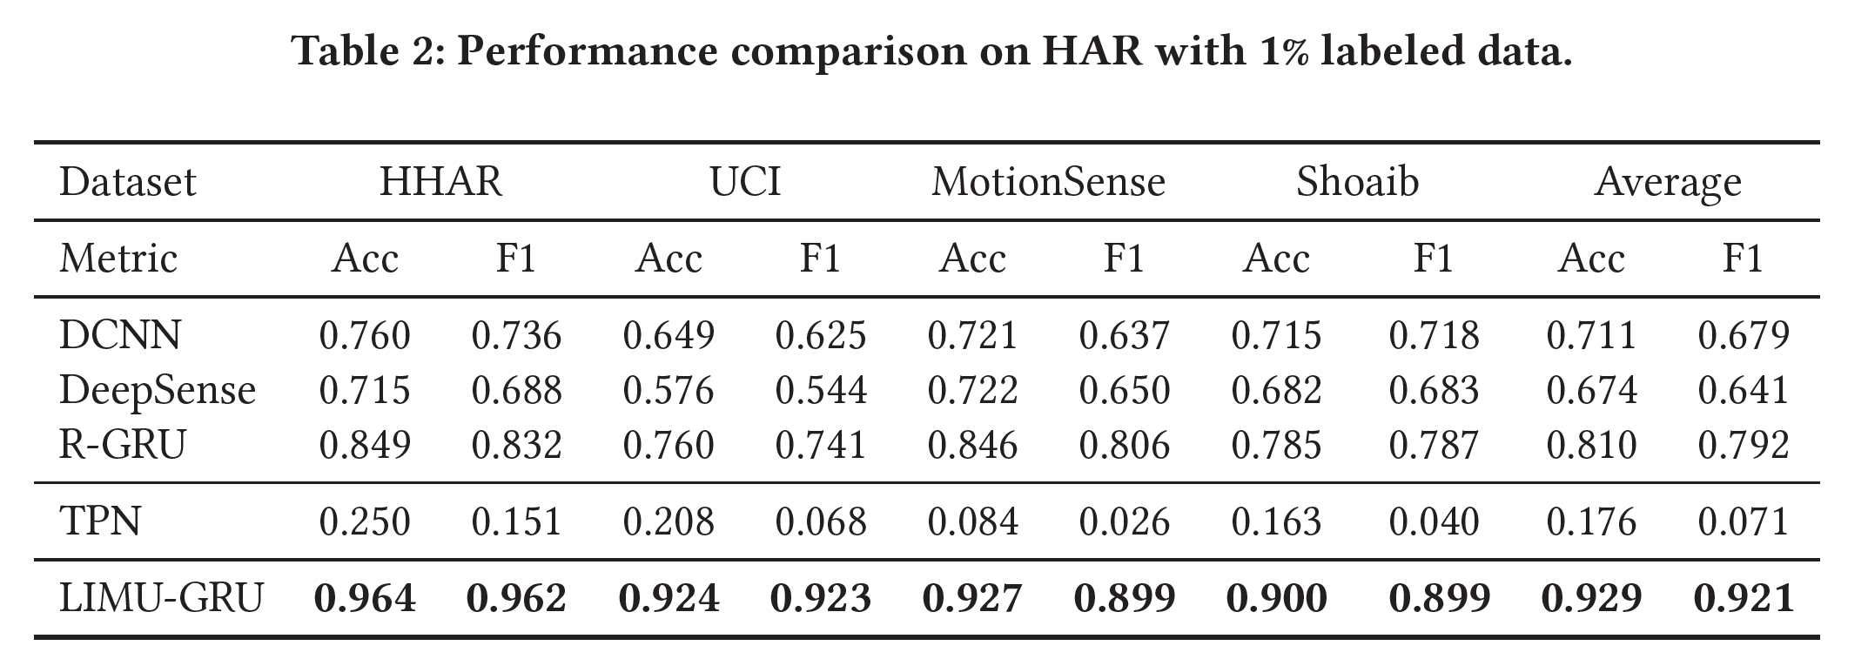
Evaluation - HAR
Overall performances with 1% labeled samples.

Slide 33
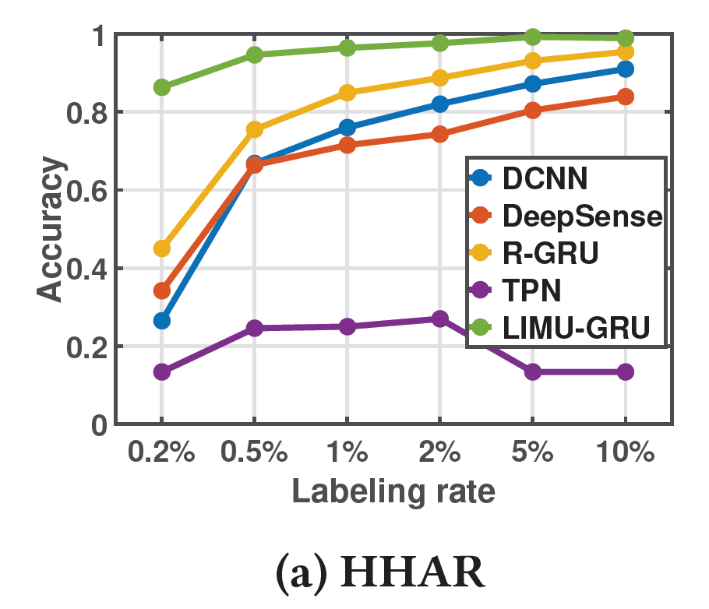
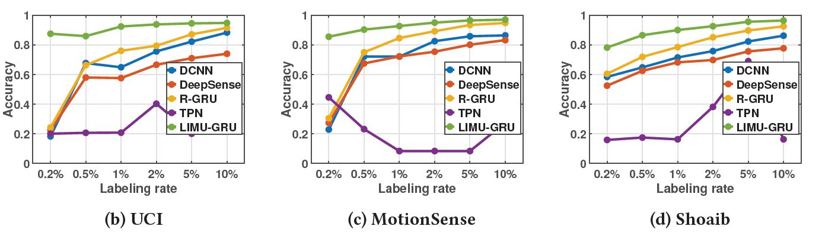
Evaluation - HAR
Varying number of labeled samples.

Slide 34
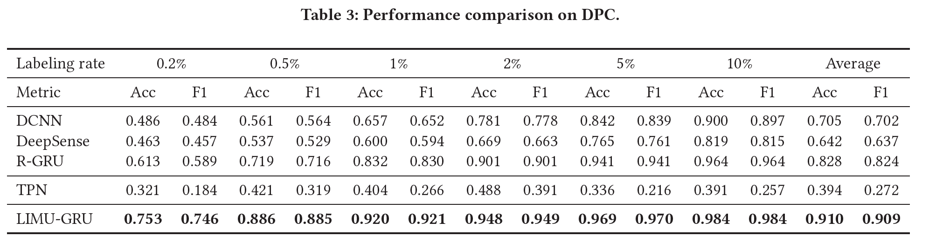
Evaluation - DPC
Overall performances.

Slide 35
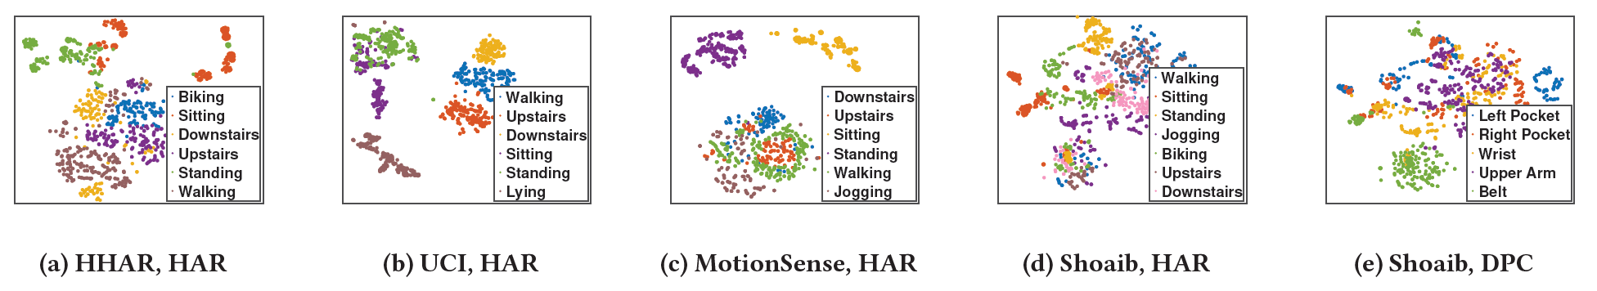
Micro-benchmark
Representation visualization with t-SNE.

Slide 36
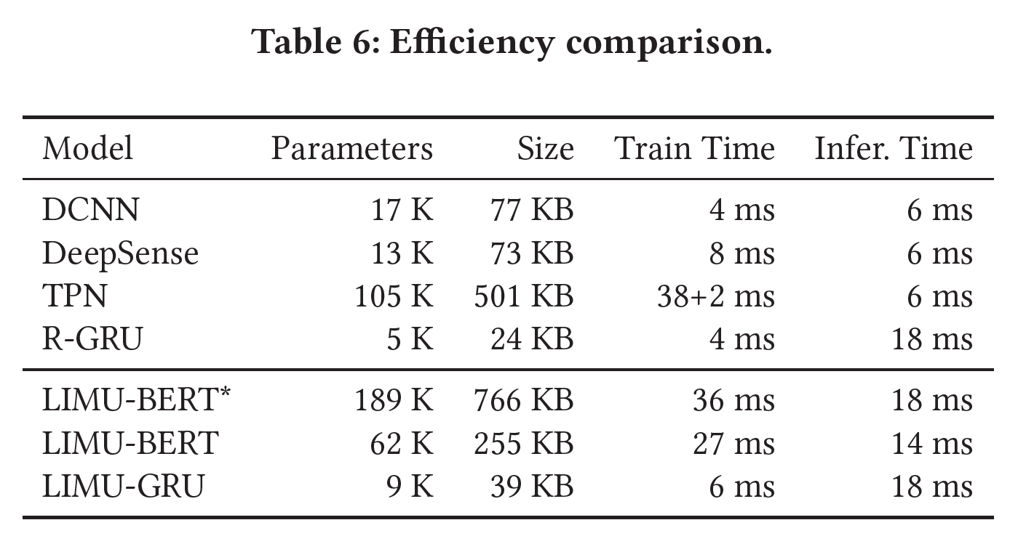
Micro-benchmark
Computation overhead:
Training time on server
Inference time on Samsung Galaxy S8

Slide 37
Conclusion
We present LIMU-BERT, a lightweight representation learning model for mobile IMU sensor data:
Extracts effective and generalized features.
No labeled data are required.
Lightweight model.
Source code:
https://github.com/dapowan/LIMU-BERT-Public

Slide 38
Thank you!
Q&A

Slide 39
Backup Slides

Slide 40
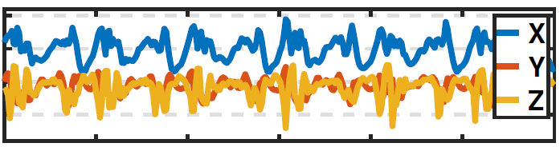
Related Work
Transformation-based: TPN [1] learns representations by recognizing the transformations applied to the raw input signal.
Noised
Shared
CNN
Noise Task Head
Noised / Not Noised
Scaled
Scaled Task Head
Scaled / Not Scaled
Accelerometer
Rotated
Rotated Task Head
Rotated / Not Rotated
2
Dimension
Reduction
2
1
1
3
3
Data Space
Feature Space
[1] Saeed, Aaqib, et al. "Multi-task self-supervised learning for human activity detection." Ubicomp 2019.
Notes:
It is indeed a dimensionality-reduction method removing the redundant information. The performance is not stable in the multiple sensor cases.

Slide 41
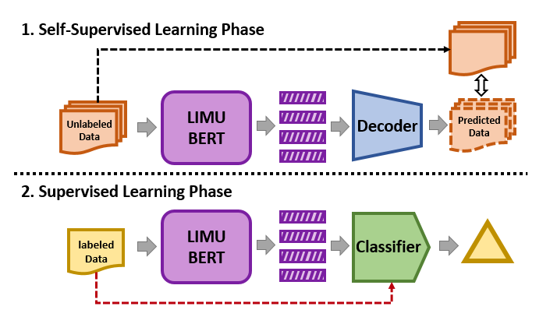
Overview
Self-supervised learning phase: learn the general representations.
Supervised learning phase: accomplish specific tasks.

Slide 42


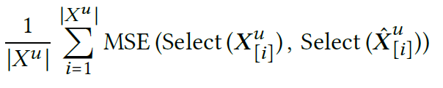
Design - Workflow
Self-supervised learning phase:
LIMU-BERT:
Decoder:
Loss:

Slide 43
Design - Workflow
Supervised learning phase:
Slicing for high granularity.
Lightweight classifier.

Slide 44
Micro-benchmark
Impact of input sensors.
Impact of normalization method.
Impact of mask approach.
Impact of representation dimension.
Impact of dataset.

Slide 45
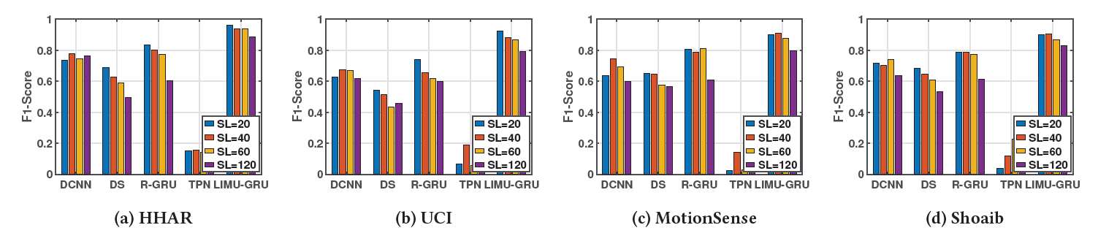
Evaluation - HAR
Varying window size / sequence length(SL).

Slide 46
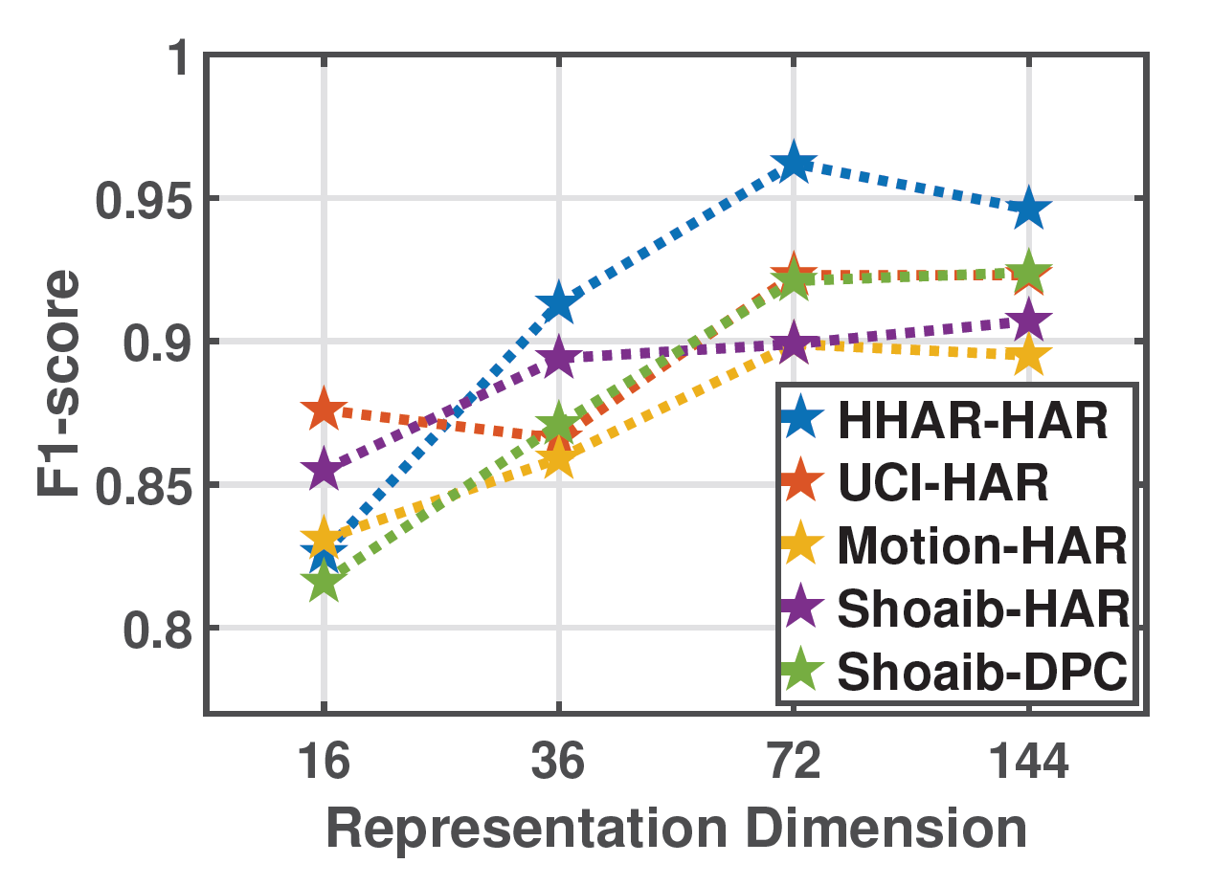
Micro-benchmark
Impact of representation dimension.

Slide 47
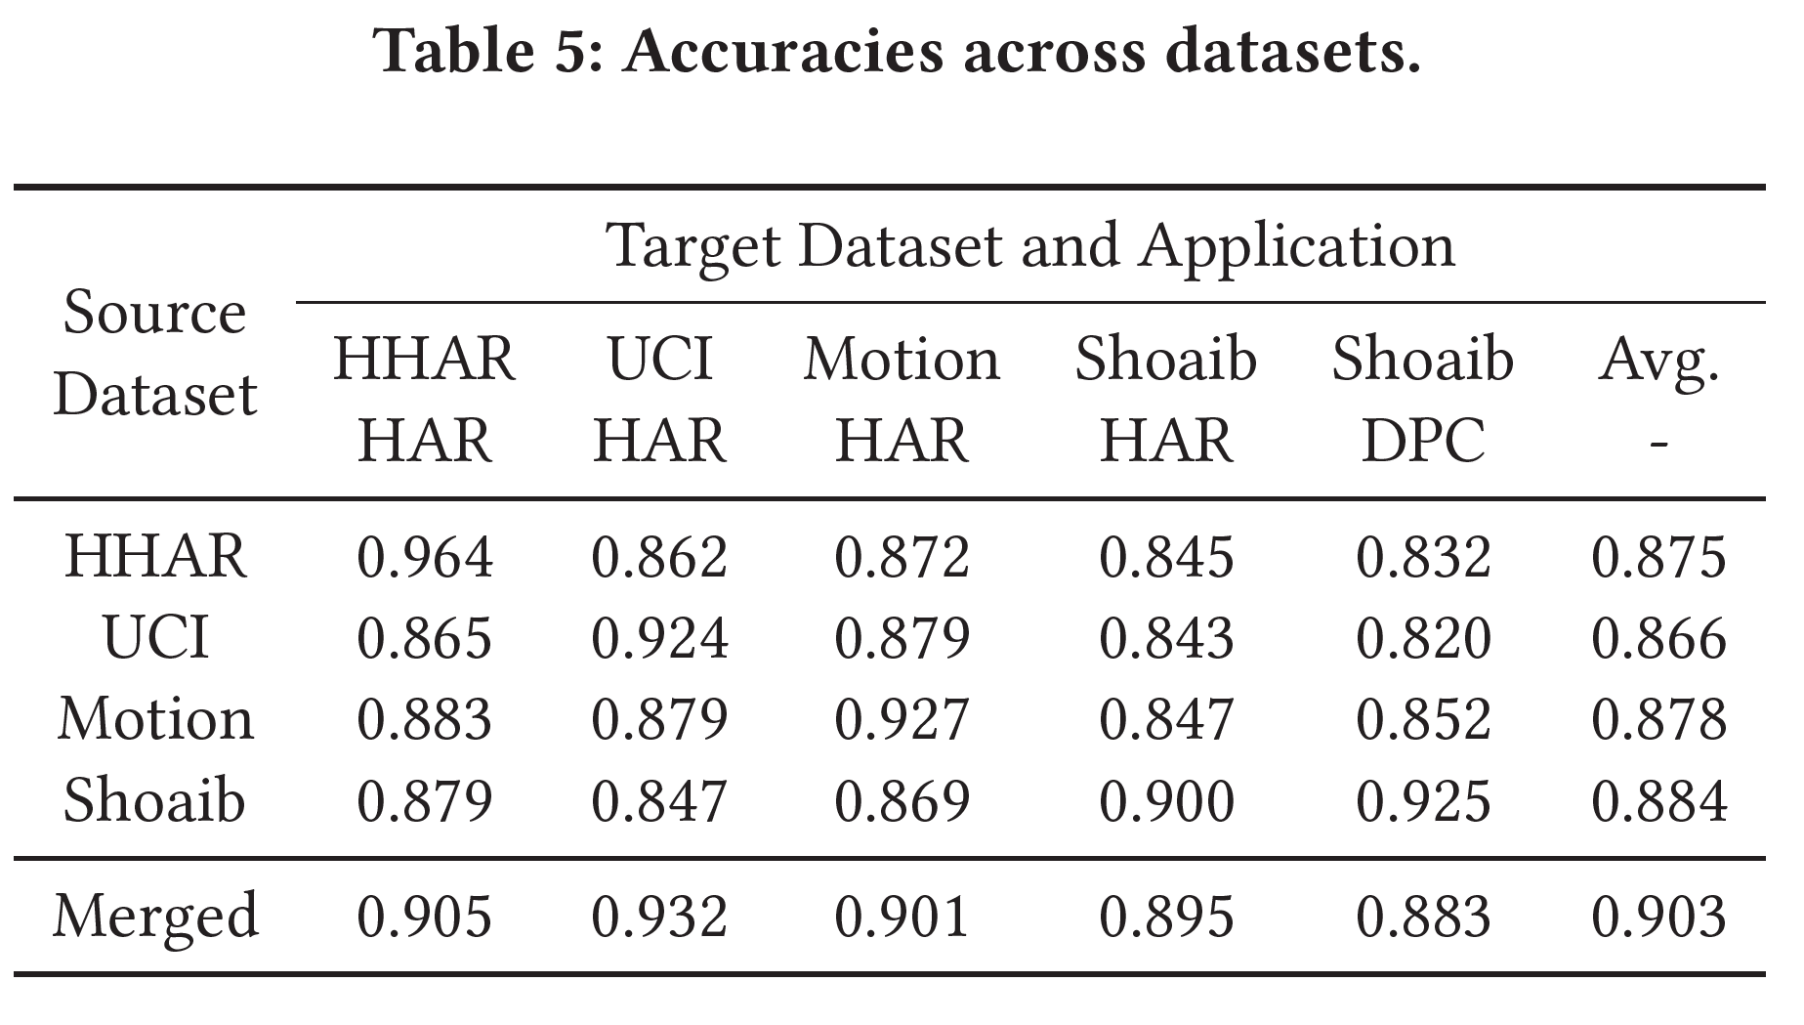
Micro-benchmark
Impact of dataset.

Slide 48
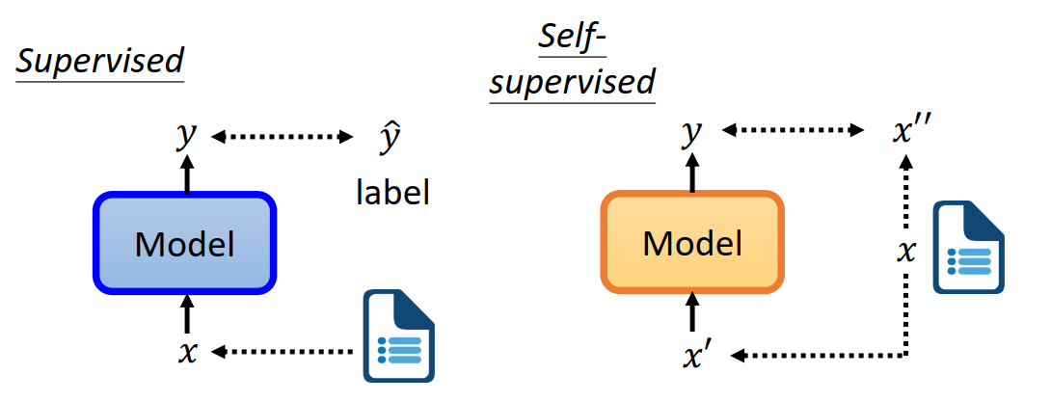
Self-supervised Learning
Supervised VS Self-supervised
Supervised: learn the mapping between x and y
Self-supervised: learn the relations among x
https://speech.ee.ntu.edu.tw/~hylee/dlhlp/2020-spring.html

Slide 49
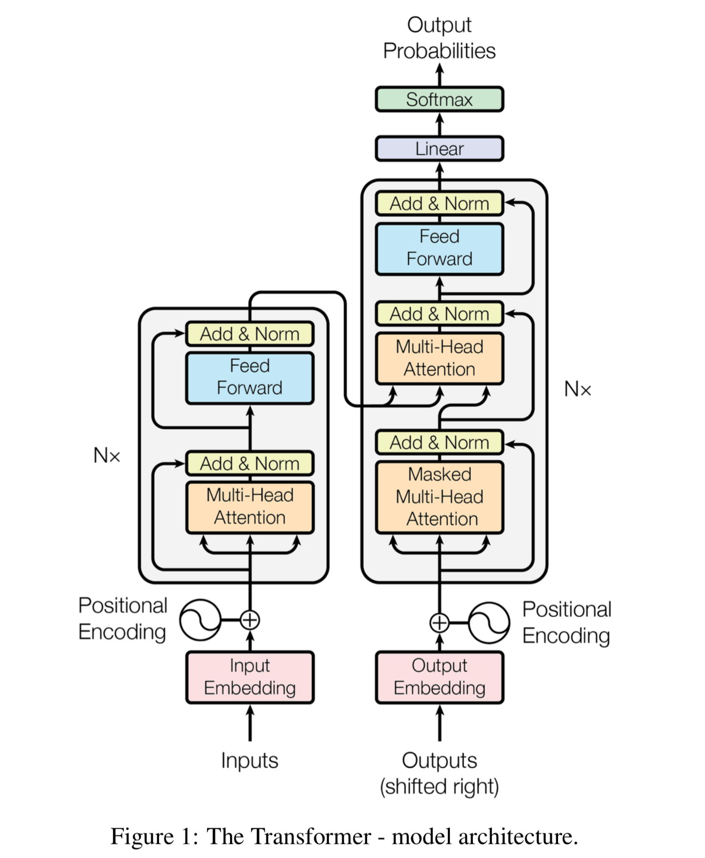
BERT
Bidirectional Encoder Representations from Transformers
Goal: Extract embedding from unlabeled data.
Idea: Bidirectional encoding with attention.
Vaswani, Ashish, et al. "Attention is all you need." Advances in neural information processing systems. 2017.

Slide 50
BERT - Training
Pre-training phase: learn representations from unlabeled text data.
1. Mask Language Model (MLM)
2. Next Sentence Prediction (NSP)
MLM
Classifier
NSP
Classifier
To
YES/NO
BERT
Welcome [MASK] ACM SenSys
[CLS] Welcome to ACM SenSys [SEP] Embedded Networked …
Devlin, Jacob, et al. "Bert: Pre-training of deep bidirectional transformers for language understanding." arXiv preprint arXiv:1810.04805 (2018).

Slide 51
BERT - Usage
Fine-tuning phase: learn to accomplish a task with labeled data.
Task
Classifier
Positive / Negative
Sentence-level task:
Input: sentence
Output: class
Application: sentiment analysis
BERT
(Fine-tuned)
[CLS] I like this T-shirt
Devlin, Jacob, et al. "Bert: Pre-training of deep bidirectional transformers for language understanding." arXiv preprint arXiv:1810.04805 (2018).

Slide 52
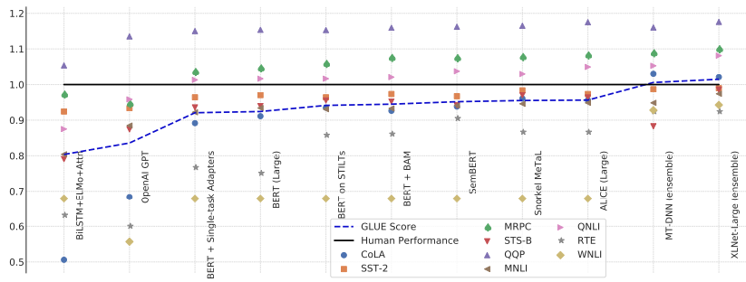
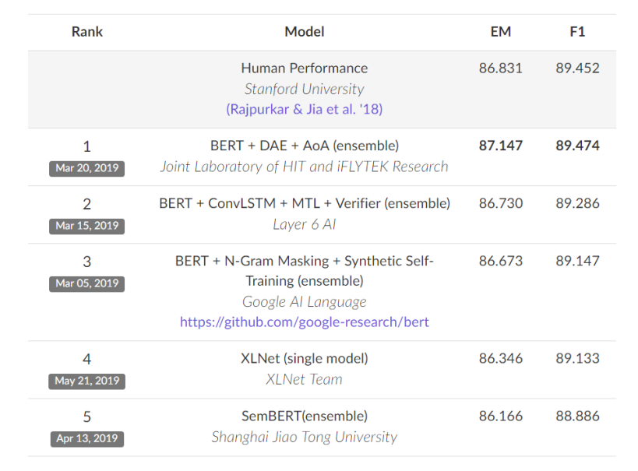
BERT
Push the performances to higher levels in wide range of NLP tasks.
https://speech.ee.ntu.edu.tw/~hylee/dlhlp/2020-spring.html

Slide 53
BERT
Learn embedding from context
bird
… apple … tree …
apple
pear
1
fish
… orange … tree …
2
… pear … tree …
orange
3
Apple
Amazon
Facebook
Target Token
Context

Slide 54
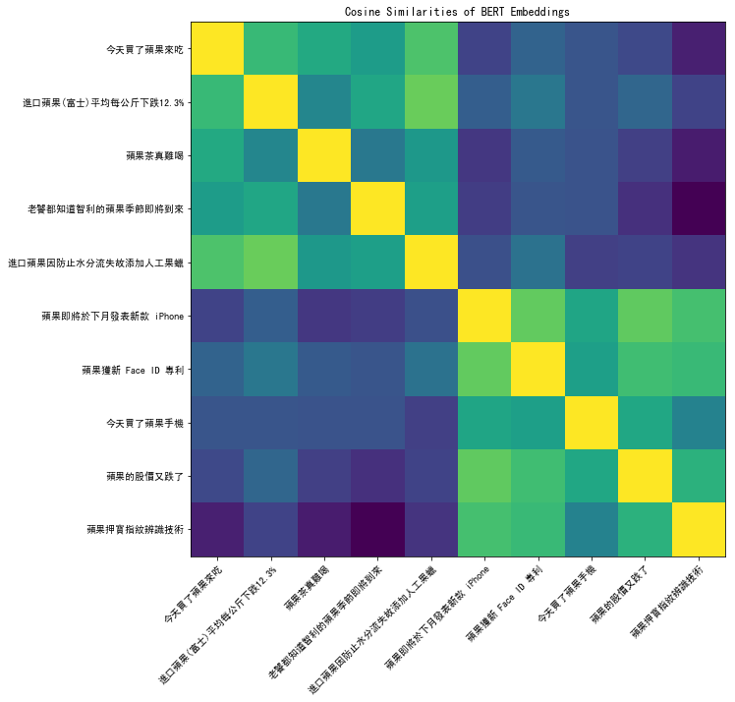
BERT
Apple juice vs Apple stock
- Contextualized embedding
https://speech.ee.ntu.edu.tw/~hylee/dlhlp/2020-spring.html

