Slide 1
PRMS: Phase and RSSI based Localization System for Tagged Objects on Multilayer with a Single Antenna
Huatao Xu, Run Zhao , Qian Zhang, Dong Wang
Presenter: Huatao Xu
Shanghai Jiao Tong University
MSWiM 2018
Notes:
Good afternoon, everyone, I am xu huatao, coming from Shanghai Jiao Tong University. It's a great honor to be here and present our work:

Slide 2

Outline
01
Motivation
02
Challenges
03
System Design
04
Implementation and Evaluation
05
Conclusion
Notes:
I will introduce our work from these five parts.

Slide 3
1
PART ONE
Motivation
Notes:
Firstly, I will show you the motivation for doing this.

Slide 4




Wireless Localization
Book managing
Product ordering
Goods Locating
Notes:
Nowadays, wireless location sensing plays a critical role in developing IoT. It attracts increasing attention in both the academia and industry in recent years.
For example
[click]It could help librarian find the books misplaced by reckless readers.
[click]In factory and other environment, wireless location sensing is capable of constructing a localization system for managing spatial[] information of all goods.
[click]Track or order the product in the conveyor[] belts is also an important application.

Slide 5
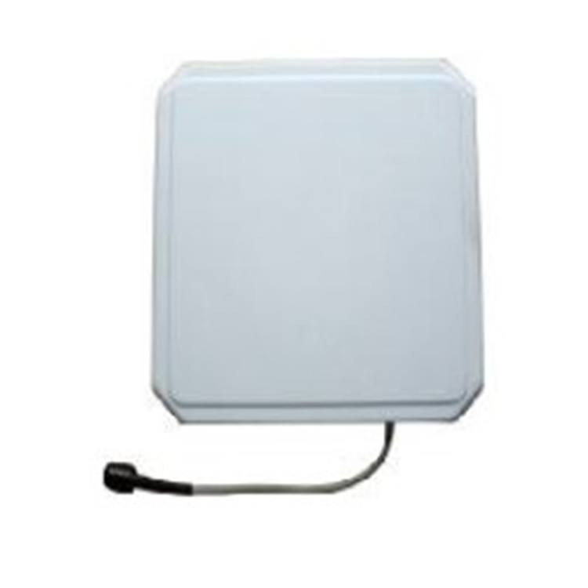
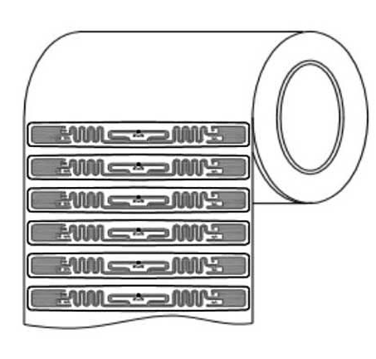
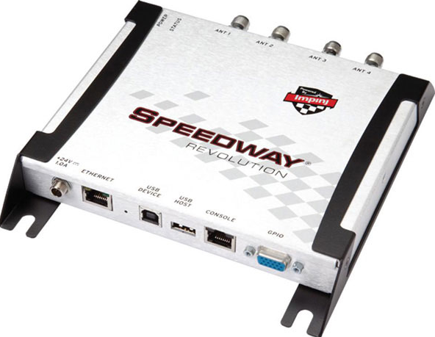
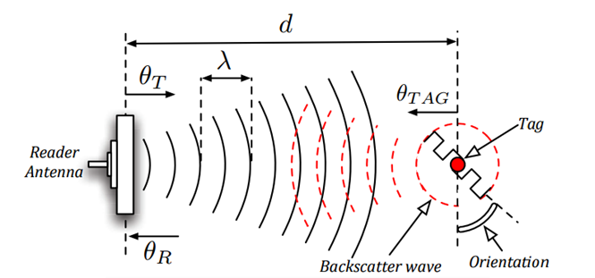
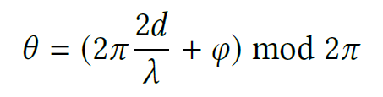
Radio Frequency Identification(RFID)
Features of RFID devices
Tiny-size
Low-cost
Battery-free
Flexible
Communication mode
RSSI
Phase
Notes:
At the same time, RFID plays a more and more indispensable role in wireless location sensing.
[click]RFID devices consists of 3 parts: reader, antenna, RFID tags.
In implementation, RFID tags are attached to product or books as information carriers for further location or ordering.
[click]RFID devices have following features. Tiny-size, low-cost, battery-free and flexible.
[click] Instead of equipped with battery, the RFID tags gain energy from the signal of reader. Induced by the signal, a voltage on the tag's antenna produces radiation. And the radiated wave carried with special information is finally captured by reader antenna.
[click]RFID reader could report RSSI, phase at the same time. RSSI measures the power of received radio signal.
[click]Meanwhile, the relationship between the reported phase $\theta$ and the distance from antenna to RFID tag d could be expressed as this equation. Phi is a offset. It is obvious that phase ranges from 0 to 2pi, so it cannot be utilized for distance estimation directly.

Slide 6
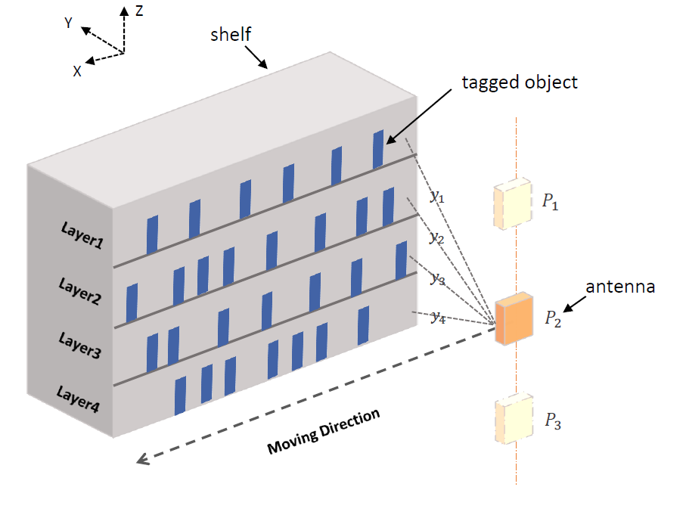
Our Work
PRMS: Phase and RSSI based Localization System on Multilayer with a Single Antenna
Notes:
We propose PRMS, a phase and RSSI based localization system on multilayer with a single antenna.
[click] Here is our application scene, tagged objects are placed on multilayer and an antenna moves along a specific line in front of the shelf to interrogate the RFID tags.
Our system could report both order and the layer of tagged objects even though there exist two layers owning similar or even same radial distance to the antenna.

Slide 7
2
PART TWO
Challenges

Slide 8
Challenges and Solutions
C1
How to acquire the relative locations of RFID tags with high precision?
S1
Propose a phase-based localization model utilizing angle of arrival (AoA) profiles
Optimize it by holography imaging

Slide 9
Challenges and Solutions
C2
How to distinguish the tags on different layers with only one antenna?
S2
Change the traditional deployment of the unique antenna smartly
Utilize both phase and RSSI values to distinguish objects on the multilayer

Slide 10
3
PART THREE
System Design

Slide 11
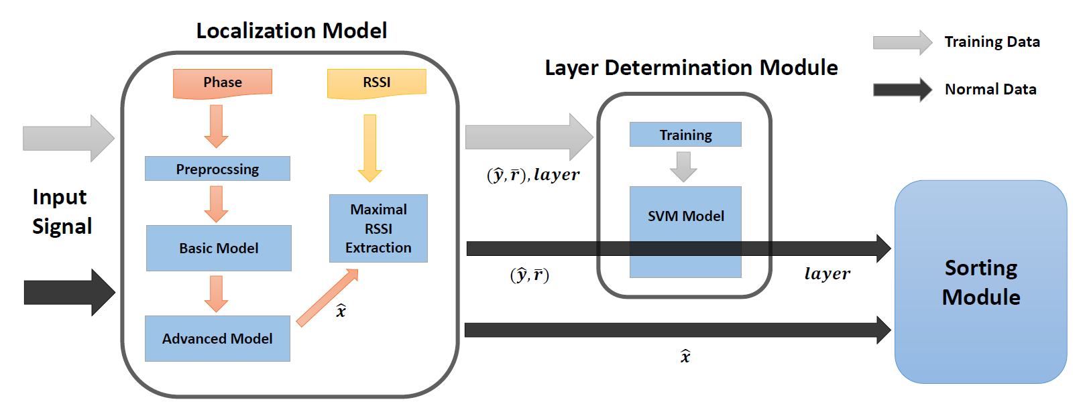
System Overview
Notes:
This is the architecture of our system.
Our system takes the phase and RSSI as input and gives the layers and orders for tagged objects. There are three main components in our whole system: 1) Localization Model; 2) Layer Determination Module; 3) Sort Module.
In the Localization Model, the initial estimated position is obtained after the preprocessed data are put into the basic localization model. Then an advanced model gains a more accurate estimated result based on the initial position. Next, RSSI extractor derives a mean value from the measuring data utilizing the estimated position.
At the beginning, raw phase and RSSI data of some tags with known layer are used to train a SVM model. Then we can use it to determine the layer of other tags according to corresponding radial distance and mean RSSI value
After having the knowledge of tags' layers, Sort Module partitions them into different groups and gives the order for each tag.

Slide 12
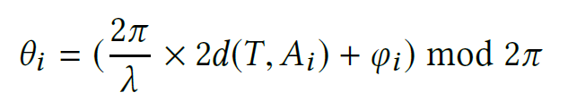
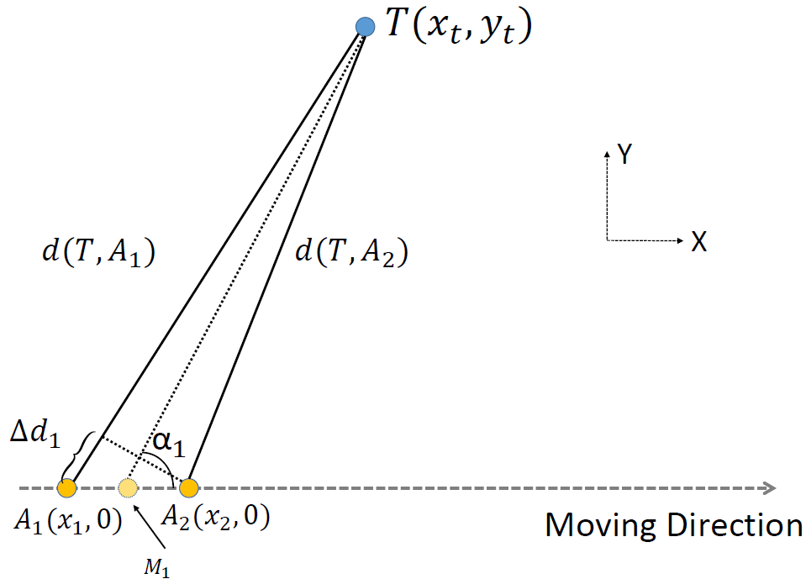
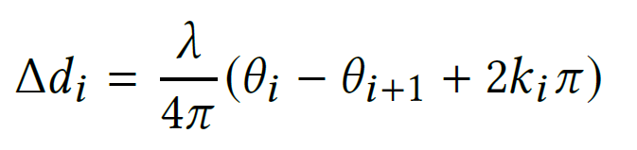

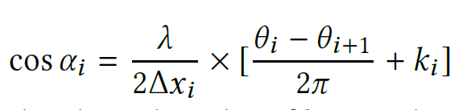
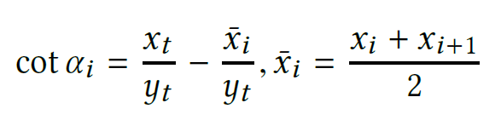
Basic Model
Notes:
As shown in the Figure, an antenna queries the target tag T at different positions A1 and A2.
Let Mi be the middle point of them and αi be the included angle between line TM and line AiAi+1, which is also the Angle of Arrival of tag T. If we use di to stand for the distance from tag to Ai.
[click] Then the relation between d and collected phase θi can be written as this equation.
[click] So the distance difference Δdi can be defined by subtracting θi and θi+1.
[click]At the same time, Δdi can also be approximated as Δxi × cos αi
[click]Combine former two equations, cos αi can be expressed as this.
[click] Considering the geometric relation in this Figure, cot αi can be calculated by coordinates of T and M.
As the antenna moves forward, the￣ xi increases while cot αi decreases continuously.
Therefore there is a typical linear relationship between ￣ xi and cot αi. there are only two unknown parameters: xt and yt . Finally they can be estimated by linear fitting with angle profiles

Slide 13
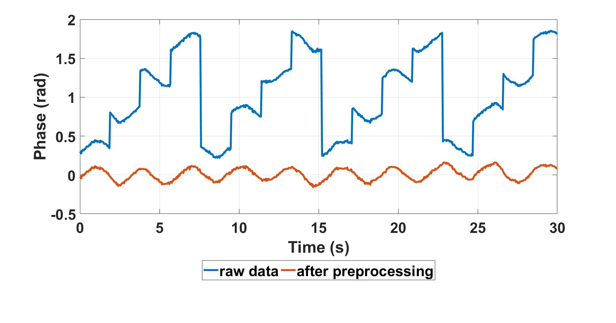
Preprocess
Smoothing (unwrapping)
Notes:
The raw phase measurements are processed by unwrapping firstly to remove the periodic change of phase values.
[click]Here is a sample data. The blue line stands for the raw data while the red line is the processed data.
Then the processed data will be put into the basic model to estimate the tag’s position.

Slide 14
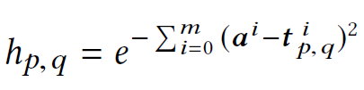



Advanced Model
$$p$$
Actual phase differences
$$q$$
Theoretical phase differences
Surveillance region
P$×Q$ grids
Notes:
However, experiments results shows the accuracy of basic model is not stable. To improve the robustness of our system, we design an advanced model.
[click]Besides employing AoA profiles for localization, holography imaging is another effective method to locate tag and it achieves higher accuracy. RF Hologram is a likelihood exhibition, using an image to display how a partitioned grid in tag’s motion plane is likely to be the ground truth.
[click]This is our likelihood function.
[click]a is a vector representing actual phase differences
[click]while t is a vector which stands for theoretical phase differences if the tag is at grid P,Q
[click] If the grid p,q is the ground truth, the theoretical phase
difference should be close to the measured one, which means the sum should be minimal leading to the maximized hp,q.

Slide 15
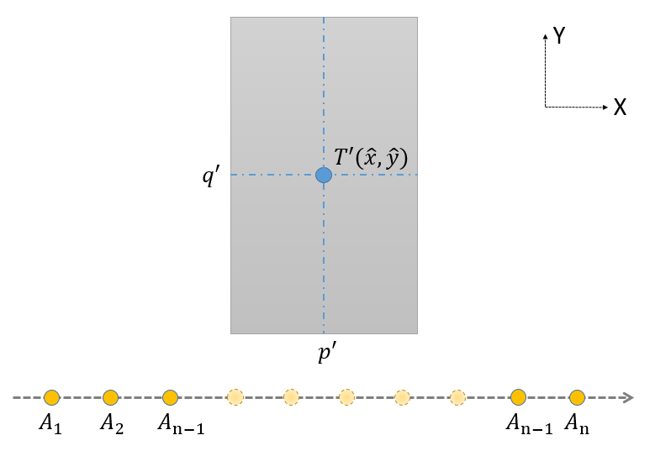
Advanced Model
dynamical Surveillance region
Notes:
However, holography imaging suffers high time complexity because it must calculate likelihood for each grid. Thanks to the basic localization model, we could overcome this defect by dynamically creating a small range of surveillance region whose central grid is corresponding to estimated position in basic model.

Slide 16
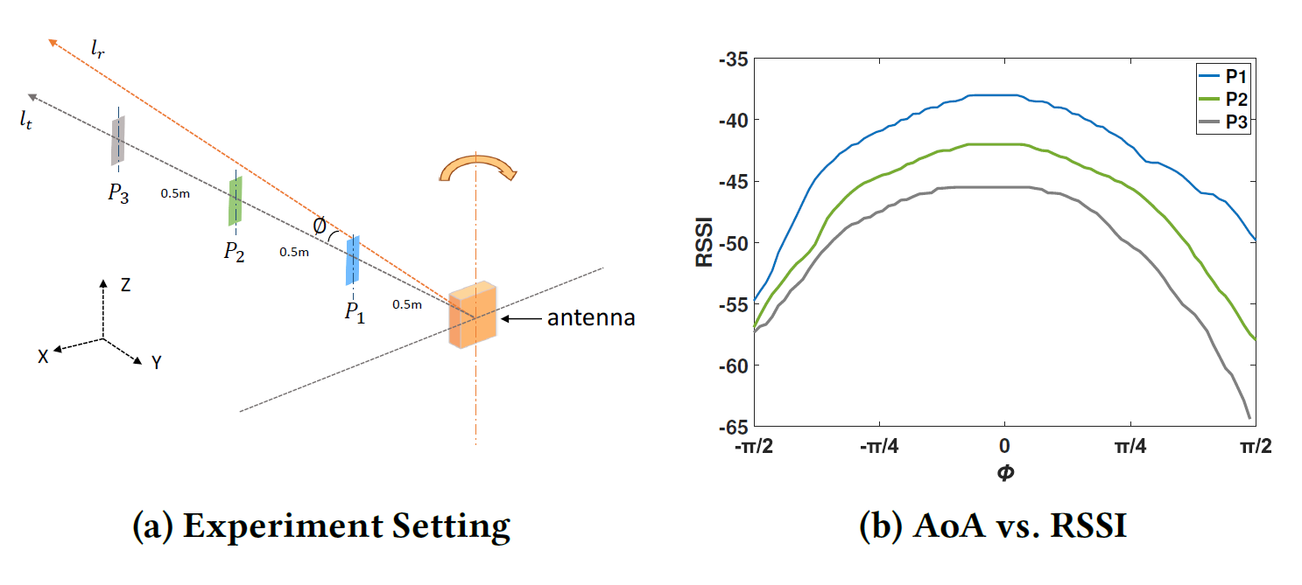
Layer Determination
Empirical Study
Notes:
After obtaining the accurate estimated position, we could determine the orders of tags but can’t decide which layer the tag is at. Due to the former assumption that the radial distance between one layer to antenna may be approximately equal to the distance of another layer. So it is difficult to determine the tag’s layer only by the reported phase.
[click] To study RSSI value’s relevance to the AoA, we conduct a simple experiment in laboratory and the setting is shown in Figure a. RIFD tag is put at three different positions and the antenna rotates at a fixed position.
[click] Experimental result on the right shows that RSSI decreases as the absolute value of AoA become bigger.

Slide 17
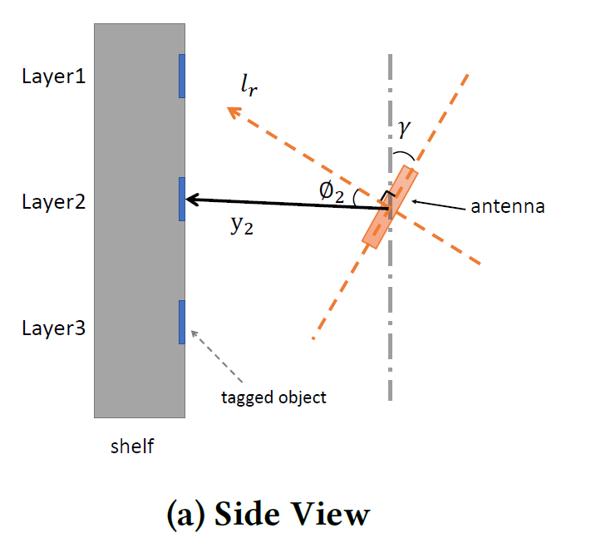
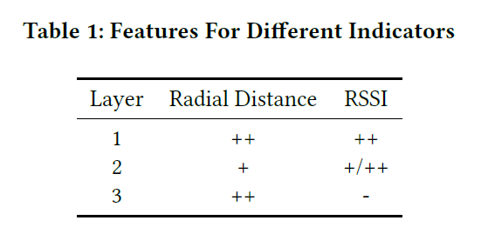
Layer Determination
Deployment of antenna
Notes:
Based on the former findings.
[click]we change the traditional deployment for reader’s antenna subtly by changing its orientation for specific degrees $gamma$ as illustrated in the side view. This change will make layer1 have different AoA compared to layer3 though they have same radial distance.
[click] In conclusion, we list the both radial distance and RSSI of tags on each layer when the antenna is in front of them at Table1. Therefore the layers of all tags can be determinate thanks to the little change.

Slide 18
4
PART FOUR
Implementation and Evaluation
Notes:
Next, let me present … of our system.

Slide 19
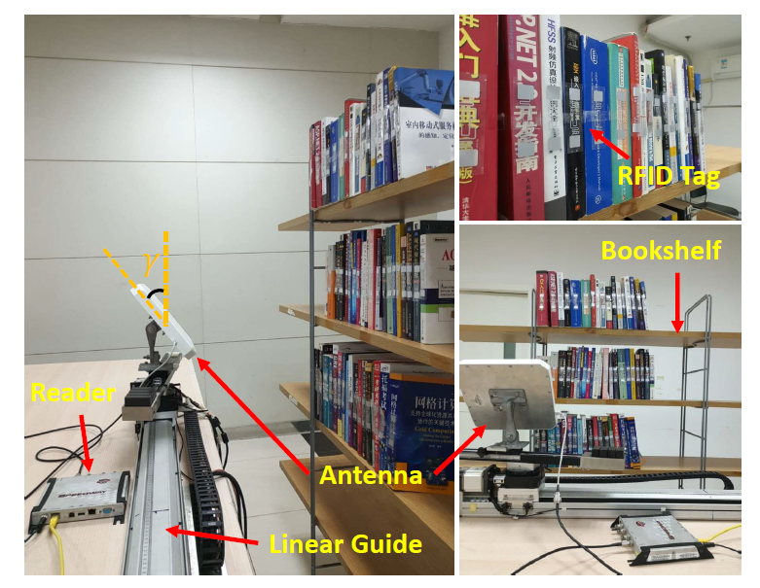
Implementation
Notes:
We implement PRMS using the COTS RFID devices and evaluate it in a meeting room.

Slide 20
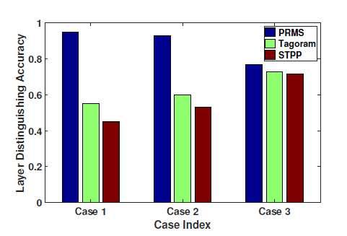
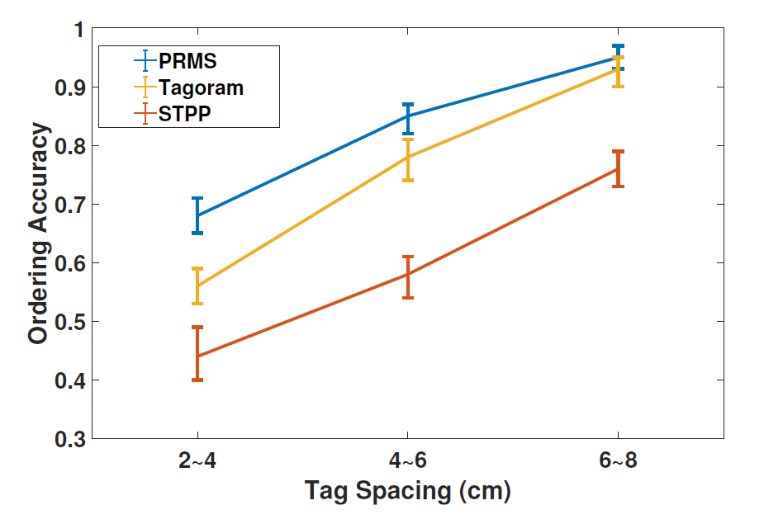
Evaluation
Different Antenna Height
Different Tag Spacing
Notes:
Here are two evaluations of our system, it is obvious that PRMS outperform other systems.

Slide 21
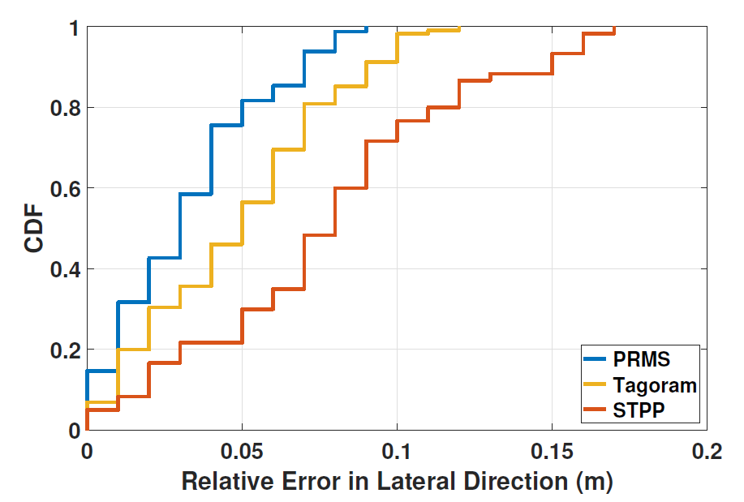
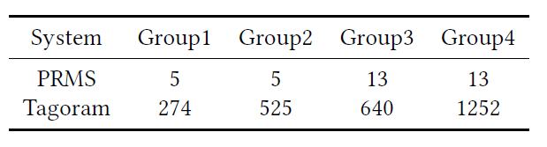
Evaluation
Relative Error
Execution Time
Notes:
Here are the other two evaluations.

Slide 22
5
PART FIVE
Conclusion
Notes:
Finally, I will conclude our work.

Slide 23
Conclusion
we present PRMS, an RFID-based localization system which gives both order and layer for RFID tags with a single antenna
Extensive experiments demonstrate that PRMS could achieve 93% layer determination accuracy and 84% ordering accuracy at low (2 ∼ 8cm) tag spacing

Slide 24

Q & A
Thanks!

