Slide 1
Data processing
Discard Algorithm:
Method 1. double SD
repeat following step until no x is discarded
1. compute average
2. compute SD
3. discard x if abs(x-X.avg)>2SD
Method 2. maximum degree
after 0.3s, the max angle of virtual gravity and velocity is
90-arctan11.3875 about 84.98(85) degree.
So we may discard all value with bigger difference to standard .

Slide 2
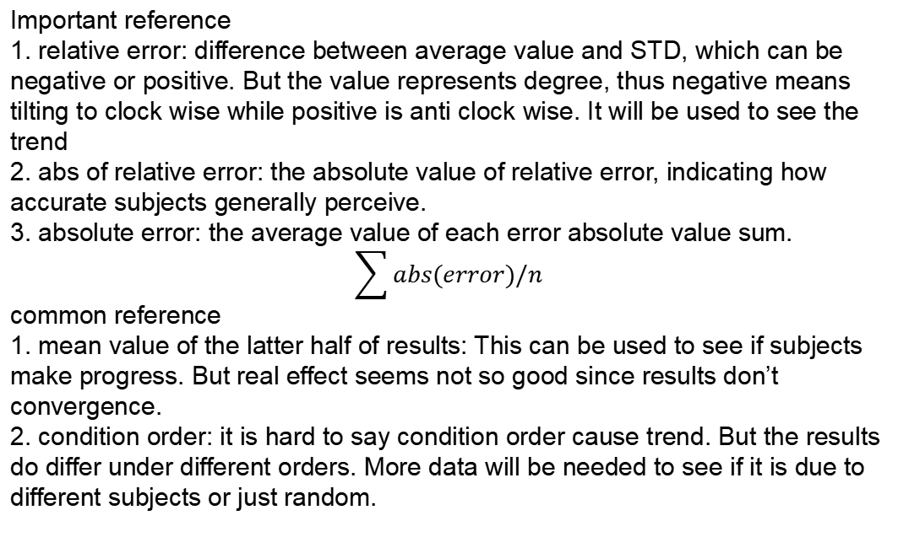
Important reference
1. relative error: difference between average value and STD, which can be negative or positive. But the value represents degree, thus negative means tilting to clock wise while positive is anti clock wise. It will be used to see the trend
2. abs of relative error: the absolute value of relative error, indicating how accurate subjects generally perceive.
3. absolute error: the average value of each error absolute value sum.
$$\sum{abs(error)}/n$$
common reference
1. mean value of the latter half of results: This can be used to see if subjects make progress. But real effect seems not so good since results don’t convergence.
2. condition order: it is hard to say condition order cause trend. But the results
do differ under different orders. More data will be needed to see if it is due to different subjects or just random.

Slide 3
result trend
1. results show a slight trend of bigger error for upward than downward
2. some special directions(0,90,180,-90) tend to have more accurate result
3. some results seem to be symmetrical to the special directions
further discussion:
1. trajectory width
wide and narrow types are considered to have huge difficulty difference when judging.
2. virtual gravity direction
some subjects said upward types are harder to judge than downward.
3.

