Slide 1
What the fuzz?
Fuzzing and debugging
Renne Jämsén

Slide 2
Contents
What is fuzzing?
Why to fuzz?
How to fuzz?
Demo
Notes:
What
- etymology history terminology
- different kinds of fuzzing
Why
- necessary tool to have in order to build robust and secure systems
How
- overlook of different fuzzing tools
Demo
- using ffuf

Slide 3
What is fuzzing?
A technique to find out bugs and security flaws in computer systems using automated inputs.
Notes:
Nutshell description. Emphasize this.
Inputs vary depending on target.
Can be url endpoints/directories.
Data that your system handles, type, length and value should be tampered with when testing.
Changing bits: places, current value +1/-1
OR anything random!

Slide 4
What is fuzzing?
First used in 1988 at University of Wisconsin by Prof. Barton Miller
Started as a class project
Project goal: a program that tests the robustness of UNIX utilities i.e. a fuzz generator
Miller, B. 1988
Notes:
- homework for prof Miller’s students
- it was a dark and stormy night in Madison Wisconsin…

Slide 5
From: Barton Miller
Sent: Wednesday, February 16, 2005 4:39 AM
To: Shawn Hernan
Subject: Re: origins of the term "fuzz"
Thanks for the note. As far as I know, I coined the term.
The original work was inspired by being logged on to a modem during a storm with lots of line noise. And the line noise was generating junk characters that seemingly was causing programs to crash. The noise suggested the term "fuzz".
--bart miller
Correspondance between Miller, B. and Hernan, S. (Neystadt, J. 2009)
Notes:
- Shawn Hernan has worked for a long time for Microsoft (still is)
- security stuff for Microsoft

Slide 6
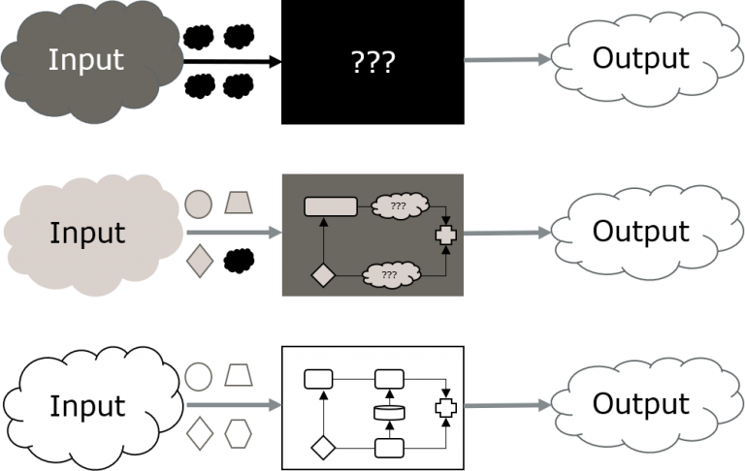
Different kinds of fuzzing
Black Box
Grey Box
White Box
Image source: https://www.coderskitchen.com/fuzzing-techniques/
Notes:
Black – hacker doesn’t know anything about the internal system just input/output
Grey – Hacker/tester knows something about system/code like method sequences or directories but not the full source code
White – tester/hacker has full access to source code and tries to break it via fuzzing

Slide 7
Why to fuzz?
To map attack vectors that could be exploited to gain access into your system
To discover program breaking cases of user input (malicious and unmalicious)
Recommended by international standards in many fields
Notes:
- api endpoints / directories
- unit testing and unit mutations
-guaranteed that threat actors are using it so better do it first

Slide 8
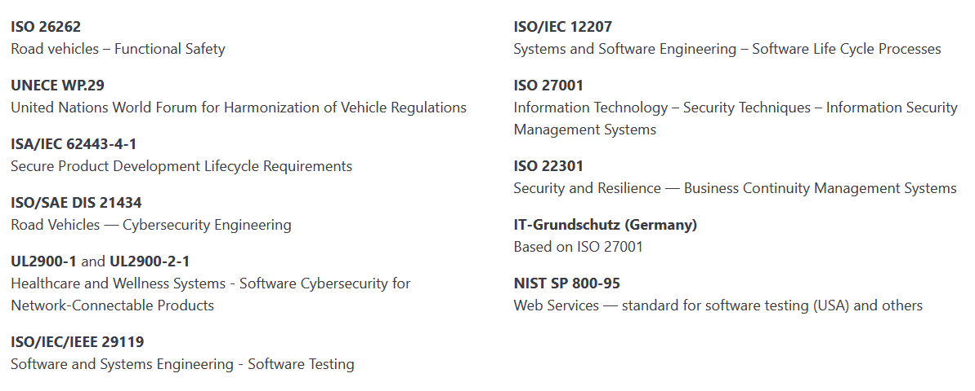
International standards that require or recommend fuzzing
Image source: https://www.code-intelligence.com/what-is-fuzz-testing
Notes:
- show this quick, not relevant

Slide 9
How to fuzz?
Use a fuzzer
ffuf (MIT License)
  fuzzes a wordlist against a target (Hoikkala, J. 2021)
Radamsa (MIT License)
  Test case generator, mutates inputs (Helin, A. 2013)
Notes:
To fuzz u need to automate inputs so u need to use a fuzzing program.
Ffuf: MIT License (open). Instead of wordlist can be a command that produces different inputs
Radamsa: MIT License (open). Analyzes samples of example input and mutates it “interestingly

Slide 10
Other fuzzing tools
beStorm by Beyond Security
CI Fuzz by Code Intelligence
Fuzzing Test Suite by Synopsys (toolkit)
Mayhem by ForAllSecure
(Breeden, J. 2022)
Notes:
These are not totally free and/or open source. Marketed to businesses.

Slide 11
When to fuzz?
Preferably all the time
More mutations tested = more robust system
Notes:
MY CONCLUSIONS
Business operations quite likely put limitations → product needs to shipped at some point, and mutations can be infinite

Slide 12
Sources:
Helin, A. 2013. A Crash Course to Radamsa. https://gitlab.com/akihe/radamsa/-/blob/develop/README.md?ref_type=heads. Accessed: 2023/10/07
Hoikkala, J. 2021. ffuf documentation. https://github.com/ffuf/ffuf/wiki. Accessed: 2023/10/07
Miller, B. 1988. Project List. Computer Sciences Department University of Wisconsin-Madison. https://pages.cs.wisc.edu/~bart/fuzz/CS736-Projects-f1988.pdf. Accessed: 2023/10/06
Neystadt, J. 2009. Automated Penetration Testing with White-Box Fuzzing. Microsoft Corporation. https://learn.microsoft.com/en-us/previous-versions/software-testing/cc162782(v=msdn.10). Accessed: 2023/10/02

