Slide 1
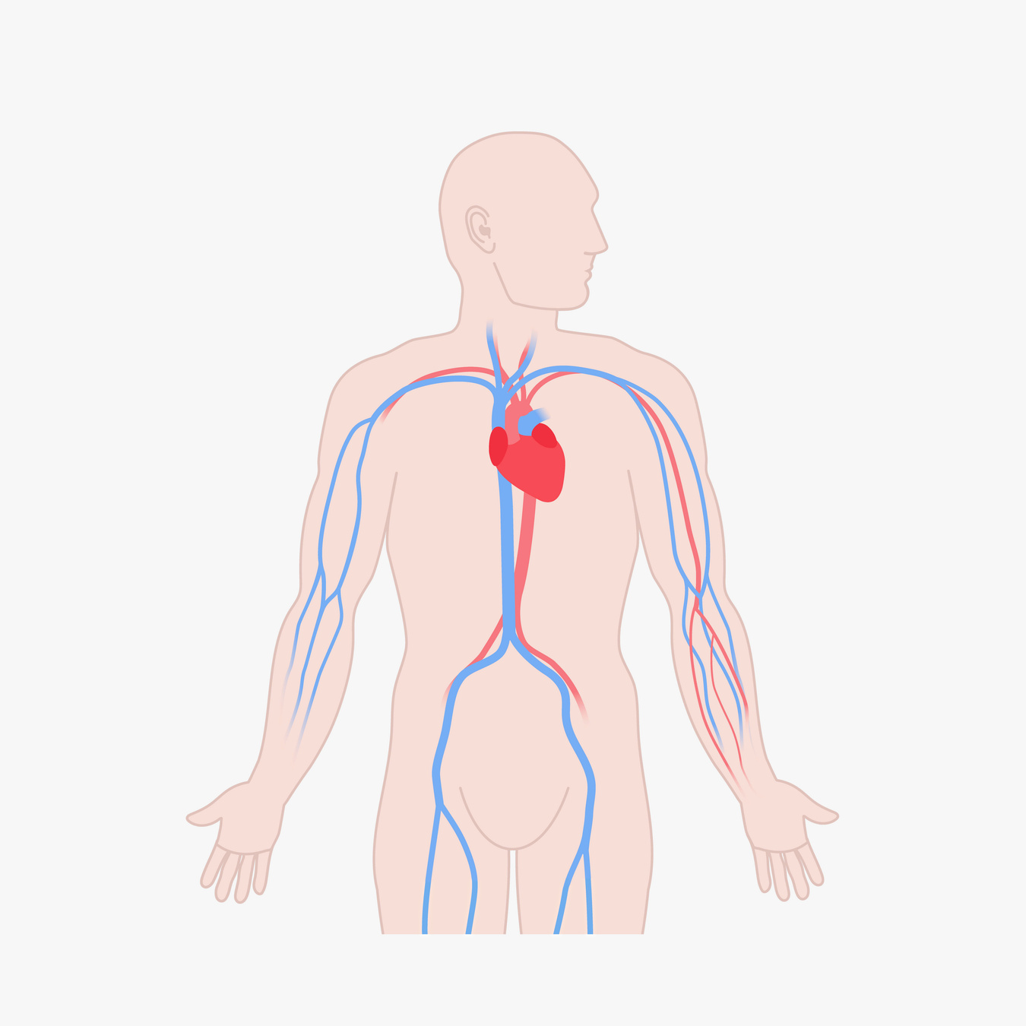
EXPLAINABLE PREDICTION OF PREMATURE HEART DISEASE AMONG YOUNG ADULTS
Presented by
Reno Reji Matthew
2547145

Slide 2
Introduction
MISSON HEALTH
Adults aged 18–39
Non-invasive lifestyle and health indicators

Slide 3
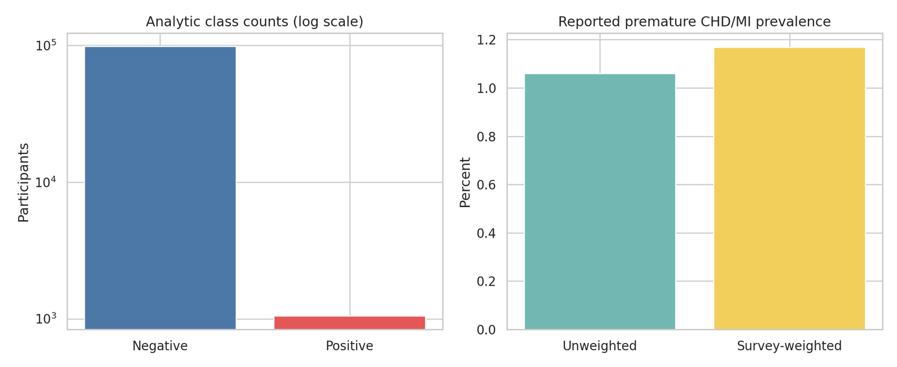
Dataset and problem
CDC BRFSS 2023
4,33,323 original respondents
99,114 valid young-adult records
1,050 positive cases
Class imbalance: 1 positive to 93 negatives

Slide 4
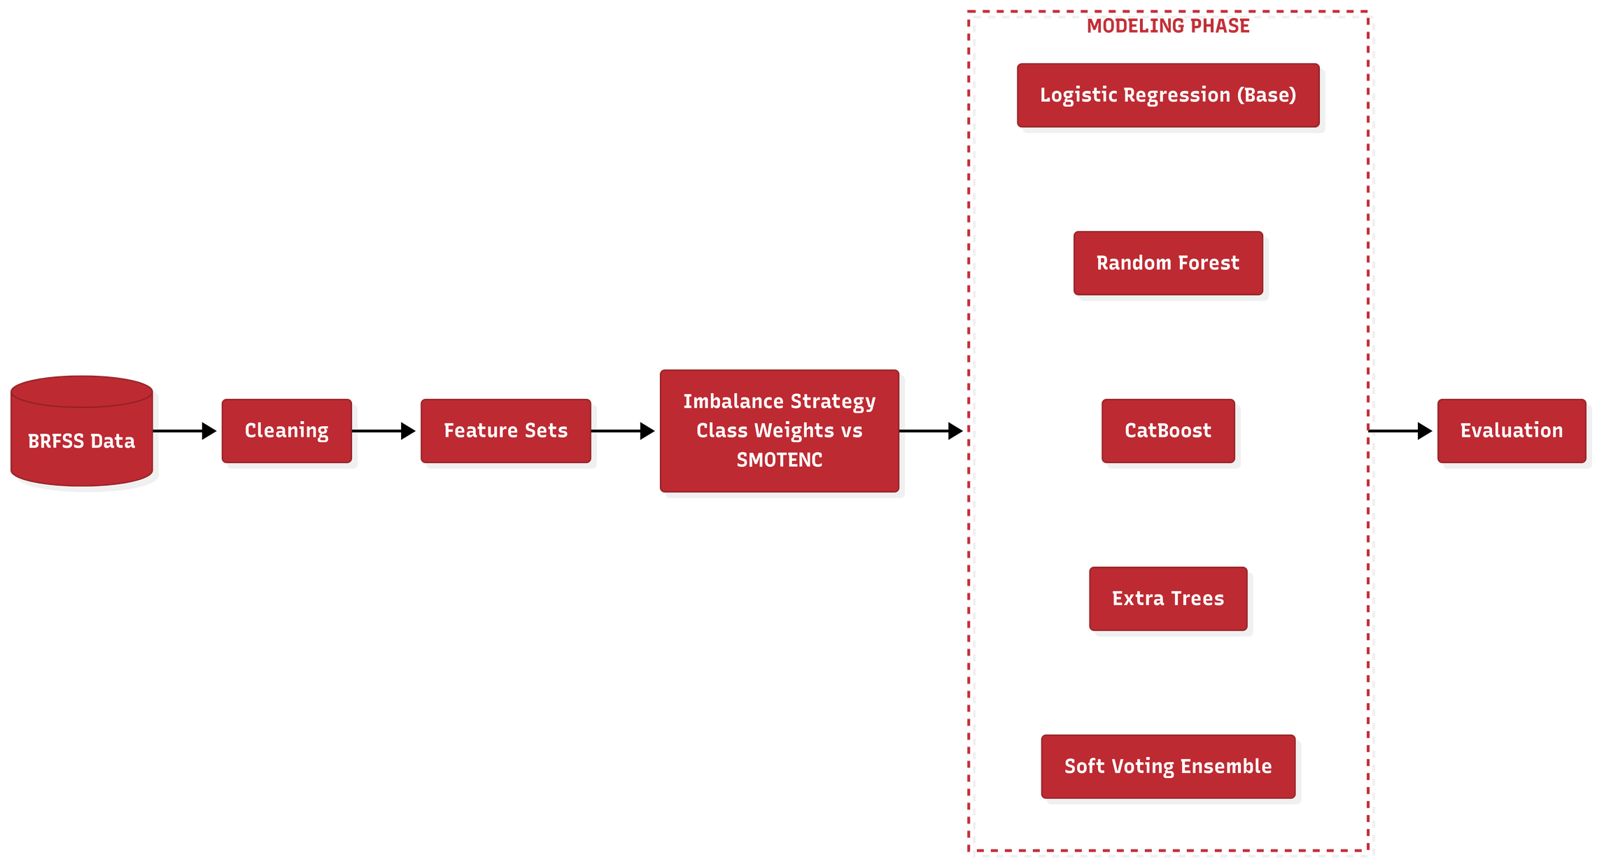
Machine-learning approach

Slide 5
Model Comparison on the Untouched Test Set
  VALIDATION-SELECTED MODEL — Logistic Regression
Model | Role | PR-AUC | Recall | Positive F1
Logistic Regression Validation-selected model | Baseline | 0.069 | 0.297 | 0.115
Random Forest | Bagging | 0.080 | 0.291 | 0.138
CatBoost | Boosting | 0.094 | 0.304 | 0.122
Soft Voting | Heterogeneous | 0.081 | 0.323 | 0.126
  TEST RANKING — CatBoost later had the highest test PR-AUC, but it did not replace the declared winner.
  Thresholds selected using validation data; the test set did not determine the winner.
Notes:
This comparison includes the required baseline, bagging, boosting and heterogeneous voting models. Logistic Regression is highlighted because it was selected using validation F2 before test evaluation. Although CatBoost later had the highest test PR-AUC, the untouched test set did not determine or replace the declared winner.
[Sources]
- /home/rrm/MCA/Machine Learning/CIA3/reports/final_model_comparison.csv
- /home/rrm/MCA/Machine Learning/CIA3/reports/model_selection_audit.csv

Slide 6
Results
Selected winner
METRIC | 0.50 | 0.787903
Precision | 0.032 | 0.071
Recall | 0.658 | 0.297
Positive F1 | 0.060 | 0.115
Specificity | 0.783 | 0.958
Class-weighted extended
Logistic Regression
Ranking performance
ROC-AUC 0.794
PR-AUC 0.069
Prevalence baseline ≈ 0.011
F2 operating point
47 positive cases identified
111 positive cases missed
Proof of concept only
Notes:
The validation-selected winner was the class-weighted extended Logistic Regression model. Its test ROC-AUC was 0.794 and PR-AUC was 0.069, compared with a prevalence baseline of approximately 0.011. At the selected F2 threshold, precision and specificity improved, but recall decreased. The model identified 47 positive cases while missing 111, so it is only a proof of concept.
[Sources]
- /home/rrm/MCA/Machine Learning/CIA3/reports/selected_model_operating_points.csv
- /home/rrm/MCA/Machine Learning/CIA3/reports/final_model_comparison.csv
- /home/rrm/MCA/Machine Learning/CIA3/reports/model_selection_audit.csv

Slide 7
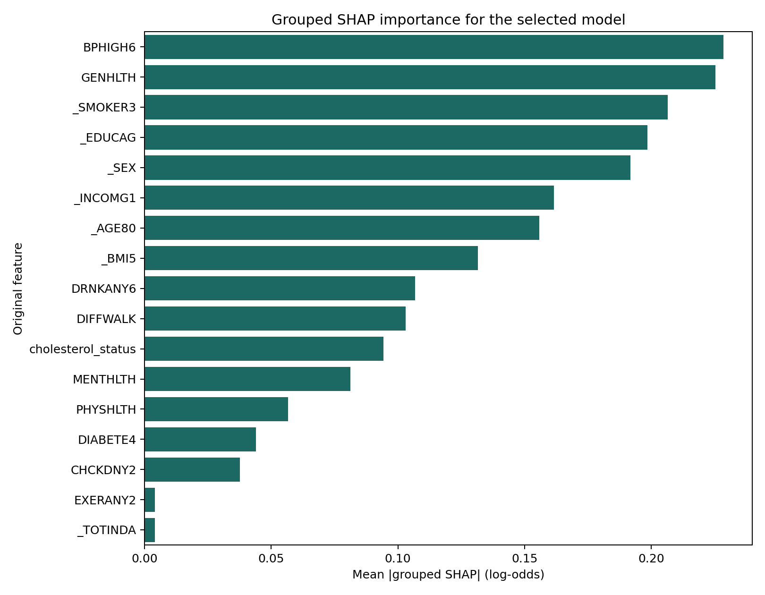
Explainability and limitations
  KEY DRIVERS — Blood-pressure history • General health • Smoking
  CONTEXT — Education and income • Sex • Age and BMI
  LIMITATIONS — Self-reported, cross-sectional data • Not validated for India • Screening aid, not diagnosis
Notes:
SHAP showed that blood-pressure history, general health, smoking, education, sex, income, age and BMI were important. However, BRFSS is self-reported and cross-sectional, and healthcare-access differences may affect who receives a diagnosis. The model is not clinically validated and cannot predict the exact occurrence of a future heart attack.
[Sources]
- /home/rrm/MCA/Machine Learning/CIA3/figures/shap/03_grouped_shap_importance.png
- /home/rrm/MCA/Machine Learning/CIA3/reports/ethics_and_limitations.md

Slide 8
THANK
YOU

