Slide 1
Architecture Constraints
Software Architecture

Slide 2
Architecture Constraints
Constraints | Background and/or motivation
Complex Deployment | With more services, the decisions between deployment combinations, independencies, configuration and management becomes complex. Especially so if there are errors or server failures, to find the problem
Testing Complexity | With a fragmented approach where each function is handled by a separate microservice, testing becomes more complex as multiple components need to be tested independently as well as together as part of the larger application.
Divergence of Enviromental | Since development and updates of services are independent, there is a possibility of conflict from different libary versions. And dependency management difficulty increases the more components are available.
Handling Scalability: | As microservices multiply, managing the scalability of the application becomes crucial. Coordinating and optimizing the scaling of different services is essential for maintaining application performance and cost-effectiveness.
Differing Goals of Teams | Developers, system administrators, and operations teams have different goals and priorities. , for example the focus of devs is on the user while the focus of admins is on the system. Achieving collaboration is crucial.

Slide 3
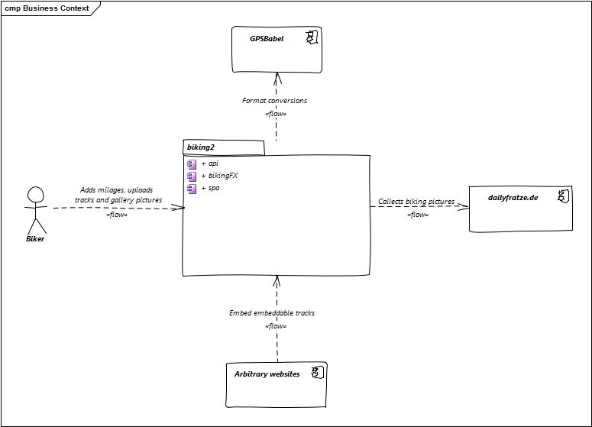
Business Context
The domain interfaces and technical interfaces to communication partners are among your system’s most critical aspects. Make sure that you completely understand them.
Make a business context diagram so all stakeholders understand which data are exchanged with the environment of the system.
Help: https://docs.arc42.org/section-3/ & https://biking.michael-simons.eu/docs/index.html#section-system-scope-and-context

