Slide 1
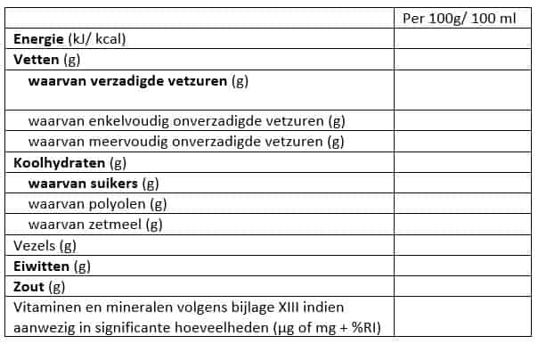
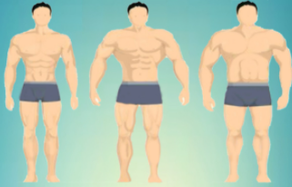
Daily intake
Men kcal: 66.5 + 13.8 x (body weight in kilograms) + 5 x (body height in cm) divided by 6.8 x age
Women kcal: 655.1 + 9.6 x (body weight in kilograms) + 1.9 x (body height in cm) divided by 4.7 x age
Protein: 1.6g x (body weight in kg)
Creatine: 0.03g x (body weight in kg)
_____________________________________________________________________
Fitness scheme
Different exercises
Current weights for exercise
One-rep max
Future goals
Creatine check mark
_____________________________________________________________________

