Slide 1
Data Mining
Classification: Basic Concepts and Techniques
Lecture Notes for Chapter 3
Introduction to Data Mining, 2nd Edition
by
Tan, Steinbach, Karpatne, Kumar

Slide 2
Classification: Definition
Given a collection of records (training set )
  Each record is by characterized by a tuple (x,y), where x is the attribute set and y is the class label
    x: attribute, predictor, independent variable, input
    y: class, response, dependent variable, output
Task:
  Learn a model that maps each attribute set x into one of the predefined class labels y

Slide 3
Examples of Classification Task
Task | Attribute set, x | Class label, y
Categorizing email messages | Features extracted from email message header and content | spam or non-spam
Identifying tumor cells | Features extracted from x-rays or MRI scans | malignant or benign cells
Cataloging galaxies | Features extracted from telescope images | Elliptical, spiral, or irregular-shaped galaxies

Slide 4
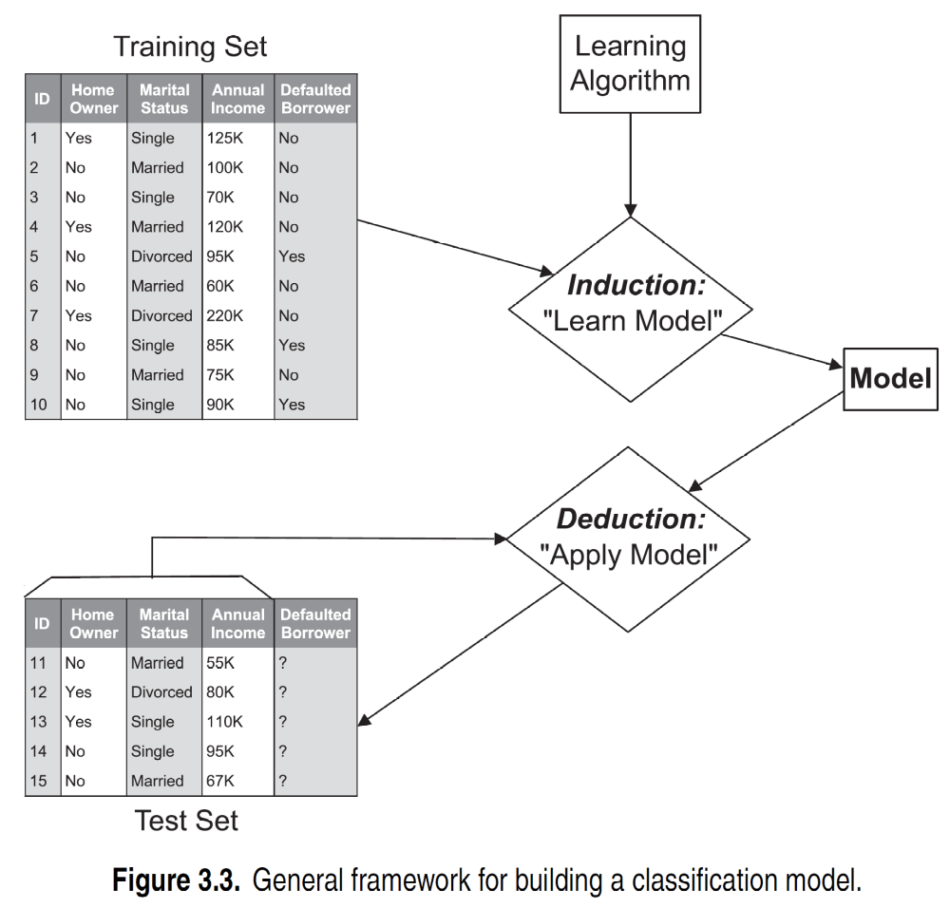
General Approach for Building Classification Model

Slide 5
Classification Techniques
Base Classifiers
  Decision Tree based Methods
  Rule-based Methods
  Nearest-neighbor
  Naïve Bayes and Bayesian Belief Networks
  Support Vector Machines
  Neural Networks, Deep Neural Nets
Ensemble Classifiers
  Boosting, Bagging, Random Forests

Slide 6
Example of a Decision Tree
categorical
categorical
continuous
class
Splitting Attributes
Home Owner
Yes
No
NO
MarSt
Single, Divorced
Married
Income
NO
< 80K
> 80K
NO
YES
Training Data
Model: Decision Tree

Slide 7
Apply Model to Test Data
Test Data
Start from the root of tree.
Home Owner
Yes
No
NO
MarSt
Single, Divorced
Married
Income
NO
< 80K
> 80K
NO
YES

Slide 8
Apply Model to Test Data
Test Data
Home Owner
Yes
No
NO
MarSt
Single, Divorced
Married
Income
NO
< 80K
> 80K
NO
YES

Slide 9
Apply Model to Test Data
Test Data
Home Owner
Yes
No
NO
MarSt
Single, Divorced
Married
Income
NO
< 80K
> 80K
NO
YES

Slide 10
Apply Model to Test Data
Test Data
Home Owner
Yes
No
NO
MarSt
Single, Divorced
Married
Income
NO
< 80K
> 80K
NO
YES

Slide 11
Apply Model to Test Data
Test Data
Home Owner
Yes
No
NO
MarSt
Single, Divorced
Married
Income
NO
< 80K
> 80K
NO
YES

Slide 12
Apply Model to Test Data
Test Data
Home Owner
Yes
No
NO
MarSt
Single, Divorced
Married
Assign Defaulted to “No”
Income
NO
< 80K
> 80K
NO
YES

Slide 13
Another Example of Decision Tree
categorical
categorical
continuous
class
Single, Divorced
MarSt
Married
NO
Home Owner
Yes
No
NO
Income
< 80K
> 80K
NO
YES
There could be more than one tree that fits the same data!

Slide 14
Decision Tree Classification Task
Decision Tree

Slide 15
Decision Tree Induction
Many Algorithms:
  Hunt’s Algorithm (one of the earliest)
  CART
  ID3, C4.5
  SLIQ,SPRINT

Slide 16
General Structure of Hunt’s Algorithm
Let D_{t} be the set of training records that reach a node t
General Procedure:
  If D_{t} contains records that belong the same class y_{t}, then t is a leaf node labeled as y_{t}
  If D_{t} contains records that belong to more than one class, use an attribute test to split the data into smaller subsets. Recursively apply the procedure to each subset.
D_{t}
?

Slide 17
Hunt’s Algorithm
(7,3)
(3,0)
(4,3)
(3,0)
(3,0)
(3,0)
(1,3)
(3,0)
(1,0)
(0,3)

Slide 18
Hunt’s Algorithm
(7,3)
(3,0)
(4,3)
(3,0)
(3,0)
(3,0)
(1,3)
(3,0)
(1,0)
(0,3)

Slide 19
Hunt’s Algorithm
(7,3)
(3,0)
(4,3)
(3,0)
(3,0)
(3,0)
(1,3)
(3,0)
(1,0)
(0,3)

Slide 20
Hunt’s Algorithm
(7,3)
(3,0)
(4,3)
(3,0)
(3,0)
(3,0)
(1,3)
(3,0)
(1,0)
(0,3)

Slide 21
Design Issues of Decision Tree Induction
How should training records be split?
  Method for expressing test condition
    depending on attribute types
  Measure for evaluating the goodness of a test condition
How should the splitting procedure stop?
  Stop splitting if all the records belong to the same class or have identical attribute values
  Early termination

Slide 22
Methods for Expressing Test Conditions
Depends on attribute types
  Binary
  Nominal
  Ordinal
  Continuous

Slide 23
Test Condition for Nominal Attributes
Multi-way split:
  Use as many partitions as distinct values.
Binary split:
  Divides values into two subsets

Slide 24
Test Condition for Ordinal Attributes
Multi-way split:
  Use as many partitions as distinct values
Binary split:
  Divides values into two subsets
  Preserve order property among attribute values
This grouping violates order property

Slide 25
Test Condition for Continuous Attributes

Slide 26
Splitting Based on Continuous Attributes
Different ways of handling
  Discretization to form an ordinal categorical attribute
    Ranges can be found by equal interval bucketing, equal frequency bucketing (percentiles), or clustering.
    Static – discretize once at the beginning
    Dynamic – repeat at each node
  Binary Decision: (A < v) or (A ≥ v)
    consider all possible splits and finds the best cut
    can be more compute intensive

Slide 27
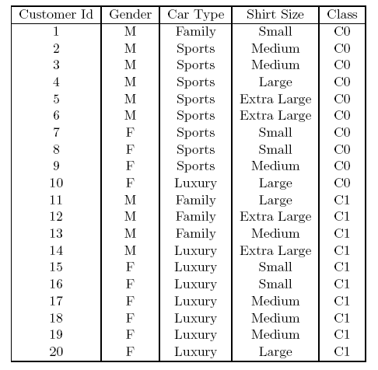
How to determine the Best Split
Before Splitting: 10 records of class 0,
10 records of class 1
Which test condition is the best?

Slide 28
How to determine the Best Split
Greedy approach:
  Nodes with purer class distribution are preferred
Need a measure of node impurity:
High degree of impurity
Low degree of impurity

Slide 29
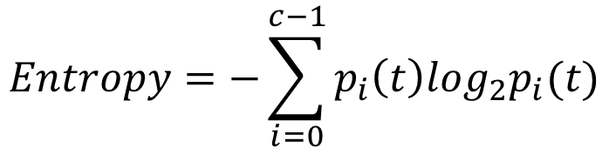
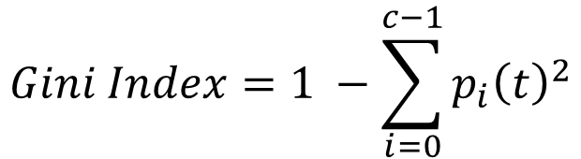
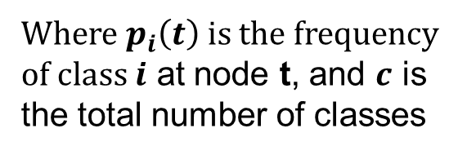
Measures of Node Impurity
Gini Index
Entropy
Misclassification error
$$Gini Index=1 −\sum_{i=0}^{c−1}{p_{i}{\left(t\right)}^{2}}$$
Where $p_{i}\left(t\right)$ is the frequency of class $i$ at node t, and $c$ is the total number of classes
$$Entropy=−\sum_{i=0}^{c−1}{p_{i}\left(t\right)log_{2}p_{i}(t)}$$
$$Classification error={1 −max⁡[p}_{i}(t)]$$

Slide 30
Finding the Best Split
Compute impurity measure (P) before splitting
Compute impurity measure (M) after splitting
    Compute impurity measure of each child node
    M is the weighted impurity of child nodes
Choose the attribute test condition that produces the highest gain
    Gain = P - M
    or equivalently, lowest impurity measure after splitting (M)

Slide 31
Finding the Best Split
Before Splitting:
P
A?
B?
Yes
No
Yes
No
Node N1
Node N2
Node N3
Node N4
M11
M12
M21
M22
M1
M2
Gain = P – M1 vs P – M2

Slide 32
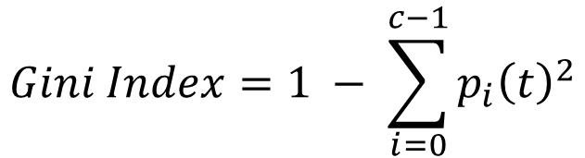
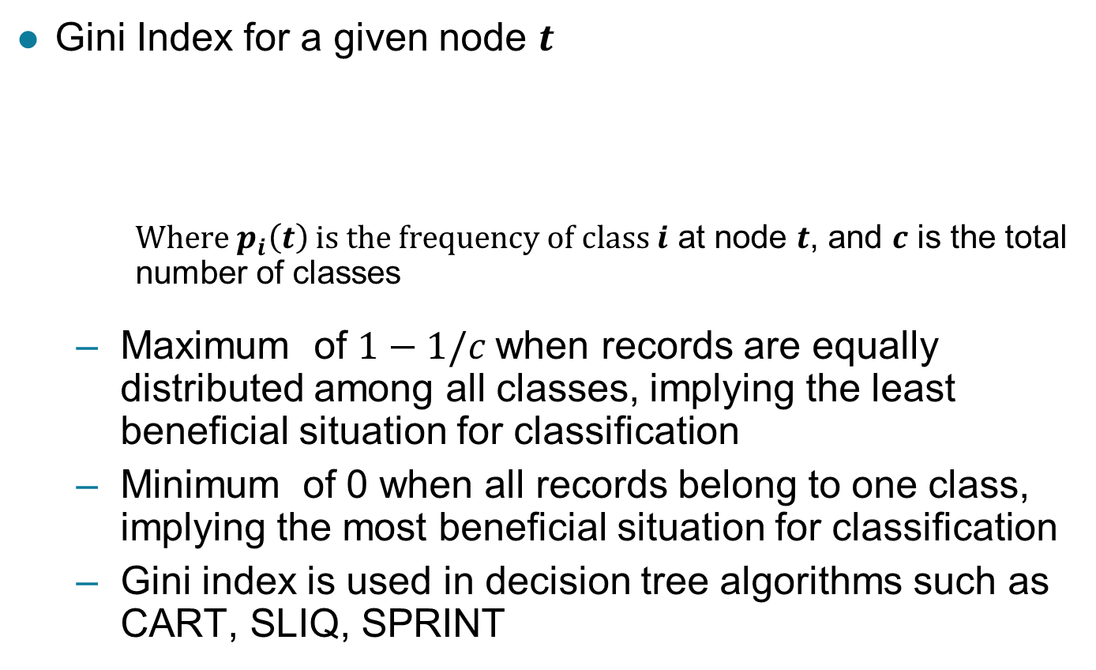
Measure of Impurity: GINI
Gini Index for a given node $t$
    Where $p_{i}\left(t\right)$ is the frequency of class $i$ at node $t$, and $c$ is the total number of classes
  Maximum of $1−1/c$when records are equally distributed among all classes, implying the least beneficial situation for classification
  Minimum of 0 when all records belong to one class, implying the most beneficial situation for classification
  Gini index is used in decision tree algorithms such as CART, SLIQ, SPRINT
$$Gini Index=1 − \sum_{i=0}^{c−1}{p_{i}{\left(t\right)}^{2}}$$

Slide 33
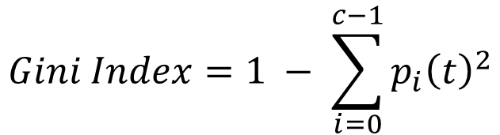
Measure of Impurity: GINI
Gini Index for a given node t :
  For 2-class problem (p, 1 – p):
    GINI = 1 – p² – (1 – p)² = 2p (1-p)
$$Gini Index=1 − \sum_{i=0}^{c−1}{p_{i}{\left(t\right)}^{2}}$$

Slide 34
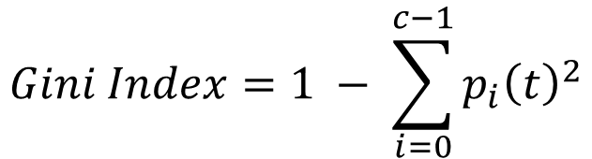
Computing Gini Index of a Single Node
$$Gini Index=1 − \sum_{i=0}^{c−1}{p_{i}{\left(t\right)}^{2}}$$
P(C1) = 0/6 = 0 P(C2) = 6/6 = 1
Gini = 1 – P(C1)² – P(C2)² = 1 – 0 – 1 = 0
P(C1) = 1/6 P(C2) = 5/6
Gini = 1 – (1/6)² – (5/6)² = 0.278
P(C1) = 2/6 P(C2) = 4/6
Gini = 1 – (2/6)² – (4/6)² = 0.444

Slide 35
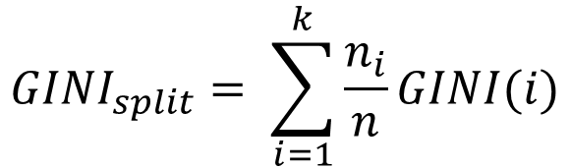
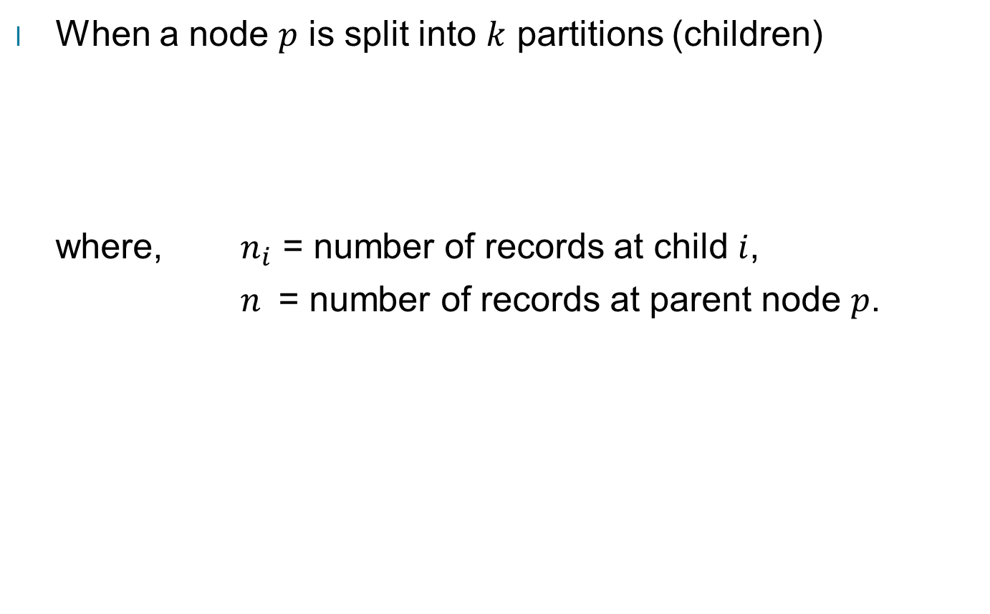
Computing Gini Index for a Collection of Nodes
When a node $p$ is split into $k$ partitions (children)
where, $n_{i}$ = number of records at child $i$,
$n$ = number of records at parent node $p$.
$$GINI_{split}= \sum_{i=1}^{k}{\frac{n_{i}}{n}GINI(i)}$$

Slide 36
Binary Attributes: Computing GINI Index
Splits into two partitions (child nodes)
Effect of Weighing partitions:
  Larger and purer partitions are sought
B?
Yes
No
Node N1
Node N2
Gini(N1)
= 1 – (5/6)² – (1/6)²
= 0.278
Gini(N2)
= 1 – (2/6)² – (4/6)²
= 0.444
Weighted Gini of N1 N2
= 6/12 * 0.278 +
6/12 * 0.444
= 0.361
Gain = 0.486 – 0.361 = 0.125

Slide 37
Categorical Attributes: Computing Gini Index
For each distinct value, gather counts for each class in the dataset
Use the count matrix to make decisions
Multi-way split
Two-way split
(find best partition of values)
Which of these is the best?

Slide 38
Continuous Attributes: Computing Gini Index
Use Binary Decisions based on one value
Several Choices for the splitting value
  Number of possible splitting values
  = Number of distinct values
Each splitting value has a count matrix associated with it
  Class counts in each of the partitions, A ≤ v and A > v
Simple method to choose best v
  For each v, scan the database to gather count matrix and compute its Gini index
  Computationally Inefficient! Repetition of work.
Annual Income ?
 | ≤ 80 | > 80
Defaulted Yes | 0 | 3
Defaulted No | 3 | 4

Slide 39
Continuous Attributes: Computing Gini Index...
For efficient computation: for each attribute,
  Sort the attribute on values
  Linearly scan these values, each time updating the count matrix and computing gini index
  Choose the split position that has the least gini index
Sorted Values

Slide 40
Continuous Attributes: Computing Gini Index...
For efficient computation: for each attribute,
  Sort the attribute on values
  Linearly scan these values, each time updating the count matrix and computing gini index
  Choose the split position that has the least gini index
Sorted Values
Split Positions

Slide 41
Continuous Attributes: Computing Gini Index...
For efficient computation: for each attribute,
  Sort the attribute on values
  Linearly scan these values, each time updating the count matrix and computing gini index
  Choose the split position that has the least gini index
Sorted Values
Split Positions

Slide 42
Continuous Attributes: Computing Gini Index...
For efficient computation: for each attribute,
  Sort the attribute on values
  Linearly scan these values, each time updating the count matrix and computing gini index
  Choose the split position that has the least gini index
Sorted Values
Split Positions

Slide 43
Continuous Attributes: Computing Gini Index...
For efficient computation: for each attribute,
  Sort the attribute on values
  Linearly scan these values, each time updating the count matrix and computing gini index
  Choose the split position that has the least gini index
Sorted Values
Split Positions

Slide 44
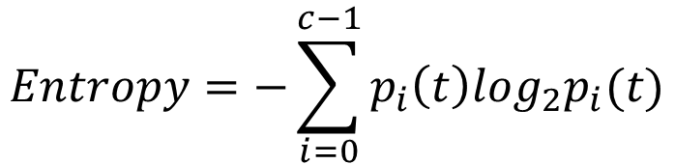
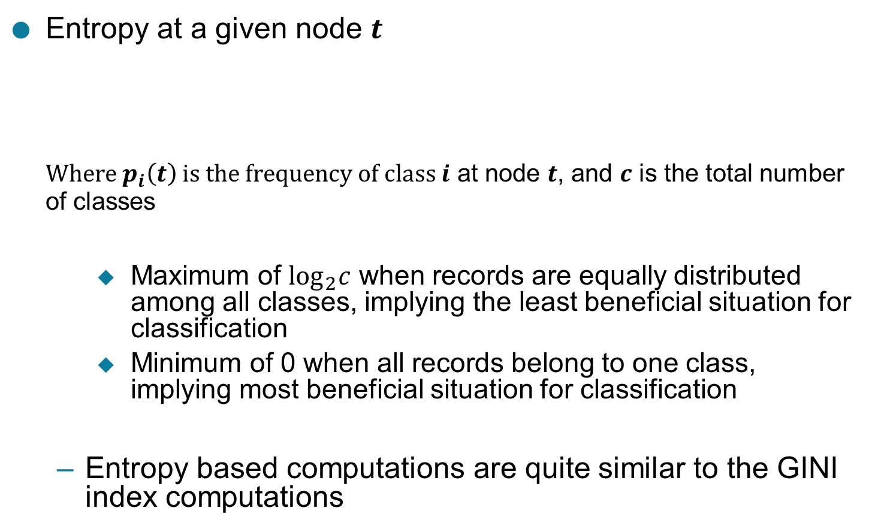
Measure of Impurity: Entropy
Entropy at a given node $t$
Where $p_{i}\left(t\right)$ is the frequency of class $i$ at node $t$, and $c$ is the total number of classes
    Maximum of $\log_{2}c$ when records are equally distributed among all classes, implying the least beneficial situation for classification
    Minimum of 0 when all records belong to one class, implying most beneficial situation for classification
  Entropy based computations are quite similar to the GINI index computations
$$Entropy=−\sum_{i=0}^{c−1}{p_{i}\left(t\right)log_{2}p_{i}(t)}$$

Slide 45
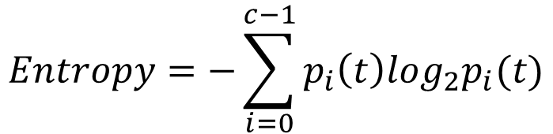
Computing Entropy of a Single Node
$$Entropy=−\sum_{i=0}^{c−1}{p_{i}\left(t\right)log_{2}p_{i}(t)}$$
P(C1) = 0/6 = 0 P(C2) = 6/6 = 1
Entropy = – 0 log 0 – 1 log 1 = – 0 – 0 = 0
P(C1) = 1/6 P(C2) = 5/6
Entropy = – (1/6) log₂ (1/6) – (5/6) log₂ (1/6) = 0.65
P(C1) = 2/6 P(C2) = 4/6
Entropy = – (2/6) log₂ (2/6) – (4/6) log₂ (4/6) = 0.92

Slide 46
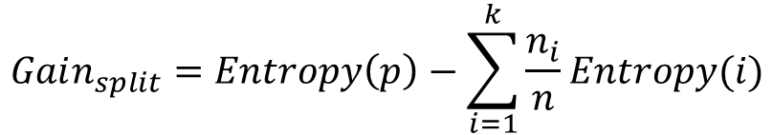
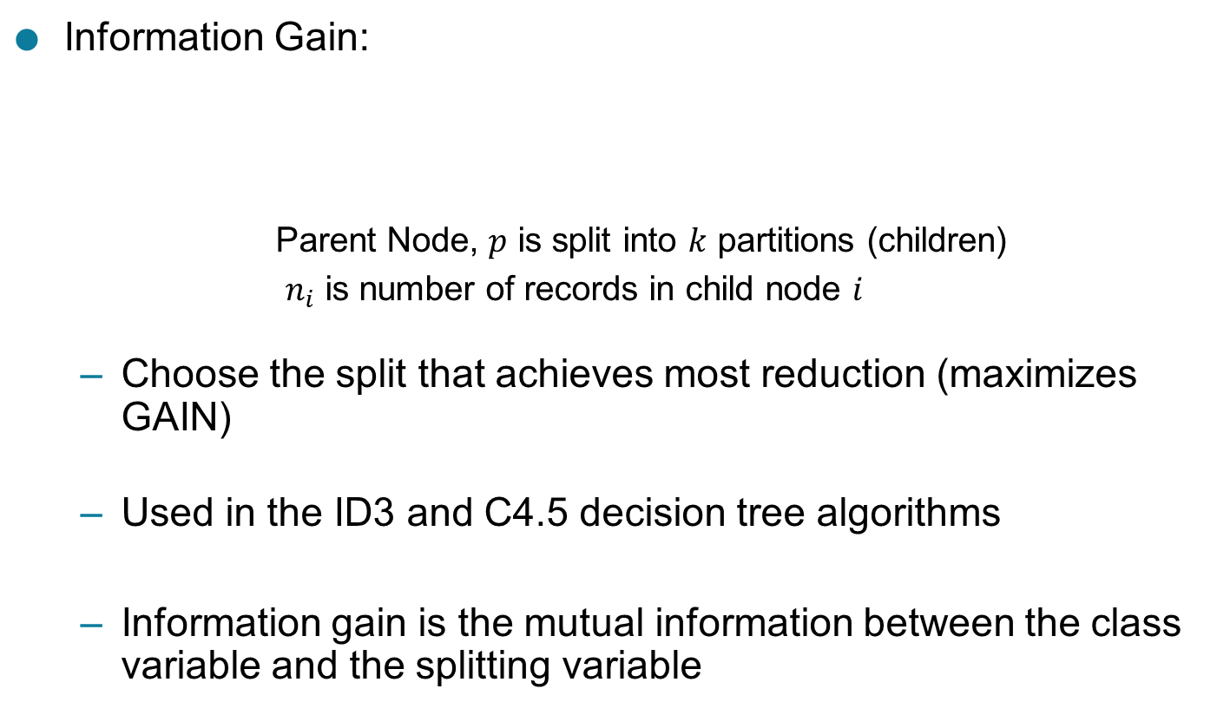
Computing Information Gain After Splitting
Information Gain:
    Parent Node, $p$ is split into $k$ partitions (children)
    $n_{i}$ is number of records in child node $i$
  Choose the split that achieves most reduction (maximizes GAIN)
  Used in the ID3 and C4.5 decision tree algorithms
  Information gain is the mutual information between the class variable and the splitting variable
$$Gain_{split}=Entropy\left(p\right)−\sum_{i=1}^{k}{\frac{n_{i}}{n}Entropy(i)}$$

Slide 47
Problem with large number of partitions
Node impurity measures tend to prefer splits that result in large number of partitions, each being small but pure
  Customer ID has highest information gain because entropy for all the children is zero

Slide 48
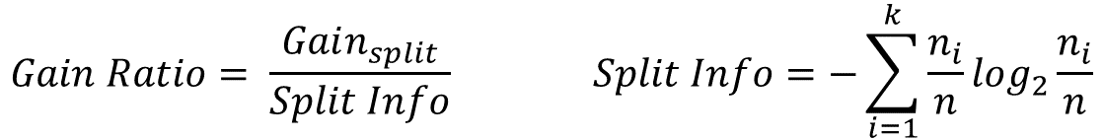
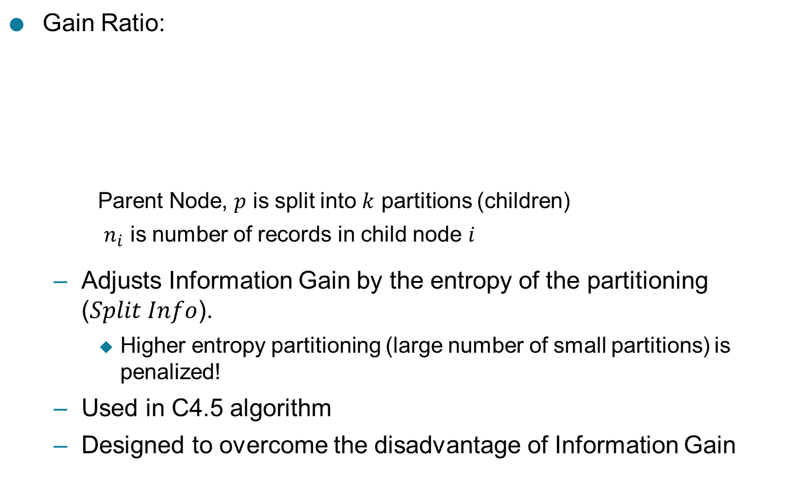
Gain Ratio
Gain Ratio:
    Parent Node, $p$ is split into $k$ partitions (children)
    $n_{i}$ is number of records in child node $i$
  Adjusts Information Gain by the entropy of the partitioning ($Split Info$).
    Higher entropy partitioning (large number of small partitions) is penalized!
  Used in C4.5 algorithm
  Designed to overcome the disadvantage of Information Gain
$$Gain Ratio= \frac{Gain_{split}}{Split Info} Split Info=−\sum_{i=1}^{k}{\frac{n_{i}}{n}log_{2}}\frac{n_{i}}{n}$$

Slide 49
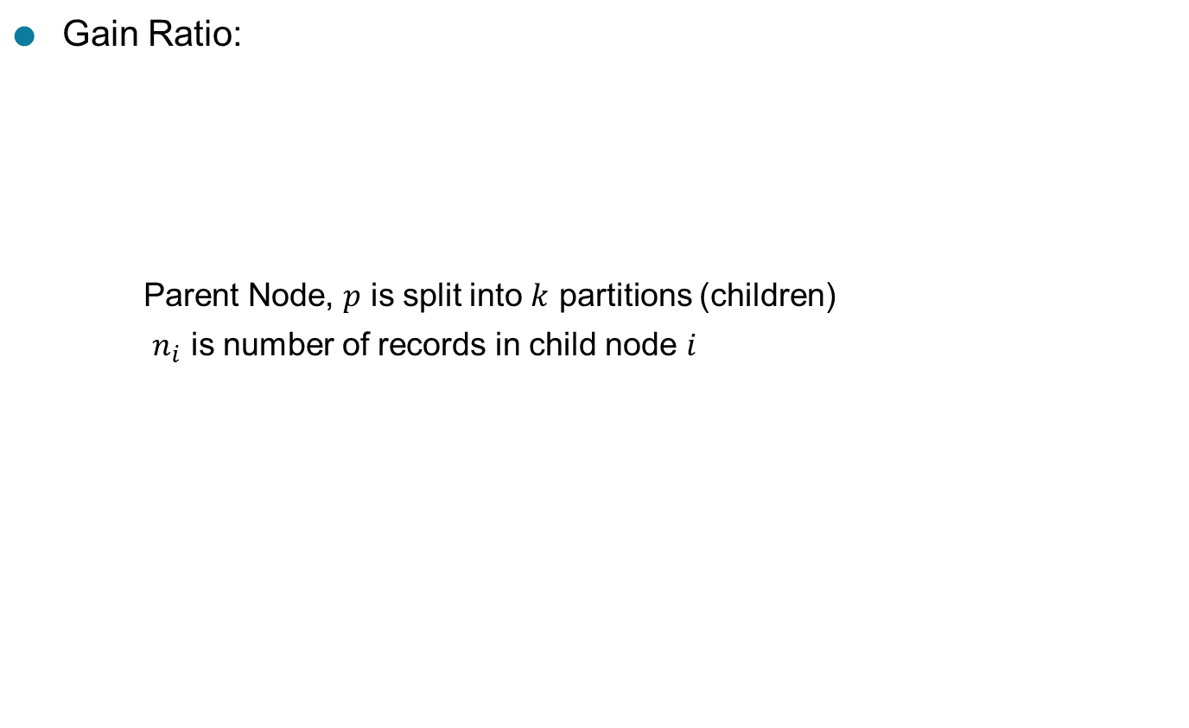
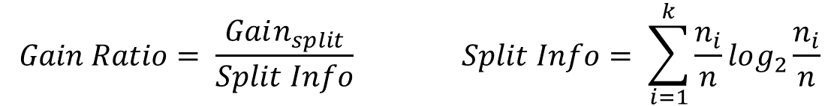
Gain Ratio
Gain Ratio:
    Parent Node, $p$ is split into $k$ partitions (children)
    $n_{i}$ is number of records in child node $i$
$$Gain Ratio= \frac{Gain_{split}}{Split Info} Split Info= \sum_{i=1}^{k}{\frac{n_{i}}{n}log_{2}}\frac{n_{i}}{n}$$
SplitINFO = 1.52
SplitINFO = 0.72
SplitINFO = 0.97

Slide 50

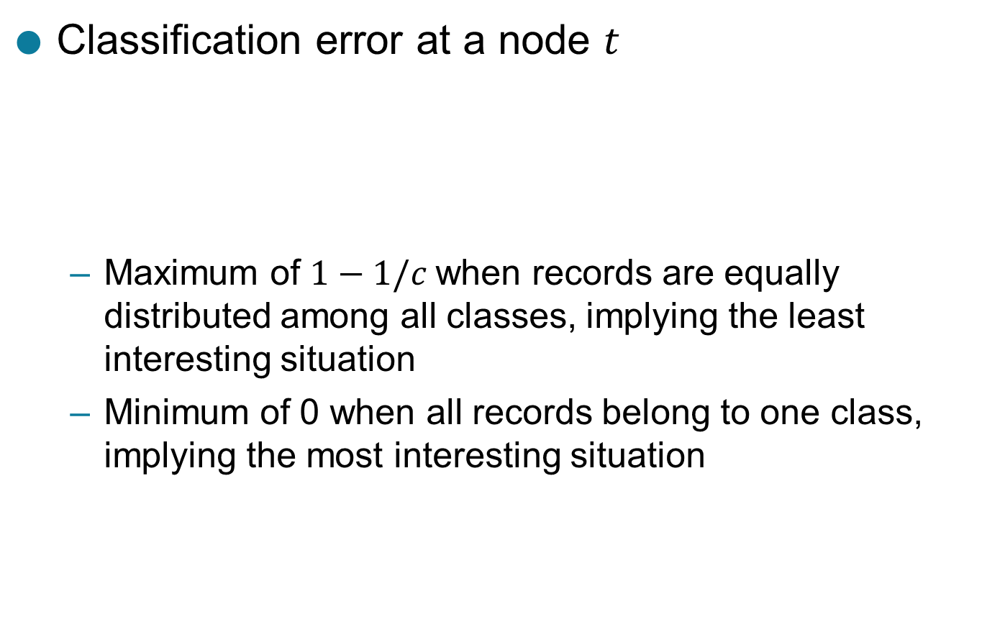
Measure of Impurity: Classification Error
Classification error at a node $t$
  Maximum of $1−1/c$when records are equally distributed among all classes, implying the least interesting situation
  Minimum of 0 when all records belong to one class, implying the most interesting situation
$$Error\left(t\right)=\underset{ i}{1 −max}⁡[p_{i}\left(t\right)]$$

Slide 51

Computing Error of a Single Node
$$Error\left(t\right)=\underset{ i}{1 −max}⁡[p_{i}\left(t\right)]$$
P(C1) = 0/6 = 0 P(C2) = 6/6 = 1
Error = 1 – max (0, 1) = 1 – 1 = 0
P(C1) = 1/6 P(C2) = 5/6
Error = 1 – max (1/6, 5/6) = 1 – 5/6 = 1/6
P(C1) = 2/6 P(C2) = 4/6
Error = 1 – max (2/6, 4/6) = 1 – 4/6 = 1/3

Slide 52
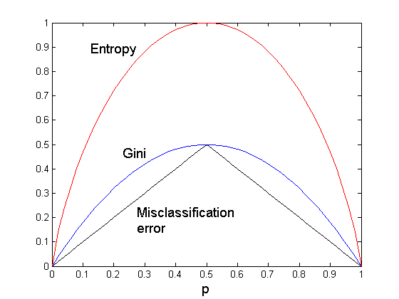
Comparison among Impurity Measures
For a 2-class problem:

Slide 53
Misclassification Error vs Gini Index
A?
Yes
No
Node N1
Node N2
Gini(N1)
= 1 – (3/3)² – (0/3)²
= 0
Gini(N2)
= 1 – (4/7)² – (3/7)²
= 0.489
Gini(Children)
= 3/10 * 0
+ 7/10 * 0.489
= 0.342
Gini improves but error remains the same!!

Slide 54
Misclassification Error vs Gini Index
A?
Yes
No
Node N1
Node N2
Misclassification error for all three cases = 0.3 !

Slide 55
Decision Tree Based Classification
Advantages:
  Relatively inexpensive to construct
  Extremely fast at classifying unknown records
  Easy to interpret for small-sized trees
  Robust to noise (especially when methods to avoid overfitting are employed)
  Can easily handle redundant attributes
  Can easily handle irrelevant attributes (unless the attributes are interacting)
Disadvantages: .
  Due to the greedy nature of splitting criterion, interacting attributes (that can distinguish between classes together but not individually) may be passed over in favor of other attributed that are less discriminating.
  Each decision boundary involves only a single attribute

Slide 56
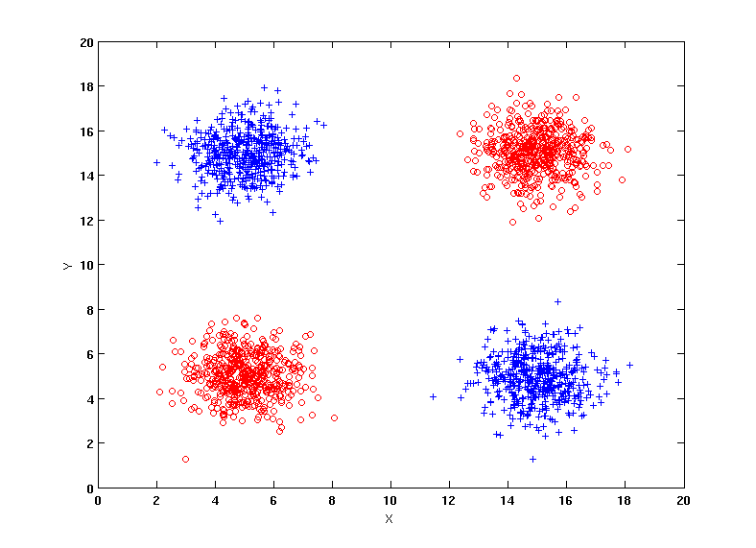
Handling interactions
+ : 1000 instances
o : 1000 instances
Entropy (X) : 0.99
Entropy (Y) : 0.99
Y
X

Slide 57
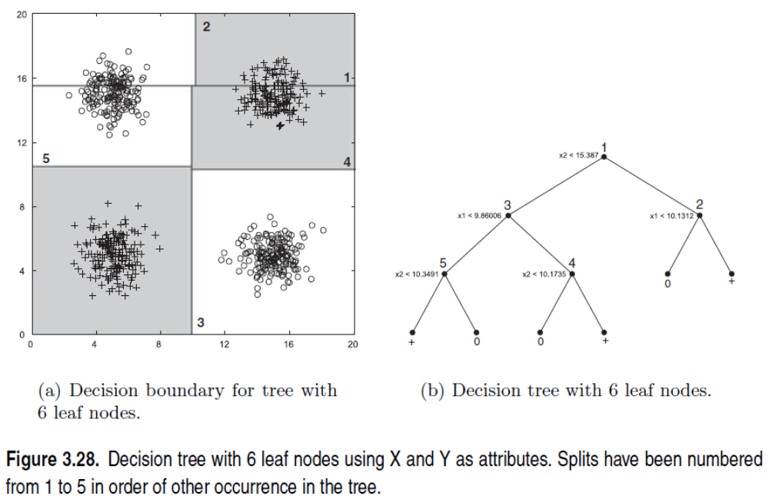
Handling interactions

Slide 58
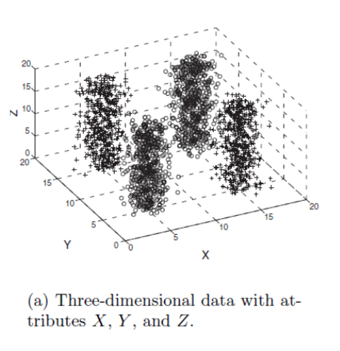
Handling interactions given irrelevant attributes
+ : 1000 instances
o : 1000 instances
Adding Z as a noisy attribute generated from a uniform distribution
Entropy (X) : 0.99
Entropy (Y) : 0.99
Entropy (Z) : 0.98
Attribute Z will be chosen for splitting!
Y
X

Slide 59
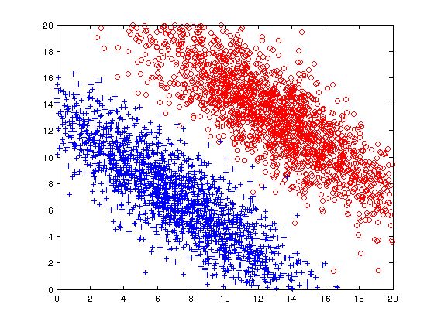
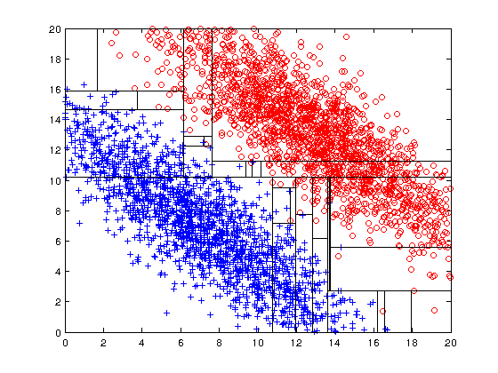
Limitations of single attribute-based decision boundaries
Both positive (+) and negative (o) classes generated from skewed Gaussians with centers at (8,8) and (12,12) respectively.

Slide 60
Advantages of Artificial Neural Networks
Artificial neural networks have the ability to provide the data to be processed in parallel, which means they can handle more than one task at the same time.
Artificial neural networks have been in resistance. This means that the loss of one or more cells, or neural networks, influences the performance of Artificial Neural networks.
Artificial neural networks are used to store information on the network so that, even in the absence of a data pair, it does not mean that the network is not generating results.
Artificial neural networks are gradually being broken down, which means that they will not suddenly stop working and these networks are gradually being broken down.
We are able to train ANN’s that these networks learn from past events and make decisions.

Slide 61
Disadvantages of Artificial Neural Networks
As we mentioned before, with ANN arms hanging along with the execution of parallel processing, and so they need processors that support parallel processing, so the ANNs are dependent on the hardware.
Since it’s similar to the functionality of the human brain, we may not be able to determine what is the proper network structure of an Artificial Neural network.
Not only do artificial neural networks, but also the statistical models can be trained with only numeric data, so it makes it very difficult for ANN to understand the problem statement.
When an artificial neural network that provides a solution to the problem statements that we really don’t know on what basis it will give the solution, and this time, ANN is not a reliable

Slide 62
Advantages of Using Naive Bayes Classifier
Simple to Implement. The conditional probabilities are easy to evaluate.
Very fast – no iterations since the probabilities can be directly computed. So this technique is useful where speed of training is important.
If the conditional Independence assumption holds, it could give great results.
Disadvantages of Using Naive Bayes Classifier
Conditional Independence Assumption does not always hold. In most situations, the feature show some form of dependency.
Zero probability problem : When we encounter words in the test data for a particular class that are not present in the training data, we might end up with zero class probabilities. See the example below for more details: P(bumper | Ham) is 0 since bumper does not occuer in any ham (non-spam) documents in the training data.

