Slide 1
Data Mining
Lecture Notes for Chapter 4
Artificial Neural Networks
Introduction to Data Mining , 2nd Edition
by
Tan, Steinbach, Karpatne, Kumar

Slide 2
Artificial Neural Networks (ANN)
Basic Idea: A complex non-linear function can be learned as a composition of simple processing units
ANN is a collection of simple processing units (nodes) that are connected by directed links (edges)
  Every node receives signals from incoming edges, performs computations, and transmits signals to outgoing edges
  Analogous to human brain where nodes are neurons and signals are electrical impulses
  Weight of an edge determines the strength of connection between the nodes
Simplest ANN: Perceptron (single neuron)

Slide 3
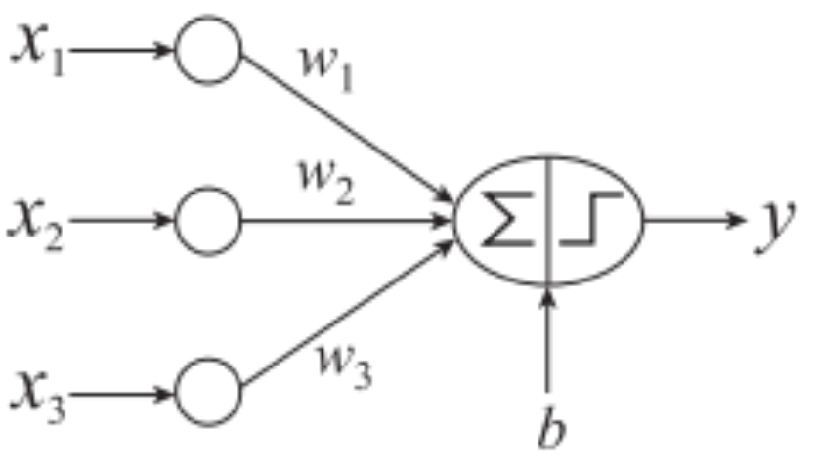
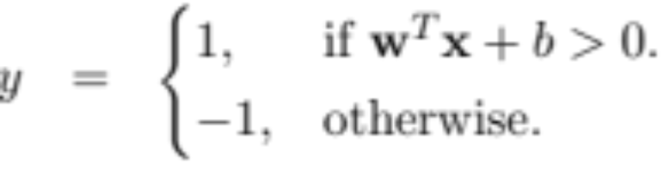


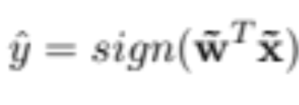
Basic Architecture of Perceptron
Activation Function
Learns linear decision boundaries
Related to logistic regression (activation function is sign instead of sigmoid)

Slide 4
Perceptron Example
Output Y is 1 if at least two of the three inputs are equal to 1.

Slide 5
Perceptron Example

Slide 6
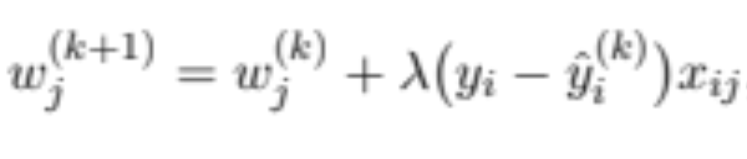
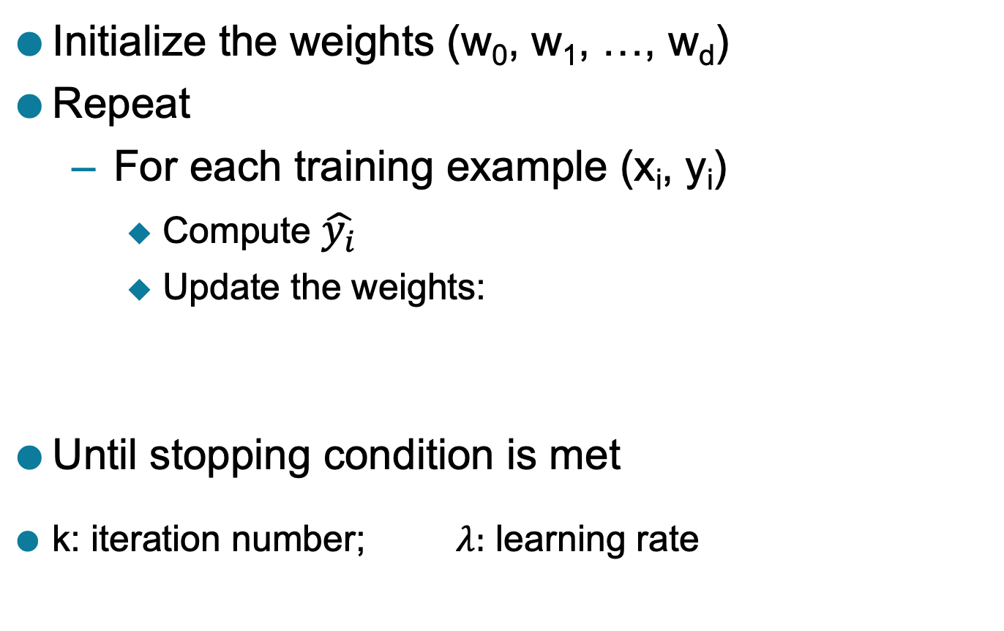
Perceptron Learning Rule
Initialize the weights (w₀, w₁, …, w_{d})
Repeat
  For each training example (x_{i}, y_{i})
    Compute $\hat{y_{i}}$
    Update the weights:
Until stopping condition is met
k: iteration number; $λ:$ learning rate

Slide 7
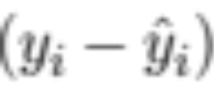
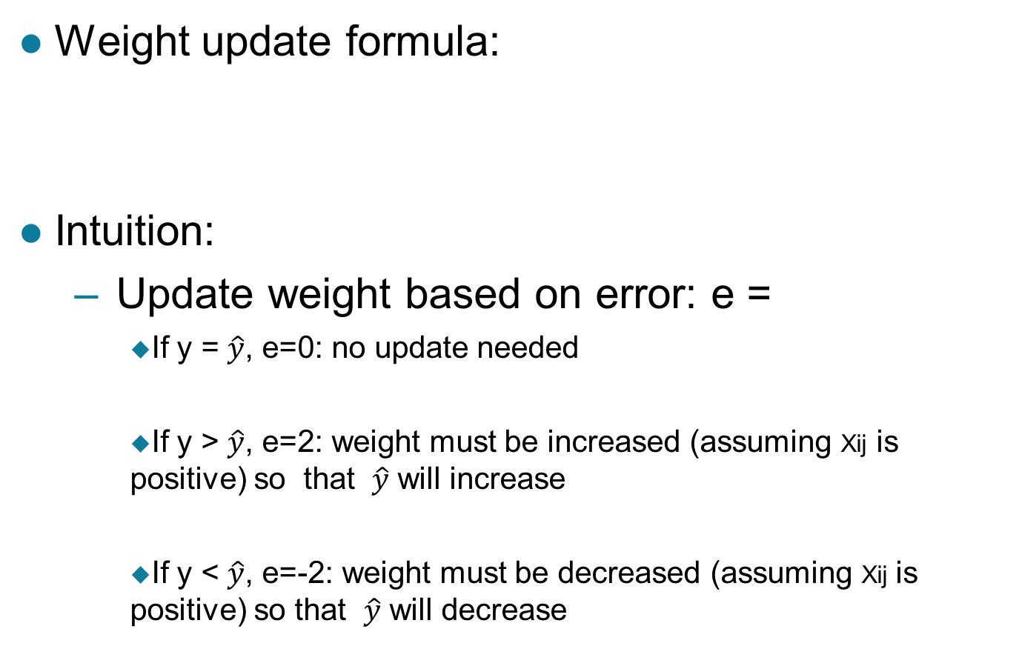
Perceptron Learning Rule
Weight update formula:
Intuition:
  Update weight based on error: e =
    If y = $\hat{y}$, e=0: no update needed
    If y > $\hat{y}$, e=2: weight must be increased (assuming Xij is positive) so that $\hat{y}$ will increase
    If y < $\hat{y}$, e=-2: weight must be decreased (assuming Xij is positive) so that $\hat{y}$ will decrease

Slide 8
Example of Perceptron Learning
Weight updates over all epochs
Weight updates over first epoch

Slide 9
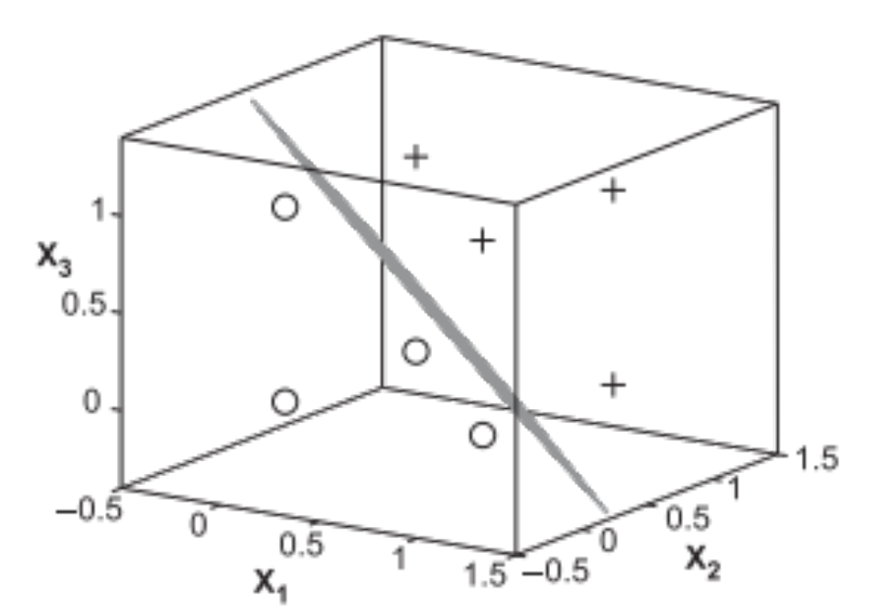
Perceptron Learning
Since y is a linear
combination of input
variables, decision
boundary is linear

Slide 10
Nonlinearly Separable Data
For nonlinearly separable problems, perceptron learning algorithm will fail because no linear hyperplane can separate the data perfectly
XOR Data

Slide 11
Multi-layer Neural Network
More than one hidden layer of computing nodes
Every node in a hidden layer operates on activations from preceding layer and transmits activations forward to nodes of next layer
Also referred to as “feedforward neural networks”
Notes:
Hidden layers represent levels of abstraction. ANN models provide a natural way of representing features at multiple levels of abstraction, where complex features are seen as compositions of simpler features. In many classification problems, modeling such a hierarchy of features turns out to be very useful. For example, in order to detect a human face in an image, we can first identify low-level features such as sharp edges with different gradients and orientations. These features can then be combined to identify facial parts such as eyes, nose, ears, and lips. Finally, an appropriate arrangement of facial parts can be used to correctly identify a human face. ANN models provide a powerful architecture to represent a hierarchical abstraction of features, from
k lower levels of abstraction (e.g., edges) to higher levels (e.g., facial parts).

Slide 12
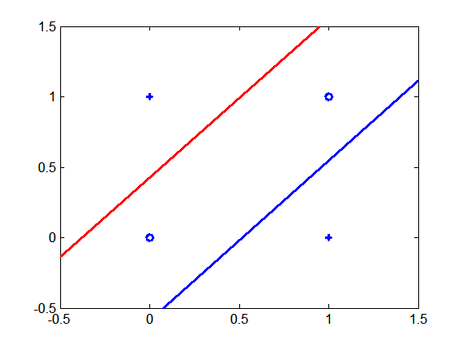
Multi-layer Neural Network
Multi-layer neural networks with at least one hidden layer can solve any type of classification task involving nonlinear decision surfaces
XOR Data

Slide 13
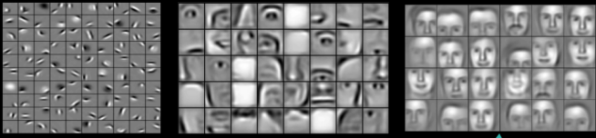
Why Multiple Hidden Layers?
Activations at hidden layers can be viewed as features extracted as functions of inputs
Every hidden layer represents a level of abstraction
  Complex features are compositions of simpler features
Number of layers is known as depth of ANN
  Deeper networks express complex hierarchy of features
Notes:
ANN models provide a natural way of representing features at multiple levels of abstraction, where complex features are seen as compositions of simpler features. In many classification problems, modeling such a hierarchy of features turns out to be very useful. For example, in order to detect a human face in an image, we can first identify low-level features such as sharp edges with different gradients and orientations. These features can then be combined to identify facial parts such as eyes, nose, ears, and lips. Finally, an appropriate arrangement of facial parts can be used to correctly identify a human face. ANN models provide a powerful architecture to represent a hierarchical abstraction of features, from
k lower levels of abstraction (e.g., edges) to higher levels (e.g., facial parts).

Slide 14
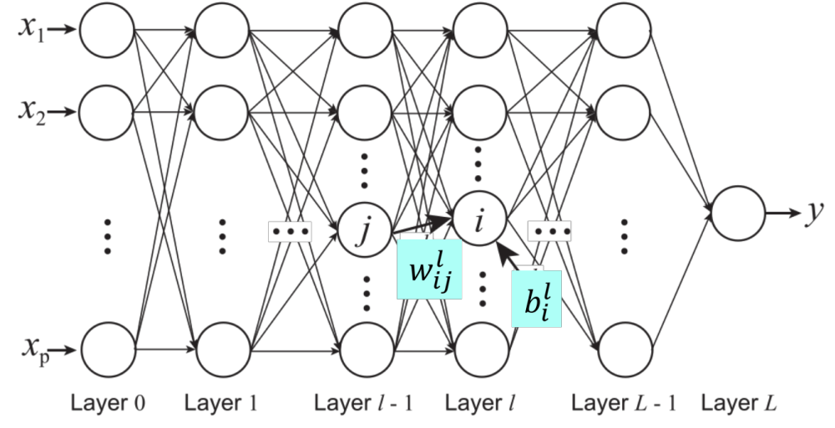
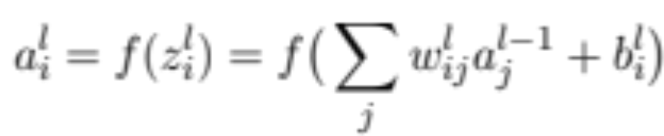
Multi-Layer Network Architecture
Activation value at node i at layer l
Activation Function
Linear Predictor

Slide 15
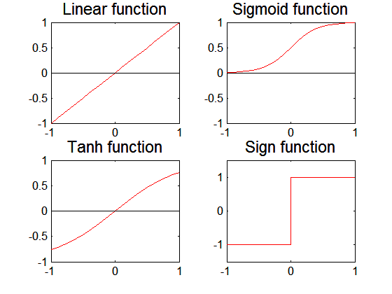
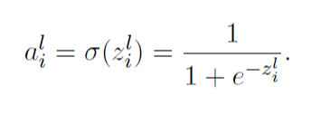
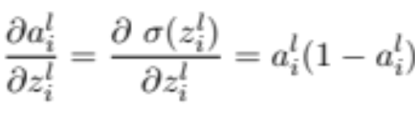
Activation Functions

Slide 16
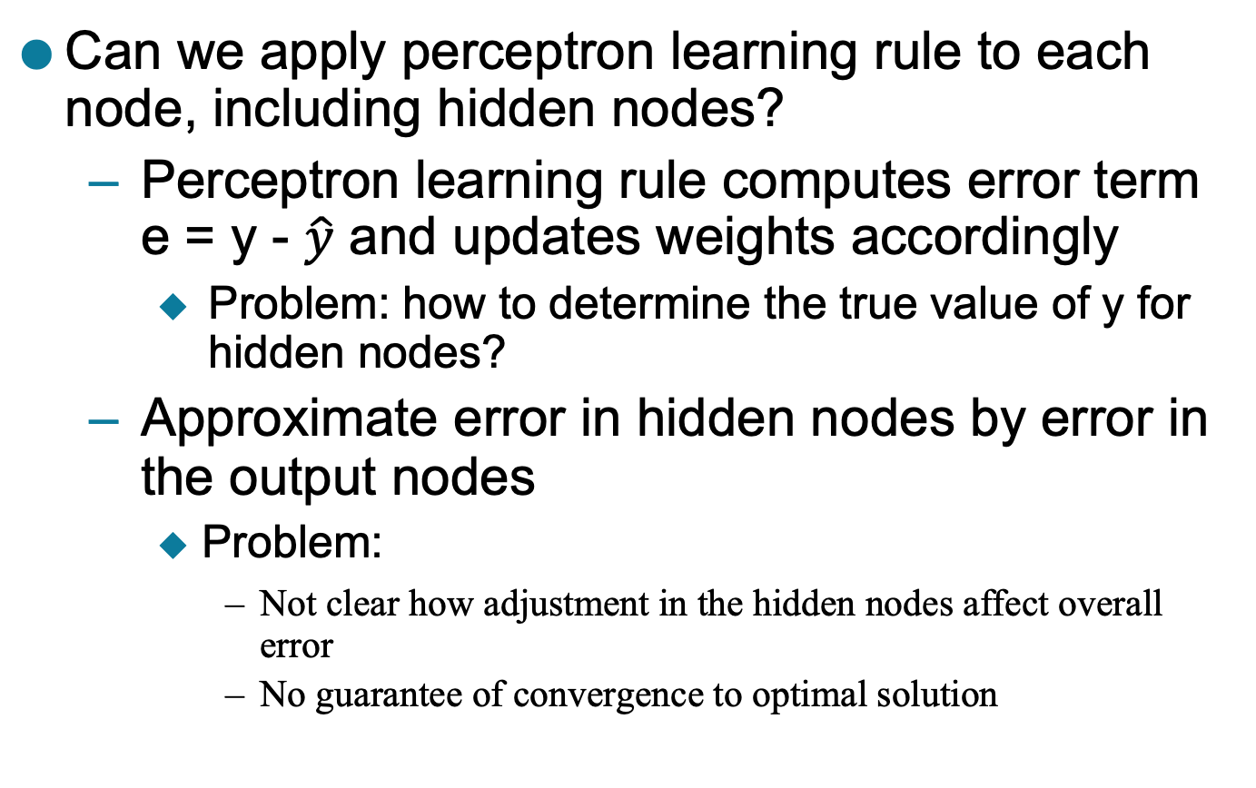
Learning Multi-layer Neural Network
Can we apply perceptron learning rule to each node, including hidden nodes?
  Perceptron learning rule computes error term e = y - $\hat{y}$ and updates weights accordingly
    Problem: how to determine the true value of y for hidden nodes?
  Approximate error in hidden nodes by error in the output nodes
    Problem:
      Not clear how adjustment in the hidden nodes affect overall error
      No guarantee of convergence to optimal solution

Slide 17
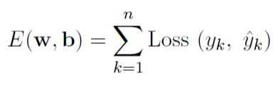

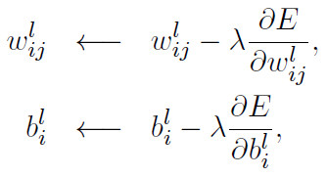

Gradient Descent
Loss Function to measure errors across all training points
Gradient descent: Update parameters in the direction of “maximum descent” in the loss function across all points
Stochastic gradient descent (SGD): update the weight for every instance (minibatch SGD: update over min-batches of instances)
  Squared Loss:
$λ$: learning rate

Slide 18
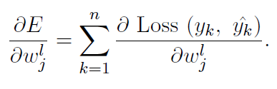

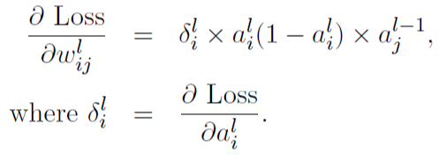


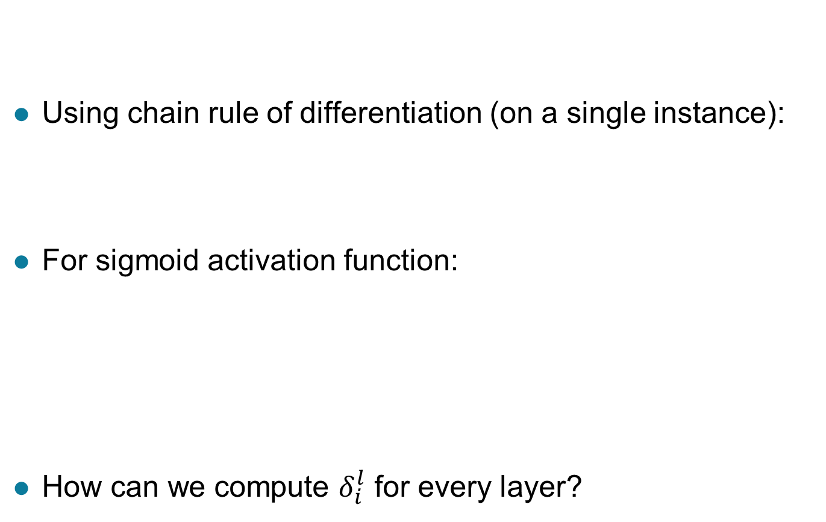

Computing Gradients
$$\hat{y}=a^{L}$$
Using chain rule of differentiation (on a single instance):
For sigmoid activation function:
How can we compute $δ_{i}^{l}$ for every layer?
$$ij$$
$$ij$$

Slide 19
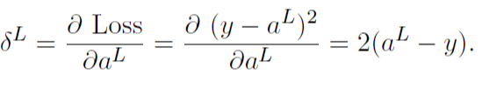
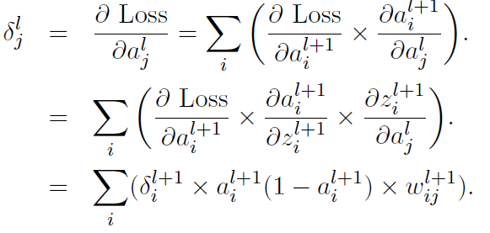
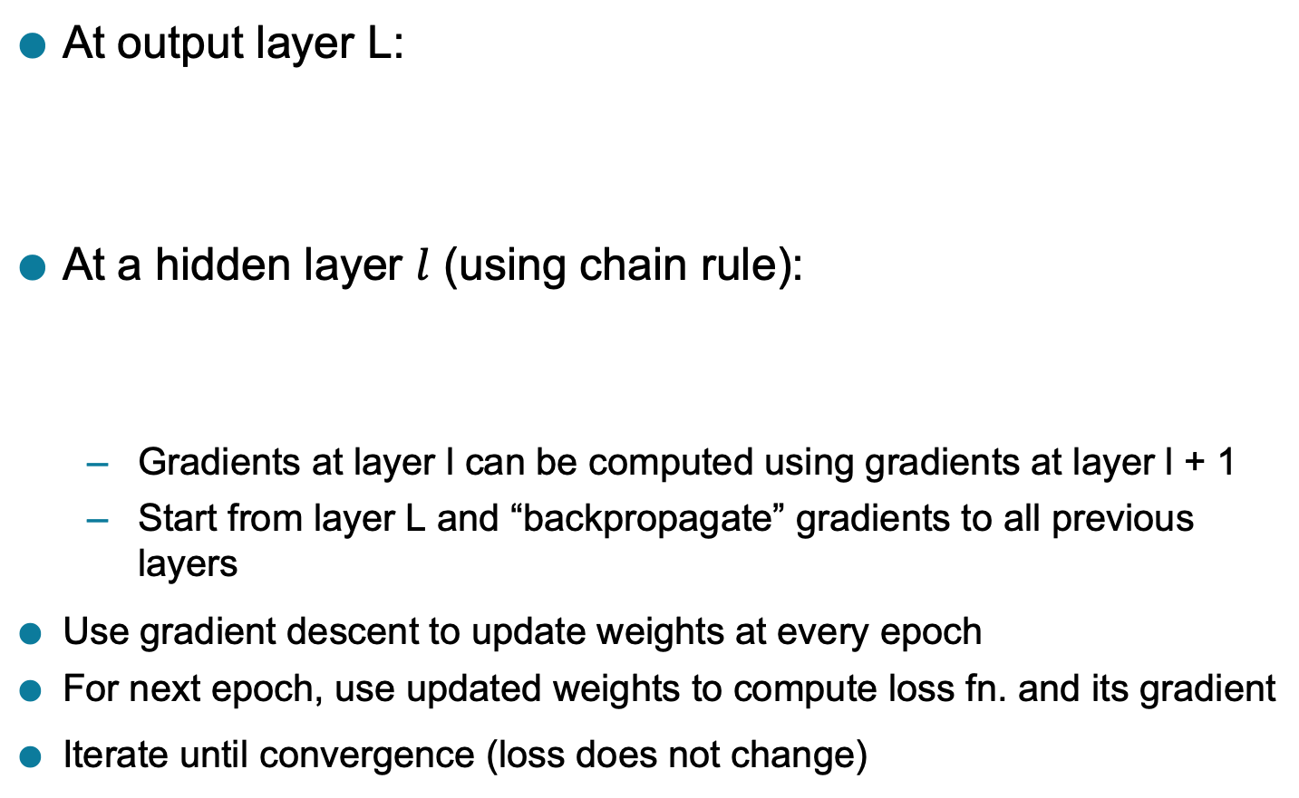
Backpropagation Algorithm
At output layer L:
At a hidden layer $l$ (using chain rule):
  Gradients at layer l can be computed using gradients at layer l + 1
  Start from layer L and “backpropagate” gradients to all previous layers
Use gradient descent to update weights at every epoch
For next epoch, use updated weights to compute loss fn. and its gradient
Iterate until convergence (loss does not change)

Slide 20
Design Issues in ANN
Number of nodes in input layer
  One input node per binary/continuous attribute
  k or log₂ k nodes for each categorical attribute with k values
Number of nodes in output layer
  One output for binary class problem
  k or log₂ k nodes for k-class problem
Number of hidden layers and nodes per layer
Initial weights and biases
Learning rate, max. number of epochs, mini-batch size for mini-batch SGD, …

Slide 21
Characteristics of ANN
Multilayer ANN are universal approximators but could suffer from overfitting if the network is too large
  Naturally represents a hierarchy of features at multiple levels of abstractions
Gradient descent may converge to local minimum
Model building is compute intensive, but testing is fast
Can handle redundant and irrelevant attributes because weights are automatically learnt for all attributes
Sensitive to noise in training data
  This issue can be addressed by incorporating model complexity in the loss function
Difficult to handle missing attributes

Slide 22
Deep Learning Trends
Training deep neural networks (more than 5-10 layers) could only be possible in recent times with:
  Faster computing resources (GPU)
  Larger labeled training sets
Algorithmic Improvements in Deep Learning
  Responsive activation functions (e.g., RELU)
  Regularization (e.g., Dropout)
  Supervised pre-training
  Unsupervised pre-training (auto-encoders)
Specialized ANN Architectures:
  Convolutional Neural Networks (for image data)
  Recurrent Neural Networks (for sequence data)
  Residual Networks (with skip connections)
Generative Models: Generative Adversarial Networks

Slide 23
Linear Discriminant Analysis (LDA)
Linear Discriminant Analysis (LDA) is a supervised learning algorithm used for classification tasks in machine learning. It is a technique used to find a linear combination of features that best separates the classes in a dataset.
LDA works by projecting the data onto a lower-dimensional space that maximizes the separation between the classes. It does this by finding a set of linear discriminants that maximize the ratio of between-class variance to within-class variance. In other words, it finds the directions in the feature space that best separate the different classes of data.
LDA assumes that the data has a Gaussian distribution and that the covariance matrices of the different classes are equal. It also assumes that the data is linearly separable, meaning that a linear decision boundary can accurately classify the different classes.

Slide 24
LDA has several advantages, including:
It is a simple and computationally efficient algorithm.
It can work well even when the number of features is much larger than the number of training samples.
It can handle multicollinearity (correlation between features) in the data.
However, LDA also has some limitations, including:
It assumes that the data has a Gaussian distribution, which may not always be the case.
It assumes that the covariance matrices of the different classes are equal, which may not be true in some datasets.
It assumes that the data is linearly separable, which may not be the case for some datasets.
It may not perform well in high-dimensional feature spaces.

Slide 25

Linear Discriminant Analysis or Normal Discriminant Analysis or Discriminant Function Analysis is a dimensionality reduction technique that is commonly used for supervised classification problems. It is used for modelling differences in groups i.e. separating two or more classes. It is used to project the features in higher dimension space into a lower dimension space.

Slide 26
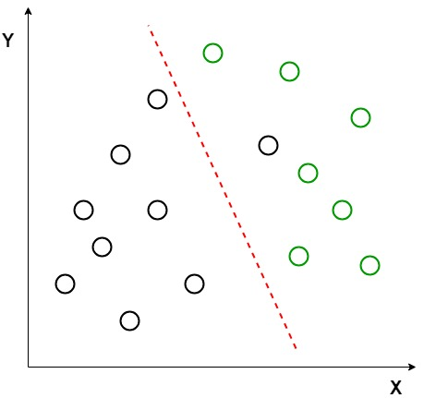
Two criteria are used by LDA to create a new axis:
Maximize the distance between means of the two classes.
Minimize the variation within each class.

Slide 27
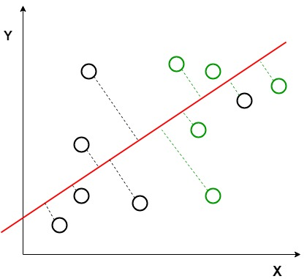

Slide 28
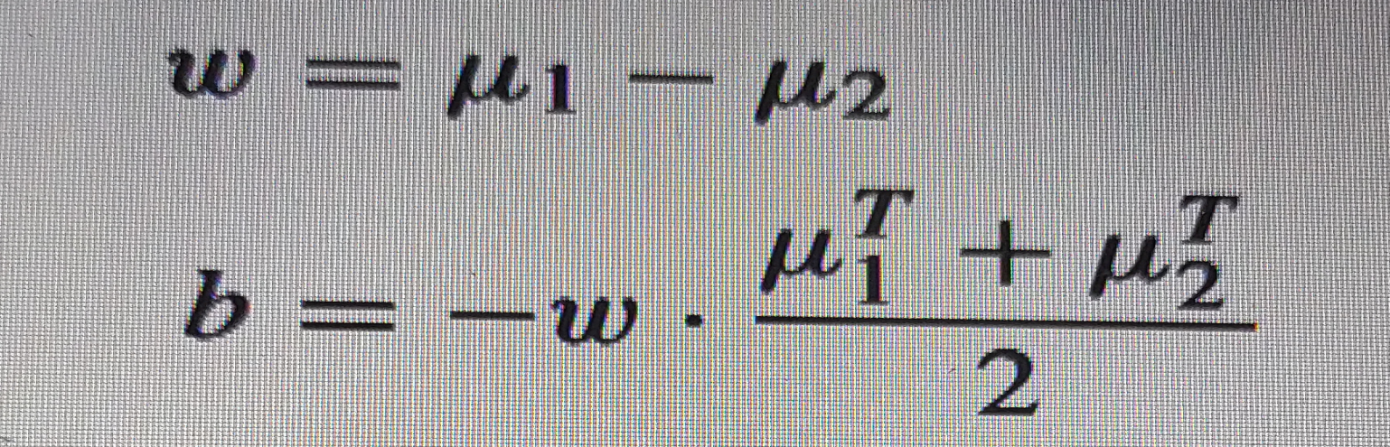
w · x^{T} + b = 0, w ∈ R^{p}, b ∈ R
w = μ1 − μ2

Slide 29
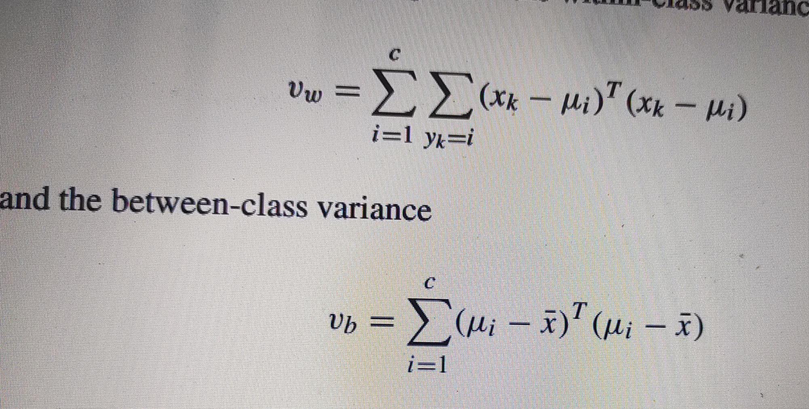

Slide 30
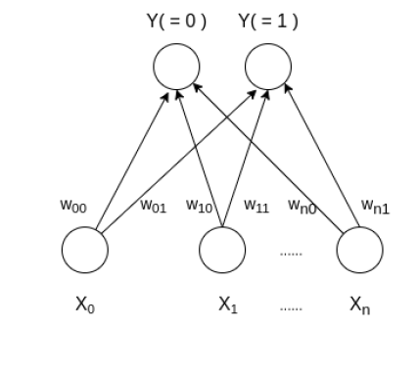
Learning Vector Quantization ( or LVQ ) is a type of Artificial Neural Network which also inspired by biological models of neural systems. It is based on prototype supervised learning classification algorithm and trained its network through a competitive learning algorithm similar to Self Organizing Map. It can also deal with the multiclass classification problem. LVQ has two layers, one is the Input layer and the other one is the Output layer. The architecture of the Learning Vector Quantization with the number of classes in an input data and n number of input features for any sample is given below:

Slide 31
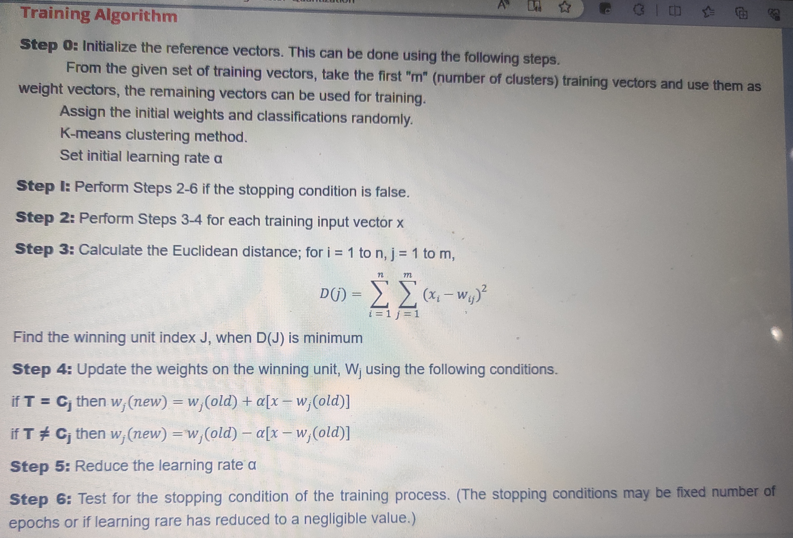

Slide 32
Construct an LVQ net with five vector assigned to 2 clusters. Given vector along with classes are shown,
Sol: First 2 vector are used as initial weight vector and remaining 3 vectors are i/p vectors.
Vector |  |  |  | Class
0 | 0 | 1 | 1 | 1
1 | 0 | 0 | 0 | 2
0 | 0 | 0 | 1 | 2
1 | 1 | 0 | 0 | 1
0 | 1 | 1 | 0 | 1

Slide 33
Initialize reference weight vector as:
W1=[0 0 1 1]
W2=[ 1 0 0 0]
Let alpha = 0.1

