Slide 1
Nucleation Limited Switching varying pulse width
07/23/2024

Slide 2
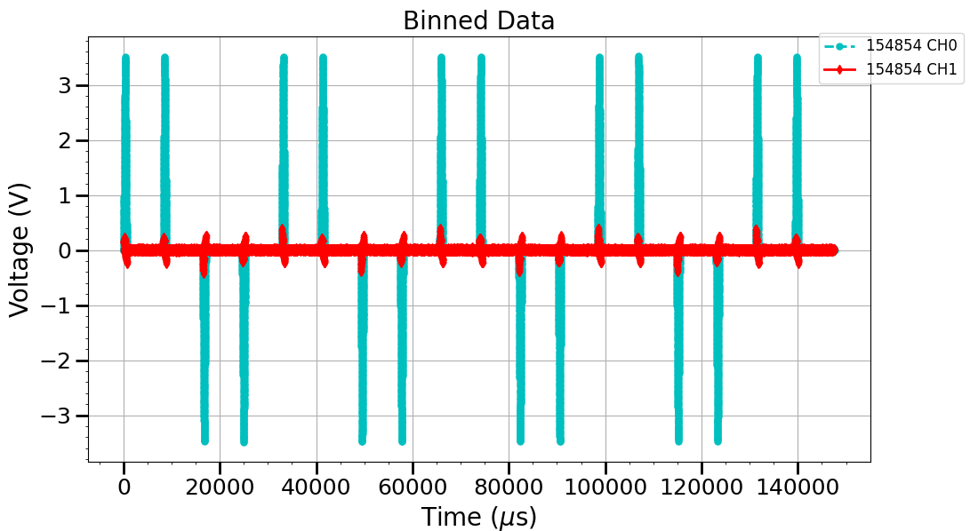
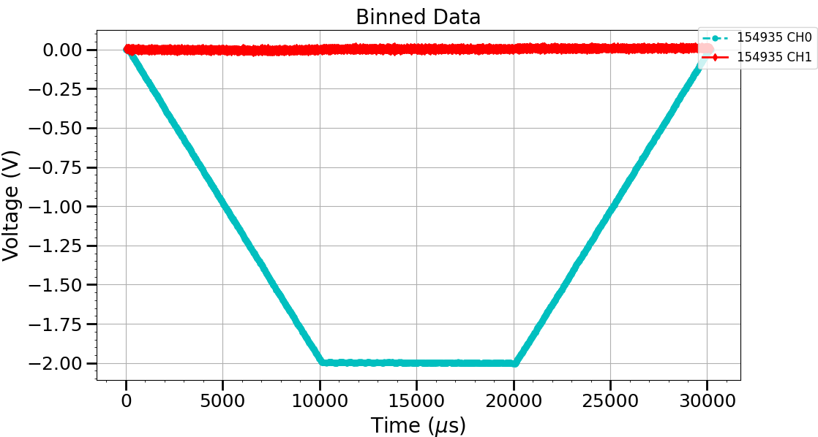
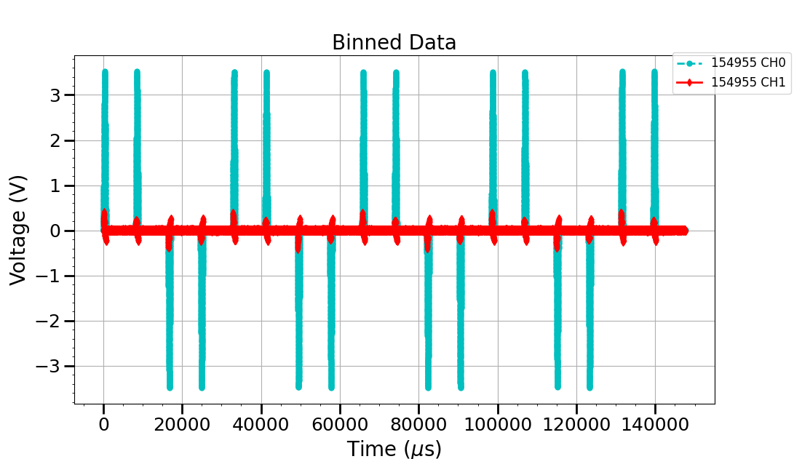




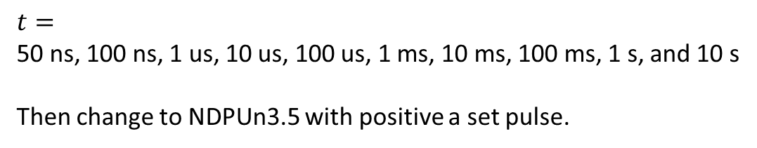
Waveforms
Use to construct PE loop
1) PUNDp3.5
2) set
3) PUNDp3.5
$$t$$
$$t$$
$$t$$
Change $t$
$$t=$$
50 ns, 100 ns, 1 us, 10 us, 100 us, 1 ms, 10 ms, 100 ms, 1 s, and 10 s
Then change to NDPUn3.5 with positive a set pulse.

Slide 3
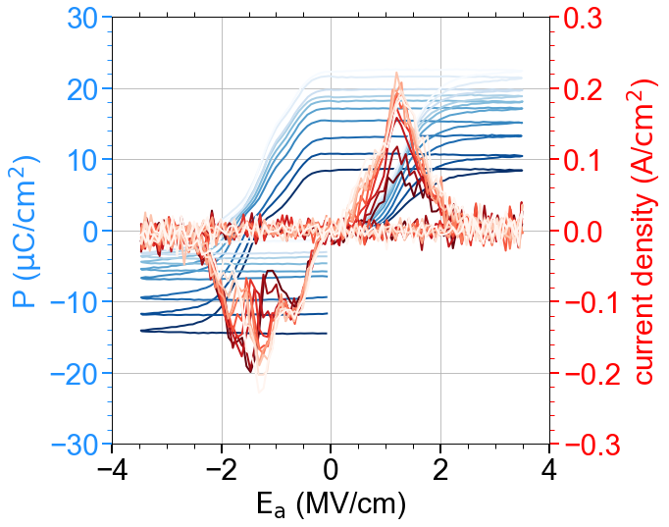
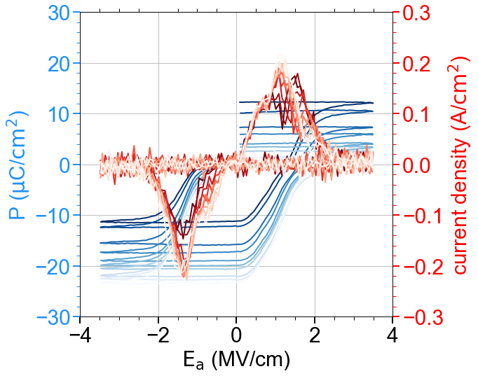




Sample: SX19C bot
PUNDp3.5
NDPUn3.5
$−1.5$V set
$+1.5$V set
Darker color = smaller $t$
$$ΔP$$

Slide 4
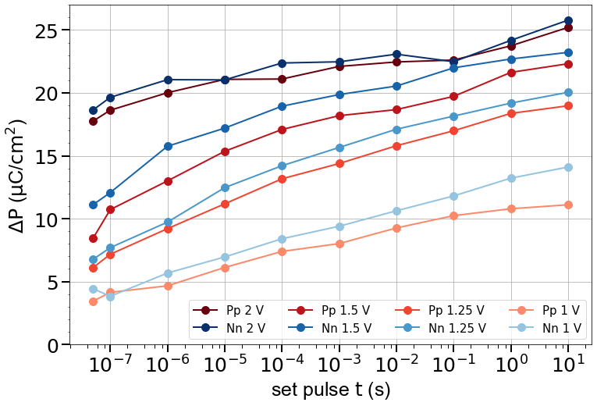

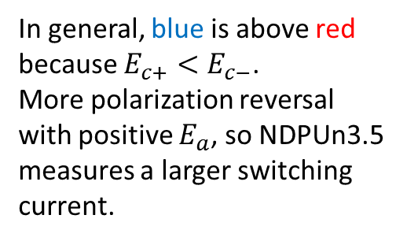
In general, blue is above red because $E_{c+}<E_{c−}$.
More polarization reversal with positive $E_{a}$, so NDPUn3.5 measures a larger switching current.
Net zero $P$ line
Pp: PUNDp3.5
1 V: set pulse at 1 V
Nn: NDPUn3.5

Slide 5
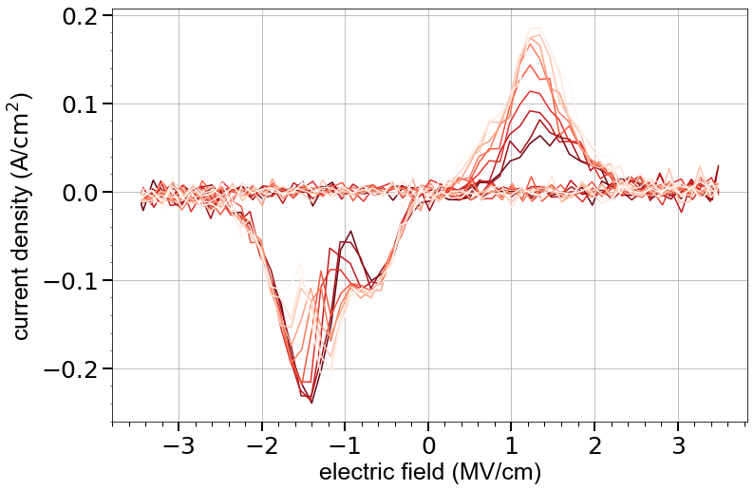
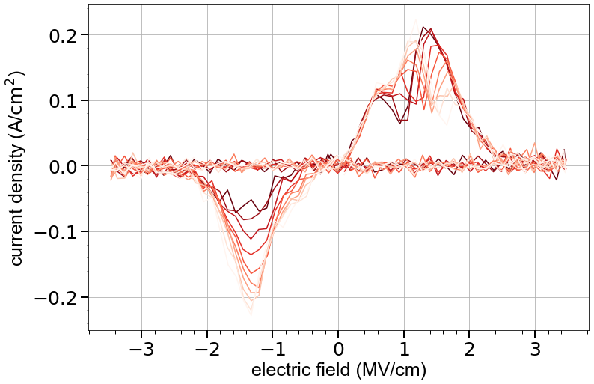
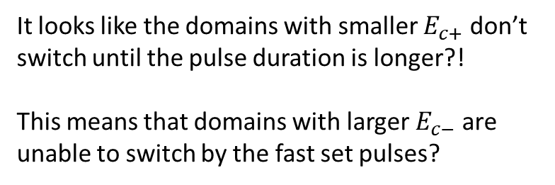
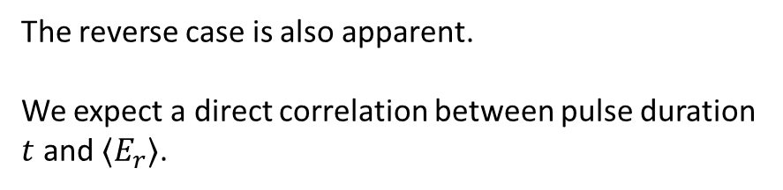


Darker color = faster set pulse
$−1.25$ V
It looks like the domains with smaller $E_{c+}$ don’t switch until the pulse duration is longer?!
This means that domains with larger $E_{c−}$ are unable to switch by the fast set pulses?
Faster set pulses generate more imprint
$+1.25$ V
The reverse case is also apparent.
We expect a direct correlation between pulse duration $t$ and $〈E_{r}〉$.

