Slide 1
RENOVARA - AUSTRALIAN ENERGY MARKET ANALYSIS
Where your power dollar goes
Seven years of Australia's Default Market Offer, decomposed
NSW - South-East QLD - South Australia DMO 1-8 - 2019-2027
Source: AER final determinations 2019-20 to 2026-27 (aer.gov.au)

Slide 2
THE BASICS
A safety net - and the market's yardstick
A price cap
The most a retailer can charge someone who never switched — a 'standing offer' customer.
A reference price
Every market offer is advertised against it: '15% below the reference price'.
Covers ~8% directly
Only about 1-in-12 households is on it — but it anchors how everyone's plan is priced.
Reset every 1 July
The AER sets it yearly for NSW, SE QLD & SA. Victoria runs its own (the VDO).

Slide 3
HOW THE NUMBERS ARE DERIVED
How the AER builds a DMO bill
The AER builds the price bottom-up for a model customer, then adds GST:
Worked example - Ausgrid 2026-27
Network - AER-approved poles-and-wires tariffs
model customer, 3,900 kWh/yr
Wholesale - ACIL Allen models the cost to hedge the load (futures + cap contracts)
Network
$838
Wholesale
$735
Environmental - Renewable Energy Target (certificates) plus state green schemes
Retail + margin
$266
Retail operating cost - Benchmark efficient cost to serve a customer
Environmental
$60
Retail margin - A set percentage (10% homes, 15% small business)
Reference price
$1,899
Network & retail split indicative; wholesale & environmental from AER cost data.
( sum of components ) x GST = annual reference price
AER DMO methodology - ACIL Allen wholesale modelling

Slide 4
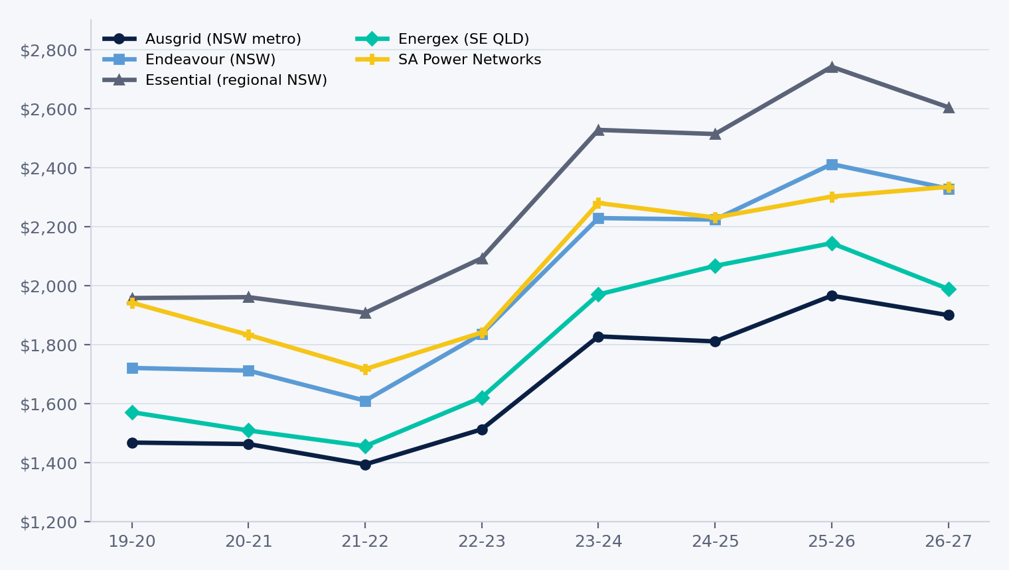
THE SEVEN-YEAR ARC
The bill went on a rollercoaster
+36% to +50%
trough (2021) to peak
Then 2026 brings the first real relief - except in South Australia.
Outside regional NSW, SA is now the most expensive zone.
AER final determinations, DMO 1-8 - residential flat rate

Slide 5
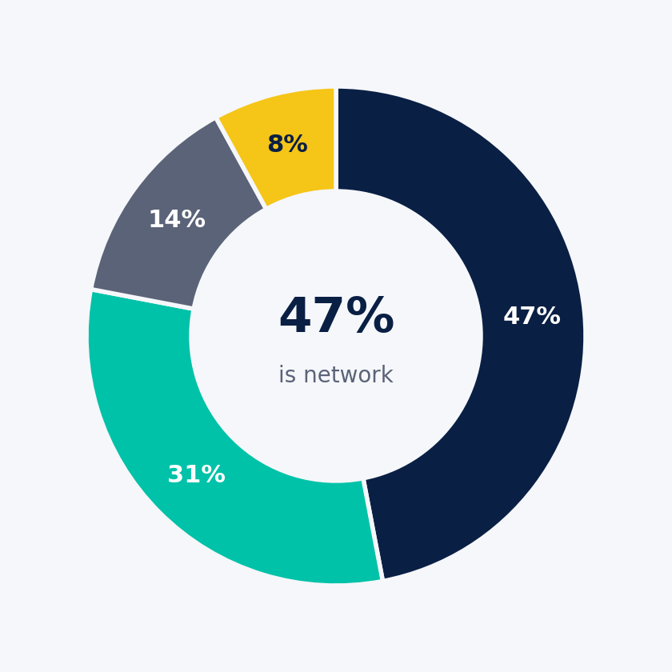
WHERE YOUR DOLLAR GOES
Four costs stack up to your bill
Network 47%
Poles, wires & transmission. The biggest slice — and it never stops rising.
Wholesale 31%
Buying the actual electricity. The volatile one that drove the spike.
Retail + margin 14%
Running the retailer, plus profit.
Environmental 8%
Renewable & rooftop-solar schemes. Falling lately.
Indicative split - AER DMO 8 cost-stack proportions; varies by zone

Slide 6
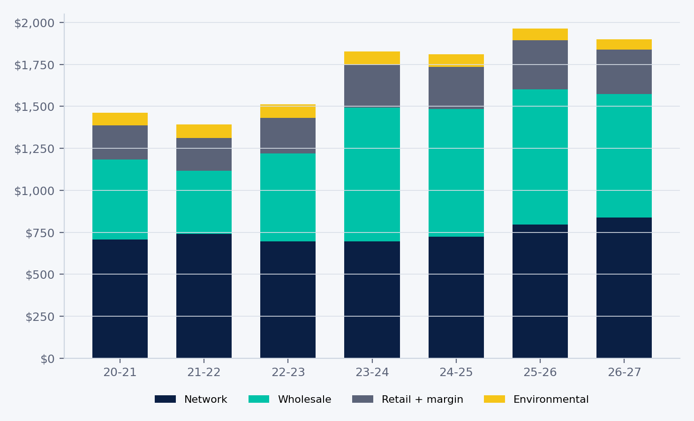
WHERE YOUR DOLLAR GOES OVER TIME
Every component, tracked year by year
Year-on-year, 2025-26 to 2026-27
Wholesale
v -8.7%
Network
^ +5.4%
Retail + margin
v -9.8%
Environmental
v -14.3%
Nominal dollars; adjusted for inflation the rise is far smaller (next slide). Bars reconcile to the published bill.
Ausgrid residential - wholesale & environmental from AER cost data; network/retail split indicative

Slide 7
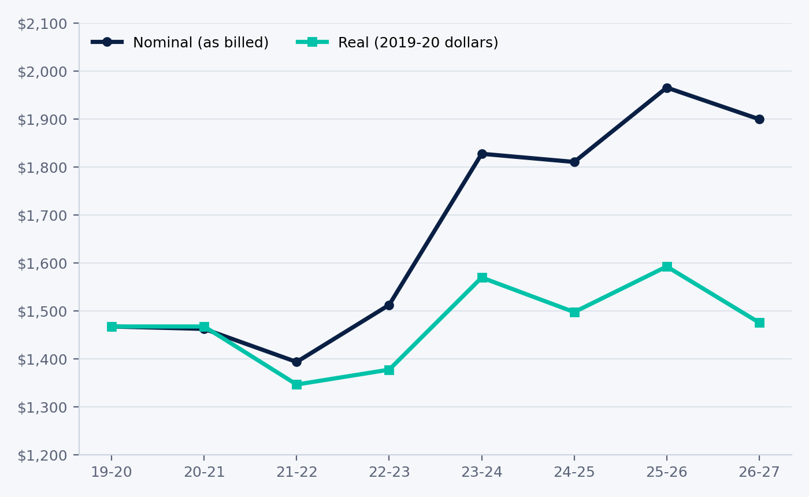
ADJUSTED FOR INFLATION
Adjust for inflation, and the rise shrinks
2019-20 to 2026-27 change
Zone
Nominal
Real
Ausgrid
+29%
+1%
Endeavour
+35%
+5%
Essential
+33%
+3%
Energex
+27%
-2%
SA Power Networks
+20%
-7%
When we account for economy-wide inflation, the typical bill is roughly back to 2019 - SA and QLD are lower. The 2022 crisis spike was real, but has largely unwound.
Ausgrid residential - nominal vs real
ABS CPI, all groups, weighted average of 8 capital cities (June quarter). 2026-27 estimated (~+4.3% y/y).

Slide 8
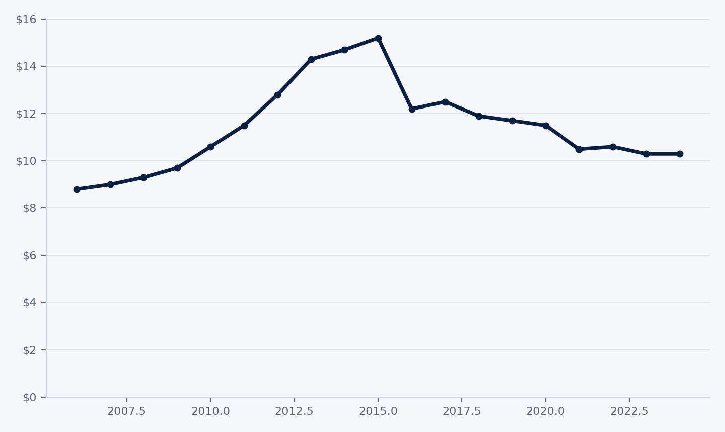
NETWORK - THE LONG VIEW
In real terms, the network peaked a decade ago
Real revenue
-32%
since the 2015 peak ($15.2bn -> $10.3bn)
Asset base
x2, then flat
doubled 2006-15; ~flat since (~$95bn)
Capex
-36%
from the 2012 peak ($8.4bn -> $5.4bn)
Allowed return
~halved
~10% (2011) -> ~5% (2024)
Real, 2024 dollars. Nominal revenue rose in the latest resets (+33-47%; see 'every network just reset'), but adjusted for inflation it sits below the 2015 peak. The recent bill rises are inflation and a rate-of-return bounce - not a transition-driven cost boom.
AER State of the Energy Market 2025, ch.3 - real (June-2024 $) - NEM distribution aggregate

Slide 9
NETWORK - DECOMPOSED
Network costs, decomposed
How allowed network revenue is built (approx. shares):
Return on capital 58%
Operating expenditure 29%
Depreciation 6% - Adjustments + tax 7%
Return on capital = the regulated asset base x the AER-allowed rate of return. It is the biggest block by far - which is why a rate-of-return reset or asset-base growth moves network costs more than anything else.
AER's own attribution: ~46-50% of the latest distribution increases is higher inflation and interest rates - SA Power Networks 46%, Energex ~50%.
Building-block shares: Ausgrid 2024-29 draft decision (indicative); final differs slightly

Slide 10
NETWORK - EVERY RESET
Every DMO-region network just reset
Five-year allowed revenue the AER set for each network serving the DMO regions:
Distribution
Period
Revenue
vs prior
Transmission charges
Period
Revenue
SA Power Networks
25-30
$5.2bn
+33%
TransGrid (NSW)
23-28
$4.9bn
Energex (SE QLD)
25-30
$9.0bn
+47%
Powerlink (QLD)
22-27
$3.8bn
Ausgrid (NSW)
24-29
$9.6bn
~+5%/yr*
ElectraNet (SA)
23-28
$2.2bn
Endeavour (NSW)
24-29
$5.6bn
n/p
Essential (NSW)
24-29
$6.2bn
n/p
Project EnergyConnect: $1.8bn -> $3.6bn
The common thread: every reset in 2022-25 landed in a high-rate, high-inflation window - the AER attributes ~46-50% of the distribution increases to higher inflation and interest rates.
* Ausgrid draft-decision figure; 'n/p' = % vs prior not published. Transmission is ~4-11% of a typical bill; Project EnergyConnect is a near-term cost but a net saving.

Slide 11
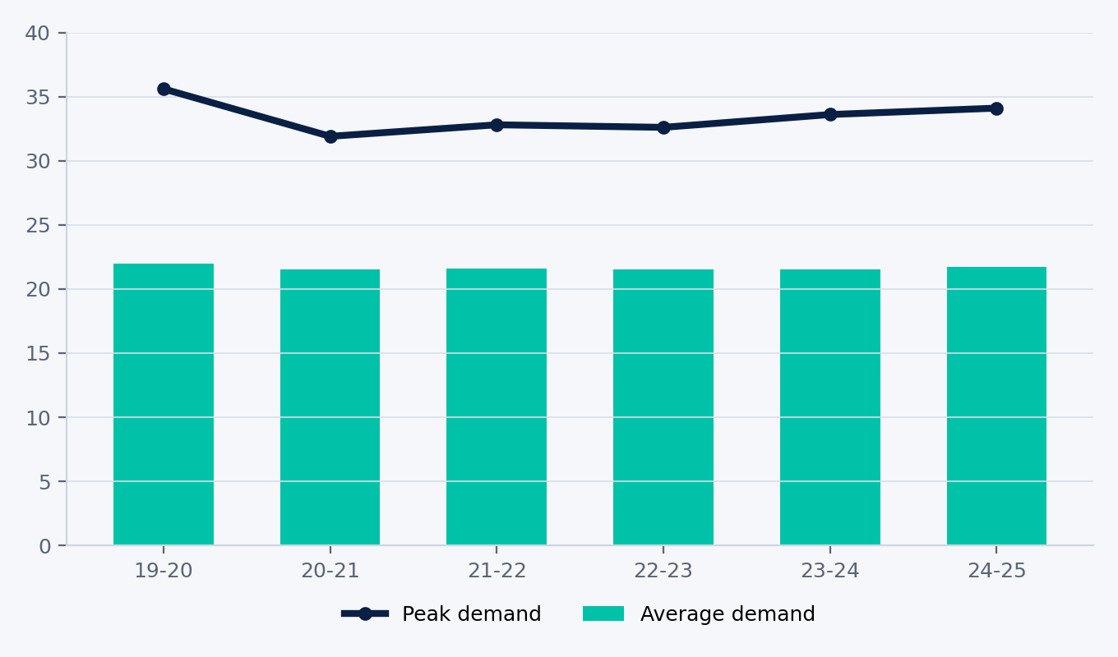
NETWORK - COST VS DEMAND
Rising cost, flat grid
Network revenue
+33% to +47%
latest 5-year resets vs prior period
Average demand
~22 GW, flat
grid energy barely moved since 2019
Peak demand
~33-34 GW
no upward trend; 2019-20 a heat outlier
NEM, financial year - demand in GW. Peak = annual maximum (summer or winter).
Demand has been flat on both measures since 2019, yet allowed network revenue rose 33-47% - about half from higher financing costs (the rate-of-return reset and inflation) and about half from real investment in replacing and modernising an ageing grid, not load growth. (See next slide.)
AER demand & energy charts (NEM) - network revenue: AER determinations

Slide 12
NETWORK - WHAT'S REALLY DRIVING IT
Why the network bill rose — not demand
SA Power Networks' reset shows the split — +$1,299m (+33%) for 2025-30:
Financing + inflation ~46%
Real investment + opex ~54%
rate-of-return reset + the asset base re-priced by inflation
replacing & modernising an ageing grid — not demand growth
What the investment is for
Renewal, not a new build-out
Replacing an ageing grid
Customers keep growing (+26% since 2006), so the network is still extending. But the heavy build-out was last decade - capex is now replacement-led (augmentation down ~63%) and the real asset base has been flat since 2015. (The AER does not publish line length yearly.)
— the largest capex; assets built decades ago
Resilience & cybersecurity
— hardening against bushfire, flood & cyber risk
Hosting rooftop solar & batteries
— re-engineering for two-way power flows
And the AER cut demand-driven augmentation — on lower demand forecasts.
AER SA Power Networks 2025-30 final decision - network length from company disclosures

Slide 13
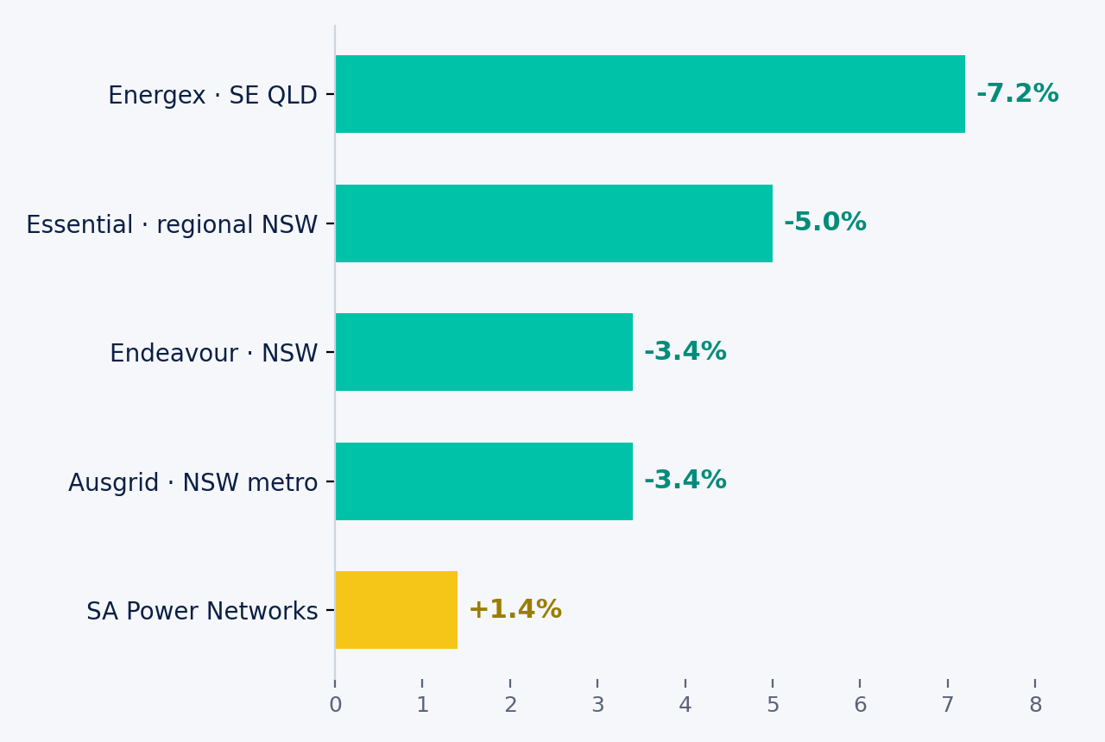
REGIONS
Same year, opposite directions
SA's network costs outweigh its wholesale savings - the lone riser.
Residential flat rate - DMO 8 (2026-27) vs DMO 7

Slide 14
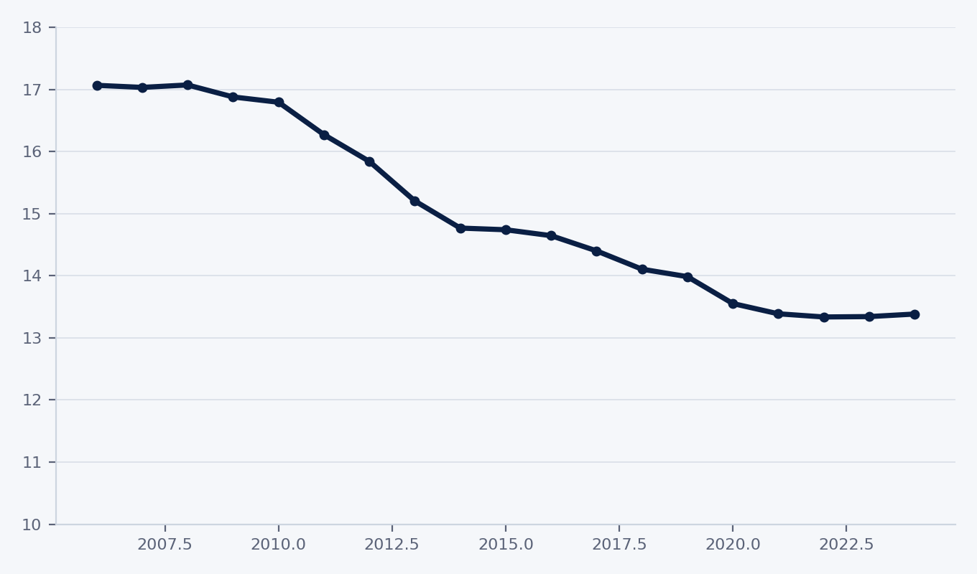
NETWORK - THE STRUCTURAL SHIFT
Falling usage is reshaping your bill
-22%
grid energy per customer, 2006->2024 (17.1 -> 13.4 MWh)
9% -> 37%
residential customers on cost-reflective tariffs, 2018->2024
Network costs are largely fixed, so as rooftop solar and efficiency cut usage, flat per-kWh tariffs stop recovering them fairly. Networks are shifting to fixed daily, demand and time-of-use charges - the structural change behind DMO 8's tariff caps and Solar Sharer Offer.
Grid energy used per distribution customer (MWh/yr)
AER State of the Energy Market 2025, ch.3 (usage Fig 3.31; tariffs Fig 3.9)

Slide 15
THE 2026 RESET
DMO 8: the rules changed
Competition allowance removed
Tariff caps introduced
A retail-margin line stripped out to ease cost-of-living pressure.
Caps daily supply & usage rates now — not just the annual bill total.
Solar Sharer Offer
Blended network tariffs
Three hours of free midday power for smart-meter homes, renters included.
Pricing now reflects the accelerated smart-meter rollout.
AER DMO 8 final determination, 26 May 2026

Slide 16
YOUR ANALYSIS
Add your own slide here
This placeholder is the fork point. Edit add_custom_analysis() in scripts/build_report.py to drop in your own chart, forecast or client view - then delete this note.

Slide 17
RENOVARA
AI analysis and tools for the energy sector
This entire analysis was generated from public AER determinations - and the tool that builds it is open source.
Clone the open-source AER Market Agent skill, add it to your AI platform (tested on Anthropic's Claude), point it at the latest AER data, customise the skill to your requirements and regenerate this deck in minutes. Ask natural language questions and the skill will analyse.
renovara.co

Slide 18
METHOD & SOURCES
How we built this
Data
AER final determinations, DMO 1 (2019-20) to DMO 8 (2026-27).
Open the sources
AER — Default Market Offer 2026-27
Headline series
Residential flat rate, no controlled load - comparable across all years.
AER — network revenue determinations
Cost stack
Wholesale & environmental from AER cost data; network/retail split per AER proportions.
AER — SA Power Networks 2025-30 decision
Network
AER network revenue determinations; AER State of the Energy Market (revenue, asset base, capex, utilisation, tariffs); AEMO 2024 system plan; AER demand & energy charts.
AEMO — 2024 Integrated System Plan
AER — demand & energy charts
Inflation
Real terms use ABS CPI (8 capitals, June quarter); 2026-27 estimated.
ABS CPI (via the ATO table)
Caveat
Small-business benchmark changed 20,000 to 10,000 kWh at DMO 4 - not comparable across it.
AER — State of the Energy Market (data)

