Slide 1
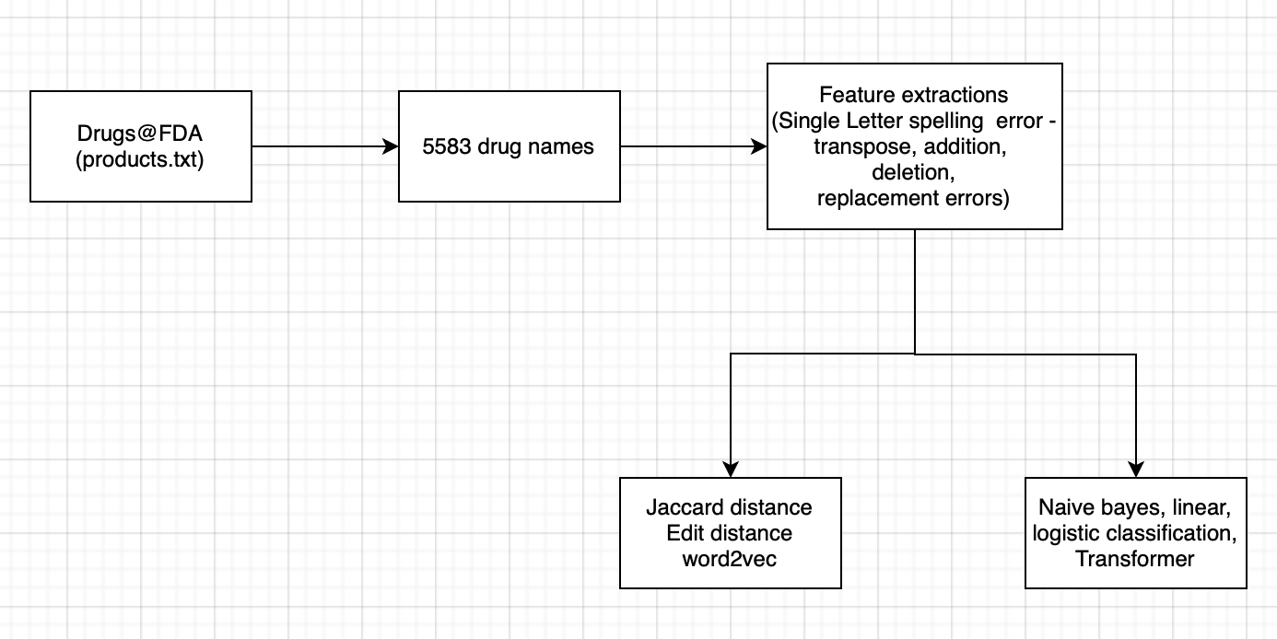

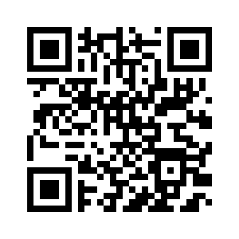
Drug Name Spelling Checker using Drugs@FDA Data Files
By Shusma Kafle, Qinglu Ren
Abstract
Drug spelling error is common error in the healthcare in field. In our study, we are exploring multiple methods to detect and recommend correct drug spell based on products list in Drugs@FDA. In this study, we focus on single-letter spelling error. Jaccard distance and edit distance methods recommends correct drug spelling with accuracy of 96% to 98%. Word2Vec and supervised machine learning models (naive bayes, linear regression and logistic regression) failed to recommend drug spelling error with accuracy of 0%. Transformer could be good candidate for spelling error correction task.
Introduction
Previous studies show that drug spelling error may occur up to 17.5% and medical translation error is significant part of medical error in healthcare field.. In this study, we are identifying feasible solutions to check drug spelling and recommend correct drug names if drug names are spelled incorrectly.
Methodology
Data source
Drugs@FDA Data file:
products.txt (weekly update)
We focus on outpatient setting and removed drugs that are in intravenous and intramuscular formulations.
Types of drug spelling errors
-transpose (positions of two letters are exchanged)
-addition (add one letter)
-deletion (delete one letter)
-replacemen (vow to vow replacement, consonant to consonant replacement).
Unsupervised Methods
Jaccard distance, edit distance (Levenshtein distance), word2vec, pyspellchecker python package (edit distance)
Supervised Machine Learning Methods
Naive Bayes, linear classification, logistic classification, Transformer
Measurement
Accuracies of test samples are reported.
Results
5,583 drug names are identified from Drugs@FDA datafile.
In this study, we only study single-letter spelling error and find that Jaccard distance and edit distance (Levenshtein distance) can have 96+% accuracy in finding correct spelling. The accuracy of word2vec, supervised machine learning models (naive bayes, linear regression and logistic regressions) are 0 %. Transformer shows accuracy of 70.39%.
Study limitation
In this study, we only created single letter errors and our result is solely based on spelling errors on 1 letter error.
182669 were split into train and test with 80 and 20 percent split for transformer and data we use for the drug was single word.
Conclusion
Jaccard distance and edit distance provide high accuracy in recommending correct drug spelling and supervised machine learning models are not feasible ways to provide correct drug spelling.
Reference
1. Senger C, Kaltschmidt J, Schmitt SP, Pruszydlo MG, Haefeli WE. Misspellings in drug information system queries: characteristics of drug name spelling errors and strategies for their prevention. Int J Med Inform. 2010 Dec;79(12):832-9. doi: 10.1016/j.ijmedinf.2010.09.005. Epub 2010 Oct 15. PMID: 20951634.
2. Drugs@FDA. https://www.fda.gov/drugs/drug-approvals-and-databases/drugsfda-data-files
3. Project repo:
Method | Accuracy
Jaccard distance | 96%
Edit distance | 99%
Transformer | 70.39%*
User Interface
Recommendations
Jaccard distance and edit distance methods are feasible solution in drug spelling correction. Word2Vec, naive bayes, linear classification, logistic classification models are not suitable for drug spelling tasks. Transformer is promising in this task. Further studies are needed for multiple letters spelling errors.

