Slide 1
GNN-Based Lung Nodule Malignancy Classification
Multi-Modal Feature Embedding on CT Scans
Harrison Lavins • Rensildi Kalanxhi • Swathi Gopal
CSC 7760 — Deep Learning | Status Update — April 2026
1 / 20

Slide 2
Project Goals
Primary research question:
Does modeling inter-nodule relationships as a similarity graph improve malignancy classification versus classifying each nodule independently?
• Head-to-head comparison on LIDC-IDRI dataset
– 2-layer Graph Convolutional Network head
– Parameter-matched MLP baseline on identical multi-modal features
• Cross-dataset generalization test: LIDC-IDRI → LUNA25
• Validation against pathology-confirmed subset (~157 nodules with biopsy / surgery ground truth)
• Keep architecture within an RTX 3060 (12 GB VRAM) training budget
2 / 20

Slide 3
Background
• Lung cancer is the leading cause of cancer mortality worldwide
• CT-based nodule classifiers reach AUC 0.88 – 0.96 on LIDC-IDRI
– But they classify each nodule independently, ignoring inter-case similarity
• Graph Neural Networks propagate information across similar cases via message passing
– Patient-similarity GNNs help in cancer subtyping and prognosis
– Not yet applied to LIDC lung nodule malignancy classification on CT — this project fills that gap
• Closest prior work: Ma et al. 2023 (AUC 0.9629 on LIDC)
– Uses GCN for cross-CNN feature fusion, not for node classification on a similarity graph
3 / 20

Slide 4
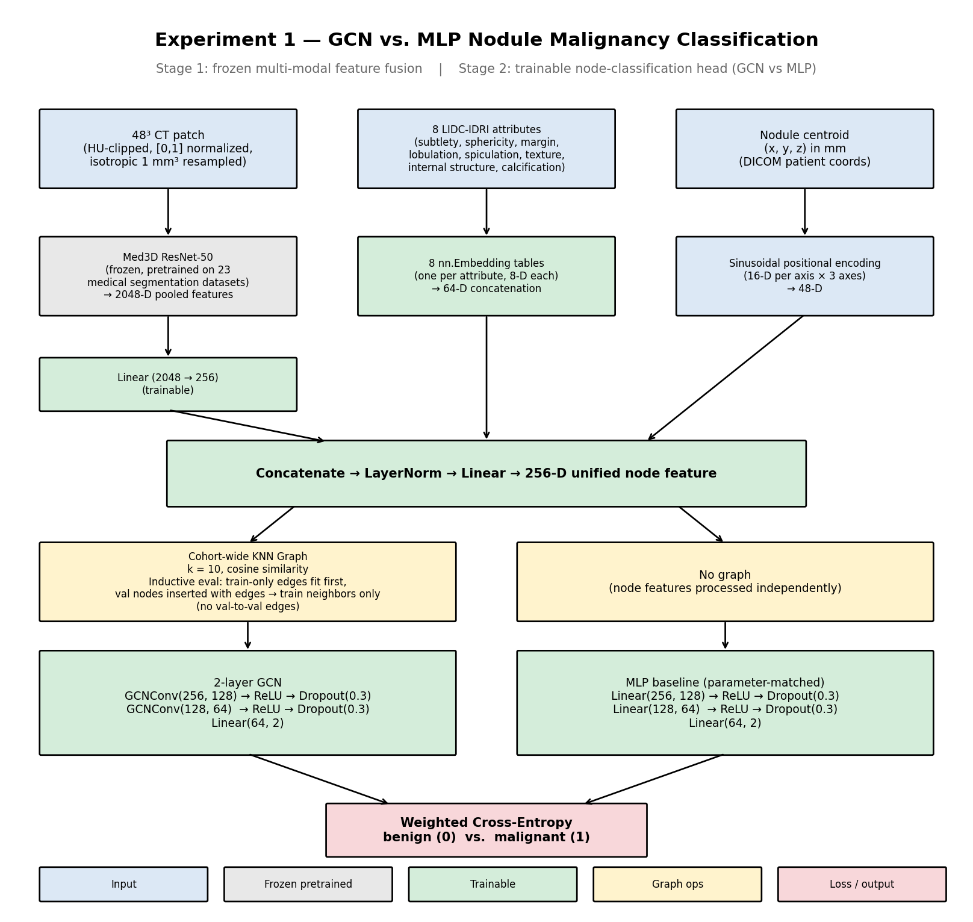
Proposed Approach — Two-Stage Pipeline
• Stage 1 — frozen multi-modal feature extraction
– Image: 48³-voxel CT patch → frozen Med3D ResNet-50 → 2048-D pooled features → Linear → 256-D
– Clinical: 8 LIDC-IDRI attributes → per-attribute nn.Embedding tables → 64-D
– Spatial: nodule centroid (x, y, z) in mm → sinusoidal positional encoding → 48-D
– Concatenate → LayerNorm → Linear → 256-D unified node feature
• Stage 2 — trained node-classification head
– GCN: 2 × GCNConv layers over the cohort-wide KNN graph, with dropout + Linear head
– MLP baseline: same widths and dropout, no graph structure — isolates the graph effect
• Training: weighted cross-entropy, Adam (lr 1e-3), 5-fold patient-level CV, early stop on val AUC
4 / 20

Slide 5
Architecture
5 / 20

Slide 6
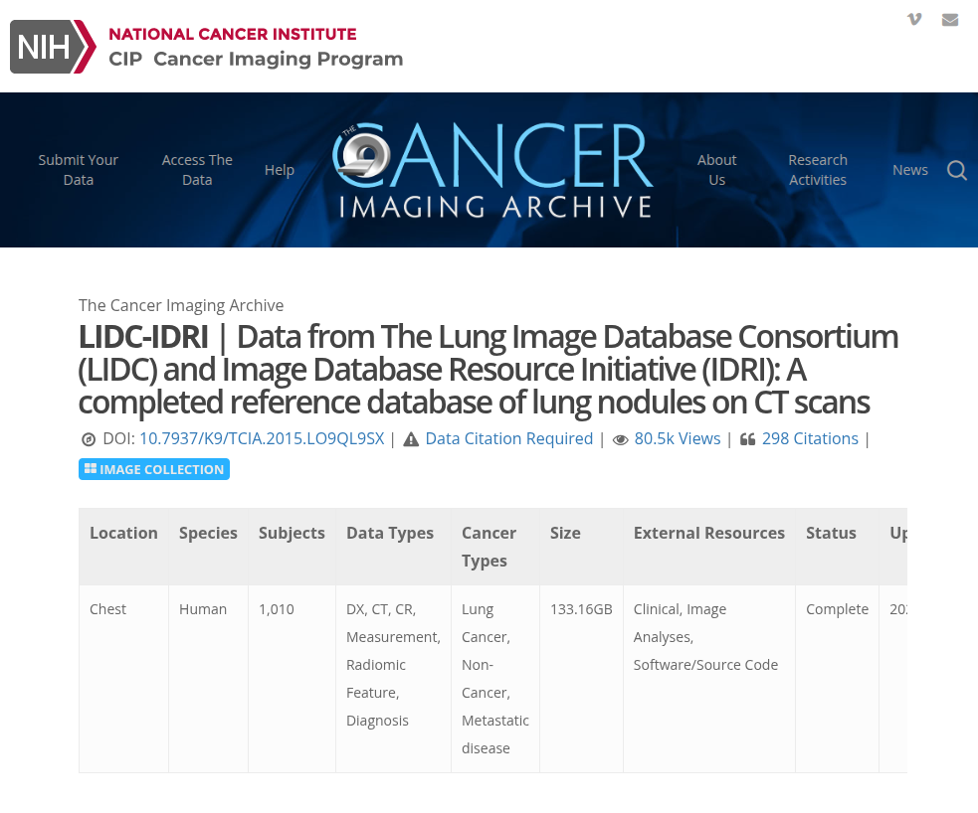
Datasets
• LIDC-IDRI (primary — training + within-dataset eval)
– 1,010 patients • 1,308 CT studies • ~133 GB DICOM
– ≈ 7,371 nodules ≥ 3 mm, up to 4 radiologist readings per nodule
– 8 descriptive attributes + 1-5 malignancy rating per reader per nodule
– ~157 pathology-confirmed diagnoses (biopsy / surgery / follow-up)
– After preprocessing + binarization: 1,128 nodules across 588 patients (805 benign / 323 malignant)
• LUNA25 (secondary — cross-dataset generalization, Experiment 4)
– 4,096 CT exams • 6,163 nodules from National Lung Screening Trial
– Binary malignancy labels from clinical follow-up
– Released for MICCAI 2025 (Zenodo, CC BY 4.0)
6 / 20

Slide 7
Dataset Visualization — Nodule Size Distribution
Histogram/visualization of nodule diameters across LIDC-IDRI (to be added after preprocess run)
7 / 20

Slide 8
Dataset Visualization — Example 48³ CT Patches
Grid of representative benign and malignant patches (axial mid-slice)
8 / 20

Slide 9
Dataset Visualization — Attribute Correlations
Heatmap of the 8 LIDC attribute means vs. malignancy label
9 / 20

Slide 10
Preprocessing & Data Cleaning
• XML annotations — stdlib ElementTree parser (no pylidc)
– Malignancy rating tracked in a separate field from the 8 feature attributes to prevent label leakage
• DICOM series loading via pydicom
– Slices ordered by physical Z (ImagePositionPatient[2]) — robust to vendor-reversed InstanceNumber
– Per-slice RescaleSlope / RescaleIntercept applied to get Hounsfield Units
• Cross-reader nodule clustering
– Greedy centroid-distance match (8 mm threshold) across up to 4 radiologists per scan
– Follow-up: 6 / 1,128 clusters have >4 merged readers → retighten or switch to IoU-based clustering
• Patch extraction & normalization (feature-time)
– 48³-voxel patches centered on each nodule, HU-clipped to [-1000, 400] and normalized to [0, 1]
– Resampled to isotropic 1 mm³ before Med3D inference
• Label binarization: mean malignancy ≤ 2 → benign (0), ≥ 4 → malignant (1), ~3 excluded
• Patient-level 5-fold StratifiedGroupKFold — no patient straddles train / val
10 / 20

Slide 11
What's Novel
• First node-classification GCN applied to LIDC malignancy
– Prior GCN work on LIDC uses the GCN for cross-CNN feature fusion, not for inter-nodule reasoning
• Multi-modal node features fuse three complementary sources
– Imaging (Med3D), clinical (8 radiologist attributes), spatial (sinusoidal positional encoding)
• Inductive evaluation protocol for the cohort-wide graph
– Edges fit on train-only nodes; val nodes inserted at eval time with edges into train neighbors only
– No val-to-val edges — eliminates the standard transductive-leak failure mode under patient-level CV
• Parameter-matched MLP control isolates the effect of message passing from raw capacity
• Committed encoder follow-up: FMCIB (Aerts lab, 2024) as a second encoder axis in Experiment 3
11 / 20

Slide 12
Experiments
• Experiment 1 — GCN vs. MLP baseline on LIDC-IDRI
– Status: pipeline complete, training blocked on Med3D checkpoint download
• Experiment 2 — Graph construction ablation
– 8-cell grid: k ∈ {5, 10, 15, 20} × metric ∈ {cosine, euclidean}
– Best (k, metric) adopted as default for downstream experiments
• Experiment 3 — Feature-modality × encoder ablation
– 6-cell 3×2 grid: {image, image+attrs, image+attrs+spatial} × {Med3D, FMCIB}
– Pathology-confirmed subset is primary validation axis
• Experiment 4 — Cross-dataset generalization to LUNA25
– Apply LIDC-trained model to LUNA25 nodules (different scanners, protocols, patients)
12 / 20

Slide 13
Experiment 1 — GCN vs. MLP Baseline
• Objective: head-to-head AUC test of graph-based aggregation versus independent classification
• Hypothesis (H1): GCN macro-AUC > MLP macro-AUC by ≥ 0.01 (paired Wilcoxon p < 0.05, 5 folds)
• Both models consume identical 256-D fused features — the only difference is the KNN graph
• Inductive KNN construction prevents train / val leakage
• Metrics: AUC, AUPRC, sensitivity / specificity at Youden-J, Brier score, 10-bin reliability diagram
• Per-fold class balance: val malignant counts 67, 77, 63, 62, 54 (all above the plan's ≥ 30 threshold)
• Training: Adam (lr 1e-3, wd 1e-4), 100 epochs with patience-15 early stop on val AUC
• Status: code + splits committed; waiting on Tencent/MedicalNet resnet_50.pth download
13 / 20

Slide 14
Experiment 2 — Graph Construction Ablation (Planned)
• 8-cell grid: k ∈ {5, 10, 15, 20} × metric ∈ {cosine, euclidean}
• Fixed GCN architecture from Experiment 1; re-fit KNN per cell per fold
• Decision rule: Bonferroni-corrected paired Wilcoxon across the 8 cells
• Best cell becomes the default for Experiments 3 and 4; null result → keep (k=10, cosine)
Results to follow — AUC heatmap over (k, metric)
14 / 20

Slide 15
Experiment 3 — Feature × Encoder Ablation (Planned)
• 3 × 2 grid: feature configs × image encoders
– Features: {image only, image + attributes, image + attributes + spatial}
– Encoders: {Med3D ResNet-50 (baseline), FMCIB foundation model (follow-up)}
• Pathology-confirmed subset is the primary validation axis (true ground truth)
• Tests whether radiologist attributes add unique signal beyond the image branch (leakage check)
Results to follow — AUC heatmap over feature-config × encoder
15 / 20

Slide 16
Experiment 4 — LUNA25 Cross-Dataset (Planned)
• Apply LIDC-trained model to LUNA25 nodules (held-out entirely from training)
• Different source patients, scanners, acquisition protocols
• Label source: clinical follow-up (binary), not radiologist consensus — cleaner ground truth
• Tests whether learned representations generalize beyond LIDC's specific reader distribution
Results to follow — LIDC→LUNA25 transfer performance
16 / 20

Slide 17
Rensildi's Work
(Placeholder — Rensildi to fill in focus area, methods, and current progress)
17 / 20

Slide 18
Swathi's Work
(Placeholder — Swathi to fill in focus area, methods, and current progress)
18 / 20

Slide 19
Current Results
• Data pipeline complete
– 1,128 labeled nodules from 588 patients (805 benign / 323 malignant)
– Patient-level 5-fold CV splits committed; no train / val patient leakage
• Experiment model code complete and smoke-tested
– Multi-modal fusion, 2-layer GCN, parameter-matched MLP, inductive KNN construction
– Med3D ResNet-50 backbone wired; forward pass verified at (N, 2048) on CUDA (random init)
• No training numbers yet
– Training requires Tencent/MedicalNet pretrained weights (manual download — no wget URL)
– Full GCN vs. MLP run expected to take ~1 – 2 hours on the RTX 3060 once features are cached
19 / 20

Slide 20
Next Steps
• ...
•
20 / 20

