Slide 1
Lab 08– Threads and Mutexes

Slide 2
Monte Carlo Methods
Monte Carlo methods are data analytical methods used for solving complex problems with one or more unknown variables.
Concept: use random sampling to solve problems that might be deterministic in principle.

Slide 3
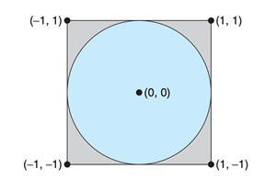
Lab Activity
The provided program (sample.c) generates a series of random (x,y) coordinates within the bounded square.
Idea: calculate pi using the randomly generated points and the following formula:
π = 4 × (number of points in circle) / (total number of points)

Slide 4
Lab Requirements
Program creates several threads, each of which generates random points and determines if points are within circle.
Each thread updates the global count of all points within circle.
Use mutex locks to protect against race conditions on updates to the shared global variable.

