Slide 1
Long Lab 9/10
Sync: Producer-Consumer

Slide 2
Producer-Consumer / Bounded-Buffer Problem
Example of multi-process synchronization problem.
Two processes, the producer and consumer, which share fixed-size buffer and use it as a circular queue.
Producer: insert data into an empty slot of buffer.
Consumer: remove data from filled slot of buffer.
Problems:
Ensure that producer cannot add data to full buffer. Ensure that consumer cannot remove data from empty buffer.
The producer thread will alternate between sleeping for a random period of time and inserting a random integer into the buffer.
The consumer will also sleep for a random period of time and, upon awakening, will attempt to remove an item from the buffer.

Slide 3
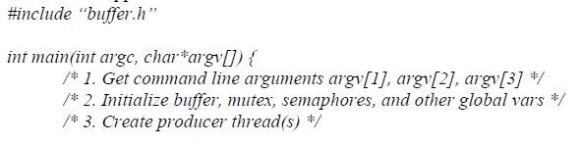
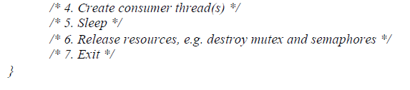
Solution
This solution uses three semaphores: mutex, empty, and full.
Empty and full, counting semaphores which count the number of empty and full slots in the buffer.
Mutex, a binary semaphore used to acquire and release the lock.
The producer and consumer – running as separate threads – will move items to and from a buffer that is synchronized with these empty, full, and mutex structures.
You are required to use the pthread package to solve the problem in this assignment.

Slide 4
Mutexes and Semaphores
A mutex is a mutual exclusion locking mechanism used to synchronize access to a resource.
Only one thread can acquire the mutex at a single time and enter critical section.
wait (mutex);
…..
Critical Section
…..
signal (mutex);
A semaphore is a signaling mechanism.
A thread waiting on a semaphore can be signaled by another thread.
Two types of semaphores: counting and binary.
Counting semaphores are integer value semaphores used to coordinate resource access. Semaphore count is the number of available resources.
Binary semaphores are similar to counting semaphores, but they are restricted to values 0 and 1.
Wait operation only works when semaphore is 1.
Signal operation only works when semaphore is 0.
This

Slide 5
Producer and Consumer
Producer
Producer waits for at least one empty slot in buffer.
Decrements empty semaphore, as there is now one less empty slot once producer inserts data in one of the slots.
Acquire lock on buffer, blocking consumer from accessing buffer until producer completes operation.
After insertion into empty slot, release lock and increment full semaphore as one more slot is now filled.
Consumer
Consumer waits for at least one full slot in buffer.
Decrements full semaphore, as there is now one less item in queue after it is consumed.
Acquire lock on buffer, blocking producer from accessing buffer until consumer completes operation.
After removal from full slot, release lock and increment empty semaphore as one more slot is now empty.

Slide 6
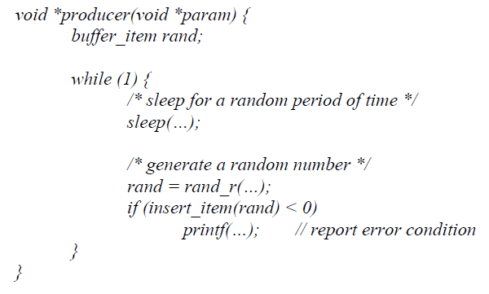
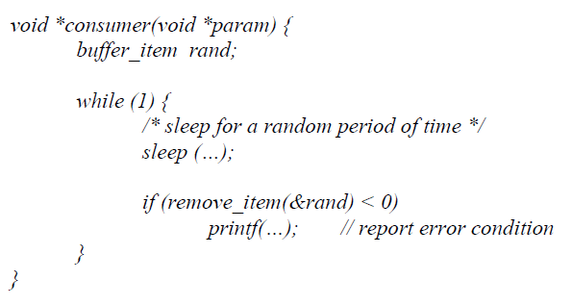
Producer and Consumer

Slide 7
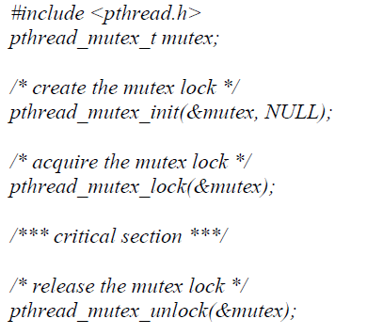
Mutex Locks
A mutex is created with the pthread_mutex_init(&mutex, NULL) function.
First parameter being a pointer to the mutex.
By passing NULL as a second parameter, we initialize the mutex to its default attributes.
The mutex is acquired and released with the pthread_mutex_lock() and pthread_mutex_unlock() functions.
If the mutex lock is unavailable when pthread_mutex_lock() is invoked, the calling thread is blocked until the owner invokes pthread_mutex_unlock().

Slide 8
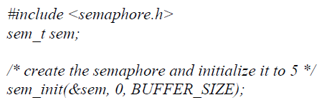
Semaphores
A semaphore is created with the sem_init() function.
First parameter is a pointer to the semaphore.
Second parameter is a flag indicating the level of sharing.
Third parameter is the semaphore’s initial value.

Slide 9
Testing your code
You can start using one producer thread and one consumer thread for testing, and gradually use more producer and consumer threads. For each test case, you need to make sure that the random numbers generated by producer threads should exactly match the random numbers consumed by consumer threads (both their orders and their values).

