Slide 1
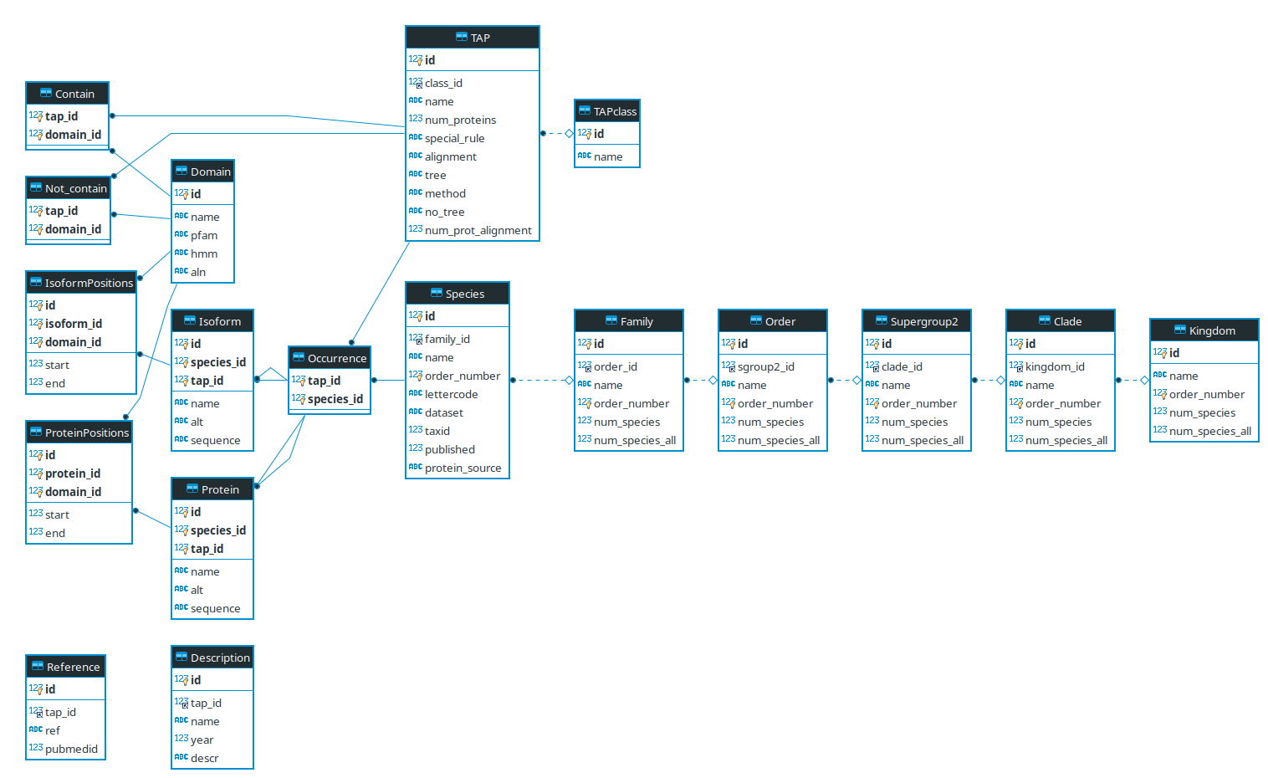
Current ER Diagramm

Slide 2
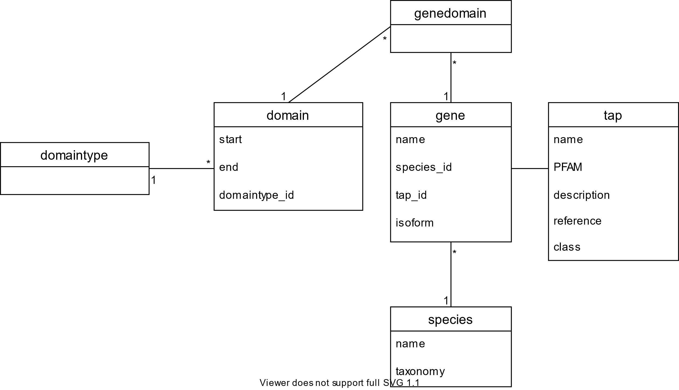
New Database Structure(Diagram done with Draw.io)

