Slide 1
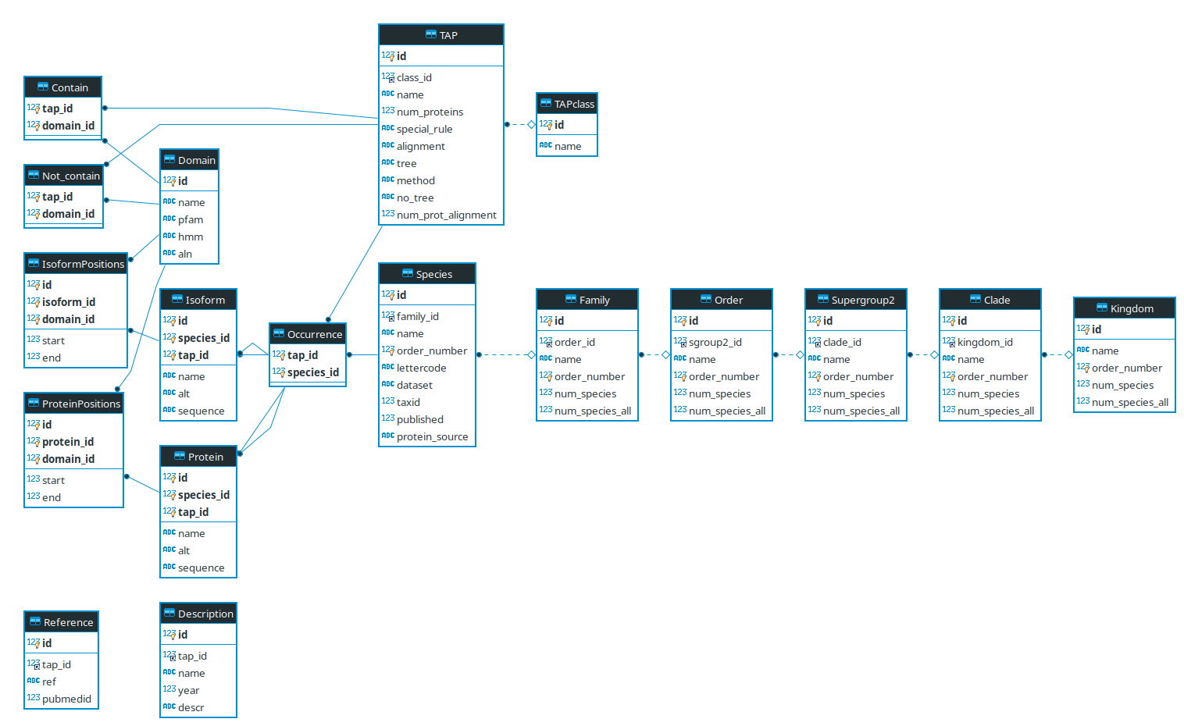
Current ER Diagramm

Slide 2
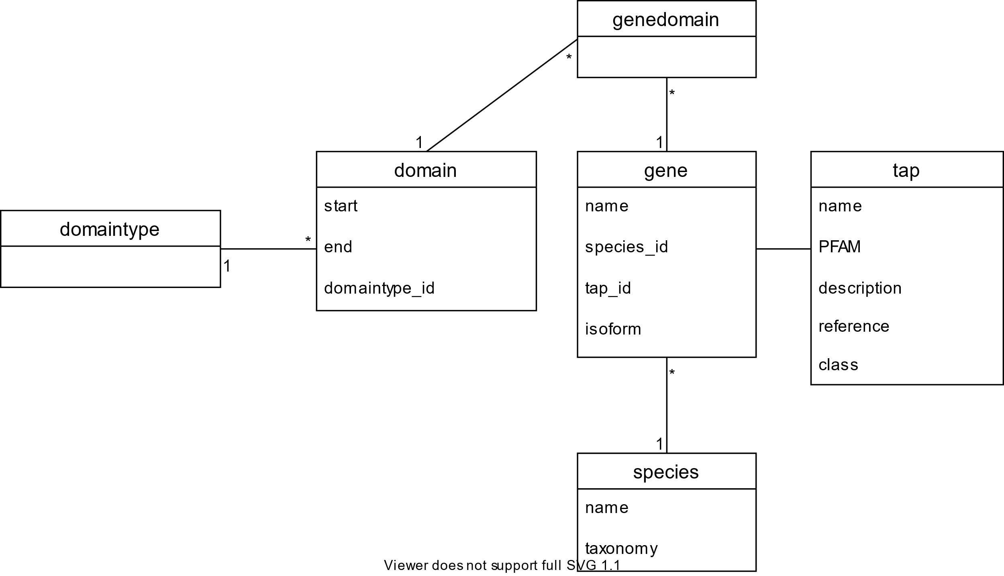
New Database Structure(Diagram done with Draw.io)

Slide 3
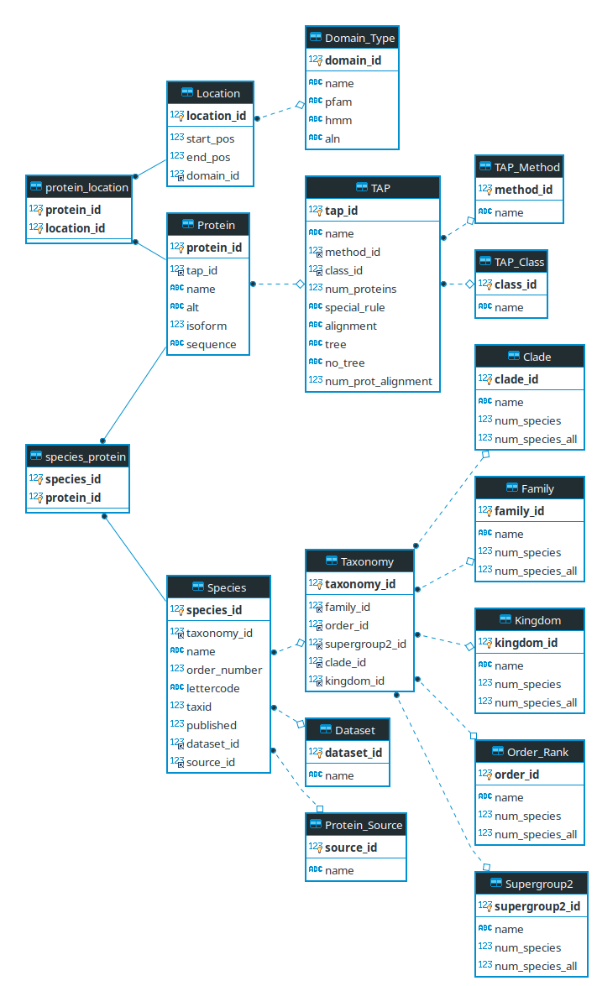
domain
Protein_location_id

