Slide 1

RentUrWay
Effortless property management
http://renturway.co

Slide 2

The Problem
Self management of real estate:
Time consuming
Scheduling nightmare
Intrusion into life

Slide 3
Removed – commercially sensitive

Slide 4
Removed – commercially sensitive

Slide 5

Self managed property and owners
Capture the agent market
Global reach

Slide 6







Sysadmin
Workflow specialist
Software Designer
Market Analyst
Lead Generation
Marketing and Communication
User Experience
Designer
Industry Expert
Lead Generation
Project management
Agile Projects
Design Thinking
Business Analysis
Scientist
Big Data
Economic
Business management
Product visionary

Slide 7
The execution strategy
DevOps
Dev
BD
Targeted marketing
Support

Slide 8
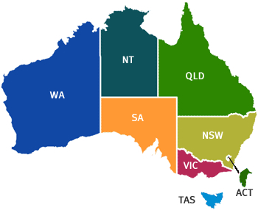

Roll Out Strategy

