Slide 1


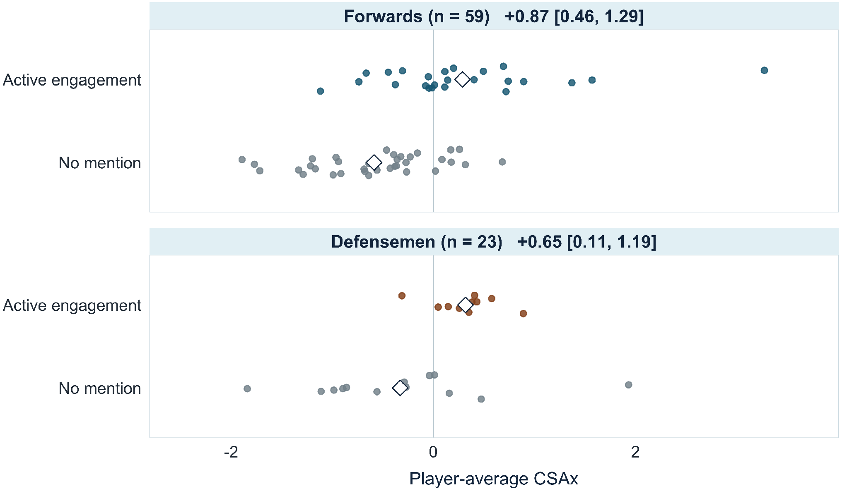


Playing Tougher for One’s Size: Positional Physicality in the NHL
Rento Saijo ‘28
Statistics and Data Science, Computer Science
Data, Information, and Society Pathway
Funded Sophomore Research Program
Jeff Moher, Connecticut College; Sian Lee, Michigan State University; Yeongjun Seo, U. of Tennessee
What does CSAx mean?
Does it match what scouts see?
Where does it matter?
CSAx measures physical presence relative to a player’s listed height and weight.
Scouting Report Example: Will Cuylle
Special-Teams Ice Time
“Powerful skater with good speed. … Heavy on the body and on pursuit of pucks. Very strong puck protection and wall play. Excellent net-front presence.”
Share of total ice time; CSAx +1 vs. −1
POWER PLAY
PENALTY KILL
DIRECT CONTACT
PUCK + SPACE
Forwards
−1.2 points
+1.4 points
Hits given or taken, blocks, fights, contact penalties
Net-front plays and forechecking; defensive recoveries and entry denials
2020 Draft Guide, NHL Central Scouting
Defensemen
−0.9 points
+1.3 points
Playoff Hitting among Forwards
First 4 playoff games vs. regular-season baseline
HIGHER CSAx
More physical presence for one’s size
Lower CSAx
+136%
LOWER CSAx
Less physical presence for one’s size
Higher CSAx
+84%
Hits rise in both forward profiles, with a smaller proportional rise
for higher-CSAx players; the defenseman contrast is uncertain.
2024-25 Top 3 CSAx
FORWARDS
DEFENSEMEN
Next-Season Roster Continuation
#
Player
CSAx
#
Player
CSAx
Chance of reaching 300 NHL minutes; CSAx +1 vs. −1
1
Sam Carrick
4.69
1
Connor Clifton
2.95
Forwards
+2.9 percentage points
2
Mathieu Olivier
3.88
2
Radko Gudas
2.93
Defensemen
+4.2 percentage points
3
Zachary L’Heureux
3.28
3
Nick Seeler
2.82
Each dot is a player; diamonds mark group means. Brackets show 95% intervals.
Active-engagement descriptions align with higher CSAx in both positions.
Among returners, higher CSAx shows no clear increase in minutes per game, so it accompanies staying power but not necessarily larger role.
Behind This Study
Data Sources
During my NHL Stats R&D internship, I discussed this research with supervisors and colleagues whose hockey and analytics perspectives helped sharpen our questions. I thank them for their guidance as this work took shape. We plan to present at Carnegie Mellon, submit to MIT Sloan, and develop a journal manuscript.
We combine NHL play-by-play and official ice-time records with Corey Sznajder’s All Three Zones tracking data. The NHL records describe contact and playing time, while the tracking data adds forechecking and defensive-zone actions. NHL Central Scouting profiles provide independent descriptions of physical engagement for comparison with CSAx.
Full 2024-25
Rankings and
Technical Details
Summer 2026 NHL Intern Cohort

