Slide 1



Playing Tougher for One’s Size
Calibrated Size Above Expected in the NHL
Rento Saijo
Presenter
Sian Lee
Jeff Moher
Yeongjun Seo
STA 496: Statistical Research
Carnegie Mellon Sports Analytics Conference 2026
Notes:
0:00–0:25 (25 seconds)
I’m Rento Saijo. This is joint work with Sian Lee, Jeff Moher, and Yeongjun Seo. We study a familiar sports judgment: a player plays bigger, or tougher, than his size. How can we turn that impression into a measure, and what can it tell us about NHL players?
Sources: Current JHK manuscript, https://github.com/RentoSaijo/CSAx_JHK . Author order and affiliations follow its research abstract. Institutional assets: https://www.conncoll.edu/offices/office-of-communications/visual-identity/logo-signature/ ; https://brand.msu.edu/logos ; https://brand.utk.edu/logos/ .
Affiliations: Rento Saijo and Jeff Moher, Connecticut College; Sian Lee, Michigan State University; Yeongjun Seo, University of Tennessee, Knoxville. Official marks: https://www.conncoll.edu/media/CircleMark-SM2-03.png ; https://brand.msu.edu/logos/identity/spartan-helmet ; https://brand.utk.edu/logos/ .

Slide 2


Which player plays tougher?
Player A
Player B
6′3″ 195 lb
5′9″ 180 lb
STA 496: Statistical Research
Carnegie Mellon Sports Analytics Conference 2026
Notes:
0:25–1:00 (35 seconds)
Before we introduce a model, take a look at these two players. Player A is six foot three and 195 pounds; Player B is five foot nine and 180 pounds. Based on those measurements, who would you expect to play the tougher game? Take a quick show of hands, then reveal the photographs. Their poses differ, so the printed measurements supply the comparison.
Source: bundled analysis, a3z$inputs$features, Martin Necas and Brad Marchand; https://github.com/RentoSaijo/CSAx_STA496/blob/main/data/analysis_data.rds .
The silhouettes follow the actual photographed poses. Sources: Colorado Avalanche, Martin Necas 2024–2025 gallery, https://www.nhl.com/avalanche/multimedia/galleries/necas-recap-25 ; Boston Bruins, January 29, 2018, https://www.nhl.com/bruins/news/photo-gallery-marchand-at-all-star-weekend-in-tampa-295403822 . Study-listed measurements are frozen registry values.

Slide 3

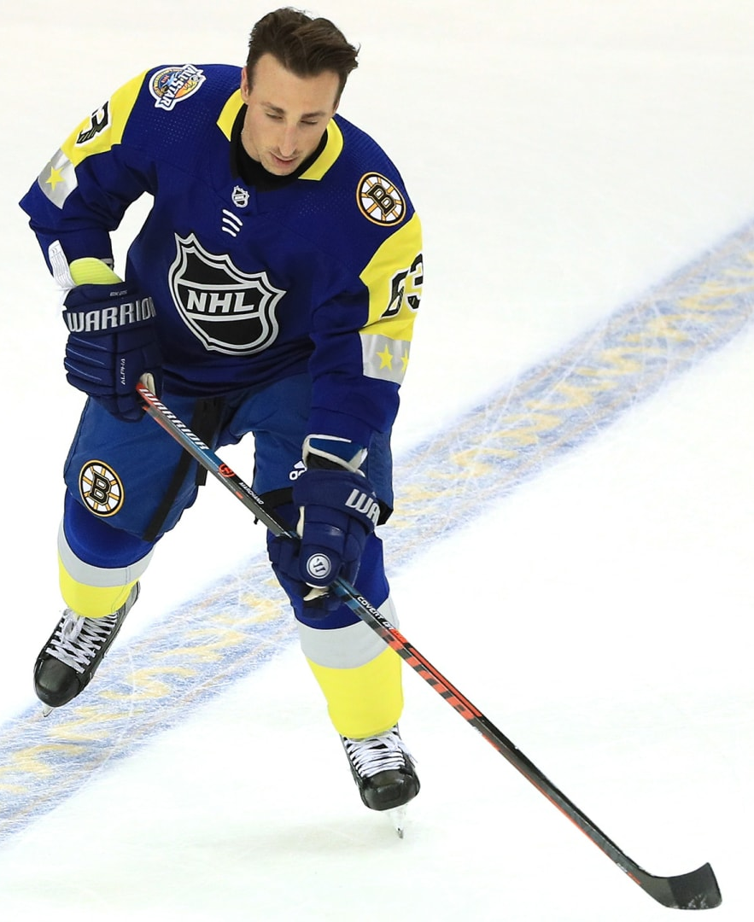
Size and reputation tell different stories
Martin Nečas
Brad Marchand
6′3″, 195 lb
5′9″, 180 lb
“soft playmaker who thrives on the perimeter”
“Plays bigger than his size. Very tough to play against.”
AJ Haefele · DNVR · 20 Jun 2017
Pat Verbeek · Stanley Cup of Chowder
6 Mar 2013
“penchant for perimeter play”
“hard-nosed game”
Ryan Henkel · The Hockey News
12 Jun 2024
Stan Fischler · NHL.com · 7 Aug 2024
“plays a very small and soft game”
“pound for pound he must be the strongest guy on the puck”
David Holliday · Pucks and Pitchforks
28 Jun 2024
Bruce Cassidy, relaying Kevin Dean
NHL.com · 4 Mar 2018
Photo: Colorado Avalanche
Photo: Boston Bruins
STA 496: Statistical Research
Carnegie Mellon Sports Analytics Conference 2026
Notes:
1:00–2:30 (90 seconds)
Player A is Martin Nečas; Player B is Brad Marchand. The larger player is described through perimeter play, while the smaller player is described as strong on the puck and difficult to play against. Give the six excerpts one shared interpretation, without reading each aloud. In hockey, perimeter play means operating farther from the crowded interior of the attacking zone. These descriptions raise a question that measurements alone cannot settle: how physical is someone’s game relative to his frame? We will return to both players after defining CSAx.
Sources: AJ Haefele, June 20, 2017, https://thednvr.com/avalanche/avalanche-draft-profile-martin-necas/ ; Ryan Henkel, June 12, 2024, https://thehockeynews.com/nhl/carolina-hurricanes/players/the-curious-case-of-martin-necas-when-talent-and-system-diverge ; Pat Verbeek interviewed by Cornelius Hardenbergh, March 6, 2013, https://www.stanleycupofchowder.com/2013/3/6/4064418/goodness-gracious-great-balls-of-hate-brad-marchand-pat-verbeek-little-ball-of-hate ; Stan Fischler, August 7, 2024, https://www.nhl.com/news/jean-beliveau-connor-mcdavid-among-best-nhl-captains . Official NHL headshots: https://assets.nhle.com/mugs/nhl/20262027/COL/8480039.png ; https://assets.nhle.com/mugs/nhl/20262027/FLA/8473419.png .
Additional sources: David Holliday, June 28, 2024, https://pucksandpitchforks.com/posts/new-jersey-devils-heavily-linked-to-martin-necas-ahead-of-nhl-draft ; Matt Kalman, March 4, 2018, quoting Bruce Cassidy relaying Kevin Dean, https://www.nhl.com/news/montreal-canadiens-boston-bruins-game-recap-296592260 . Photographs: https://www.nhl.com/avalanche/multimedia/galleries/necas-recap-25 ; https://www.nhl.com/bruins/news/photo-gallery-marchand-at-all-star-weekend-in-tampa-295403822 . These opening opinions are separate from the formal scouting sample.

Slide 4
From a hockey question to an NHL profile
Build
How do actions describe play relative to size?
Check
Does the score repeat and agree with scouting?
Interpret
What can individual players teach us?
Apply
How does the score relate to NHL roles?
STA 496: Statistical Research
Carnegie Mellon Sports Analytics Conference 2026
Notes:
2:30–3:00 (30 seconds)
We will first build the score, then check whether it carries across seasons and connects with earlier scouting descriptions. Individual players will help us interpret what goes into it. Finally, we will look at NHL assignments, playoff hitting, and continuation. Jason’s Statistical Height post offered a way to turn the opening question into something measurable.

Slide 5
Inspiration
STA 496: Statistical Research
Carnegie Mellon Sports Analytics Conference 2026
Notes:
3:00–3:05 (5 seconds)
The idea begins with a basketball question.

Slide 6
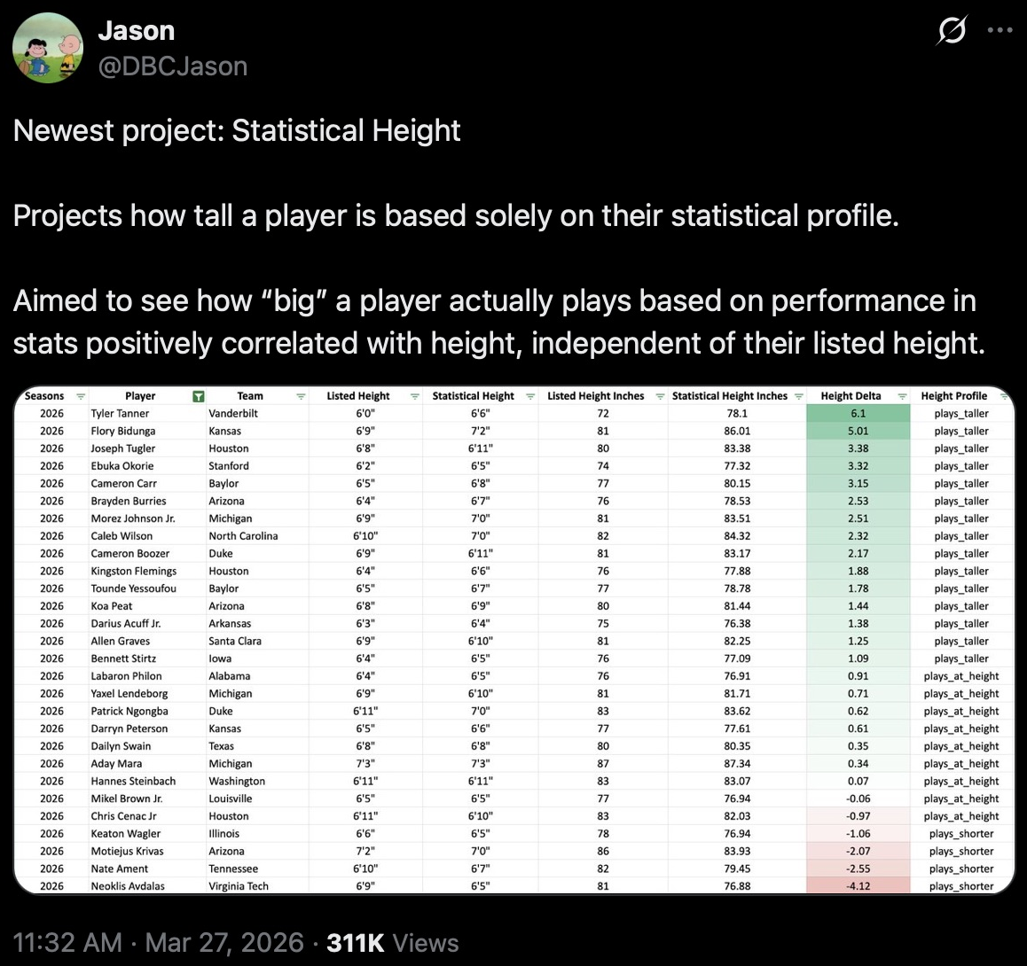
Statistical Height
STA 496: Statistical Research
Carnegie Mellon Sports Analytics Conference 2026
Notes:
3:05–3:40 (35 seconds)
This is Jason’s original post from March 2026. He asks what a basketball player’s statistical profile tells us about his height. The appeal is immediate: actions on the court can suggest a different physical profile from the roster listing. Let’s isolate one example so the idea is easier to see.
Source: Jason (@DBCJason), March 27, 2026, https://x.com/DBCJason/status/2037553268155375998 . Original graphic lists Tanner at 72 inches and statistical height 78.1 inches. Display rounds the latter to six feet six inches, as in the original graphic. Examples in that post are college basketball players.
Original post captured in Safari; source https://x.com/DBCJason/status/2037553268155375998 .

Slide 7
What height does the statistical profile suggest?
Tyler Tanner · Vanderbilt
6′0″
6′6″
Listed height
Statistical height
Could hockey actions tell us how big a player plays?
STA 496: Statistical Research
Carnegie Mellon Sports Analytics Conference 2026
Notes:
3:40–4:40 (60 seconds)
Tyler Tanner is listed at six feet, but his statistical profile produces a height of about six foot six. The numbers turn a familiar impression—playing bigger—into an observable comparison. Our hockey version starts with a related question: what size would we infer if we saw only the actions? We combine height and weight, and we add calibration so that the score has a fair reference across different frames. To bring that idea into hockey, we first need to see the actions players use to contest pucks and space.
Source: Jason (@DBCJason), March 27, 2026, https://x.com/DBCJason/status/2037553268155375998 . Original graphic lists Tanner at 72 inches and statistical height 78.1 inches. Display rounds the latter to six feet six inches, as in the original graphic. Examples in that post are college basketball players.
The original graphic reports 72 inches and 78.1 inches; six foot six is its rounded display.

Slide 8
Hockey context
STA 496: Statistical Research
Carnegie Mellon Sports Analytics Conference 2026
Notes:
4:40–4:45 (5 seconds)
Physical play takes several forms around the puck.

Slide 9
Physical play around the puck
Forwards
Attack the goal and
pursue possession.
Defensemen
Protect their end and
retrieve the puck.
Attacking direction
Goalie
Guards the net.
STA 496: Statistical Research
Carnegie Mellon Sports Analytics Conference 2026
Notes:
4:45–6:00 (75 seconds)
Teams try to put the puck in the opposing goal while protecting their own. At five-on-five, each has five skaters and a goalie. Blue dots are forwards, orange dots defensemen, and gray is the goalie. Forwards generally lead the attack and pursue possession; defensemen protect their end and retrieve the puck. Players move throughout the rink. A hit is recorded body contact with an opponent. Physical involvement also appears in a forward recovering a puck near the boards or a defenseman retrieving it under pressure. Our measure brings contact together with some of this work for pucks and useful space.
Sources: NHL game context, https://www.nhl.com/info/hockey-101 ; All Three Zones measure definitions, https://www.allthreezones.com/player-cardsfaq.html . Rink illustration is schematic.

Slide 10
Data
STA 496: Statistical Research
Carnegie Mellon Sports Analytics Conference 2026
Notes:
6:00–6:05 (5 seconds)
We bring NHL records and manually tracked actions together.

Slide 11
Study sample and data sources
825 skaters
2,314 player-seasons
NHL event and ice-time records
Retrieved through nhlscraper
All Three Zones manual tracking
Corey Sznajder’s Tableau workbook
STA 496: Statistical Research
Carnegie Mellon Sports Analytics Conference 2026
Notes:
6:05–6:50 (45 seconds)
We study four regular seasons, from 2021–22 through 2024–25: 825 skaters and 2,314 eligible player-seasons. A player-season is one player’s record for one year. NHL events and ice-time records come through nhlscraper, and All Three Zones contributes manually tracked actions. We match those sources to the same player-games, so the physical-play inputs share the same observed opportunities.
Sources: https://www.nhl.com/stats/ ; https://www.allthreezones.com/player-cardsfaq.html ; bundled analysis and current JHK Methods, https://github.com/RentoSaijo/CSAx_JHK .
Eligibility: at least 300 full-season NHL minutes and 150 matched tracked five-on-five minutes, with listed height, weight, and birth date. Forward counts:399,374,359,353; defensemen:215,203,204,207. Sources: https://github.com/RentoSaijo/nhlscraper ; https://public.tableau.com/app/profile/corey.sznajder/viz/transitionstats/Sheet1 .

Slide 12
Direct and indirect measures
Component | Position | Measures
Direct measures | Both | Hits delivered and received; blocked shots; fights; contact penalties taken and drawn
Indirect measures | Forwards | Net-front attempt share; deflection share; backhand share; median shot distance; dump-in recoveries; forecheck pressures
Indirect measures | Defensemen | Clean retrievals; botched retrievals; entry-denial share
STA 496: Statistical Research
Carnegie Mellon Sports Analytics Conference 2026
Notes:
6:50–7:45 (55 seconds)
We use direct measures of contact and position-specific indirect measures of involvement around the puck. Direct events include delivering or receiving hits, blocking shots, fighting, and contact penalties. Forwards contribute information about work near the net, puck recoveries, and pressure on opponents. Defensemen contribute retrievals and entry defense. The complete profile has twelve inputs for forwards and nine for defensemen. We let these actions jointly predict listed size; no single event determines the score.
Source: All Three Zones glossary, https://www.allthreezones.com/player-cardsfaq.html ; current JHK Methods and Table 1, https://github.com/RentoSaijo/CSAx_JHK .
Counts use matched NHL five-on-five exposure, expressed per 60 minutes. Net-front share uses located unblocked attempts in the defined net-front region. Deflection and backhand shares use typed shots on net; median shot distance uses located unblocked attempts. Entry-denial share uses stopped targeted entry attempts divided by targeted entries. Undefined opportunity shares remain missing for training-sample imputation rather than being automatically assigned zero. Clean and botched retrievals enter separately. Player-season eligibility requires at least 300 full-season NHL minutes, 150 matched tracked five-on-five minutes, and height, weight, and birth date. Inputs come from identical retained A3Z player-games for each skater. The listed-size index standardizes height and weight, combines them with equal scaling, and standardizes again within the pooled positional reference.
Sources: current JHK Methods and Table 1, https://github.com/RentoSaijo/CSAx_JHK ; https://www.allthreezones.com/player-cardsfaq.html .

Slide 13
Methods
STA 496: Statistical Research
Carnegie Mellon Sports Analytics Conference 2026
Notes:
7:45–7:50 (5 seconds)
The model turns the action profile into a size prediction.

Slide 14
What size do these actions imply?
1
2
3
Observe the actions
Learn the relationship
Predict for a new player
Combine contact with
position-specific puck work.
Ridge regression predicts
listed size from those inputs.
His own seasons stay outside
the model’s training data.
STA 496: Statistical Research
Carnegie Mellon Sports Analytics Conference 2026
Notes:
7:50–8:35 (45 seconds)
We describe the actions, learn how they relate to listed size, and predict size for a player whose own seasons remain outside the training data. Ridge regression helps us use several related predictors without letting the fitted relationship react too strongly to each one. Listed size combines standardized height and weight. We fit forwards and defensemen separately and pool four seasons within each position. The result is behavior-implied size, xS.
Source: current JHK manuscript and bundled analysis, https://github.com/RentoSaijo/CSAx_JHK . Ridge reference: Hoerl, A. E., & Kennard, R. W. (1970). Technometrics, 12(1), 55–67. https://doi.org/10.1080/00401706.1970.10488634 .

Slide 15
Predictions tend toward the middle
Schematic illustration
Predictions shrink
toward average size.
Subtracting actual size gives smaller frames an artificial advantage.
Blue: usual prediction Gray: prediction equals listed size
STA 496: Statistical Research
Carnegie Mellon Sports Analytics Conference 2026
Notes:
8:35–9:40 (65 seconds)
The obvious subtraction is predicted size minus listed size. This schematic shows the problem. Along the gray diagonal, prediction equals listed size. The blue line is the usual prediction, which moves toward the middle when prediction is imperfect. For an ordinary small player, the predicted size lies above actual size. For an ordinary large player, it lies below. Those orange gaps give opposite scores simply because their frames differ. Positive association between listed and predicted size is expected. The problem appears when we treat their raw difference as physical play relative to size.
Source: calibration method in current JHK manuscript, https://github.com/RentoSaijo/CSAx_JHK .

Slide 16
Calibration gives each frame a baseline
Compare with the usual model prediction for that listed frame
Both players exceed
their frame baseline.
CSAx expresses the gap
in standard deviations
within position.
−1 Below baseline
0 At baseline
+1 Above baseline
STA 496: Statistical Research
Carnegie Mellon Sports Analytics Conference 2026
Notes:
9:40–10:50 (70 seconds)
Keep the same axes, but compare each player with the usual model prediction at his own frame. The two orange gaps are now equal. Both players exceed the expectation for their size. We estimate the baseline using training data, then apply it to the held-out player. Finally, we express those gaps in standard deviations within position. Zero is the pooled calibrated reference. Plus one is one standard deviation above it; minus one is one below. This is Calibrated Size Above Expected, or CSAx. Let’s now see how the calibration behaves in the actual observations.
Source: current JHK Methods, https://github.com/RentoSaijo/CSAx_JHK .

Slide 17
Before calibration
Uncalibrated excess size is xS − S, standardized within position
Forwards
r = −0.95
Defensemen
r = −0.94
STA 496: Statistical Research
Carnegie Mellon Sports Analytics Conference 2026
Notes:
10:50–11:25 (35 seconds)
Each dot is an eligible player-season from the saved held-out predictions. Before calibration, the raw subtraction strongly favors smaller frames. The correlations are minus 0.95 and minus 0.94. Standardizing the difference puts it on a comparable scale but leaves that correlation unchanged. Notice the downward tilt; we will keep these axes for the next slide.
Source: https://github.com/RentoSaijo/CSAx_STA496/blob/main/data/analysis_data.rds , a3z$predictions. All 1,485 forward-seasons and 829 defenseman-seasons are plotted; no refitting or filtering. Listed size uses the pooled positional reference. Before score=(xS−S−mean(xS−S))/sd(xS−S); after score=CSAx. Positive correlation of S and xS is expected; the unwanted association concerns the uncalibrated excess score.

Slide 18
After calibration
CSAx has little remaining linear association with listed size
Forwards
r = 0.01
Defensemen
r = 0.02
STA 496: Statistical Research
Carnegie Mellon Sports Analytics Conference 2026
Notes:
11:25–11:55 (30 seconds)
After calibration, both plots use exactly the same axes. There is now very little linear association with listed size: 0.01 for forwards and 0.02 for defensemen. The scores vary widely at a given frame, which lets us compare how players’ recorded actions exceed or fall below their own reference. We have removed the strong linear size pattern in the raw subtraction.
Source: https://github.com/RentoSaijo/CSAx_STA496/blob/main/data/analysis_data.rds , a3z$predictions. All 1,485 forward-seasons and 829 defenseman-seasons are plotted; no refitting or filtering. Listed size uses the pooled positional reference. Before score=(xS−S−mean(xS−S))/sd(xS−S); after score=CSAx. Positive correlation of S and xS is expected; the unwanted association concerns the uncalibrated excess score.

Slide 19
Revisiting Nečas and Marchand
CSAx in every study season
Four-season mean
−1.04
Martin Nečas
+0.12
Brad Marchand
STA 496: Statistical Research
Carnegie Mellon Sports Analytics Conference 2026
Notes:
11:55–12:30 (35 seconds)
Now we can return to the opening with a precise comparison. Nečas is below his frame baseline in all four seasons, averaging minus 1.04. Marchand is higher in each season but varies, averaging close to baseline at plus 0.12. The complete series gives us more than a single reputation label. Beyond these two players, do the scores repeat across seasons and connect with earlier descriptions of physical play?
Source: a3z$predictions, https://github.com/RentoSaijo/CSAx_STA496/blob/main/data/analysis_data.rds .

Slide 20
Reliability
STA 496: Statistical Research
Carnegie Mellon Sports Analytics Conference 2026
Notes:
12:30–12:35 (5 seconds)
First, we check how relative standing carries from one season to the next.

Slide 21
Relative standing carries across seasons
Correlation between adjacent-season CSAx scores
STA 496: Statistical Research
Carnegie Mellon Sports Analytics Conference 2026
Notes:
12:35–13:15 (40 seconds)
Players’ relative standing tends to persist. Adjacent-season correlations are about 0.70 for forwards and 0.59 to 0.64 for defensemen. A correlation of one would mean a perfectly consistent linear pattern; zero would mean no linear relationship. Here we see substantial repeatability alongside room for annual change. This reliability check leads to a different question: does CSAx connect with independent descriptions of physical play?
Source: a3z$stability and a3z$pooledPerformance. Full Pearson values: F .7021969, .7055067, .7115831; D .5932608, .6002878, .6397942. Size correlation .01041842 F, .02094931 D. https://github.com/RentoSaijo/CSAx_STA496/blob/main/data/analysis_data.rds .

Slide 22
Validation
STA 496: Statistical Research
Carnegie Mellon Sports Analytics Conference 2026
Notes:
13:15–13:20 (5 seconds)
Earlier scouting reports give us another point of reference.

Slide 23
A scouting report in its own words
“
Although not big in stature, he brings all the attributes to be a complete player. Plays bigger than his size. Excellent puck pursuit in all areas, whether on offense or defense. Hard to contain with his second and third efforts. A player who want's the puck on his stick to be a game changer. Plays a high-tempo game. Effective on both the power play and penalty kill. His quick transition game in all areas makes him dangerous. Displays very good skill and vision.”
Zach Benson · NHL Central Scouting
2023 NHL Draft Prospect Bios, p. 9 · 16 June 2023
STA 496: Statistical Research
Carnegie Mellon Sports Analytics Conference 2026
Notes:
13:20–14:05 (45 seconds)
Give the audience roughly fifteen seconds to read. This is the complete Central Scouting paragraph for Zach Benson in the supplied 2023 prospect report. “Plays bigger than his size” is explicit, and the surrounding sentences connect it to puck pursuit and repeated effort. Scouting descriptions are broader than physical contact, so we need a consistent criterion before comparing them with CSAx.
Verbatim supplied annotation, checked against NHL 2023 prospect report, PDF page 9. The original apostrophe in “want's” is retained. Source: https://media.nhl.com/site/asset/public/ext/2022-23/2023%20NHL%20Draft%20Prospect%20Bios_Final.pdf ; annotation catalog https://github.com/RentoSaijo/CSAx_STA496/blob/main/validation/scouting_annotations.csv .

Slide 24
Active physical-play profile
82
Delivered contact
Contested-puck battles
draft-era descriptions
Forceful net drives
59 forwards
23 defensemen
Physical aggression
“No mention” describes the passage’s emphasis.
STA 496: Statistical Research
Carnegie Mellon Sports Analytics Conference 2026
Notes:
14:05–14:50 (45 seconds)
We review whether each passage describes active physical play: delivered contact, puck battles, forceful net drives, or physical aggression. Strength or body size alone does not satisfy the criterion. One rater first reads redacted passages without identities or CSAx, then reviews the complete descriptions. We have 82 players: 59 forwards and 23 defensemen. “No mention” means qualifying play is absent from that passage, not that a scout judged the player unphysical. These draft reports are separate from the opening media quotes.
Sources: reviewed codebook and annotations, https://github.com/RentoSaijo/CSAx_STA496/blob/main/validation/scouting_codebook.md ; original NHL 2020 Draft Guide, Guhle p. 42, https://media.nhl.com/site/asset/public/ext/2019-20/2020DraftGuide.pdf .

Slide 25
Scouting agreement: forwards
Each dot is one player’s average CSAx
Mean difference
+0.66
95% confidence interval
[0.23, 1.08]
Horizontal lines show
group means.
No mention
n = 38 · mean −0.57
Mentioned
n = 21 · mean +0.09
STA 496: Statistical Research
Carnegie Mellon Sports Analytics Conference 2026
Notes:
14:50–15:35 (45 seconds)
Every dot is a forward, averaged across his eligible NHL seasons. Players whose draft descriptions mention active physical play have a mean CSAx 0.66 units higher, with a 95% confidence interval from 0.23 to 1.08. The dots show overlap as well as the shift in group means. Earlier scouting language therefore connects with later physical-play records, while individual cases remain worth examining.
Sources: https://github.com/RentoSaijo/CSAx_STA496/blob/main/validation/scouting_annotations.csv ; bundled a3z$scouting.
Native scatter chart uses deterministic horizontal jitter only to separate players. Vertical values are the saved player means, with no analysis refit. These are unadjusted differences, with player-clustered HC1 intervals conditional on estimated scores and the observed cohort.

Slide 26
Scouting agreement: defensemen
Each dot is one player’s average CSAx
Mean difference
+0.75
95% confidence interval
[0.30, 1.21]
Horizontal lines show
group means.
No mention
n = 14 · mean −0.50
Mentioned
n = 9 · mean +0.26
STA 496: Statistical Research
Carnegie Mellon Sports Analytics Conference 2026
Notes:
15:35–16:05 (30 seconds)
The defensemen show the same direction. Their mean difference is 0.75 CSAx units, with a 95% interval from 0.30 to 1.21. There are only 23 defensemen here, and the individual dots help us see the sample behind that average. Agreement at the group level gives us a useful reference; the contrasting cases can tell us where to look more closely.
Sources: https://github.com/RentoSaijo/CSAx_STA496/blob/main/validation/scouting_annotations.csv ; bundled a3z$scouting.
Native scatter chart uses deterministic horizontal jitter only to separate players. Vertical values are the saved player means, with no analysis refit. These are unadjusted differences, with player-clustered HC1 intervals conditional on estimated scores and the observed cohort.

Slide 27
Samoskevich invites a closer look
2021 draft description
2024–25
“A very good skater who is quick and shifty with the puck. Possesses a quick release with good hands. Handles the puck well – a creative player with the puck. Possesses a high hockey IQ and can play a 200-foot game.”
+1.10
CSAx
12.75
hits delivered per 60 minutes
NHL prospect profiles, p. 26 · 14 July 2021
STA 496: Statistical Research
Carnegie Mellon Sports Analytics Conference 2026
Notes:
16:05–17:00 (55 seconds)
Mackie Samoskevich’s draft passage highlights skating, creativity, hands, and a full-rink game. It receives a no-mention code. Yet his one eligible NHL season has CSAx plus 1.10 and 12.75 delivered hits per 60 matched five-on-five minutes. Hits per 60 puts different amounts of playing time on a common scale. This is a contact-rich profile alongside an earlier public description centered on puck skill. What happened between those two records? Several explanations are worth investigating.
Source: NHL 2021 Prospect Profiles, p. 26, July 14, 2021, https://media.nhl.com/site/asset/public/ext/nhl%20stats/ProspectBios2021_Text.pdf ; https://github.com/RentoSaijo/CSAx_STA496/blob/main/validation/scouting_annotations.csv ; current JHK Discussion, https://github.com/RentoSaijo/CSAx_JHK . Exact case: sole eligible 2024–25 season; direct +0.87, indirect −0.16, frame +0.40; rounded components may not sum to rounded total.

Slide 28
Possible explanations
Public-summary emphasis
A short profile may highlight skill and leave physical habits unmentioned.
Evaluation or projection
Physical play may receive less attention, or translate differently than expected.
Development and maturation
The player’s choices and capacity for contact may change over time.
Role and playing environment
Assignments, coaching, space, and pressure may change the opportunities.
STA 496: Statistical Research
Carnegie Mellon Sports Analytics Conference 2026
Notes:
17:00–18:30 (90 seconds)
The first possibility is emphasis: would fuller reports describe contact or battles that the brief public summary leaves out? Draft-era video and complete contemporaneous evaluations could answer that. Second, evaluators may underread physical play or judge its NHL translation differently. A player’s build could affect what receives attention, but we would need an actual recorded projection before evaluating its accuracy. Third, Samoskevich may develop or mature: comparable footage could show changes in how he initiates contact and sustains a contest. Finally, his role or environment may change what he is asked to do and where the opportunities arise. Deployment and comparable game situations would help separate those accounts. These hypotheses can coexist. The point is to turn a disagreement into specific questions for scouting and video review.
Interpretation follows the Samoskevich discussion in the current JHK manuscript: https://github.com/RentoSaijo/CSAx_JHK . These are possible accounts, not established explanations for this player.

Slide 29
Similar scores, different physical-play profiles
Kaiden Guhle
+0.73
Mean across 2022–23
to 2024–25
Emil Andrae
+0.70
2024–25
One eligible season
STA 496: Statistical Research
Carnegie Mellon Sports Analytics Conference 2026
Notes:
18:30–20:00 (90 seconds)
Here is a different kind of puzzle: how do these profiles finish at almost the same score? Guhle averages plus 0.73 over three seasons, with a strong positive direct contribution. Andrae reaches plus 0.70 in one eligible season through the indirect component and the frame adjustment, alongside a negative direct contribution. The frame term belongs to calibration; it is not another on-ice action. For Andrae, the indirect profile points us toward retrievals and entry defense. Because botched retrievals are included alongside clean ones, the next question concerns activity, opportunity, and execution. Similar total scores can direct a coach or analyst toward very different video. We can now ask how those scores relate to NHL assignments.
Sources: bundled predictions and current JHK Discussion, https://github.com/RentoSaijo/CSAx_JHK .

Slide 30
Applications
STA 496: Statistical Research
Carnegie Mellon Sports Analytics Conference 2026
Notes:
20:00–20:05 (5 seconds)
We now turn from measuring physical style to its NHL context.

Slide 31
Comparing NHL roles and outcomes
CSAx −1
CSAx +1
Below the frame baseline
Above the frame baseline
Two standard deviations apart, within position
We account for size, age, usage, performance, and season.
STA 496: Statistical Research
Carnegie Mellon Sports Analytics Conference 2026
Notes:
20:05–20:45 (40 seconds)
For the adjusted applications, we compare players at CSAx minus one and plus one: a two-standard-deviation contrast within position. We account for listed size, age, current usage and performance, and season. Think of this as comparing profiles after accounting for those measured differences. The observations show associations with NHL work and outcomes; they do not tell us what would happen if we could simply increase a player’s CSAx.
Source: current JHK application methods, https://github.com/RentoSaijo/CSAx_JHK .

Slide 32
Different special-teams assignments
CSAx +1 versus −1 · share of total official ice time
Penalty kill
Playing with fewer skaters after a penalty
Power play
Playing with a numerical advantage
STA 496: Statistical Research
Carnegie Mellon Sports Analytics Conference 2026
Notes:
20:45–22:00 (75 seconds)
Penalties create special teams. On the penalty kill, a team plays with fewer skaters; on the power play, it has a numerical advantage. Higher-CSAx players have larger penalty-kill shares and smaller power-play shares. The differences are about one to one-and-a-third percentage points of total official ice time. In hockey terms, this fits complementary assignments: physical engagement can accompany defensive and disruptive work, while power-play time often emphasizes offensive creation. A smaller power-play share does not erase the role; it helps describe where that role is used.
Source: a3z$applications$deployment, https://github.com/RentoSaijo/CSAx_STA496/blob/main/data/analysis_data.rds .
Exact +1 versus −1 differences: penalty kill F +1.35 [0.63,2.08] pp,D +1.33 [0.73,1.93] pp; power play F −1.26 [−1.86,−0.66] pp,D −1.12 [−1.83,−0.41] pp.

Slide 33
Hitting rises in the playoffs
Observed forward groups · same player-seasons in both periods
Higher-CSAx forwards remain the more frequent hitters.
STA 496: Statistical Research
Carnegie Mellon Sports Analytics Conference 2026
Notes:
22:00–23:30 (90 seconds)
Playoff hockey gives us a chance to examine physical engagement in another setting. These are observed threshold groups: CSAx at most minus one or at least plus one. Follow each group from its regular-season baseline into the first four playoff games. Both hit more. The lower group rises from 2.17 to 5.57 hits per 60; the higher group rises from 11.21 to 18.19. Higher-CSAx forwards remain much more frequent hitters and add more hits per hour. Now consider a different question: whose rate changes more relative to its starting point? That distinction matters because the lower group begins with much more proportional headroom.
Source: current JHK Results and a3z$applications$engagement, https://github.com/RentoSaijo/CSAx_JHK .
The baseline uses the same players’ regular-season games excluded from CSAx construction. Threshold groups here are descriptive; the next slide compares adjusted point values −1 and +1.

Slide 34
Proportional change tells another story
Adjusted postseason change relative to each player-season’s baseline
The proportional contrast is clearer for forwards.
STA 496: Statistical Research
Carnegie Mellon Sports Analytics Conference 2026
Notes:
23:30–25:00 (90 seconds)
We now return to the adjusted comparison at minus one and plus one. For forwards, the estimated postseason-to-baseline multipliers are 2.47 and 1.80. Lower-CSAx forwards make the larger proportional increase. That is consistent with starting farther from the hitting rates already reached by frequent hitters. Roles and playoff tactics may also change the opportunities for contact. For defensemen, the multipliers are 1.66 and 1.48, and the contrast is less clear. Keep the three questions separate: who hits more, who adds more hits, and who increases by a larger proportion. The observed high-CSAx group remains the more frequent hitting group even though its proportional increase is smaller.
Source: a3z$applications$engagement$rateChanges and $estimates, https://github.com/RentoSaijo/CSAx_STA496/blob/main/data/analysis_data.rds .
Ratio of rate ratios, CSAx +1 versus −1: F 0.73 [0.64,0.83]; D 0.89 [0.76,1.05]. This is a contrast of postseason multipliers, not a ratio of absolute playoff hit rates.

Slide 35
Continuing in the NHL
Continuation: at least 300 NHL minutes in the following season
+4.07
percentage points
Forwards
95% CI [1.06, 7.09]
+5.09
percentage points
Defensemen
95% CI [1.08, 9.10]
About 4–5 more continuations per 100 player-seasons
STA 496: Statistical Research
Carnegie Mellon Sports Analytics Conference 2026
Notes:
25:00–26:30 (90 seconds)
The next question concerns continued NHL involvement. We define continuation as at least 300 NHL minutes in the following season. The adjusted probabilities rise from 87.22 to 91.30 percent for forwards and from 85.84 to 90.93 percent for defensemen. Using the unrounded predictions, the differences are 4.07 and 5.09 percentage points. That is about four more continuing forward-seasons and five more defenseman-seasons per hundred in this comparison. This association gives physical style a concrete career context. It also raises a follow-up: among those who return, do higher-CSAx players receive more minutes each night?
Source: a3z$continuationProbabilities and $continuationContrasts, https://github.com/RentoSaijo/CSAx_STA496/blob/main/data/analysis_data.rds .
Contrasts are calculated before rounding, so rounded probabilities may not subtract to the displayed contrast. Outcomes extend through 2025–26.

Slide 36
Returners’ nightly minutes are similar
Adjusted difference at CSAx +1 versus −1 · 95% confidence intervals
Difference in next-season minutes per game
Forwards: −0.14 [−0.32, 0.03] Defensemen: −0.18 [−0.46, 0.11]
STA 496: Statistical Research
Carnegie Mellon Sports Analytics Conference 2026
Notes:
26:30–27:30 (60 seconds)
Among returners, the estimates show little separation in nightly minutes. The forward difference is minus 0.14 minutes per game and the defenseman difference minus 0.18; both intervals include zero. This returner group includes any next-season NHL appearance, which differs from the 300-minute continuation threshold. Higher CSAx accompanies a greater chance of another qualifying season, while a larger nightly role does not follow clearly in these estimates. Physical-play profiles may help describe complementary ways of remaining involved in the league.
Source: a3z$applications$playingTime, https://github.com/RentoSaijo/CSAx_STA496/blob/main/data/analysis_data.rds .

Slide 37
Conclusions
STA 496: Statistical Research
Carnegie Mellon Sports Analytics Conference 2026
Notes:
27:30–27:35 (5 seconds)
We can now put the results and their limits together.

Slide 38
Limitations
Coverage
Selected tracked games capture about one-third of an eligible season.
Construct
Recorded actions relate to size, with incomplete context and information about effectiveness.
Scouting
Brief descriptions, one rater, and development between the draft and NHL shape the comparison.
Inference
The comparisons are observational, and the pooled reference is retrospective.
STA 496: Statistical Research
Carnegie Mellon Sports Analytics Conference 2026
Notes:
27:35–28:30 (55 seconds)
Four limits guide the interpretation. Tracking covers selected games, about a third of an eligible season. The model relates recorded actions to size, so context and effectiveness remain incomplete. The scouting comparison uses brief descriptions, one rater, and players who later meet NHL eligibility. Finally, roles and outcomes reflect more than the measured controls, and the common four-season reference is retrospective. Confidence intervals condition on the estimated scores and observed samples. These limits point to how the score should be used: as a structured description that directs closer hockey evaluation.
Sources: current JHK Limitations, https://github.com/RentoSaijo/CSAx_JHK ; tracking definitions, https://www.allthreezones.com/player-cardsfaq.html .

Slide 39
What we take away
1
Recorded actions describe physical play relative to a player’s size.
2
CSAx persists across seasons and aligns with earlier scouting descriptions.
3
Similar scores can come from different kinds of physical play.
4
Higher CSAx accompanies distinct NHL roles and continued participation.
STA 496: Statistical Research
Carnegie Mellon Sports Analytics Conference 2026
Notes:
28:30–29:30 (60 seconds)
Return to the opening question. Size alone leaves much to learn about how a player competes for pucks and space. CSAx gives those recorded actions a reference tied to the player’s frame. The score carries across seasons and agrees, on average, with earlier descriptions of active physical play. Its components reveal different profiles beneath similar totals. And in the NHL, it accompanies different assignments and continued participation, with little separation in nightly minutes among returners. For coaches and analysts, that makes the score a starting point for more specific player comparisons and video questions.

Slide 40

Thank you for listening
Acknowledgements
We thank everyone on the National Hockey League Research & Development Team for their advice and insights.
Selected references
NHL records and Central Scouting reports
Corey Sznajder · All Three Zones
Jason (2026) · Statistical Height
Hoerl & Kennard (1970) · Ridge regression
Explore annual rankings
Scan with your phone
STA 496: Statistical Research
Carnegie Mellon Sports Analytics Conference 2026
Notes:
29:30–30:00 (30 seconds)
Thank you for listening. We thank everyone on the NHL Research & Development Team for their advice and insights. The QR code opens the annual rankings, where you can choose a season and position or search for a player. I’m happy to take questions.
Rankings: https://rentosaijo.github.io/CSAx_STA496/ . The public page includes all 2,314 study-eligible player-seasons from the same saved pooled analysis. Leave this slide displayed during questions. Backups follow as hidden slides.

Slide 41
Model details and diagnostics
Pooled models within position
Size prediction | R²
Forwards | 0.10
Defensemen | 0.11
Five outer player-grouped folds
Five inner folds · 20 ridge penalties
Training-only preprocessing and calibration
All seasons of each player stay together
2024–25 defensemen
R² = 0.05
Eligibility
≥300 NHL minutes · ≥150 matched tracked minutes
Height, weight, and birth date available
STA 496: Statistical Research
Carnegie Mellon Sports Analytics Conference 2026
Notes:
Backup · for questions
Separate pooled ridge models predict standardized listed size for forwards and defensemen. Five outer folds hold all seasons of a player together. Five inner grouped folds tune 20 ridge penalties using the outer training sample. Training-only preprocessing includes median imputation, removal of zero-variance predictors, Yeo–Johnson transformation, and normalization. Inner held-out expected-size predictions are regressed on listed size to estimate the calibration baseline. The outer held-out prediction minus that baseline yields the calibrated residual, standardized across the pooled positional reference. This is retrospective generalization to held-out players within four study seasons; training data may include later seasons than a scored observation. Predictive R² values .10 and .11 refer to predicting listed size, relative to a same-season training-mean benchmark. All eight annual evaluations improve on the benchmark; 2024–25 defensemen have the weakest annual value, .05.
Sources: current JHK Methods, https://github.com/RentoSaijo/CSAx_JHK ; Hoerl & Kennard (1970), https://doi.org/10.1080/00401706.1970.10488634 ; Yeo & Johnson (2000), https://doi.org/10.1093/biomet/87.4.954 .

Slide 42
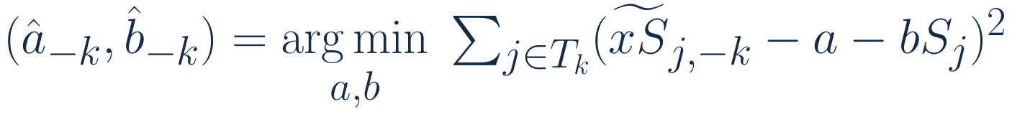
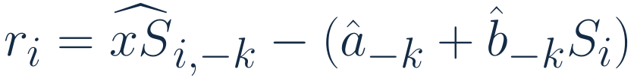
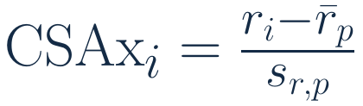
Calibration equations
Within each position, k denotes the player-grouped outer held-out fold
Estimate calibration from inner held-out predictions in training sample Tₖ
$$({\hat{a}}_{−k}, {\hat{b}}_{−k}) = \underset{a,b}{arg min}\sum_{j∈T_{k}}{{({\tilde{xS}}_{j,−k} − a − bS_{j})}^{2}}$$
Evaluate outer held-out player-season i
$$r_{i} = {\hat{xS}}_{i,−k} − ({\hat{a}}_{−k} + {\hat{b}}_{−k}S_{i})$$
Standardize across pooled positional reference p
$${CSAx}_{i} = \frac{r_{i} − {\bar{r}}_{p}}{s_{r,p}}$$
STA 496: Statistical Research
Carnegie Mellon Sports Analytics Conference 2026
Notes:
Backup · for questions
Let T_k denote the outer training sample, excluding every season of players in outer fold k. For each j in T_k, xS-tilde is the prediction from the selected ridge penalty in its inner held-out fold. Regress those inner held-out predictions on listed size S to obtain calibration intercept and slope. For i in outer fold k, xS-hat is the prediction from the ridge model fitted to T_k. Subtract the calibration baseline for S_i. Pool those outer held-out residuals within position p, across four seasons, then subtract their mean and divide by their sample standard deviation. All calibration fitting uses outer training data; the last standardization defines the retrospective pooled reference scale. Listed size itself standardizes height and weight in the pooled position, combines (zH+zW)/sqrt(2), then restandardizes that combined index.
Sources: https://github.com/RentoSaijo/CSAx_JHK ; implementation https://github.com/RentoSaijo/CSAx_STA496/blob/main/R/models.R .

Slide 43
Application estimates and controls
CSAx +1 versus −1 · 95% confidence intervals
Outcome | Forwards | Defensemen
Penalty-kill share (pp) | +1.35 [0.63, 2.08] | +1.33 [0.73, 1.93]
Power-play share (pp) | −1.26 [−1.86, −0.66] | −1.12 [−1.83, −0.41]
Continuation (pp) | +4.07 [1.06, 7.09] | +5.09 [1.08, 9.10]
Returner minutes/game | −0.14 [−0.32, 0.03] | −0.18 [−0.46, 0.11]
Controls: listed size, age and age², games, minutes/game, five-on-five points/60,
relative shot-attempt share, and season.
Player-clustered HC1 intervals condition on estimated CSAx and observed samples.
STA 496: Statistical Research
Carnegie Mellon Sports Analytics Conference 2026
Notes:
Backup · for questions
All displayed contrasts compare CSAx +1 with −1. Deployment shares and returner minutes use ordinary least squares. Continuation uses logistic regression and covariate-standardized average predictions; contrasts are percentage-point differences. Common controls are listed size, centered age and age squared, current-season games dressed, all-situations ice time/game, five-on-five points/60, relative five-on-five shot-attempt share, and season. Confidence intervals use player-clustered HC1 covariance estimates, conditional on estimated CSAx and observed samples. Deployment and main continuation include 1,485 forward-seasons and 829 defenseman-seasons. The returner sample includes 1,408 and 780. On identical matched previous-appearance cohorts, continuation contrasts are F 4.01 pp with current-role controls versus 4.69 with prior-role controls, and D 4.93 versus 6.50. Those matched comparisons are separate from the full-panel 4.07 and 5.09 estimates.
Source: bundled a3z$applications, a3z$continuationContrasts, current JHK Table 3, https://github.com/RentoSaijo/CSAx_JHK .

Slide 44
Postseason contrasts and starting rates
Adjusted ratio of rate ratios | Forwards | Defensemen
First four playoff games | 0.73 [0.64, 0.83] | 0.89 [0.76, 1.05]
Full postseason | 0.76 [0.68, 0.85] | 0.90 [0.80, 1.01]
Observed defensemen · first four playoff games
CSAx ≤ −1: 2.16 to 3.68 hits/60 (75 player-seasons)
CSAx ≥ +1: 8.48 to 13.01 hits/60 (42 player-seasons)
Regular-season baseline excludes games used to construct CSAx.
STA 496: Statistical Research
Carnegie Mellon Sports Analytics Conference 2026
Notes:
Backup · for questions
Player-season fixed-effects Poisson models compare NHL five-on-five event counts across a disjoint regular-season baseline and the postseason, with ice-time offsets. Each team's first four postseason games form the main window. The first-four hitting analysis includes 752 paired forward-seasons and 395 defenseman-seasons. CSAx and controls interact with the postseason indicator. Exponentiating twice the CSAx interaction coefficient gives the +1 versus −1 ratio of postseason-to-baseline hit-rate multipliers. A forward contrast of .73 therefore concerns relative multipliers, not the ratio of the players' absolute playoff hit rates. The observed low and high CSAx groups follow the same paired player-seasons in both periods and have positive exposure in each. Full-postseason comparisons use 774 forward-seasons and 409 defenseman-seasons. Higher-CSAx observed groups have higher levels and larger absolute increases; the adjusted proportional contrast is clearer for forwards.
Source: bundled a3z$applications$engagement and current JHK Results, https://github.com/RentoSaijo/CSAx_JHK .

Slide 45
Two development paths
Annual CSAx against the same pooled positional reference
Dylan Cozens
Hits delivered / 60
2.33 → 13.68
Noah Dobson
Entry-denial share
4.42% → 14.17%
STA 496: Statistical Research
Carnegie Mellon Sports Analytics Conference 2026
Notes:
Backup · for questions
Cozens moves from −1.06 and −1.21 to +0.07 and +0.44. His direct contribution rises from −0.51 to +1.51 and his hits/60 from 2.33 to 13.68. His 2019 description says he can “drive the net with authority.” Dobson moves from −0.64 to −0.14, +0.26, and +0.38. His indirect contribution rises from −0.13 to +0.81, with entry-denial share rising from 4.42% to 14.17%; delivered hits fluctuate and end at 2.67 versus 3.50 initially. His 2018 passage emphasizes puck distribution, positioning, and a defensive stick. These are two distinct paths for video investigation: contact and its possession consequences for Cozens, and targeted entries and responses for Dobson. The changes describe profiles over time; their causes require further evidence.
Sources: current JHK Discussion, https://github.com/RentoSaijo/CSAx_JHK ; saved predictions https://github.com/RentoSaijo/CSAx_STA496/blob/main/data/analysis_data.rds ; NHL draft passages in https://github.com/RentoSaijo/CSAx_STA496/blob/main/validation/scouting_annotations.csv .

