Slide 1
Can we accurately predict free agent skaters’ contracts?

Slide 2
What are expected goals (xG)?
Distance & Angle
Strength
Flow
Context
Shot
%
Likelihood of Goal

Slide 3
GSAx
Team Play

Slide 4
1. Seasonality
How related is goalie performance to team play?
3. Comparison
How do goalies with different circumstances compare?
2. Independence
Do goalies experience waves of success?

Slide 5
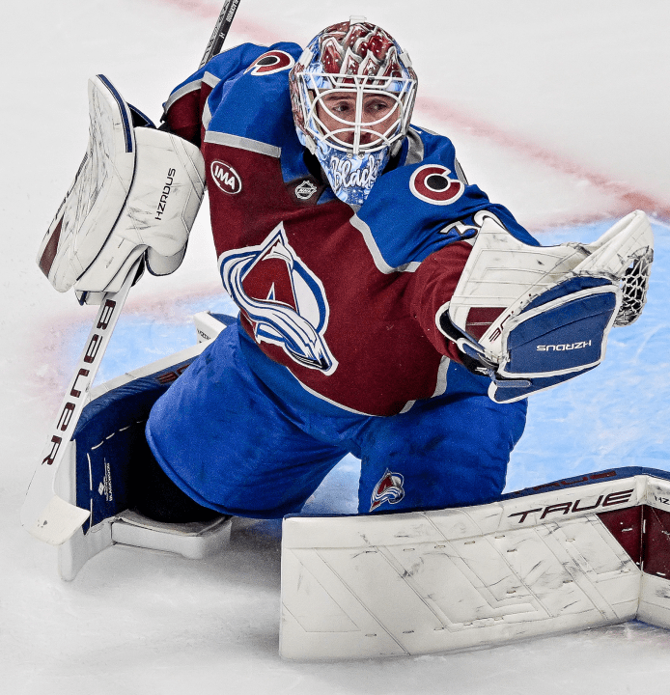
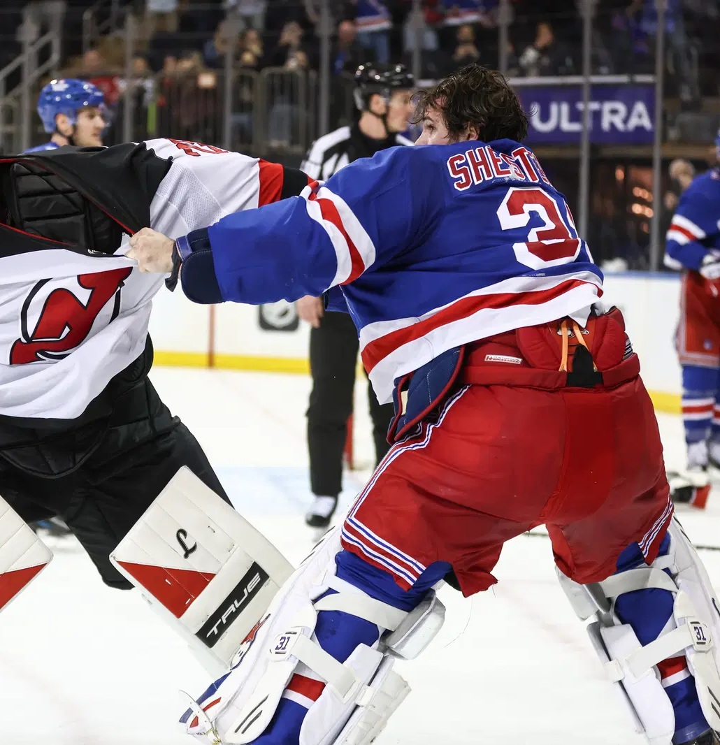

Slide 6
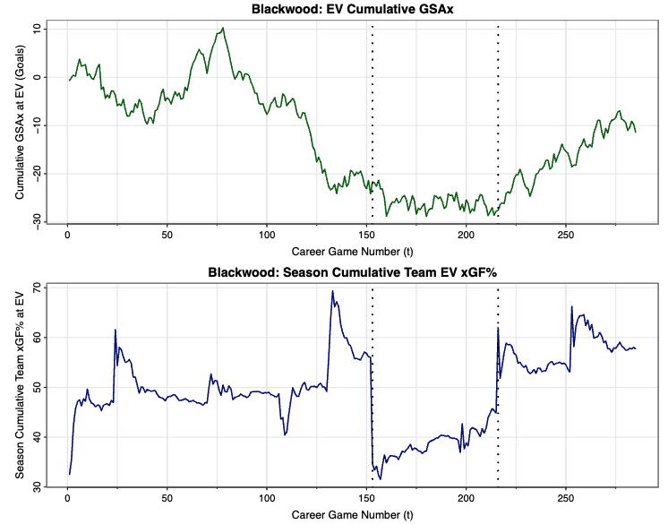

Slide 7
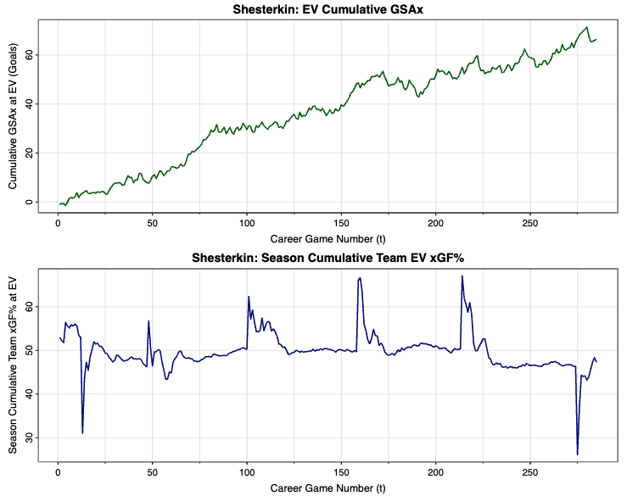

Slide 8
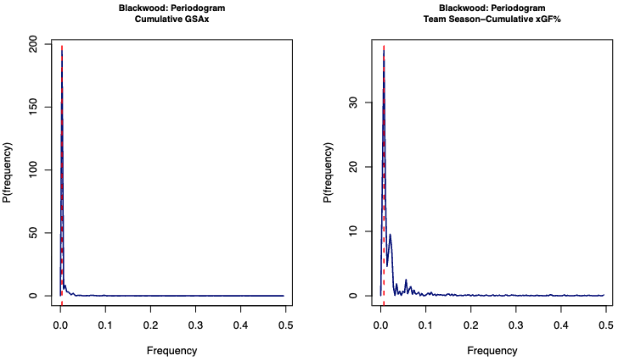

Slide 9
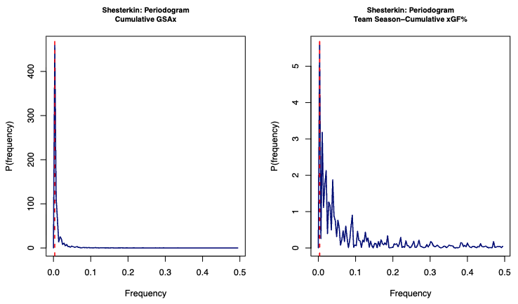

Slide 10
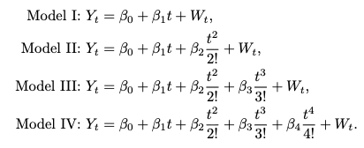

Slide 11
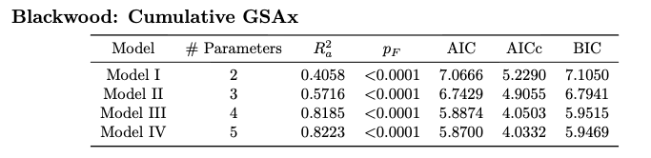
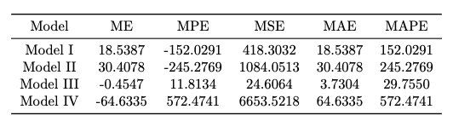

Slide 12
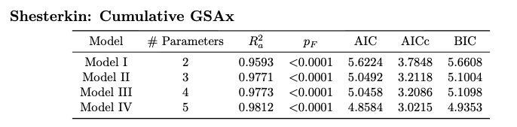
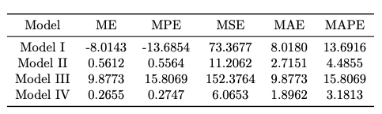

Slide 13
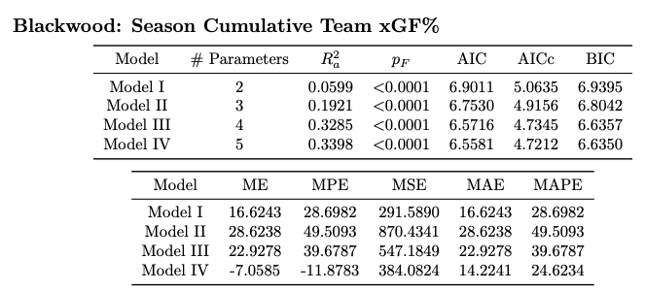

Slide 14
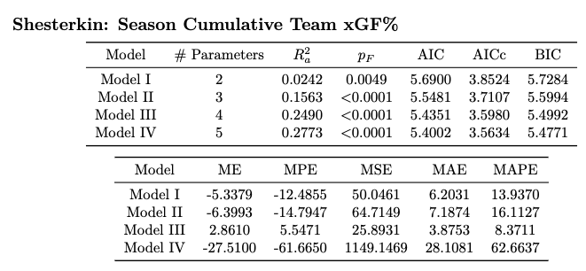

Slide 15
No plausible seasonality.
Splitting at trade changes selection.
Need CCF/lagged predictors.
Visible trend changes at trade.

