Slide 1
Identifying Underreporting of Adverse Events

Slide 2
What: Vaccine Candidate for Seasonal Illness
Who: Adults 50+ in Age, n = 727
Where: Only U.S. Sites
When: Started in January 2023
How: Blinded, No Control

Slide 3
Visit 1
Day 1
Visit 2
~1 Month
Visit 3
~6 Months

Slide 4
AE: any untoward medical occurrence associated with the use of a drug whether or not considered drug-related
AE of Interest: specified cardiac condition
Serious AE: fatal, life-threatening

Slide 5
Underreporting of Adverse Events

Slide 6



Slide 7
Subject | Site | Visits
0.14814814814814800 | 138 | Visit2
0.2592555559258890 | 207 | Visit1
1.11100001111E-05 | 46 | UnplannedVisit
0.9629407429627410 | 644 | IllnessVisit
0.18518518518518500 | 161 | Visit3
n = 1410
Subject | Site | AE_Category | SeriousAE
0.7407201662092950 | 506 | ADVERSE EVENT | NO
0.25931316453164800 | 207 | ADVERSE EVENT | NO
0.703704526684962 | 483 | ADVERSE EVENT | NO
0.07409423711489110 | 92 | AE OF SPECIAL INTEREST | NO
0.2223123386699550 | 184 | ADVERSE EVENT | YES
n = 44

Slide 8
Most AEs are already reported!
Visit 1
Day 1
Visit 2
~1 Month
Visit 3
~6 Months
Here

Slide 9
Site 23
Site 230
Site 276
Site 322
Site 598
Site 621
Site 391

Slide 10
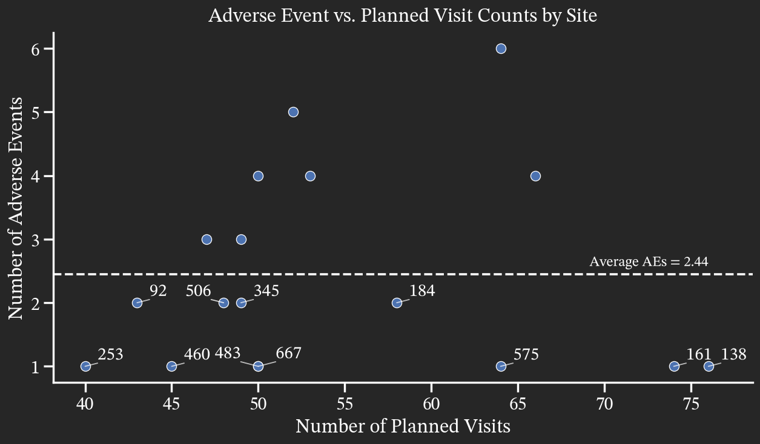

Slide 11
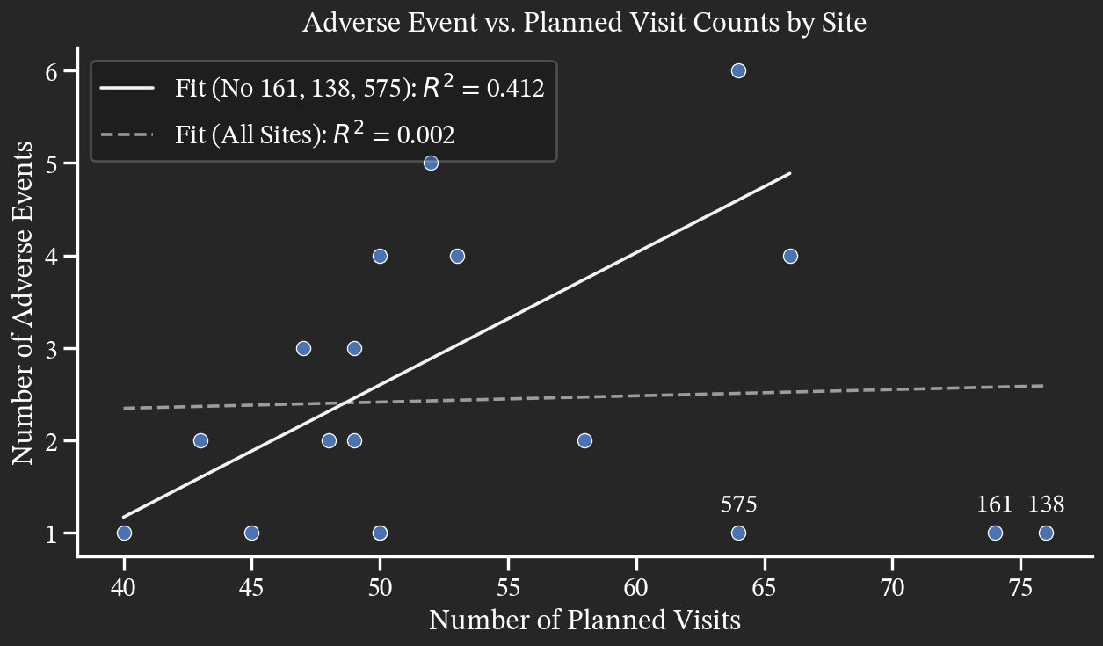

Slide 12
Site 138
Site 161
Site 575

Slide 13

Probability that there should be more AEs reported than there are currently reported (i.e., probability of underreporting) given
n # of planned visits
k₀ # of reported AEs
p pooled AE rate: 0.045
$$P\left(X>k_{0}\right)=1−P\left(X≤k_{0}\right)=1−\sum_{k=0}^{k_{0}}{\left({n \atop k}\right)p^{k}{(1−p)}^{n−k}}$$

Slide 14
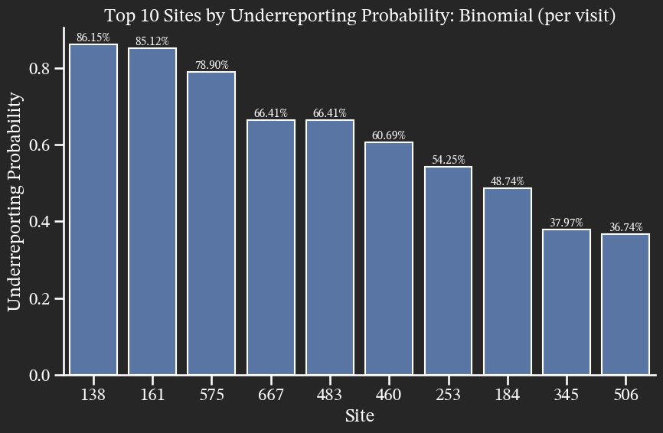

Slide 15
Assumption 1: Each planned visit is independent of each other.
Assumption 2: The probability of AE is the same across all planned visits.
Assumption 3: Each planned visit can have 1 of 2 outcomes: AE or not AE.

Slide 16
Assumption 1: Each subject is independent of each other.
Assumption 2: The probability of AE is similar across all subjects.
Assumption 3: Each subject can have 1 of 2 outcomes: AE or not AE.

Slide 17
Probability that there should be more AEs reported than there are currently reported (i.e., probability of underreporting) given
n # of subjects
k₀ # of subjects reporting AE(s)
p pooled AE rate: 0.059
$$P\left(X>k_{0}\right)=1−P\left(X≤k_{0}\right)=1−\sum_{k=0}^{k_{0}}{\left({n \atop k}\right)p^{k}{(1−p)}^{n−k}}$$

Slide 18
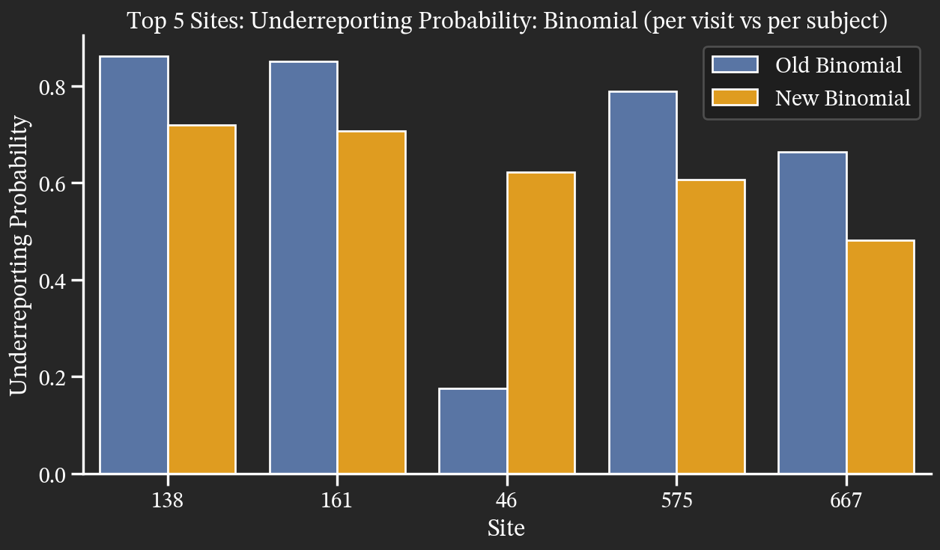

Slide 19
Assumption 1: Each subject is independent of each other.
Assumption 2: The probability of AE is similar across all subjects.
Assumption 3: Each subject can have 1 of 2 outcomes: AE or not AE.

Slide 20
Assumption 1: Each subject is independent of each other.
Assumption 2: The probability of AE is similar across all subjects.
Assumption 3: Each subject can have 1 of finite number of outcomes.

Slide 21
Assumption 1: Each subject is independent of each other.
Assumption 2: The probability of AE is similar across all subjects.
Assumption 3: Each subject can have 1 of 5 outcomes.
No AEs
1 AE
2 AEs
3 AEs
4 AEs

Slide 22
Probability that any reporting category exceeds its observed count (i.e., probability of underreporting) given:
n # of subjects
x₁ # of subjects reporting 0 AEs
x₂ # of subjects reporting 1 AE
…
x₅ # of subjects reporting 4 AEs
p₁ pooled rate of subjects reporting 0 AEs
p₂ pooled rate of subjects reporting 1 AE
…
p₅ pooled rate of subjects reporting 4 AEs

Slide 23



$$P\left(\bigcup_{i=2}^{5}{\{X_{i}>x_{i}\}}\right)=1−P\left(X_{i}≤x_{i}∀i=2, 3, 4, 5\right)=1−\sum_{t=x_{1}}^{n}{\left({n \atop t}\right){p_{1}}^{t}{(1−p_{1})}^{n−t}}\sum_{δ(n−t,{ x}_{2:5})}{\frac{\left(n−t\right)!}{\prod_{i=2}^{5}{y_{i}!}}}\prod_{i=2}^{5}{{q_{i}}^{y_{i}}}$$
where
$$δ\left(m,x_{2:5}\right)=\{y ε ℤ≥0^{4}:0≤y_{i}≤x_{i},\sum_{i=2}^{5}{y_{i}}=m\}$$
for
$$q_{i}=\frac{p_{i}}{1−p_{1}}∀i=2, 3, 4, 5$$

Slide 24
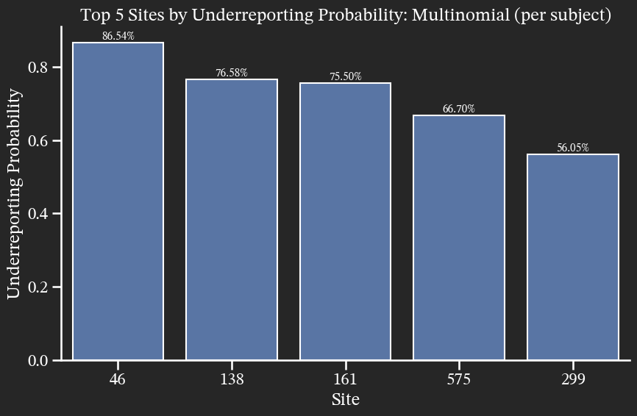

Slide 25
Site 23
Site 230
Site 276
Site 322
Site 598
Site 621
Site 391
Site 138
Site 161
Site 575
Site 46

