Slide 1
Can we accurately predict free agent skaters’ contracts?

Slide 2
2022 (Y1)
2025 (Y4)
2026
2023 (Y2)
2024 (Y3)
Sign 4-year Deal
Free Agent

Slide 3
1. Term
How many years?
2. AAV
How much $ every year?

Slide 4
12 F
6 D
2 G
$95.5M
Data: NHLPA

Slide 5
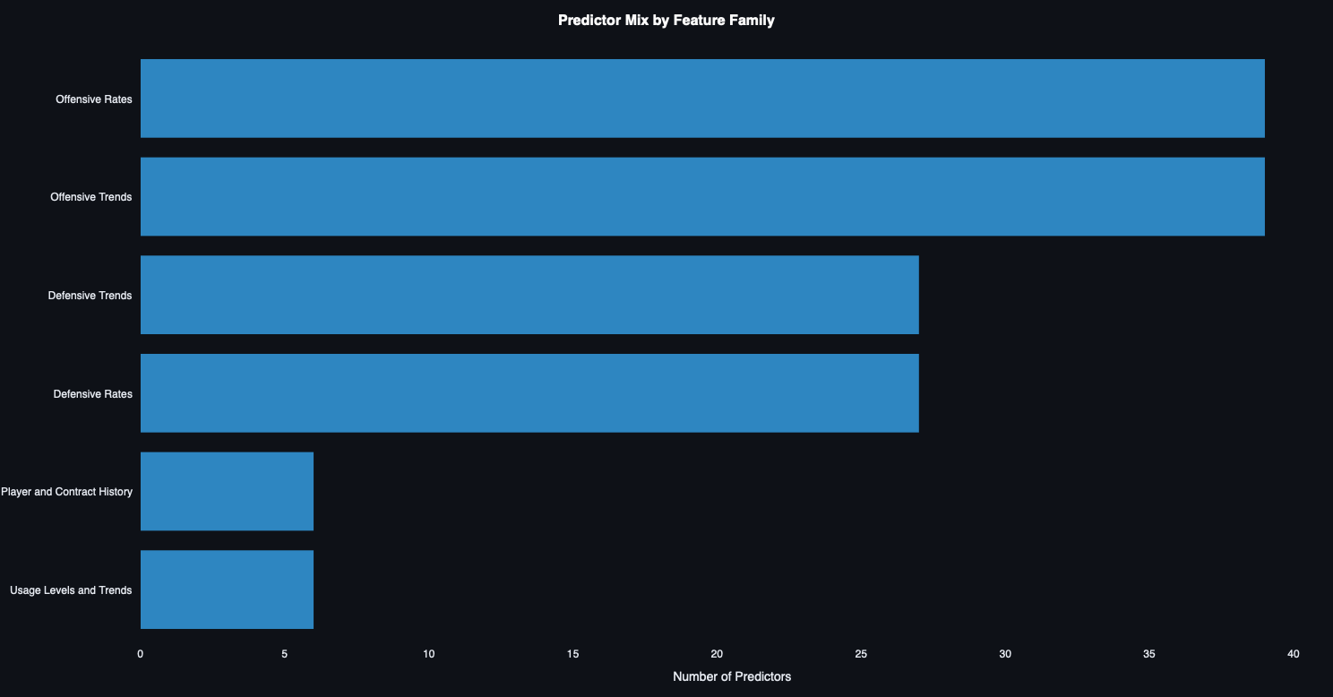
Data: NHL and Spotrac | Models: @RentoSaijo

Slide 6
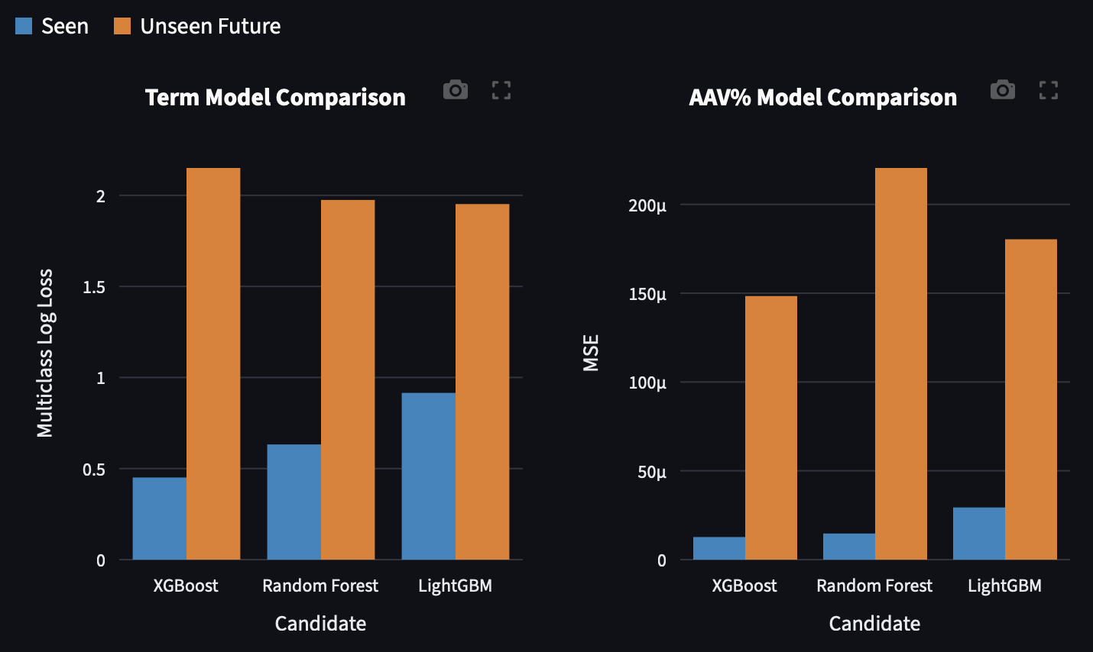
Data: NHL and Spotrac | Models: @RentoSaijo

Slide 7
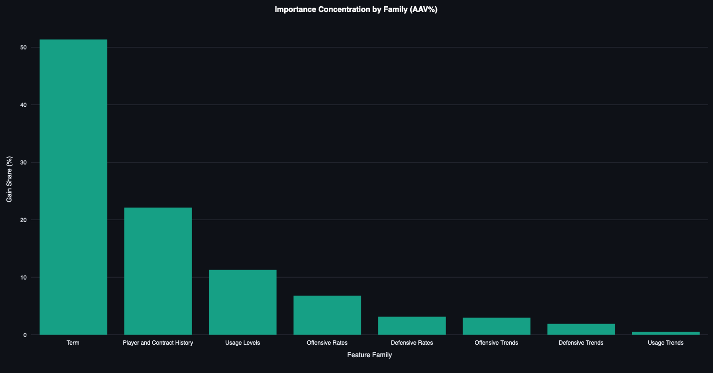
Data: NHL and Spotrac | Models: @RentoSaijo

Slide 8
Term is difficult to predict.
AAV depends heavily on term.
Offer multiple possibilities.
AAV is possible to predict.

Slide 9
