Slide 1
Pass Detection using NHL’s Puck & Player Tracking (PPT)

Slide 2
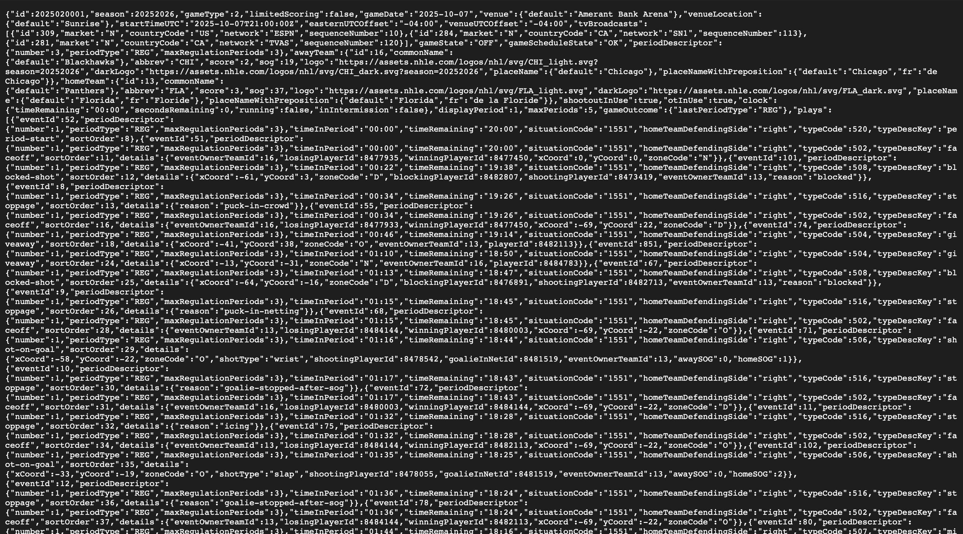
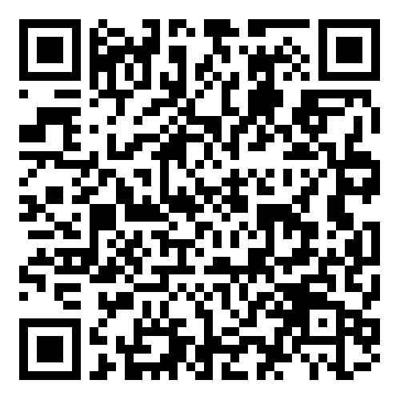

Slide 3
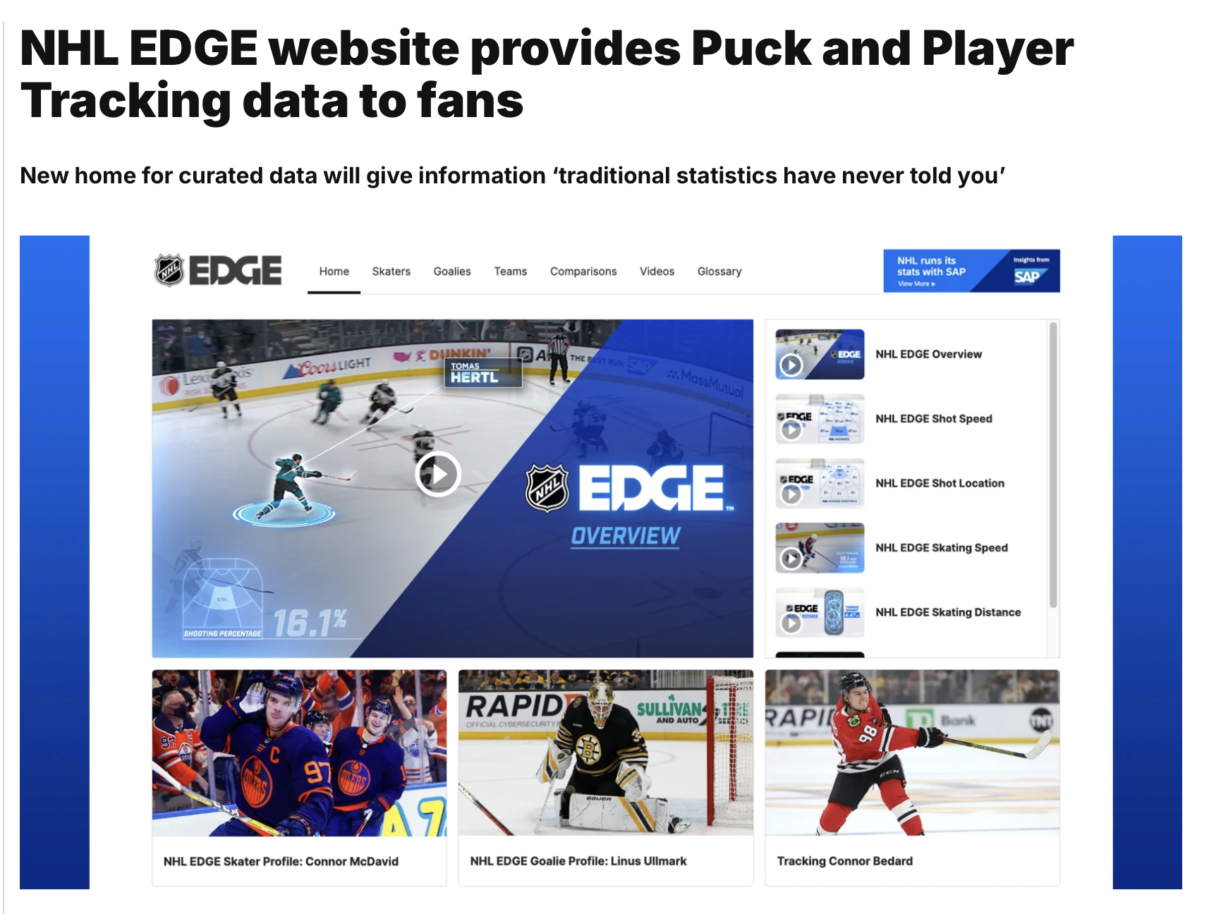

Slide 4
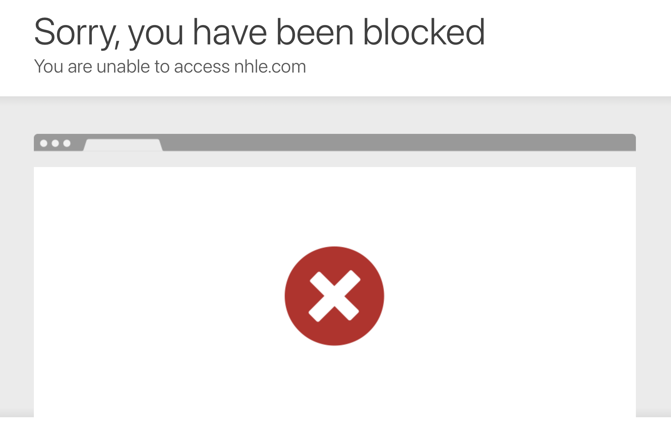
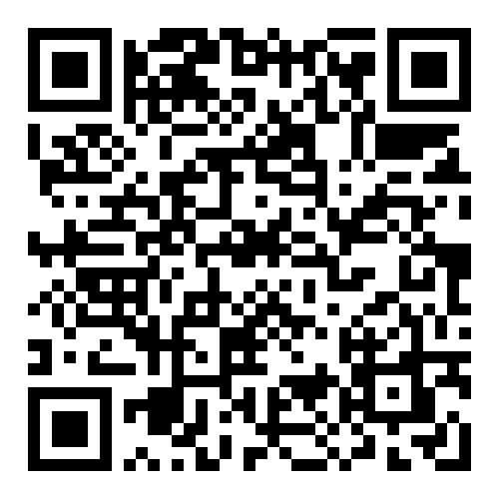

Slide 5
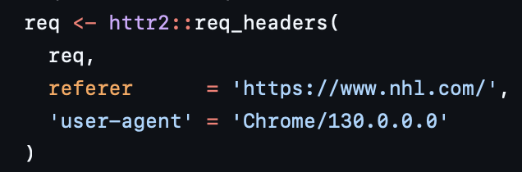
For every decisecond (0.1 seconds) up to 12 seconds before any goal…
Player’s
x & y
Puck’s
x & y

Slide 6
Pre-shot pass movement is dismissed.

