Slide 1
CourseProject
Human–Robot Handover
Created by: Tong Ren Date: 2026.11.17

Slide 2
Reinforcement Learning
Part 1 of 3

Slide 3
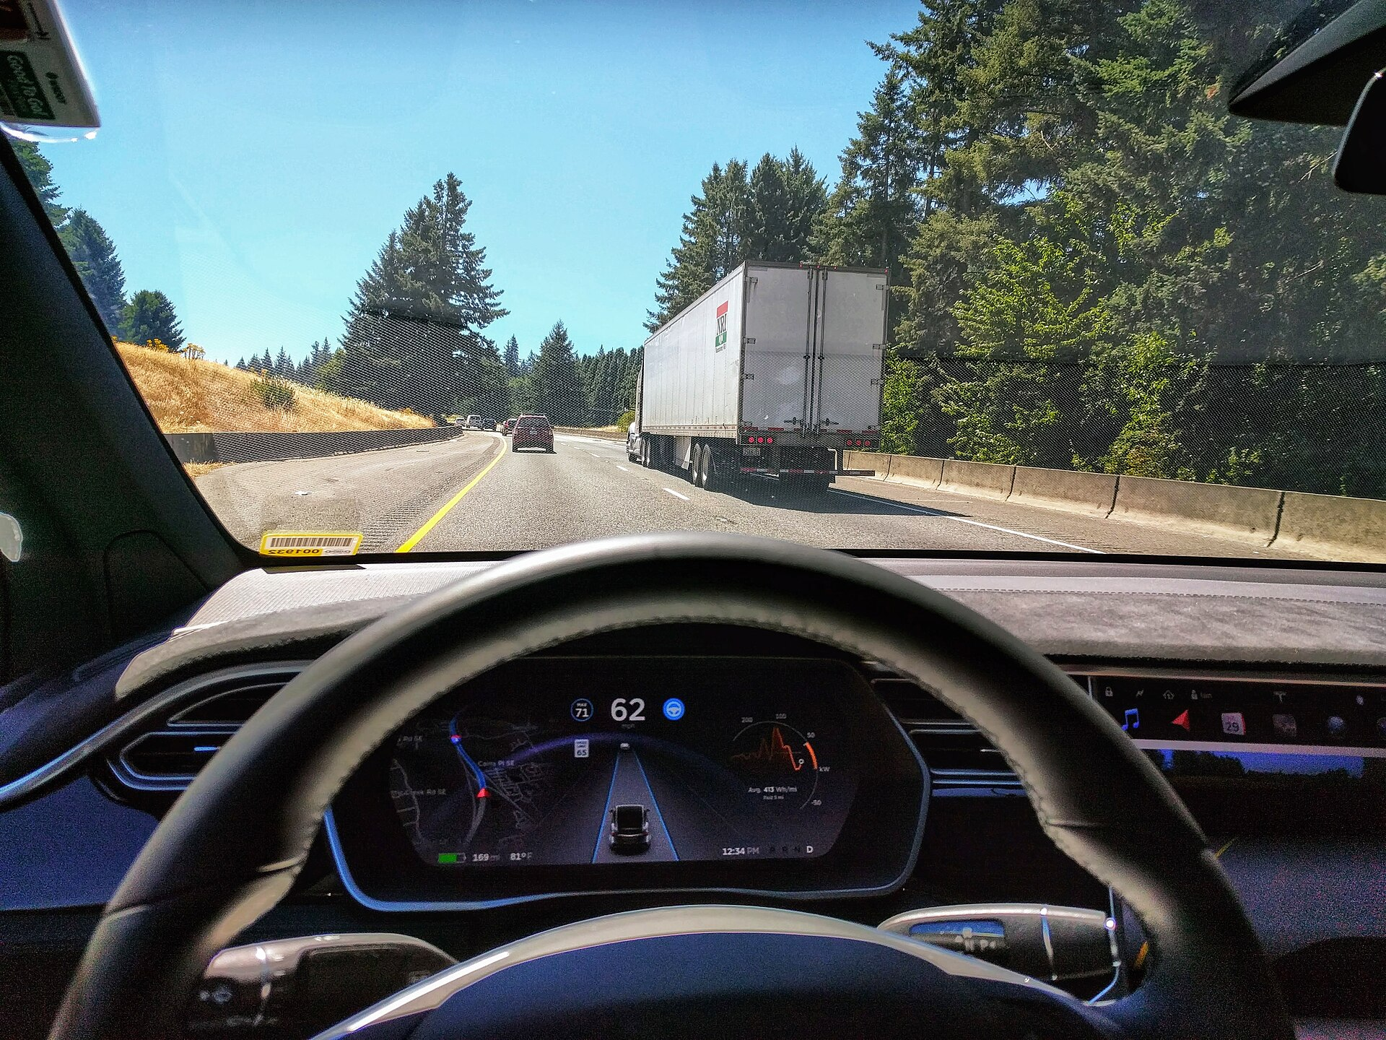
Tesla Autopilot
A chain of decisions.
See 8 cameras around the car
Act steer, accelerate, brake
Goal arrive safely and smoothly
Learned mostly from human driving video. Can it get better than its teachers?
Partially observed: cameras miss things
Autopilot engaged in a Model X. Photo: Isnoop, CC BY-SA 4.0, Wikimedia Commons

Slide 4
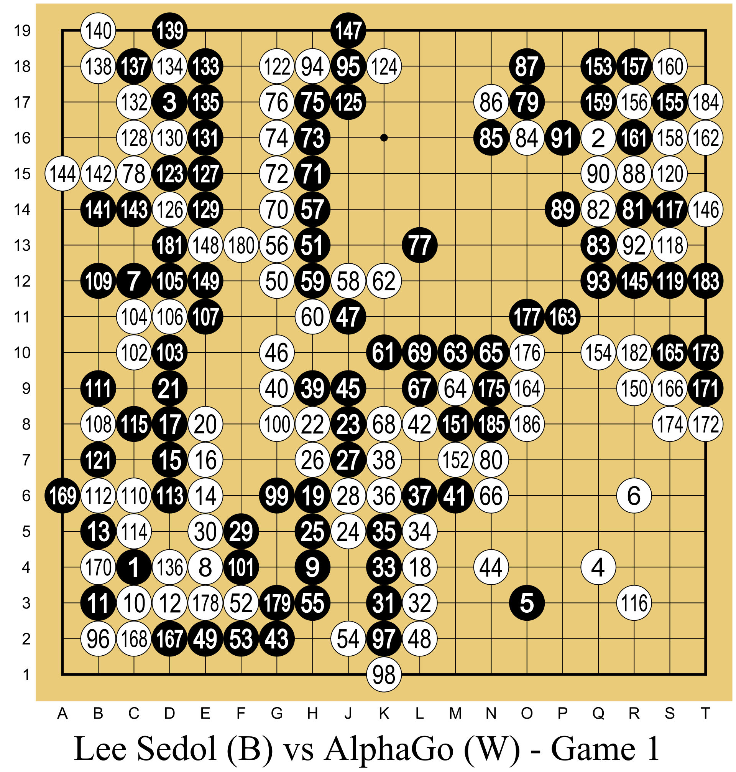
AlphaGo, 2016
Beat Lee Sedol 4–1.
See the whole board, nothing hidden
Act where to place the next stone
Reward +1 win, −1 loss, at the end
Started from human games, then improved by playing against itself.
Fully observed: the board is the state
Lee Sedol (black) vs AlphaGo (white), Game 1. Diagram: Wesalius, CC BY-SA 4.0, Wikimedia Commons

Slide 5
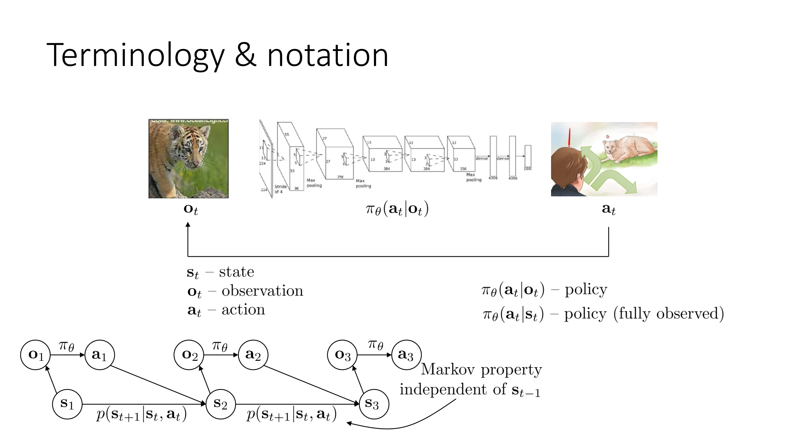
Sergey Levine, CS 285: Deep Reinforcement Learning, UC Berkeley, Lecture 4.

Slide 6
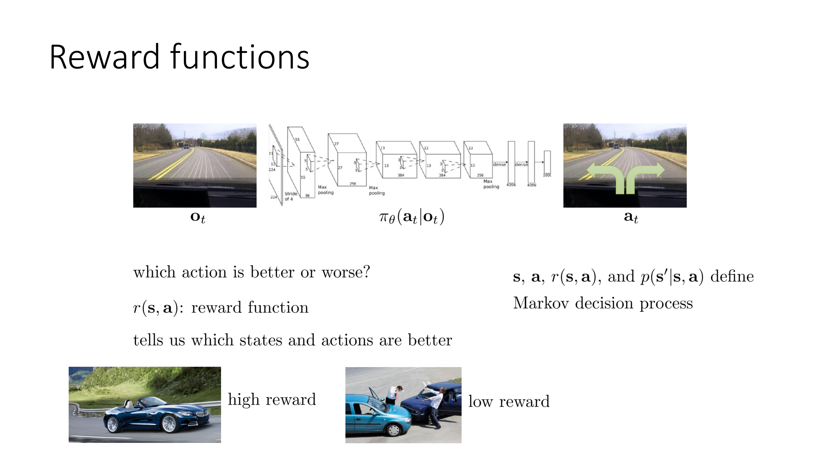
Sergey Levine, CS 285: Deep Reinforcement Learning, UC Berkeley, Lecture 4.

Slide 7
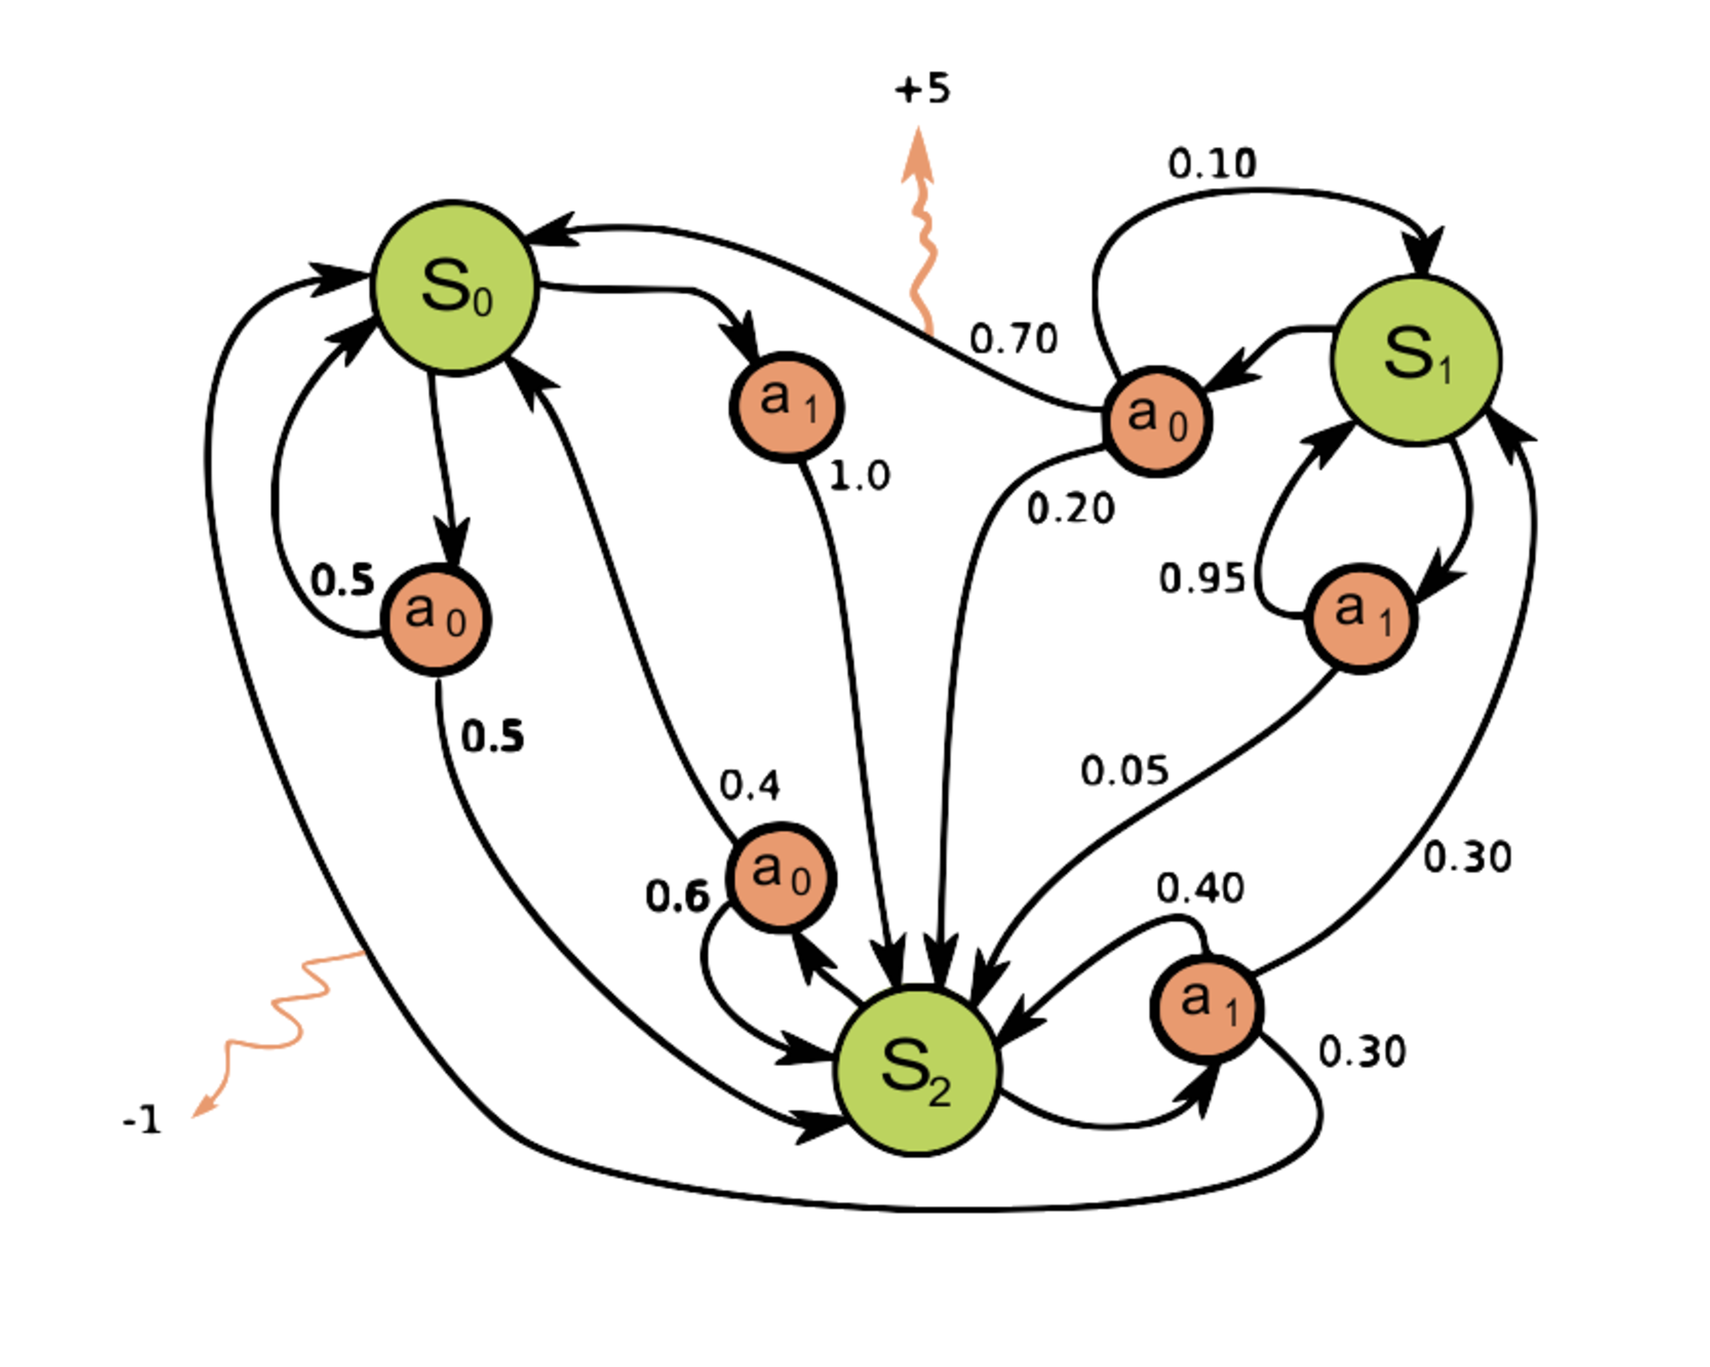
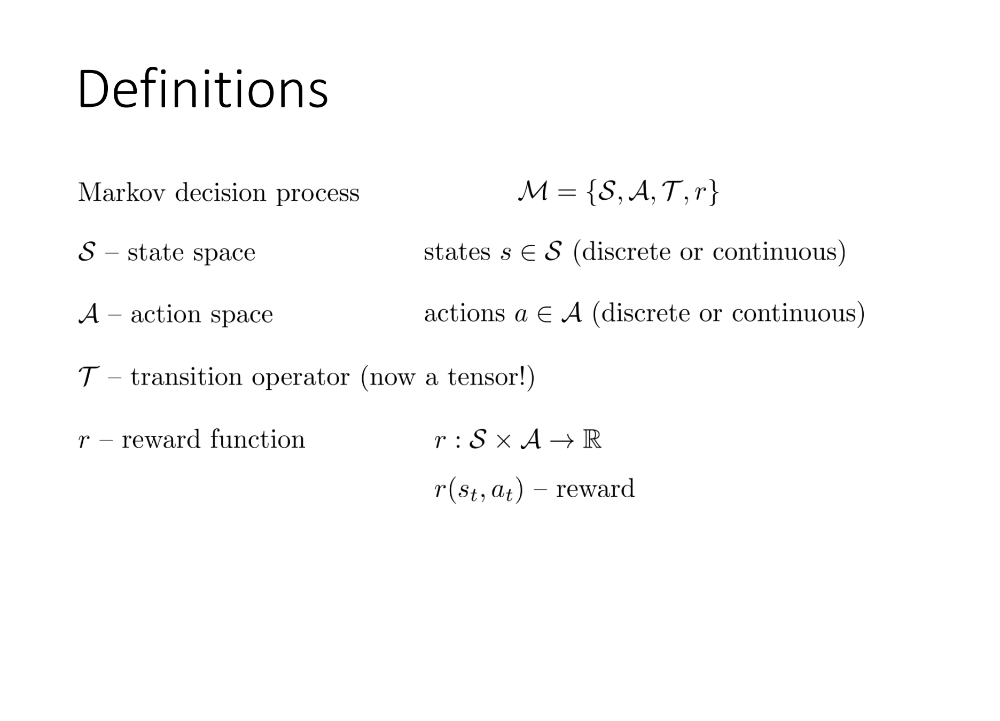
Markov decision process. Diagram: waldoalvarez, CC BY-SA 4.0, Wikimedia Commons
Sergey Levine, CS 285: Deep Reinforcement Learning, UC Berkeley, Lecture 4.

Slide 8
Algorithm families
Bold names are used in this course.
Axis | Type | Representative algorithms
Model | Model-based. Plan with a known or learned model. | MPC, PETS, MuZero
 | Model-free. Learn from samples only. | DQN, PPO, SAC, TD3
What is learned | Value-based. Learn Q or V only. | Q-learning, DQN
 | Policy-based. Learn the policy only. | REINFORCE
 | Actor-critic. Learn a policy and a value together. | A2C, PPO, DDPG, TD3, SAC
Data reuse | On-policy. Use only the current policy's data. | REINFORCE, A2C, TRPO, PPO
 | Off-policy. Reuse past data from a replay buffer. | DQN, DDPG, TD3, SAC
Policy | Stochastic. One state can yield different actions. | A2C, PPO, SAC
 | Deterministic. One state maps to one action. | DDPG, TD3

Slide 9
Four ideas
On-policy
Current policy only. PPO.
Off-policy
Replay buffer. SAC and TD3.
Explore
Entropy bonus in SAC.
Exploit
Use the best policy.

Slide 10
Algorithms
PPO
On-policy
Fresh data each update
Stable, easy default
Notebook exercise
SAC (and TD3)
Off-policy, replay buffer
Strong on continuous control
We train handover with SAC
TD3: deterministic actor

Slide 11
How we train
SB3: SAC("MlpPolicy", env).learn(…).
Test with predict(obs, deterministic=True).
Handover setup: learning_starts 1000.
Entropy coefficient ent_coef = 0.005.

Slide 12
Check the run
The same reward can fail on another seed.
Save checkpoints and read the learning curve.
Evaluate in simulation before the live demo.
Notebook Part 6 is this loop on our env.

Slide 13
Simulation
Part 2 of 3

Slide 14
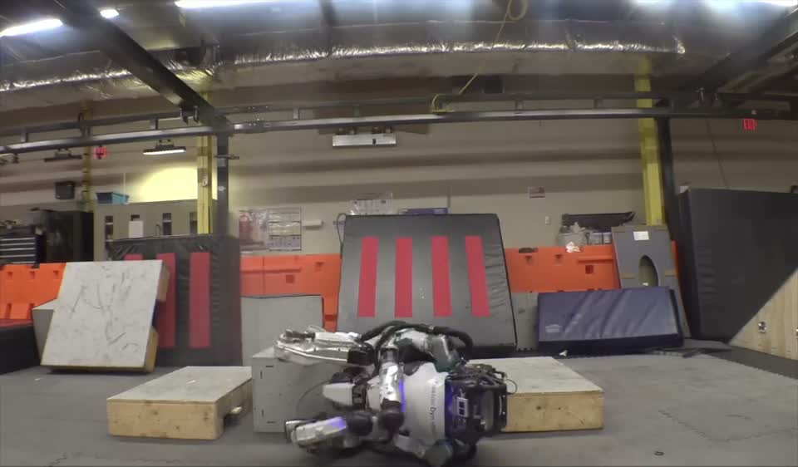
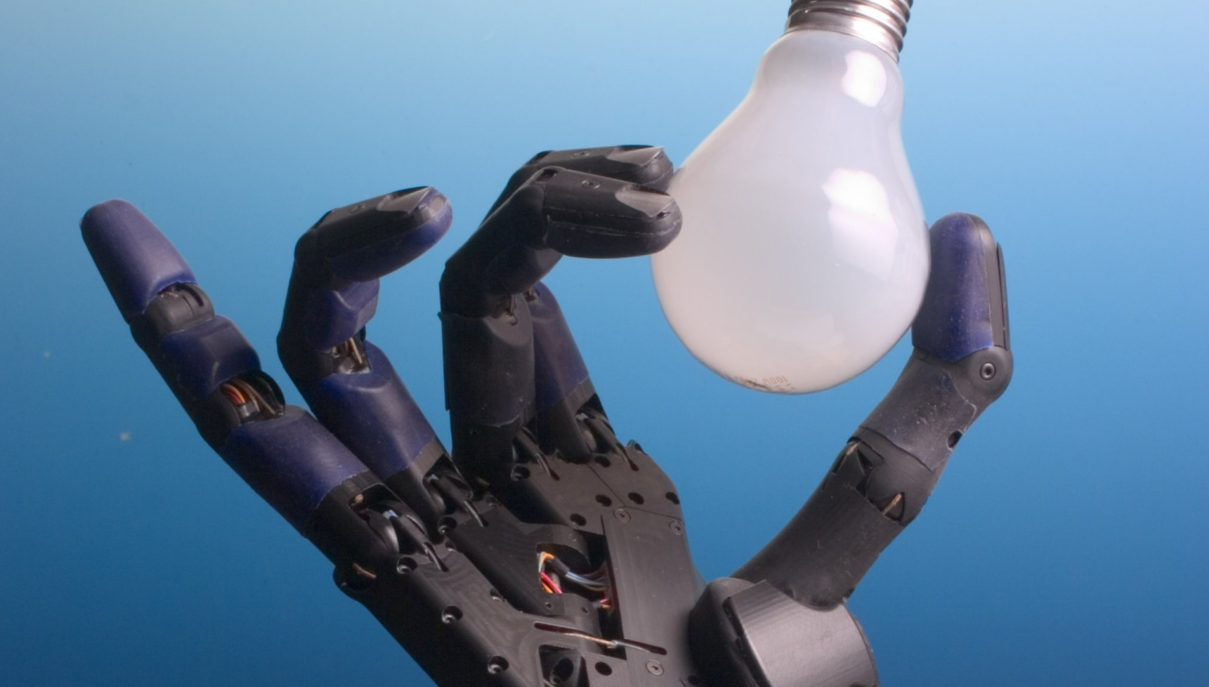
Why simulation?
Example 1: testing a controller on an expensive robot without knowing if it will crash
Example 2: an RL policy that needed about 13,000 years of experience in simulation
Boston Dynamics, Farewell to HD Atlas, YouTube, 2024.
OpenAI Dactyl, Rubik's Cube, 2019. Photo: Shadow Hand, CC BY-SA 3.0.
Framework after Kaifeng Zhang, COMS4733 Lecture 13, Columbia University.

Slide 15
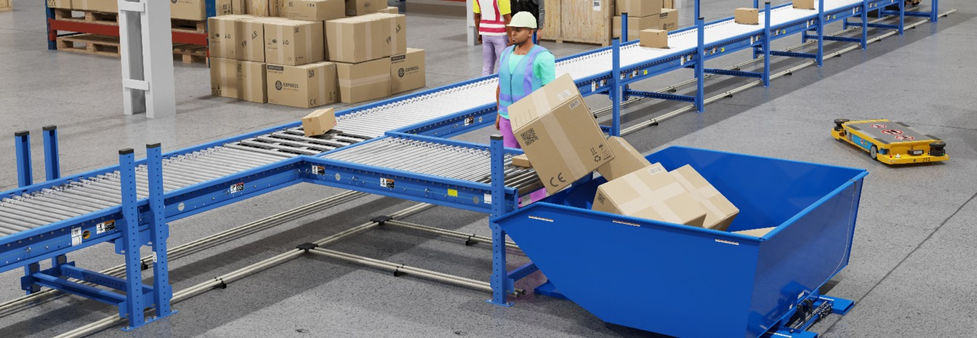
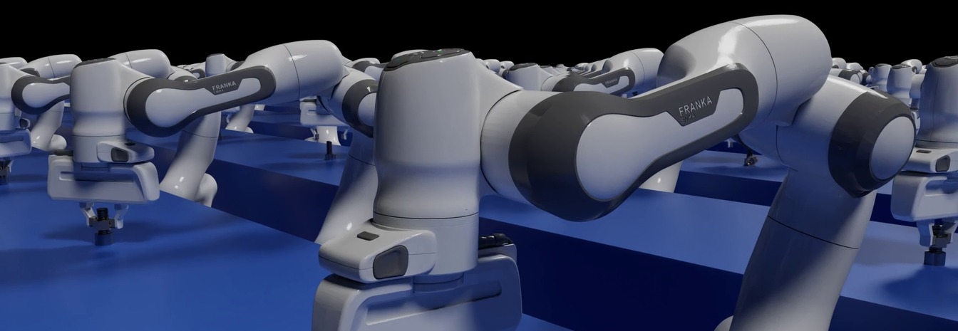
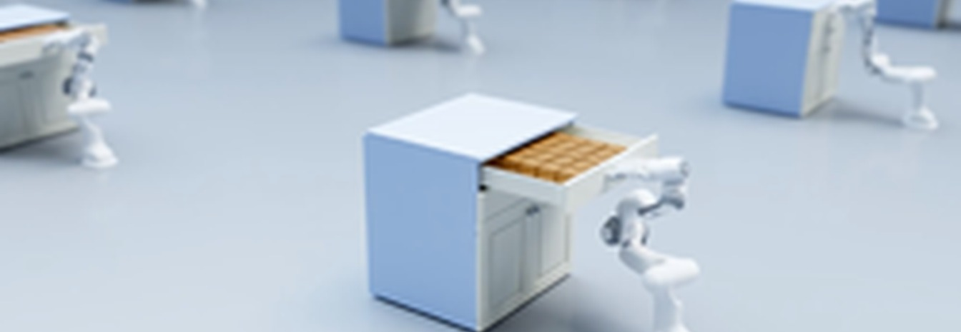
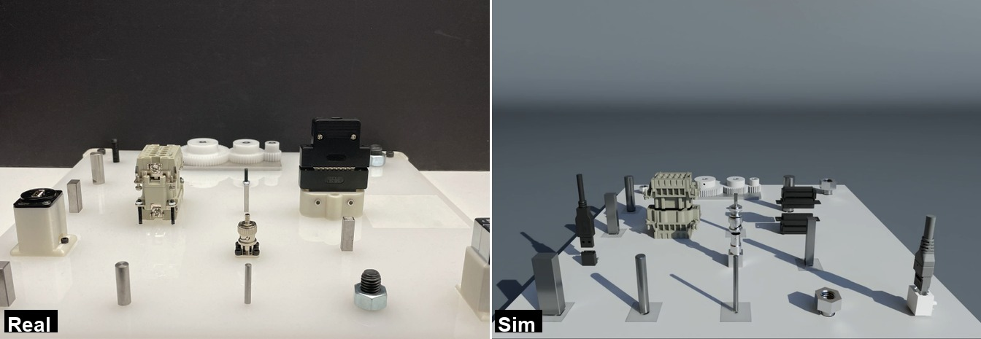
What simulation offers
• Bridging design and reality
• Safe and repeatable testing
• Scalability
• Access to ground truth signals
Images: NVIDIA Isaac Sim, Isaac Gym, and Factory. NVIDIA Technical Blog.
Kaifeng Zhang, COMS4733 Lecture 13, Columbia University.

Slide 16
Robotic simulation in practice
• Classical control verification
Study the performance, stability, and robustness of control systems
• Data generation
Generating large datasets for robot policy training
• Evaluation
Benchmark algorithms under controlled, repeatable conditions
• Design and prototyping
Rapidly test robot morphology, sensor placement, or gripper designs
Kaifeng Zhang, COMS4733 Lecture 13, Columbia University.

Slide 17
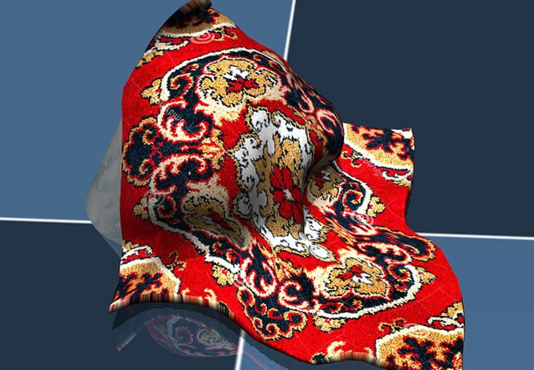
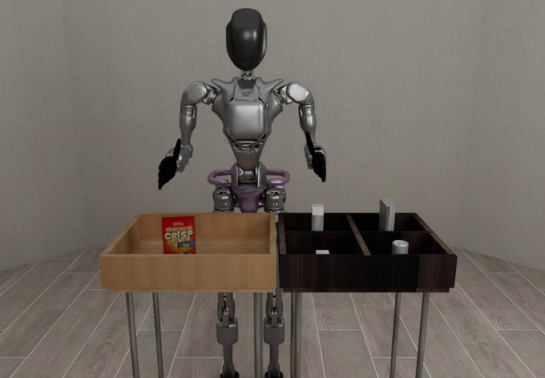
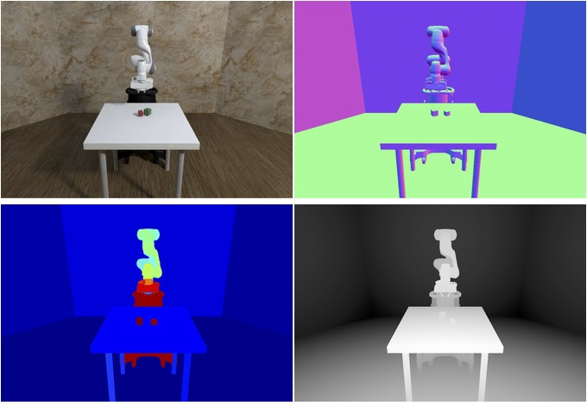
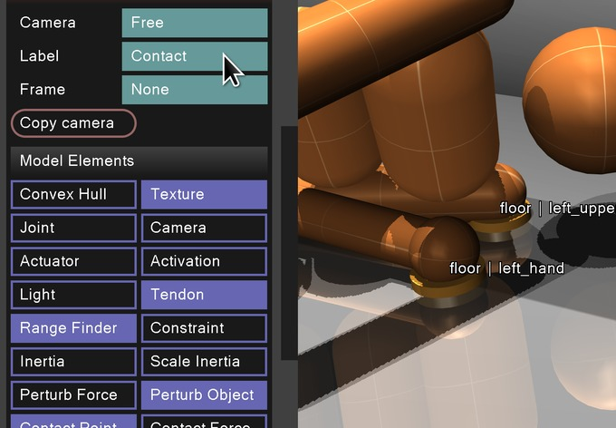
Components of a simulator
Physics Engine
Renderer
• Rigid, articulated, deformable, …
• Speed: CPU/GPU
• Accuracy
• Method: rasterization, path tracing, …
• Lighting, texture, …
• Speed
Sensor Simulation
User Interface
• RGB camera
• Depth/LiDAR
• Robot states
• Tactile
• Scene setup
• API
• Policy training
Images: MuJoCo documentation (Google DeepMind); robosuite documentation.
Kaifeng Zhang, COMS4733 Lecture 13, Columbia University.

Slide 18
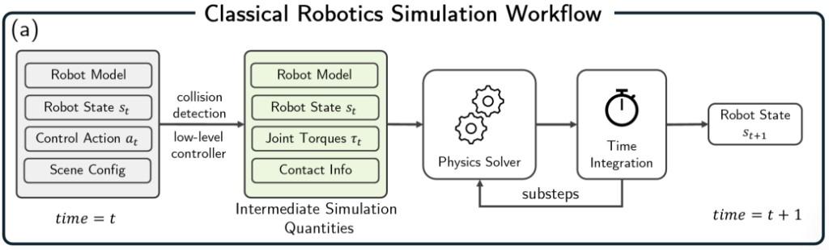
The step() function
• Update the simulation state from t to t + Δt
• Physics step:
• Detecting collision
• Solving physics (resolve collision, evolve dynamics)
• Time integration
Xu, J., Heiden, E., Akinola, I., Fox, D., Macklin, M., and Narang, Y. Neural Robot Dynamics. arXiv:2508.15755, 2025. Fig. 2(a).
Kaifeng Zhang, COMS4733 Lecture 13, Columbia University.

Slide 19
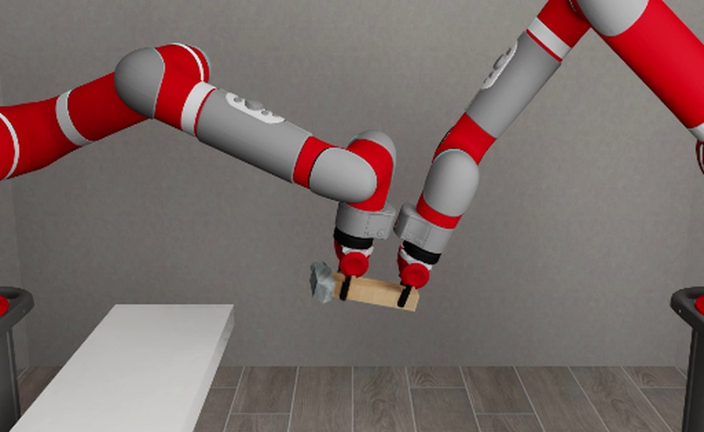
The render() function
• Get rendering and other sensor readings
• Rendering step:
• Sending simulation states to the renderer
• Run rendering algorithm
• Update viewer (if interactive)
robosuite TwoArmHandover. robosuite documentation.
Kaifeng Zhang, COMS4733 Lecture 13, Columbia University.

Slide 20


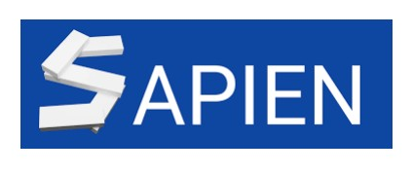

Major robotic simulators
Logos: MuJoCo (Google DeepMind); NVIDIA Isaac Lab; SAPIEN (UCSD); Genesis.
Kaifeng Zhang, COMS4733 Lecture 13, Columbia University.

Slide 21
MuJoCo
• Multi-Joint dynamics with Contact
• A physics engine for robotics, biomechanics, and machine learning
• Written at the University of Washington, 2012
Todorov, Erez, and Tassa, IROS 2012
• Sold as Roboti LLC, then acquired by DeepMind in 2021
• Open-sourced in 2022 under Apache 2.0
• Physics engine: MuJoCo
• Rendering: rasterization
• Strengths
• Fast CPU physics
• Smooth contact
• Light interface
• Weaknesses
• Limited rendering
• Single thread
• MJX / MJWarp
• Multi-thread, GPU acceleration
Wikipedia, “MuJoCo.” Todorov, Erez, and Tassa, IROS 2012.
Kaifeng Zhang, COMS4733 Lecture 13, Columbia University.

Slide 22

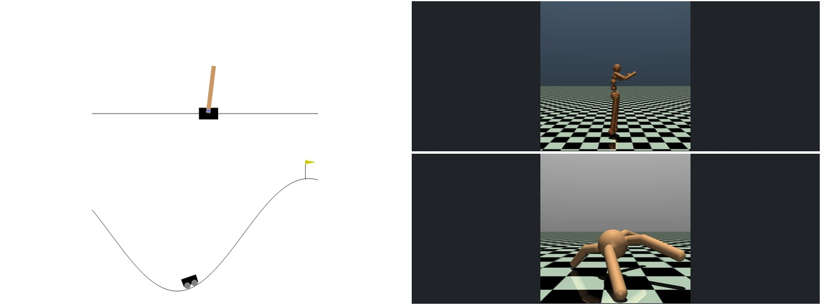
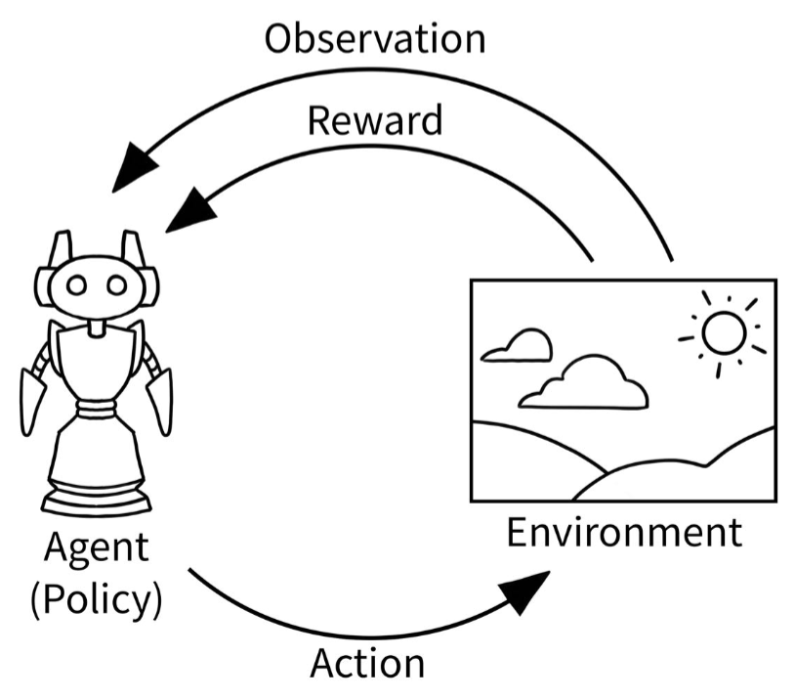
Other tools
• OpenAI Gym /
• An API standard for reinforcement learning
• Core: Step function
• Policy rollout
• Env stepping
• Obtain observation and reward
• Also: Render, Make, Reset
Gymnasium, Farama Foundation. Environment stills from Gymnasium documentation.
Kaifeng Zhang, COMS4733 Lecture 13, Columbia University.

Slide 23
Course project
Part 3 of 3

Slide 24
Set up
Hardware
Get the repo
• macOS, Linux, or Windows
• 8 GB RAM, a few GB of disk
• GPU optional; CPU is enough
to open the notebook
• Clone CourseProj from GitHub
• Conda, Python 3.10
• pip installs local robosuite
• Then open the notebook
git clone https://github.com/RentonRen/CourseProj.git
cd CourseProj
conda create -n courseproj python=3.10
conda activate courseproj
pip install -r requirements.txt
jupyter notebook hri_handover_tutorial.ipynb
Windows: create C:\tmp, copy mujoco.dll into robosuite/utils, set MUJOCO_GL=wgl.
Notebook: hri_handover_tutorial.ipynb

Slide 25
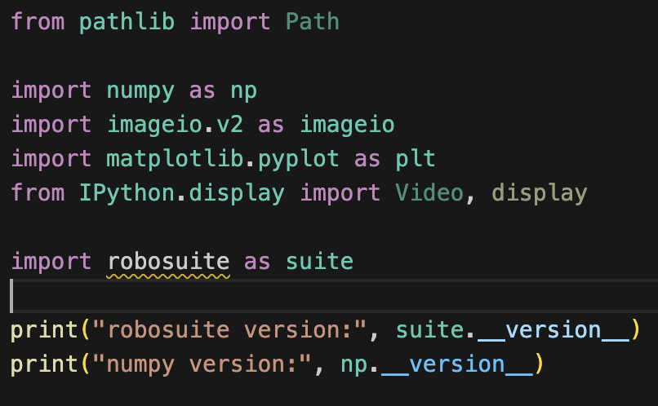
robosuite
A robotics library built on MuJoCo.
It provides:
• Ready-made robot arms
Panda, XArm7, UR5e, …
• Ready-made manipulation tasks
Lift, Pick-and-Place, Assembly, …
• Cameras, sensors, and a standard
observation / action interface
• Built-in scenes to test as-is,
or change a little and retest
obs = env.reset()
obs, reward, done, info = env.step(action)
Part 0 of hri_handover_tutorial.ipynb
Zhu et al., robosuite. arXiv:2009.12293, 2020. 2017 Stanford SVL; now ARISE.
Notebook: hri_handover_tutorial.ipynb

Slide 26
The environment
env = suite.make(
env_name="HumanRobotHandover",
robots="XArm7Handover",
has_renderer=False,
has_offscreen_renderer=True,
use_camera_obs=True,
horizon=300,
control_freq=20,
reward_shaping=False,
initialization_noise=None,
seed=0,
hard_reset=False,
)
env.start_holding = True
• One XArm7, hammer in hand
• 20 Hz, 300 steps, 15 s
• Headless images in memory
• Cameras on for the tour
• Sparse reward at first
• seed=0, held start pose
• Later: cameras off,
reward_shaping=True
Notebook: hri_handover_tutorial.ipynb

Slide 27
Thank you!
For further information: xx

Slide 28
robosuite
A robotics library built on MuJoCo.
It provides:
• Ready-made robot arms
Panda, XArm7, UR5e, …
• Ready-made manipulation tasks
Lift, Pick-and-Place, Assembly, …
• Cameras, sensors, and a standard
observation / action interface
• Built-in scenes to test as-is,
or change a little and retest
obs = env.reset()
obs, reward, done, info = env.step(action)
Part 0 of hri_handover_tutorial.ipynb
Zhu et al., robosuite. arXiv:2009.12293, 2020. 2017 Stanford SVL; now ARISE.
Notebook: hri_handover_tutorial.ipynb

