Slide 1
Developed Markets Equity Scorecard
A Systematic Framework for 3 - 6 Month Relative Market Performance
US | Eurozone | UK | Switzerland | Japan
Data through 30 April 2026 | Prepared September 2026

Slide 2
Developed Markets Scorecard
A systematic framework for relative 3-6 month equity performance
Objective: rank five developed equity markets by likely relative performance over the next 3 - 6 months.
Output: a monthly composite score and ranking, translated into Overweight / Equal Weight / Underweight views.
Monthly synchronized data
245 common monthly observations | Dec-2005 to Apr-2026
US
Eurozone
UK
Switzerland
Japan
Macro
Micro
Valuation
Technical
Indicator: PMI level
Economic rationale: Survey-based and published ahead of GDP; expansion phases typically precede earnings upgrades and stronger risk appetite.
Higher score = stronger expansion (favourable)
Indicator: 6-month consensus EPS growth
Economic rationale: Earnings anchor equity value. Faster earnings growth than peers supports relative price performance as fundamentals improve.
Higher score = faster earnings growth (favourable)
Indicator: Change in forward P/E over 6 months, sign-inverted
Economic rationale: Relative valuations mean-revert. A recent de-rating leaves more room to re-rate, while multiple expansion leaves a market richer.
Higher score = larger de-rating (favourable)
Indicator: 6-month return excluding the latest month, divided by 12-month realised volatility
Economic rationale: Medium-term price trends persist. Skipping the latest month avoids short-term reversal, and volatility scaling measures trend per unit of risk.
Higher score = stronger risk-adjusted trend (favourable)
Pillars are complementary by design (top-down and bottom-up, fundamentals and price). Pairwise correlations are low to moderate (|r| ≤ 0.39).
Equal weighting is retained: with only five markets, weights estimated from in-sample IC differences would be unreliable and prone to overfitting.
Source: Bloomberg (PMI, EPS, forward P/E); Yahoo Finance (index price series); CRISIL analysis.

Slide 3
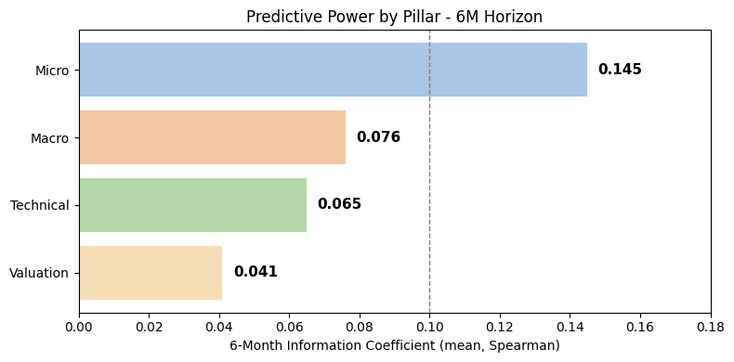
Signal Selection & Predictive Power
Which of the four signals actually forecast forward returns?
Tests
Monthly Cross-Sectional Information Coefficient (Spearman)
HAC Significance Test on Mean IC
Top-Minus-Bottom Country Spread
HAC Significance Test on Spread
Macro (PMI)
IC: 0.069 (3M) · 0.076 (6M)
IC p = 0.134 / 0.233
Spread: +0.8% (3M) · +1.3% (6M)
Spread p = 0.168 / 0.154
Directionally consistent; not significant.
Micro (EPS growth)
IC: 0.131 (3M) · 0.145 (6M)
IC p = 0.009 / 0.033
Spread: +1.1% (3M) · +2.0% (6M)
Spread p = 0.064 / 0.055
Most consistent result across both tests.
Valuation (P/E reversal)
IC: 0.050 (3M) · 0.041 (6M)
IC p = 0.234 / 0.459
Spread: +0.8% (3M) · +0.8% (6M)
Spread p = 0.069 / 0.360
Borderline at 3M (spread only); not sustained.
Technical (risk-adj. momentum)
IC: 0.008 (3M) · 0.065 (6M)
IC p = 0.871 / 0.293
Spread: −0.5% (3M) · +0.5% (6M)
Spread p = 0.385 / 0.597
Limited evidence at either horizon.
Micro (EPS growth) is the only pillar with a statistically significant mean IC at both horizons (3M: p = 0.009; 6M: p = 0.033). Macro, Valuation and Technical are not significant at either horizon.
Pillar tests are diagnostics; the scorecard is assessed as a composite on the next slides.
Source: Sample: 245 monthly observations, Dec-2005 to Apr-2026, Bloomberg; Yahoo Finance; CRISIL analysis.

Slide 4
Scorecard Construction
From four standardized signals to one monthly country ranking
Cross-sectional standardization
Sign alignment
Equal weighting
Monthly ranking
Each signal converted to a z-score relative to the five-market cross-section, same month.
Each pillar is oriented so a higher score is favourable on its economic rationale; Valuation is sign-inverted.
Four pillar scores combined, 25% each, into one Composite Score
Countries ranked 1 (highest) to 5 (lowest) by Composite Score, every month
Data requirement: The Composite Score requires all four pillars. The Technical pillar needs 12 months of price history for trailing volatility, so scoring begins on 29-Dec-2006; the first 12 observations of the 245-month panel are unscored (233 scored dates).
Outlier treatment: No winsorisation is applied. With five markets, a cross-sectional z-score (sample standard deviation) cannot exceed ±1.79 in magnitude ((n−1)/√n), so the ±3 cap used in large-universe factor indexes would never bind.
Worked example: UK, 30 Apr 2026
Pillar | Score | Weight | Contribution
Macro | 0.08 | 25% | 0.02
Micro | 0.41 | 25% | 0.10
Valuation | 0.39 | 25% | 0.10
Technical | 1.35 | 25% | 0.34
Composite |  |  | 0.56
Standardization
z-score for each signal, per date:
z = (x − μ) / σ, where μ and σ are the cross-sectional mean and standard deviation across the five markets on that date.
Composite formula
Composite = 0.25 × Macro + 0.25 × Micro + 0.25 × Valuation + 0.25 × Technical
Rebalancing
The scorecard is recalculated and re-ranked monthly as new PMI, EPS, P/E and price data become available, with no smoothing applied at the scoring stage; the backtest adds a one-month execution lag.
Source: Sample: 245 monthly observations, Dec 2005 to Apr 2026, Bloomberg; Yahoo Finance; CRISIL analysis.

Slide 5
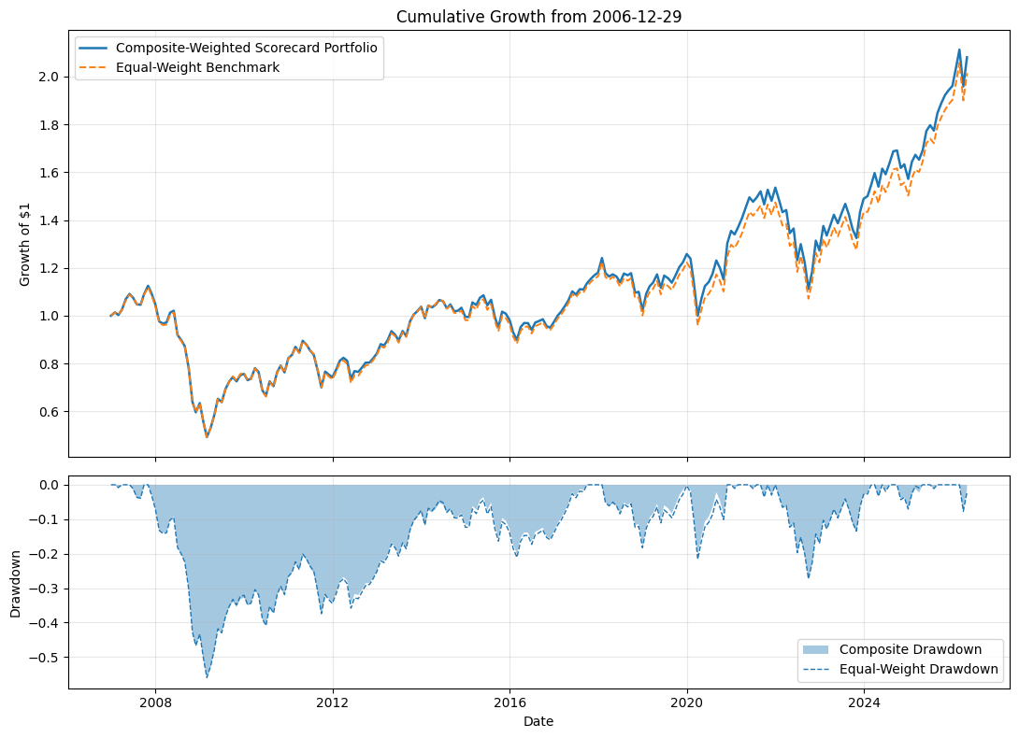
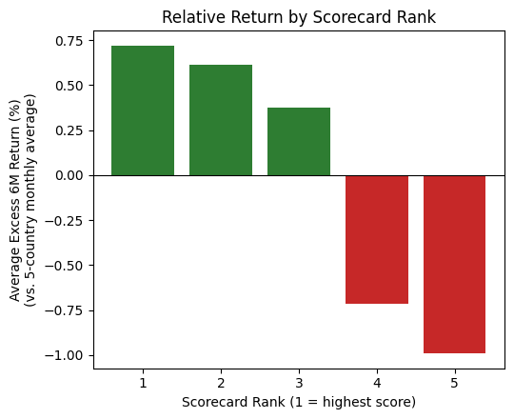
Backtest Results
Does the ranking actually predict what happens next?
Composite Portfolio: countries weighted monthly by Composite_Score via a bounded tilt function, implemented with a one-month lag to avoid look-ahead; fully invested, long-only across all five markets.
Equal-Weight Benchmark: static 20% allocation to each market, rebalanced on the same schedule and lag as the Composite Portfolio.
Metric | Composite | Equal-Weight
Annualized return | 3.84% | 3.67%
Sharpe ratio | 0.24 | 0.23
Max drawdown | −56.2% | −56.0%
Composite 6M Rank IC: 0.117 (p = 0.058)
Rank 1 - Rank 5 spread: +1.7% (6M), Sharpe 0.28, p = 0.089
Correlation: 0.999
Source: Sample: 245 monthly observations, Dec 2005 to Apr 2026, Bloomberg; Yahoo Finance; CRISIL analysis.

Slide 6
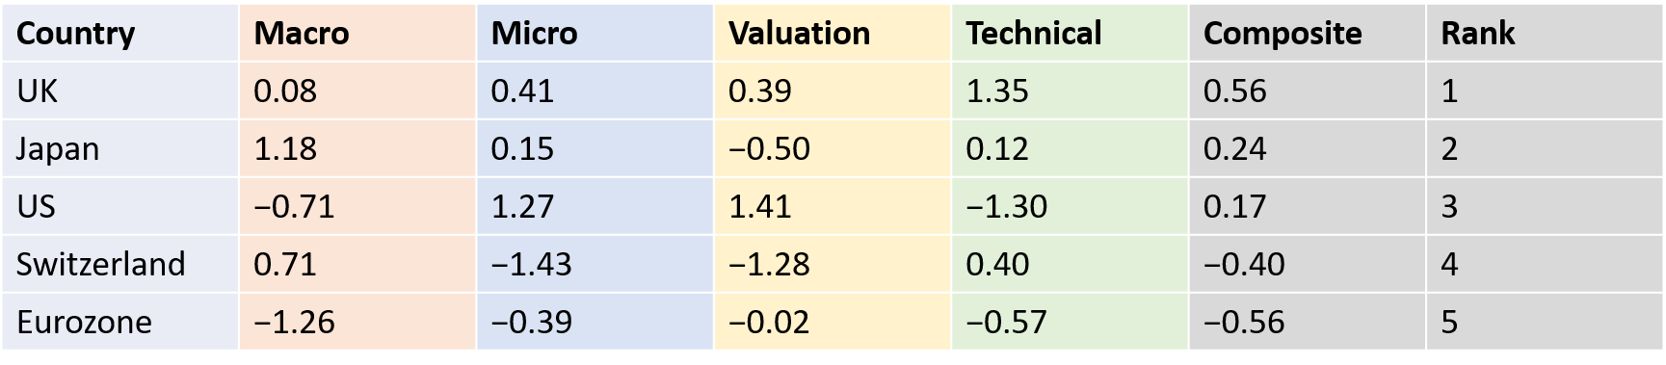
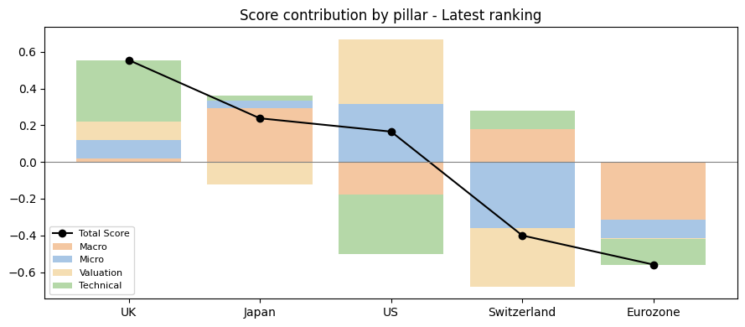
Current Ranking & Investment Recommendation
Translating the scorecard into portfolio positioning
UK
Overweight
Japan
Overweight
US
Equal Weight
Switzerland
Underweight
Eurozone
Underweight
Recommendation
Tilt a developed-markets equity allocation toward the UK and Japan, hold the US near the benchmark, and underweight Switzerland and the Eurozone, relative to an equal-weight five-market portfolio.
Applying the backtest's tilt rule to the April 2026 scores yields implied weights of UK 25.4%, Japan 22.4%, US 21.6%, Switzerland 16.0%, and Eurozone 14.5%, compared with 20% each at equal weight. The tilt is small by construction (about ±5 points).
Evidence is strongest over 6 months (rank IC: 0.117 vs 0.090 at 3M), so hold the view for roughly 6 months and re-score monthly.
The model re-scores monthly as new PMI, EPS, P/E and price data arrive. The backtest showed no drawdown protection relative to equal-weight (max drawdown −56%), so this is a relative tilt within an equity allocation
Source: Sample: 245 monthly observations, Dec 2005 to Apr 2026, Bloomberg; Yahoo Finance; CRISIL analysis.

Slide 7
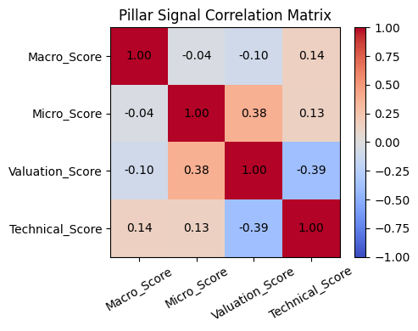
Appendix
Source: Sample: 245 monthly observations, Dec 2005 to Apr 2026, Bloomberg; Yahoo Finance; CRISIL analysis.

