Slide 1
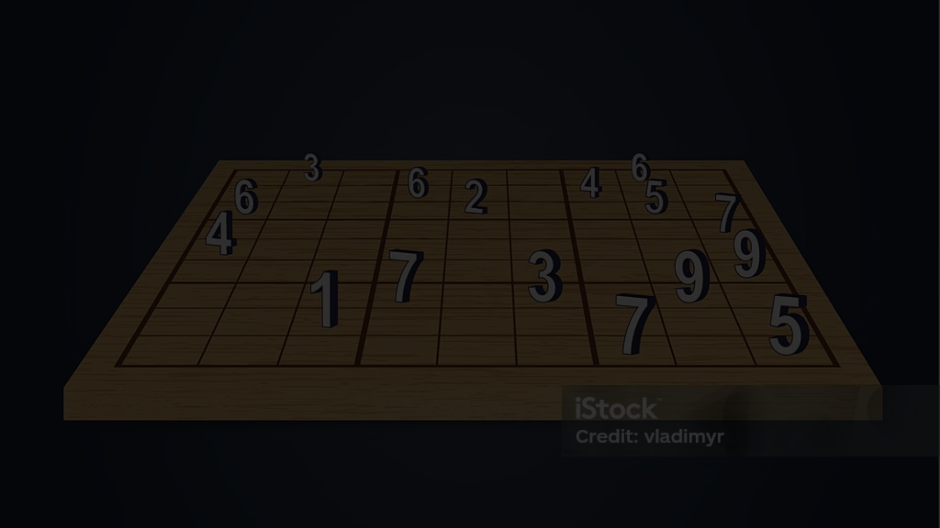


Sudoku Solver Visualizer: A Deep Dive
This document explores the creation of a Sudoku Solver Visualizer, a program that not only solves Sudoku puzzles but also presents a clear and engaging visualization of the solution process. We'll delve into the core algorithm, the backtracking technique in Java, and the methods used to display the solver's steps to the user. We'll also discuss how user input is handled and validated to ensure smooth operation and error-free solving.
by renu dhankhar

Slide 2

Backtracking Algorithm in Java
The heart of our Sudoku solver is the backtracking algorithm, a recursive approach that systematically explores all possible solutions. In Java, this algorithm is implemented as a recursive function that iterates through the cells of the Sudoku grid. For each empty cell, the function tries to fill it with a number from 1 to 9, checking if the number is valid based on Sudoku rules.
If a valid number is found, the algorithm recursively calls itself to solve the next empty cell. If no valid number is found for the current cell, the algorithm backtracks, erasing the previous number and trying the next one. This process continues until a complete solution is found or all possibilities have been exhausted.
public boolean solveSudoku(char[][] board) { for (int row = 0; row < 9; row++) { for (int col = 0; col < 9; col++) { if (board[row][col] == '.') { for (char num = '1'; num <= '9'; num++) { if (isValid(board, row, col, num)) { board[row][col] = num; if (solveSudoku(board)) { return true; // Solution found } else { board[row][col] = '.'; // Backtrack } } } return false; // No valid number found } } } return true; // All cells are filled, puzzle solved }

Slide 3
Visualizing the Solving Process
To enhance the user experience, our visualizer presents a step-by-step breakdown of the solving process. This visualization is achieved by updating the Sudoku board dynamically as the backtracking algorithm progresses. Each time a new number is placed, the corresponding cell is highlighted, showcasing the algorithm's decision-making.
The visualization can be implemented using a graphical user interface (GUI) library, such as Swing or JavaFX. The GUI displays the Sudoku board, and each recursive call to the solveSudoku function updates the board's visual representation. This allows users to observe the algorithm's thought process and understand how it arrives at the solution.

Slide 4
Handling User Input and Validation
To make the Sudoku Solver Visualizer user-friendly, we need to implement a way for users to input Sudoku puzzles. This can be done through a text field or by allowing users to directly click on the Sudoku grid to input numbers. Regardless of the input method, validation is crucial to ensure the input data conforms to Sudoku rules.
Validation involves checking if the input puzzle is well-formed, with 9 rows and 9 columns containing only digits from 1 to 9 or empty cells (represented by '.' or ' '). The validator should also ensure that no row, column, or 3x3 block contains duplicate digits. If an error is detected, the user should be provided with feedback and guidance to correct the input.
Input
Validation Check
Result
5.3.1.2....
Valid Sudoku input
True
11.3..2....
Duplicate digit in row
False
.....5.3.1
Missing columns
False

Slide 5


Conclusion and Demonstration
The Sudoku Solver Visualizer provides a unique and engaging way to learn about the backtracking algorithm and its application in solving Sudoku puzzles. By visualizing each step of the solution process, users gain a deeper understanding of how the algorithm works and how it arrives at the final solution. The user-friendly interface and input validation ensure a smooth and enjoyable experience for users of all skill levels.
The visualizer can be used as a learning tool for students and anyone interested in algorithms and problem-solving. It also serves as a fun and interactive way to play and solve Sudoku puzzles. To demonstrate the capabilities of the visualizer, we can create a sample Sudoku puzzle and observe how the algorithm efficiently solves it, highlighting each step in the process.

