Slide 1
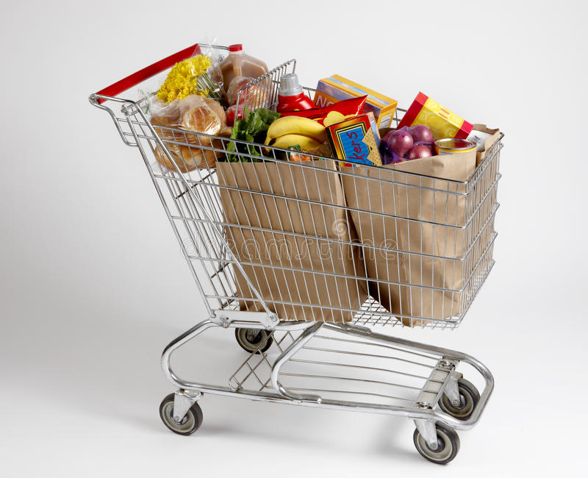
RS Mart
Presented by:
Ruby (c0813098)
Renu (c0814038)
Ritika Raj Kaur (c0816968)
Maram Srija Reddy (c0813274)

Slide 2
The main purpose of our application is to provide the customer Satisfaction.
Problems with the existing applications are they mainly focus on income and delivering the wrong products to the customer.
Also, Takes more time in refund process.
Because of these problems it motivates to build an app which will cover these aspects
Whereas, Our application provides solution to these problems by:
Refund Process in 24 hours.
Customer Service 24/7 in person executive.
Double checking the products before delivering.

Slide 3
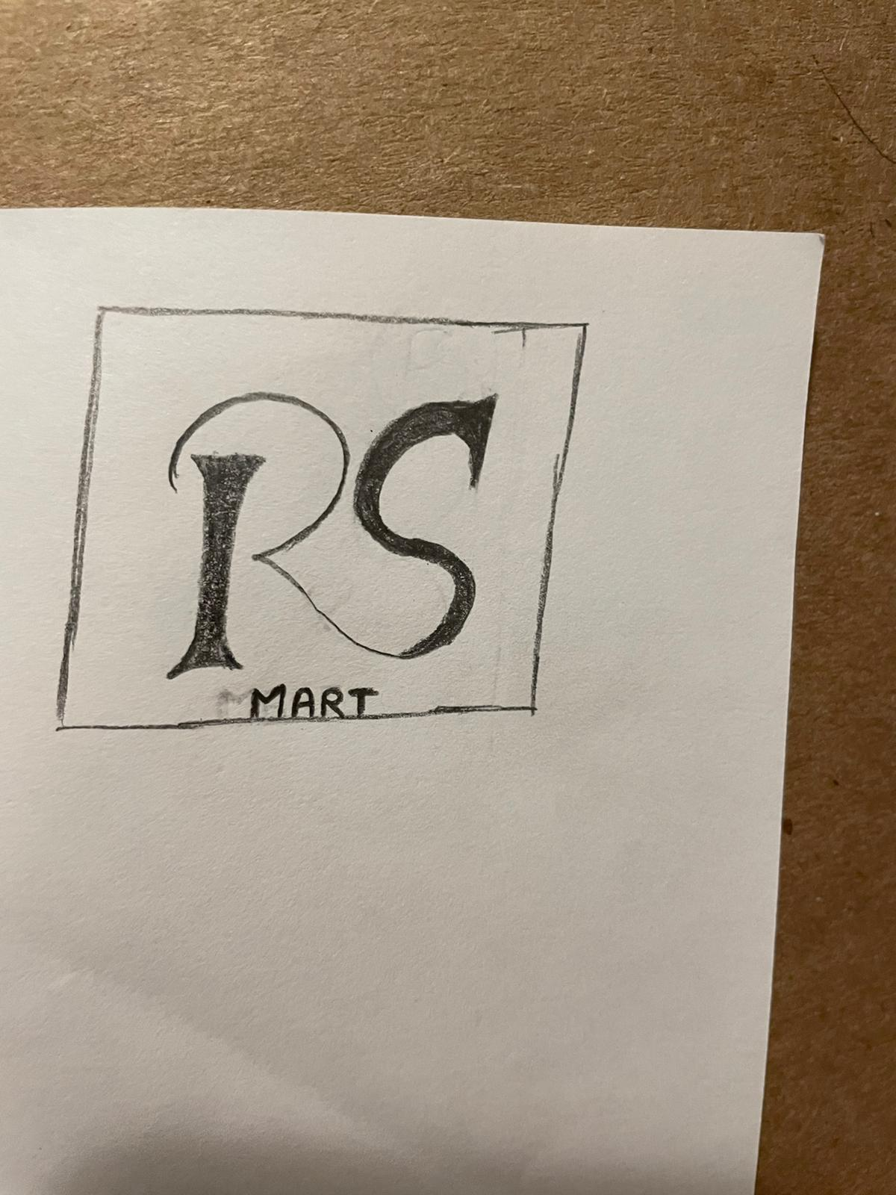
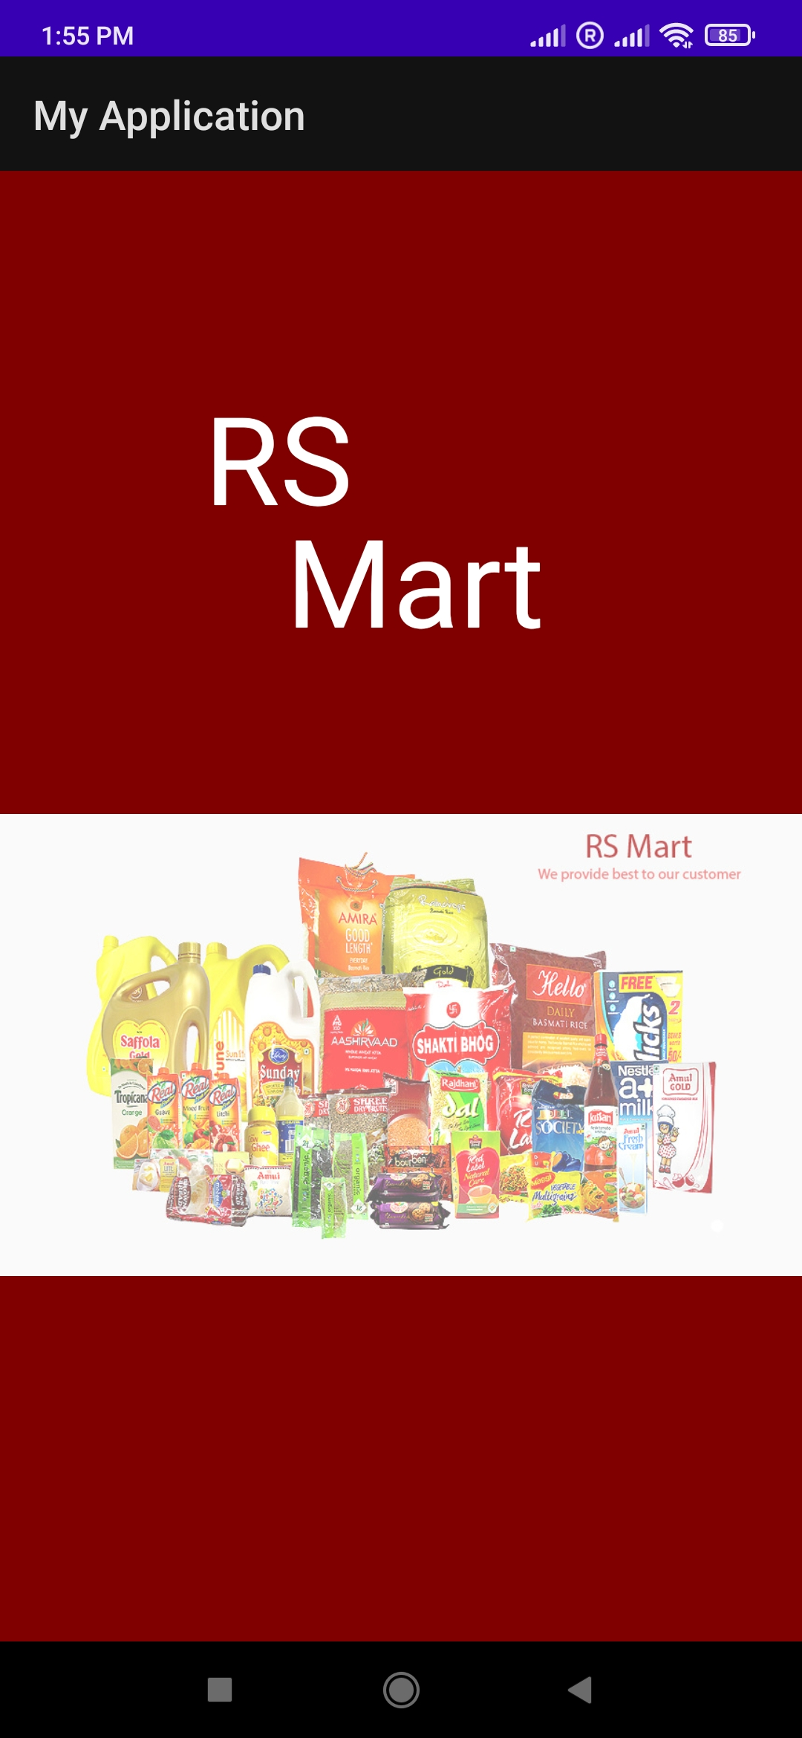
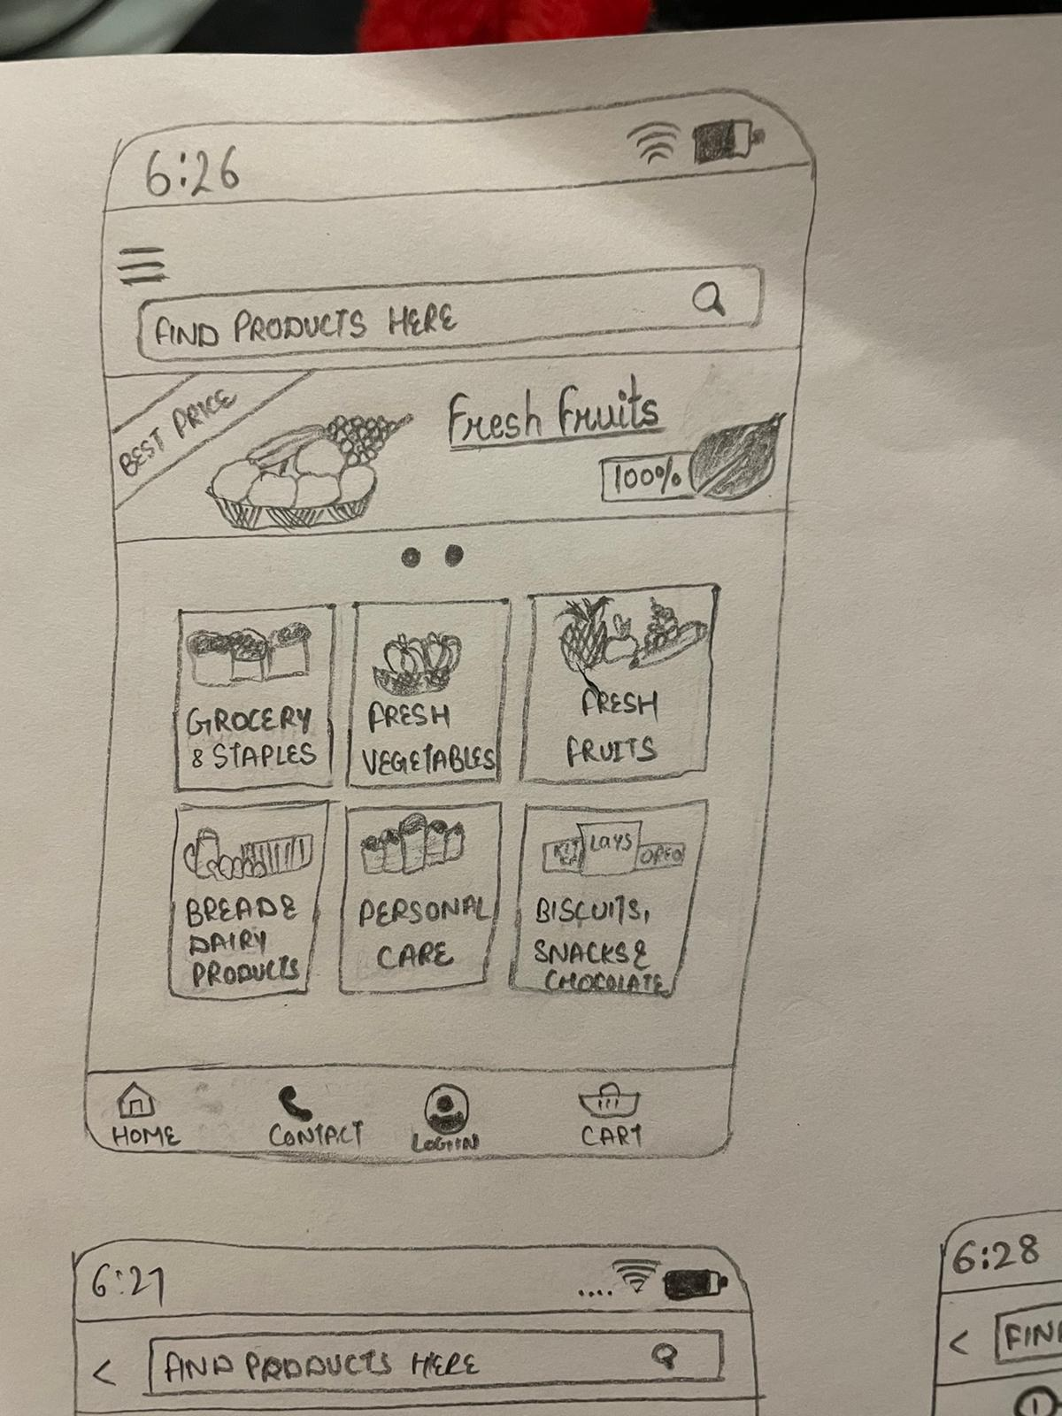

Slide 4
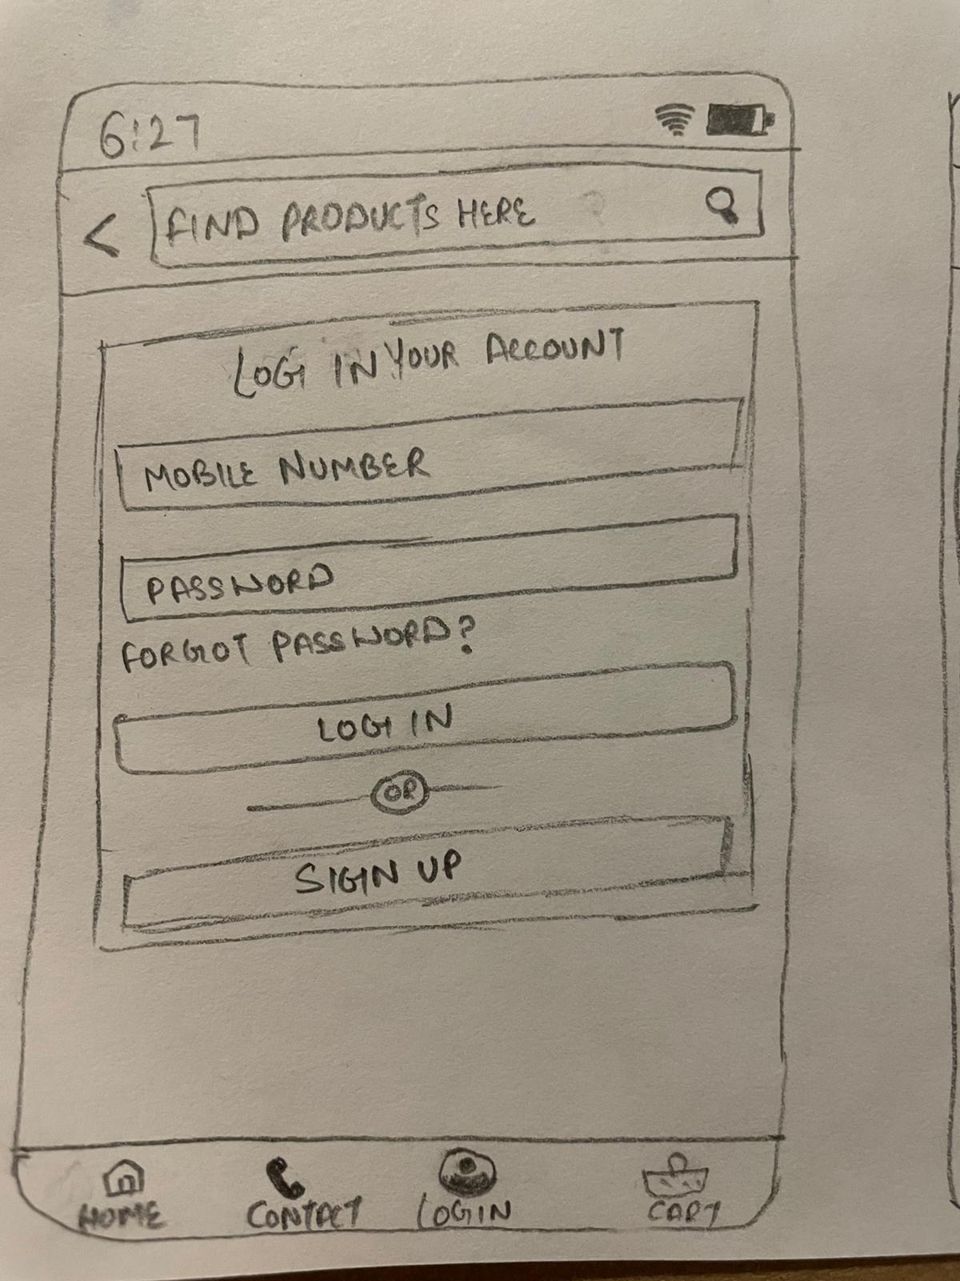
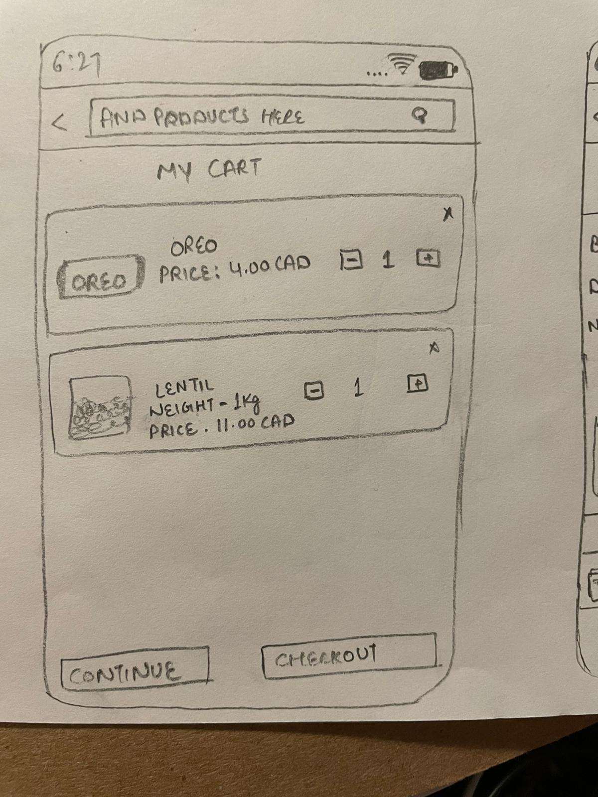
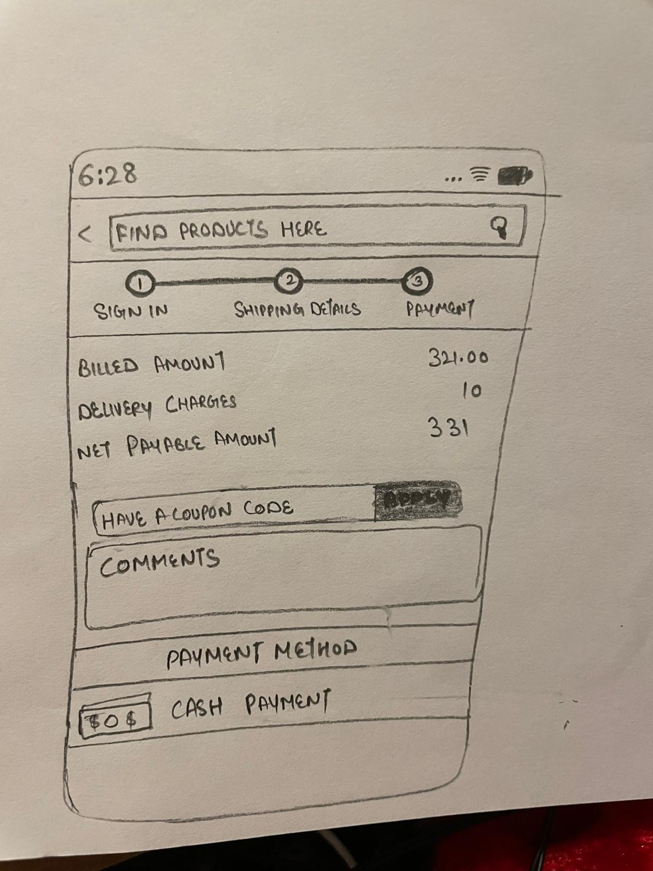

Slide 5
Technical Content
We are using firebase database
Registration process
Map for store location
Voice search
Filters – product price
Cart system
Product description
Login functionality for final order placing
Pop-up messages

Slide 6
Task to be done
Database – Srija
Design and map - Renu
Filters , cart system and voice search – Ruby
Pop-up messages - Ritika
Registration and login functionality - Ritika

Slide 7
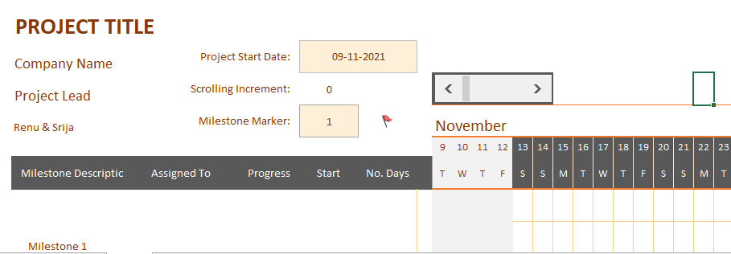
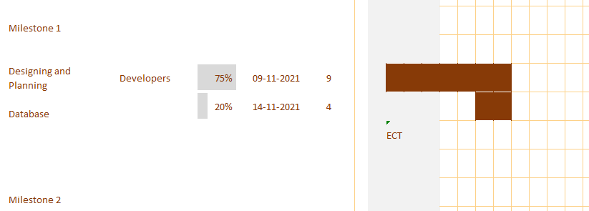
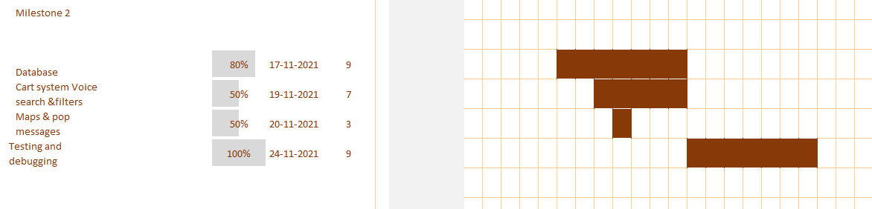

Slide 8
Average Cost
Employees | Pay (Per Hour) | Hours to complete project | Total Pay
Ritika Raj Kaur | $20 | 100 hrs. | $2000
Ruby | $20 | 100 hrs. | $2000
Renu | $20 | 100 hrs. | $2000
Maram Srija Reddy | $20 | 100 hrs. | $2000
As it stated clearly in above chart that our project will be done in total $8000, but additional expenses will be needed to consider such as yearly membership with Google Play Store to publish the app (it will cost under $200 dollars).

Slide 9
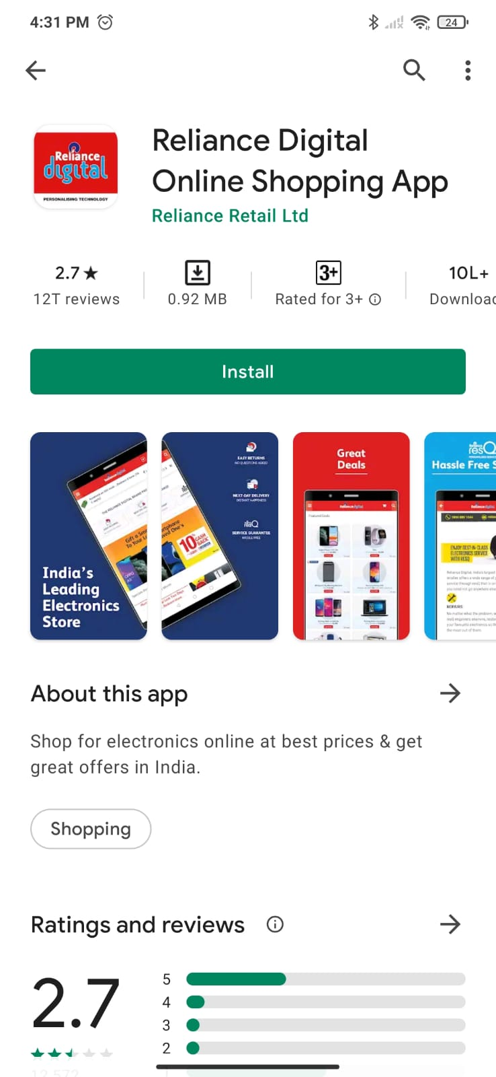
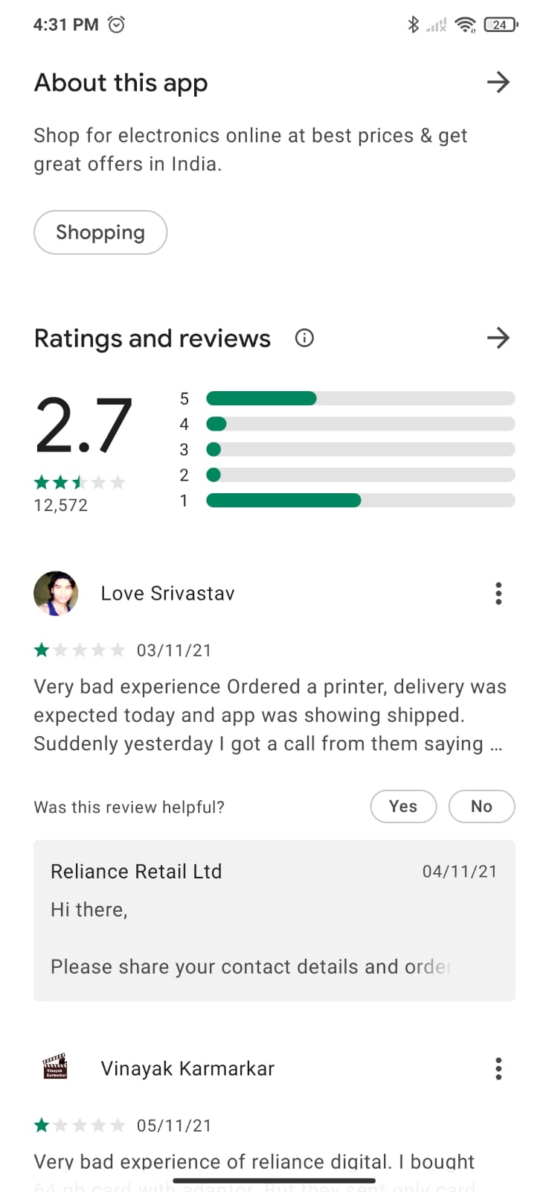
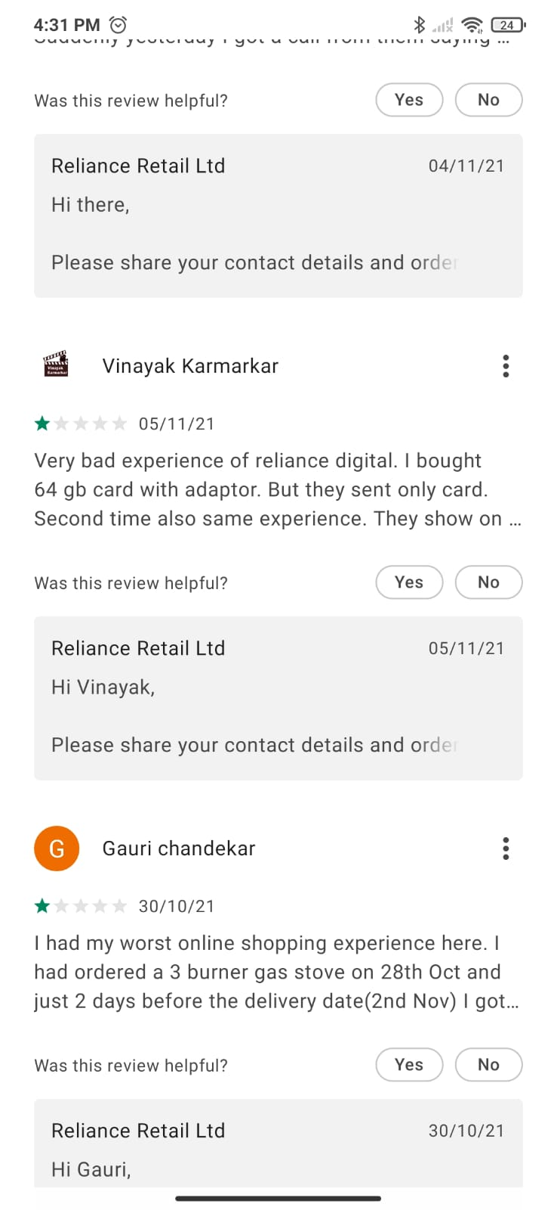
Comparing other apps

Slide 10
Monetization
In-app advertisement
In-app Purchases
Gift cards
Well, it can take 1 year depending upon the customers.
We can provide best services
We can do marketing to promote our application

