Slide 1


ParkingHelpmate Version 1.0
Renu Biradar
Ashwini Guttal

Slide 2
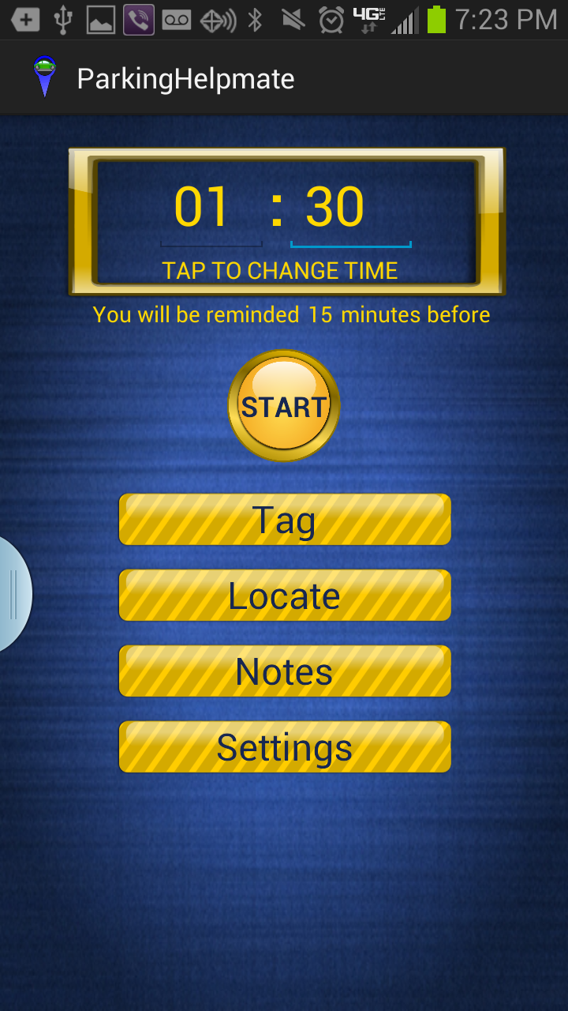
ParkingHelpmate
An Android application that helps you track your parking time and navigate back to your parking spot from current location

Slide 3
Key Features
Time Tracker
Ability to set a meter time and thereby, be notified when the timer runs out
Allows to set pre-timer alert
Ability to add and save notes about the location
Navigator
Tag the vehicle location
Allows you to get precise directions from current location to previously tagged location

Slide 4

Environment
Java Dev Kit
Android SDK
Minimum Requirements:
Android 4.3 – API level 18
Google Maps Android API v2
Android 3.0 (API level 11) or later to view Google Maps
Development Tools:
Android SDK (Android Developer Tools for Windows)
Eclipse 4.2.1
JDK 6 or JDK 7
SDK Tools and Packages
Eclipse IDE
Google Maps

Slide 5
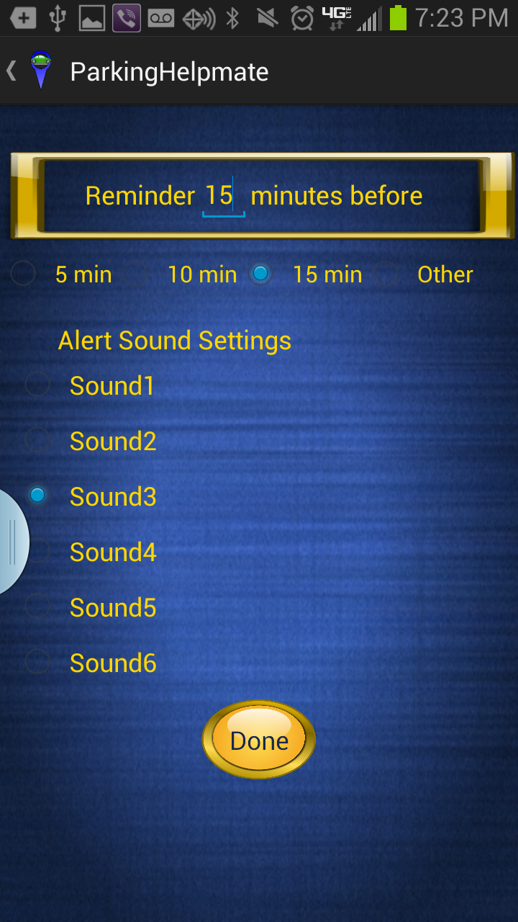
Screenshots
Home
Settings

Slide 6
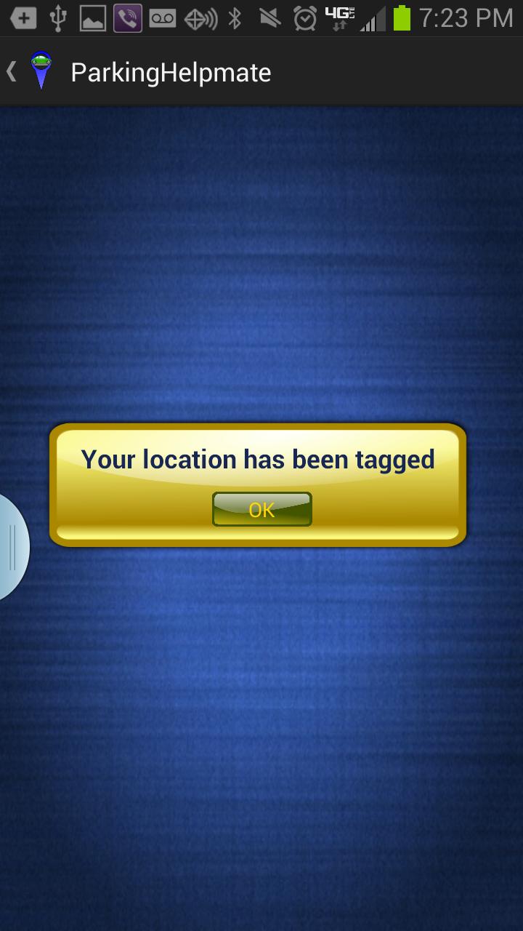
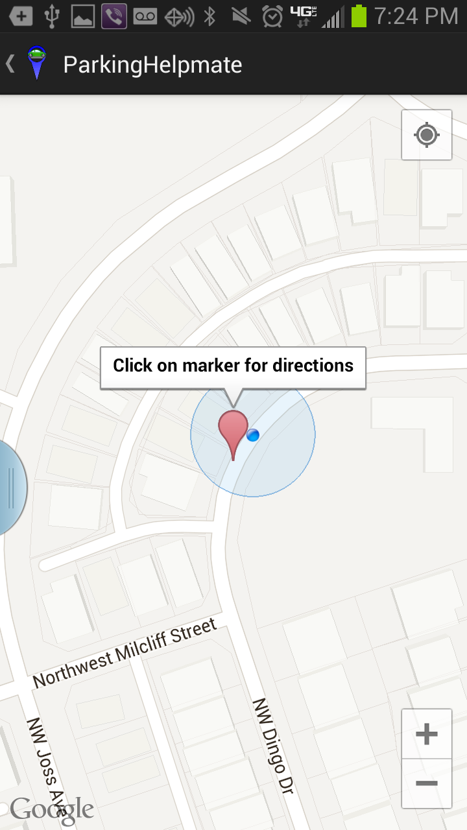
Screenshots
Tag
Locate

Slide 7
Key Challenges
Challenges
Google Map Integration using the ADT Emulator
Invoking Google Map in navigation mode
Application unable to run on old Android version
Lesson Learnt
To test the Android Application on device with latest version early enough in the development

Slide 8
Future Enhancements
ParkingHelpmate Version 2.0
Countdown timer
Auto tag location when you set the meter time
Ability to snap and save picture
Adjust the volume of alert tones
Share parking information like the meter timer, saved notes, location etc via email or text
Alert sound when close to destination
Integrate Google ads
Add Help menu

Slide 9
References & Credits
Development Tools
http://developer.android.com/training/basics/firstapp/index.html
http://developer.android.com/training/location/index.html
ClipArt's and Icons
http://openclipart.org/
Community and Forums
Android Community
Multiple user forums

Slide 10


Slide 11
Backup

