Slide 1
Employee Data Analysis using Excel
STUDENT NAME: RENUKA.M
REGISTER NO: 122204031
DEPARTMENT: CORPORATE SECRETARYSHIP
COLLEGE : SHRI KRISHNASWAMY COLLEGE FOR WOMEN

Slide 2
PROJECT TITLE
Employee Gender Analysis using Excel

Slide 3


AGENDA
Problem Statement
Project Overview
End Users
Our Solution and Proposition
Dataset Description
Modelling Approach
Results and Discussion
Conclusion
3/21/2024 Annual Review

Slide 4

PROBLEM STATEMENT
Identifying gender in companies serves various purposes, such as promoting diversity and inclusion, addressing gender disparities, and creating a more equitable work environment. By tracking gender data, companies can measure their progress towards gender equality.

Slide 5

PROJECT OVERVIEW
Identifying gender in companies is important for creating a workplace that values diversity and inclusion. By understanding the gender makeup of their workforce, companies can implement policies and initiatives that support all employees equally. This helps in addressing any gender disparities that may exist and ensures a fair and supportive environment for everyone. Tracking gender data also allows companies to measure their progress towards gender equality and make informed decisions to promote a more inclusive workplace culture.

Slide 6

WHO ARE THE END USERS?
1. HR Manager 2. Department Heads 3. Senior Leadership 4. Employee Development 5. Compensation and benefits Team 6. Employees

Slide 7

OUR SOLUTION AND ITS VALUE PROPOSITION
1. *Data-driven insights*: Accurate and reliable analysis to inform decisions about promotions, training, and resource allocation. 2. *Enhanced talent development*: Insights to inform talent development programs and retention strategies. 3. *Increased efficiency*: Streamlined analysis process saves time and resources. 4. *Better decision-making*: Clear and actionable recommendations for stakeholders to make informed decisions.

Slide 8
Dataset Description
• Bachelors - Sum of joining Year
• Bachelors. - Sum of Age
• Masters. - Sum of joining Year
• Masters - Sum of Age
• PHD - Sum of joining Year
• PHD - Sum of Age

Slide 9

THE "WOW" IN OUR SOLUTION
1. *Automated Data Visualization*: With a single click, the solution generates interactive and dynamic dashboards, providing real-time insights into employee performance. 2. *Predictive Analytics*: Using machine learning algorithms, the solution forecasts future performance trends, enabling proactive decision-making. 3. *Personalized Employee Insights*: The solution provides tailored recommendations for each employee's development and growth, enhancing engagement and retention.
3/21/2024 Annual Review
9

Slide 10
MODELLING
1. *PivotTables* for data summarization and analysis 2. *Conditional Formatting* for highlighting performance trends 3. *Charts and Graphs* for visualizing performance data.
10

Slide 11
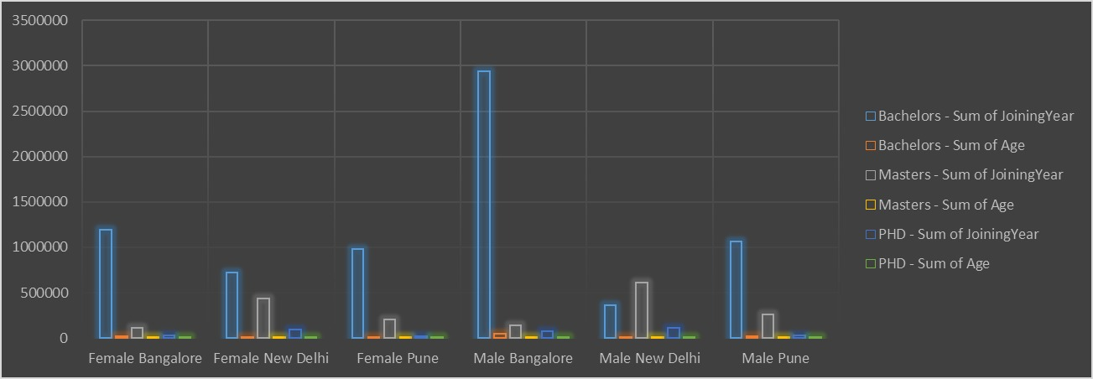
RESULTS
11

Slide 12
CONCLUSION
Identifying gender in a company involves recognizing and acknowledging the different genders present within the organization. It's essential for companies to create an inclusive environment where all genders feel respected and valued. This can be achieved through various initiatives such as gender-neutral policies, diversity training, and promoting gender equality in leadership po issitions.

