Slide 2
Objectives
To understand the relationship between the exercise and activity level of the person using the data collected from the Samsung Health application.
Data Overview
The dataset was consisted with daily records of step count, calories burned, mood as a given numeric data, hours of sleep, feeling of activeness as a Boolean data and weight starting from 06th.

Slide 3
Data Collection
Data Collection
Data Preparation
Feature Engineering
EDA
Statistical Analysis
Modelling

Slide 4
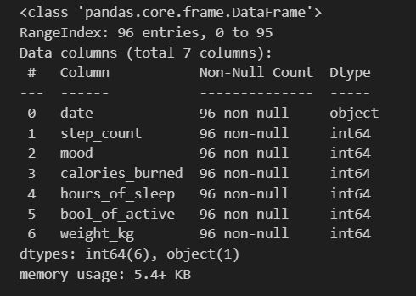
Data Preparation
Under Data preparation followings steps were taken.
Checking data frame info

Slide 5
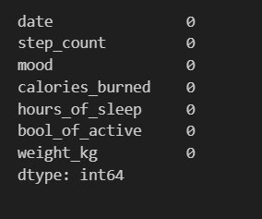
Data Preparation cont.
Under Data preparation followings steps were taken.
Checking for Null dataset

Slide 6
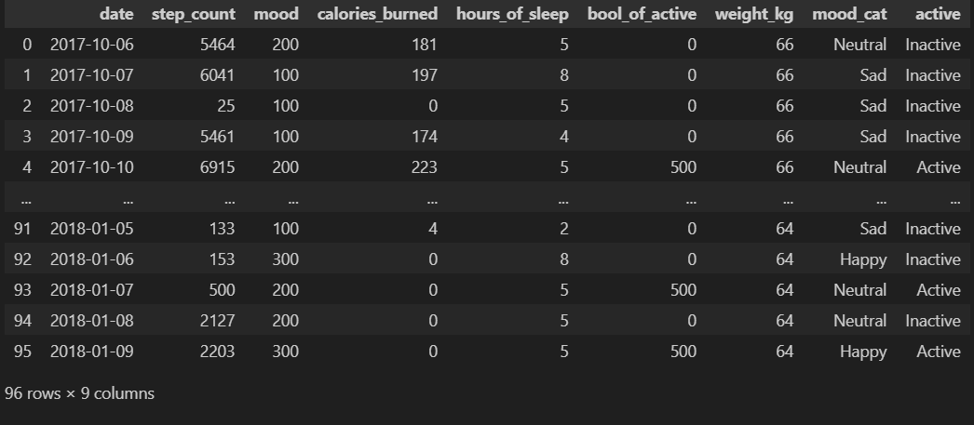
Feature Engineering
For analysis proposals, numerical values of mood and active data were converted into categories.

Slide 7
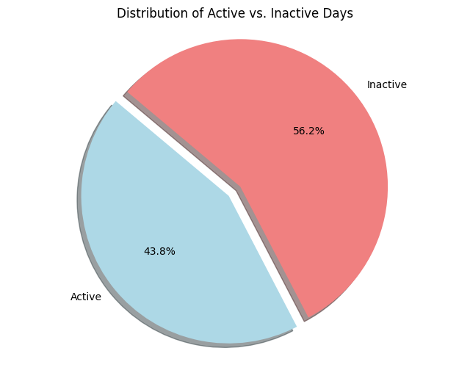
Exploratory Data Analysis (EDA)
Distribution of Active vs Inactive Days

Slide 8
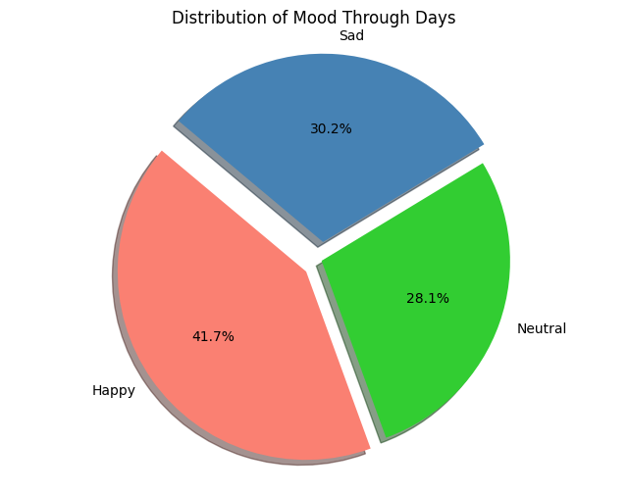
Exploratory Data Analysis (EDA) cont.
Distribution of Mood Through Days

Slide 9
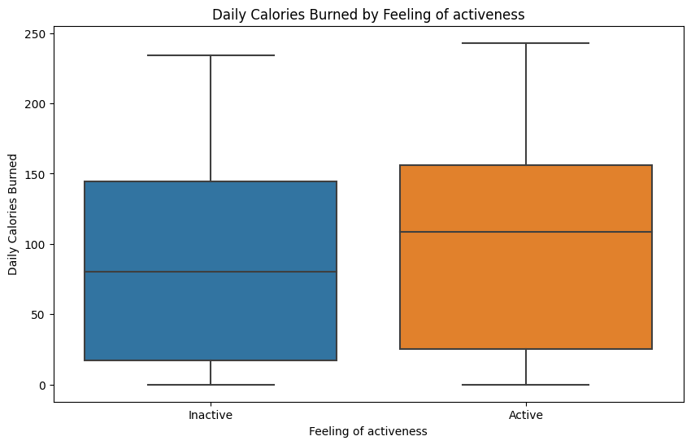
Exploratory Data Analysis (EDA) cont.
Daily Calories Burned by Feeling of activeness

Slide 10
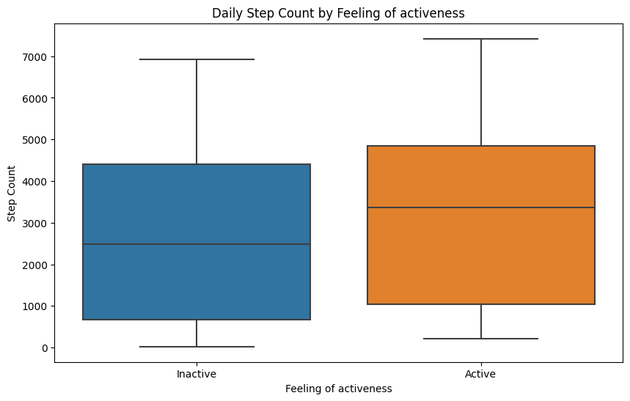
Exploratory Data Analysis (EDA) cont.
Daily Step Count by Feeling of activeness

Slide 11
Statistical Analysis
T-test comparing Step Count between Active and Inactive groups
Following Results were obtained by the analysis.
t-value = 1.174
P-value = 0.243
According to the results for t-value of 1.174, there is a moderate degree of difference in mean step counts between the Active and Inactive groups. But it can not be considered as a statically significant value, because the p-value 0.243 is much more higher than 0.05.

Slide 12
Statistical Analysis cont.
Correlation coefficient for Feel of Activeness and Step Count
Point-biserial correlation coefficient : 0.120
P-value: 0.243
Correlation coefficient between Feel of Activeness & Calories Burned Point-biserial correlation coefficient: 0.111
P-value: 0.282
Correlation coefficient has nearly taken a value of 0.1, which indicate that there is a weak positive relationship between feel of activeness with step count and calories burned.

Slide 13
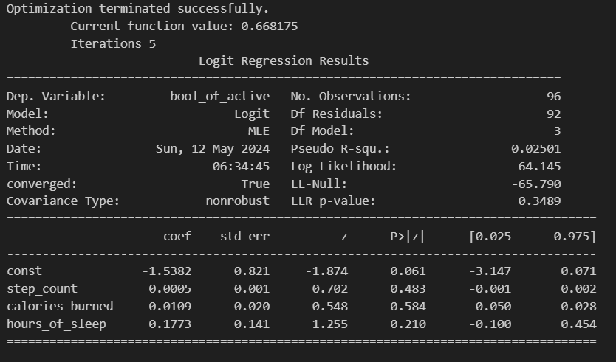
Statistical Analysis cont.
Logistic Regression Model
A logistic regression model was created to determine the relationship between feel of activeness and step count, calories burned and hours of sleep. The results of analysis are shown below.

Slide 14
Statistical Analysis cont.
Logistic Regression Model
Since p-value for step count, calories burned & hours of sleep are taken much larger values than 0.05, all those variables are not statically significant and do not have a strong linear relationship with the variable of Feeling of Activeness.
According to the log-likelihood value of (-64.145) and pseudo R-squared value of 0.025 indicate that the model explains only a small amount of the binary outcome.

Slide 15
Thank You!

