Slide 1


Code_Saturne – Modifications to the Lagrangian options in the GUI
24 September 2020, Version 1.0
Notes:
<number>

Slide 2

Contact
For further information, please contact:
<number>
Notes:
<number>

Slide 3
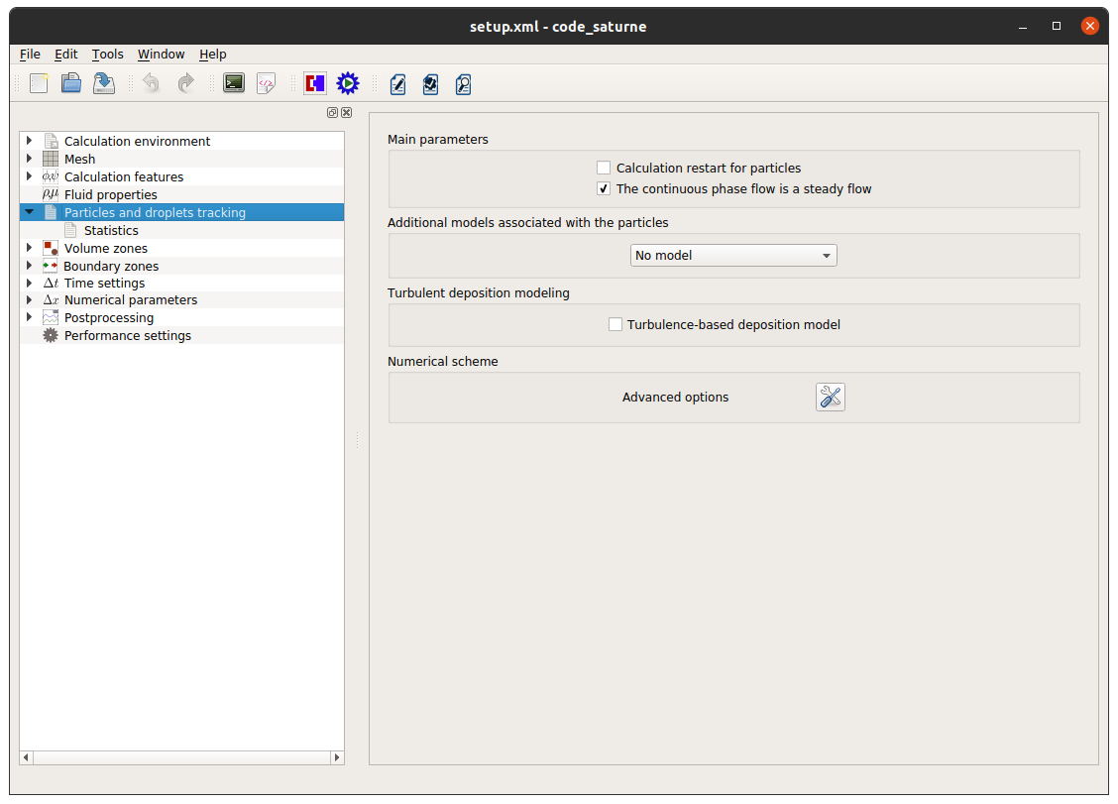
Original Lagrangian GUI
The original GUI for the Lagrangian settings.
Advanced options panel opens with a mouse click
<number>

Slide 4
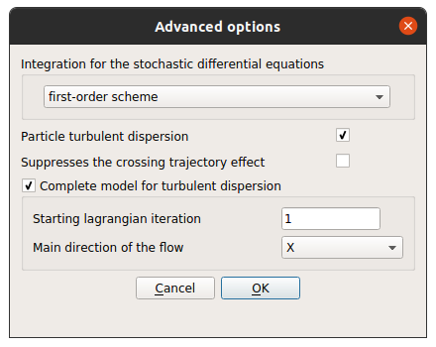
Original Lagrangian GUI
The advanced Lagrangian options panel.
<number>

Slide 5
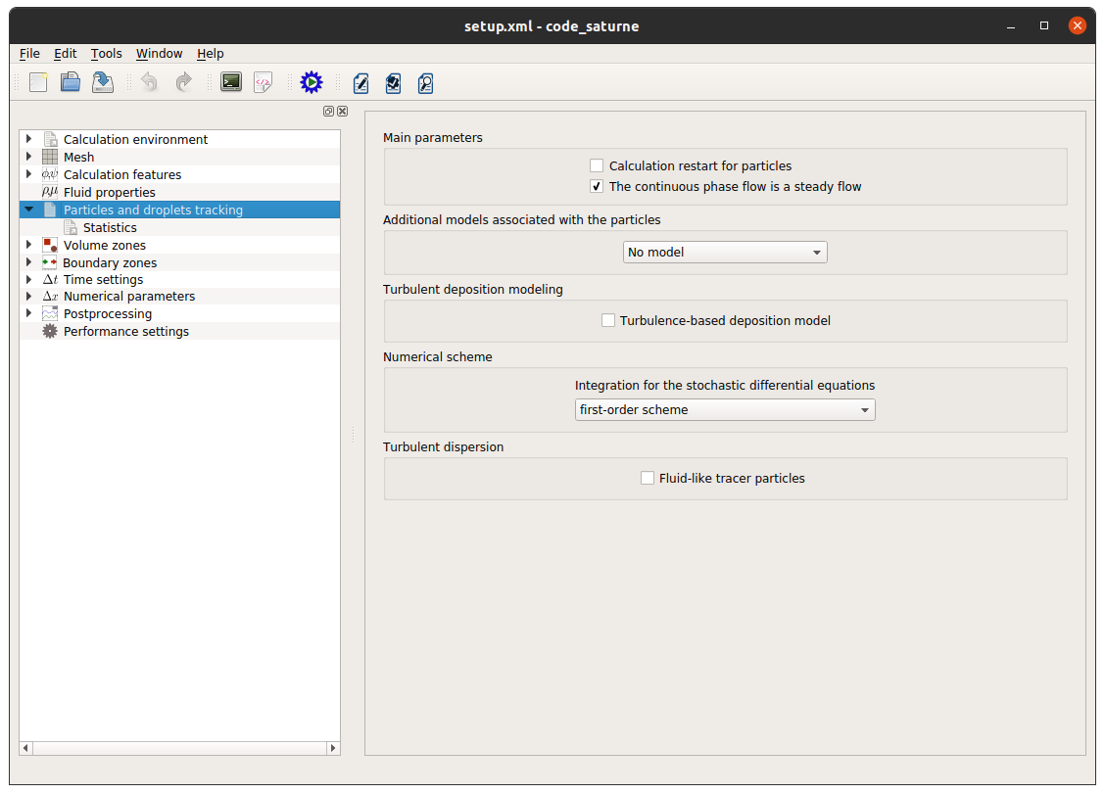
The New Lagrangian GUI
The new and simplified Lagrangian GUI.
New sections
Advanced options panel removed
<number>

Slide 6
The New Lagrangian GUI
The complete turbulent dispersion model is now the default option for the code. This implies that certain solver flags are automatically set. These are:
modcpl = 1 → Regular particles option enabled
idistu = 1 → Turbulent dispersion for particles enabled
idiffl = 0 → Turbulent diffusion for particles disabled
This option is deactivated if the user clicks on the Fluid-like tracer particles option and in this case the particles are assumed to behave like the fluid itself, tracking the flowfield and not affecting it in any manner.
<number>

Slide 7
The New Lagrangian GUI
Selection of the Fluid-like tracer particles option resets the previously mentioned flags to the following values:
modcpl = 0 → Regular particles option disabled
idistu = 0 → Turbulent dispersion for particles disabled
idiffl = 1 → Turbulent diffusion for particles enabled
The option of the advanced panel to specify the main direction of the flow no longer exists. The solver is now choosing the main direction based on the local mean relative velocity which is equivalent to selecting the local projection option in the advanced panel.
<number>

Slide 8
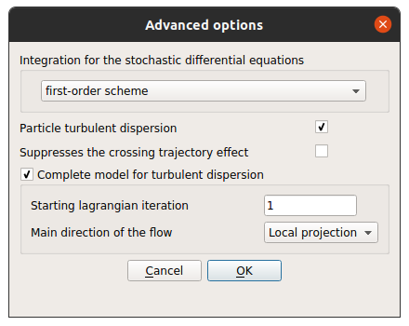
The New Lagrangian GUI
The advanced Lagrangian settings – local projection option is now the default behaviour. The order of the integration scheme option has been moved to the main settings panel.
8

