Slide 1


Code_Saturne – Lagrangian options in the GUI
21 september 2020, Version 2.0

Slide 2

Contact
For further information, please contact:

Slide 3
Definition from the CS 6.2alpha
isttio : indicates the steady (=1) or unsteady (=0) state of the continuous phase flow in particular, isttio = 1 is needed in order to: calculate steady statistics in the volume or at the boundaries (starting respectively from the iterations nstist) and calculate time-averaged two-way coupling source terms (from the time step nstits). Useful if iilagr = CS_LAGR_ONEWAY_COUPLING or iilagr = CS_LAGR_TWOWAY_COUPLING (if iilagr = CS_LAGR_FROZEN_CONTINUOUS_PHASE, then isttio=1 automatically)
iilagr : Lagrangian module status.
CS_LAGR_OFF: Lagrangian module off
CS_LAGR_ONEWAY_COUPLING: Lagrangian two-phase flow in one-way coupling (no influence of the particles on the continuous phase)
CS_LAGR_TWOWAY_COUPLING: Lagrangian two-phase flow with two-way coupling (influence of the particles on the dynamics of the continuous phase). Dynamics, temperature and mass may be coupled independently.
CS_LAGR_FROZEN_CONTINUOUS_PHASE: Lagrangian two-phase flow on frozen in continuous phase. This option may only be used in the case of a calculation restart. All the Eulerian fields are frozen (including the scalar fields). This option automatically implies iccvfg = 1 (calculation with a fixed velocity field iccvfg = 1: true, 0: false).

Slide 4
Definition from the CS 6.2alpha
nstist : absolute time step number (includings the restarts) after which the volume statistics are cumulated over time (they are then said to be steady). if the absolute time step number is lower than nstist, or if the flow is unsteady (isttio=0), the statistics are reset to zero at every time step (the volume statistics are then said to be non-steady). Useful if isttio = 1
nstits :number of absolute time steps (including the restarts) after which a time-average of the two-way coupling source terms is calculated. Indeed, if the flow is steady (isttio=1), the average quantities that appear in the two-way coupling source terms can be calculated over different time steps, in order to get a better precision. if the number of absolute time steps is strictly inferior to nstits, the code considers that the flow has not yet reached its steady state (transition period) and the averages appearing in the source terms are reinitialized at each time step, as it is the case for unsteady flows (isttio=0). Useful if iilagr = CS_LAGR_TWOWAY_COUPLING and isttio=1
postprocessing
Coupling source term

Slide 5
Logical Tree
One Way iilagr=1
Two Way iilagr=2
Frozen iilagr=3
isttio = 0 or 1
isttio = 0 or 1
isttio = 1 if Frozen
Isttio Steady state of the continuous phase
GUI Master : Always available
nstits only for Two Way+ isttio = 1
nstits
time-average of the two-way coupling source terms
GUI Master : Available independently of isttio
!
nstist only when isttio = 1
If isttio = 0, nstist no needed
nstist
volume statistics
GUI Master : Always available
!

Slide 6
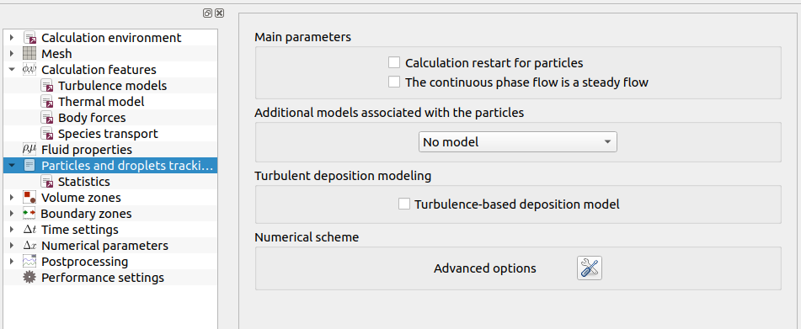

Logical Tree- One Way
One Way iilagr=1
isttio = 0 or 1
Isttio Steady state of the continuous phase
nstist only when isttio = 1
If isttio = 0, nstist no needed
nstist
volume statistics
GUI Master : Always available
!
isttio = 0
!
Why nstist?
In the doc : “Useful if isttio = 1”

Slide 7
Logical Tree- One Way – Correction to respect the doc
isttio = 0
isttio = 1

Slide 8
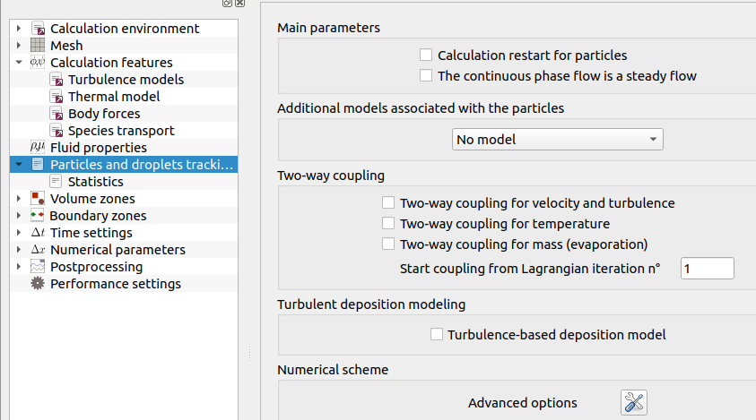
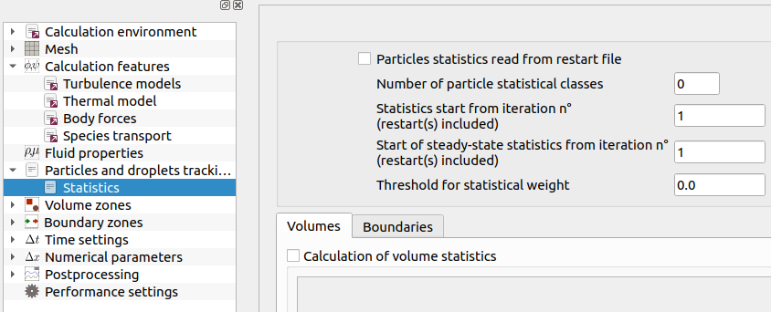
Logical Tree – Two Way
Two Way iilagr=2
isttio = 0 or 1
Isttio Steady state of the continuous phase
nstist only when isttio = 1
nstits only for Two Way+ isttio = 1
If isttio = 0, nstist no needed
nstist
volume statistics
nstits
time-average of the two-way coupling source terms
isttio = 0
!
Why nstist?
In the doc : “Useful if isttio = 1”

Slide 9
Logical Tree – Two Way
Two Way iilagr=2
isttio = 0 or 1
Isttio Steady state of the continuous phase
nstist only when isttio = 1
nstits only for Two Way+ isttio = 1
If isttio = 0, nstist no needed
nstist
volume statistics
nstits
time-average of the two-way coupling source terms
isttio = 0
!
Why nstits?
In the doc : “Useful if iilagr = CS_LAGR_TWOWAY_COUPLING and isttio=1”

Slide 10
Logical Tree – Two Way - Correction to respect the doc
isttio = 0
isttio = 1

Slide 11
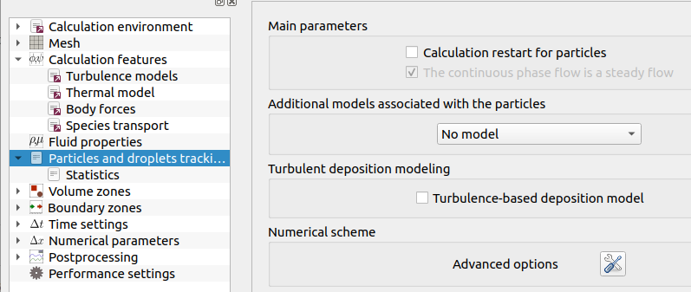
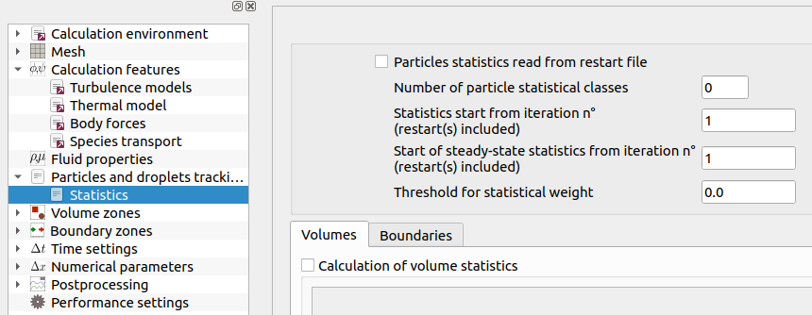
Logical Tree - Frozen
Frozen iilagr=3
isttio = 1 if Frozen
Isttio Steady state of the continuous phase
GUI Master : Always available
nstist only when isttio = 1
nstist
volume statistics
GUI Master : Always available
!
isttio = 1 if Frozen

Slide 12
Remark on Statistics
idstnt : absolute time step number (including the restarts) after which the calculation of the volume statistics is activated.
Remarks : idstnt and nstist manage the same statistics arrays for the postprocessing.
idstnt always usefull

Slide 13
Suggestions for Frozen, One or Two Way
idstnt and nstist manage the same statistics arrays for the postprocessing.
Transcient statistics start from iteration n° (restart(s) included)
Overwrite the Transcient statistics by steady-state statistic at the iteration n° (restart(s) included)

Slide 14
Suggestions for Frozen

Slide 15
Suggestions for One Way

Slide 16
Suggestions for Two Way
Time-average of the two-way coupling source terms from iteration n°(restart(s) included) (put a negative value to use the transcient two-way coupling source terms)

