Slide 1

GENERATIVE AI SIMPLE SQUARE GAN dONE bY: 311521205042 rENUGA deVI p

Slide 2
REG NO:311521205042
​
NAME:RENUGA DEVI P
​
DEPARTMENT:INFORMATION TECHNOLOGY
​
COLLEGE NAME:MEENAKSHI SUNDARARAJAN ENGINEERING COLLEGE​
GMAIL ID:siva251003@gmail.com
​
NM ID: 41C9BC20208623499C740DFE1E917895
​
ZONE III:CHENNAI III​

Slide 3
AGENDA
PROBLEM STATEMENT
GAN
PROJECT OVERVIEW
WHO ARE THE END USERS
SOLUTION AND IT'S VALUE PROPOSITION
THE WOW IN MY SOLUTION
MODELLING
CODE IMPLEMENTATION
RESULT

Slide 4
PROBLEM STATEMENT
The problem statement is to develop a Generative Adversarial Network (GAN) named "SimpleSquareGAN" to generate realistic images of squares.
This involves training a generator network to create square images from random noise and a discriminator network to differentiate between real and generated images.
The goal is to produce high-quality square images that closely resemble those in the training dataset, while also ensuring that the discriminator cannot reliably distinguish between real and fake images.

Slide 5
GAN ALGORITHM
(GENERATIVE ADVERSARIAL ALGORITHM)
The GAN algorithm consists of a generator network that creates square images from random noise and a discriminator network that distinguishes between real and fake images. Through adversarial training, the generator learns to produce realistic images, while the discriminator learns to distinguish between real and fake images. The success of the algorithm relies on achieving a balance where the generator creates images that are indistinguishable from real ones, and the discriminator cannot reliably differentiate between them.

Slide 6
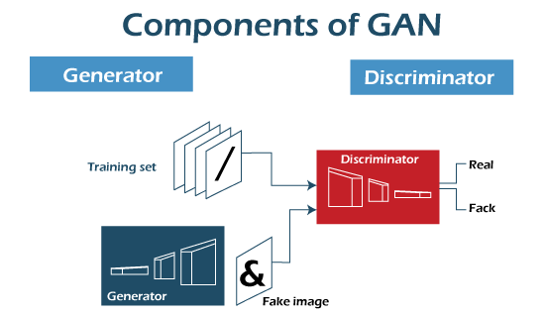

Slide 7
PROJECT OVERVIEW
OBJECTIVE: Create a Generative Adversarial Network (GAN) to generate realistic images of squares.
COMPONENTS:
Generator (G): Produces square images from random noise.
Discriminator (D): Distinguishes between real and generated square images.
TRAINING PROCESS:
*G and D are trained simultaneously in an adversarial manner.
*G generates fake square images, while D tries to differentiate between real and fake images.
*Both networks improve iteratively by feedback from each other.

Slide 8
WHO ARE THE END USERS?
ARTISTS AND DESIGNERS
INDUSTRY PROFESSIONALS
END USERS
DEVELOPERS AND RESEARCHERS
EDUCATORS AND STUDENTS

Slide 9
SOLUTION AND IT'S PROPOSITION
EFFICIENT IMAGE GENERATION
Automates the process of generating square images.
CUSTOMISABILITY AND DIVERSITY
Users can adjust parameters to generate a wide range of square images.
CUSTOMISABILITY AND DIVERSITY
Produces realistic square images meeting various standards.
READILY AVAILABLE RESOURCE
Provides square images for diverse user needs and projects.

Slide 10

THE WOW IN MY SOLUTION
AUTONOMOUS IMAGE GENERATION
REALISM
CUSTOMIZATION
INNOVATION

Slide 11
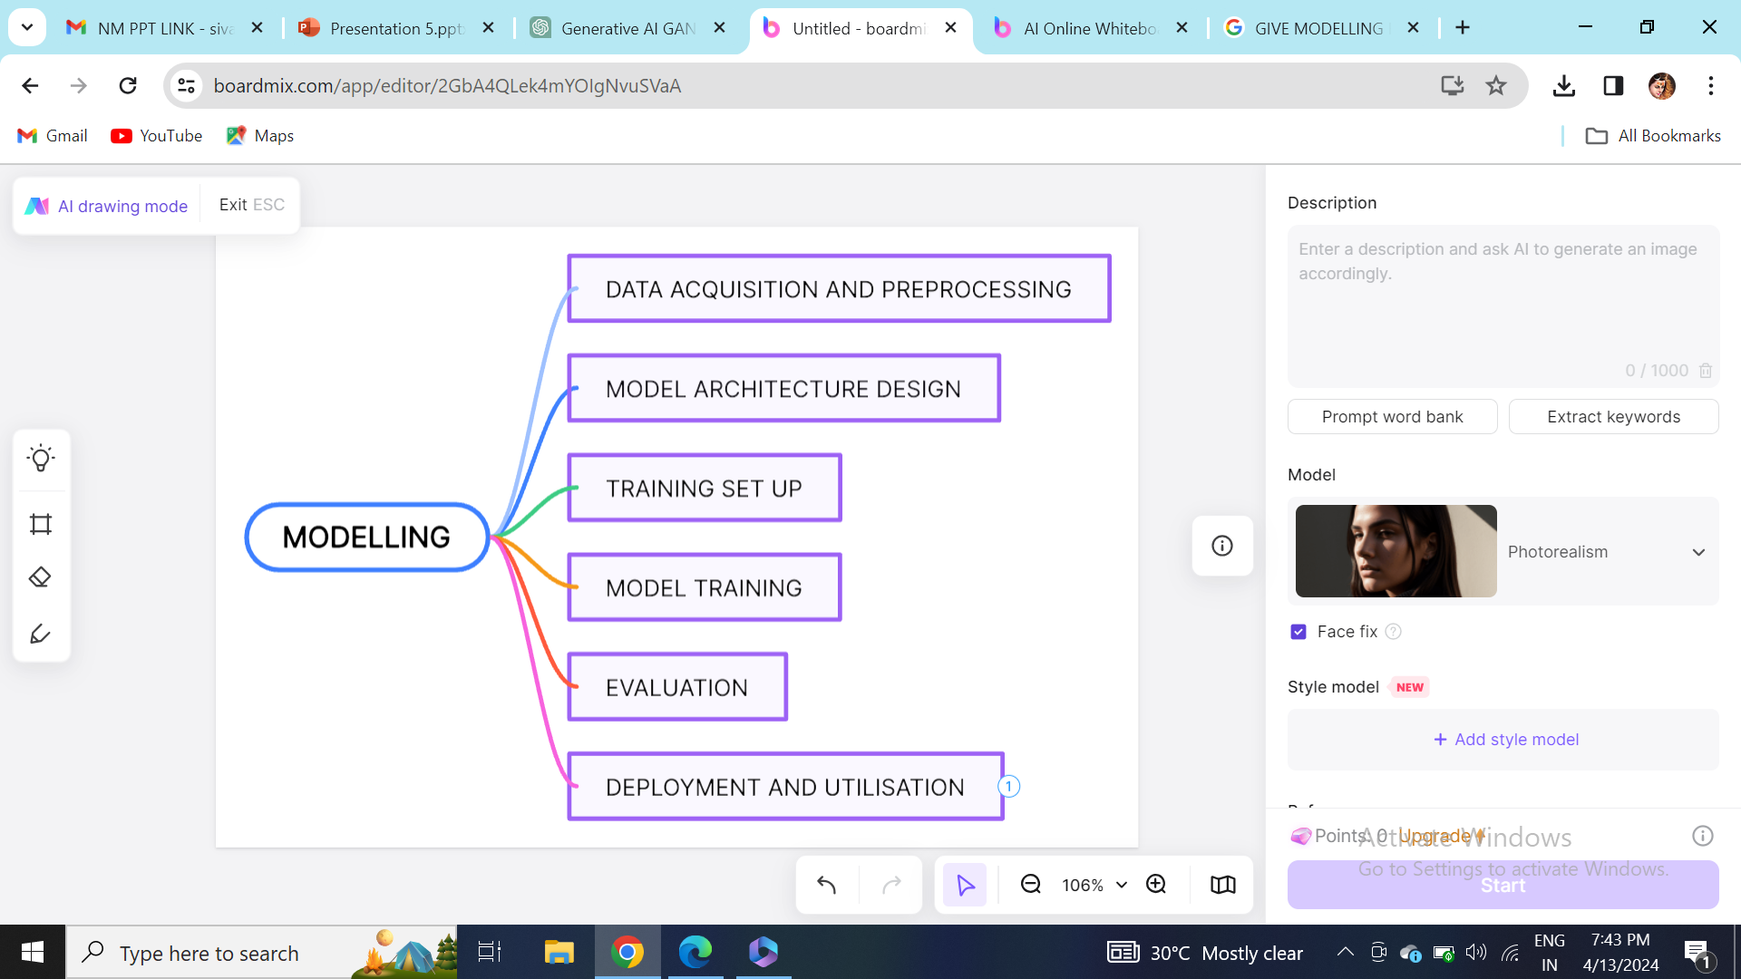
MODELLING OF SIMPLE SQUARE GAN

Slide 12
The data acquisition process involves collecting raw square images from various sources, while preprocessing prepares these images for training by resizing, normalizing, and converting them to a consistent format.
It ensures the images are ready for training the Generative Adversarial Network (GAN) model.
1)DATA ACQUISITION AND PREPROCESSING:
RAW IMAGES
DATA ACQUISITION
PREPROCESSING
FINAL DATASET

Slide 13
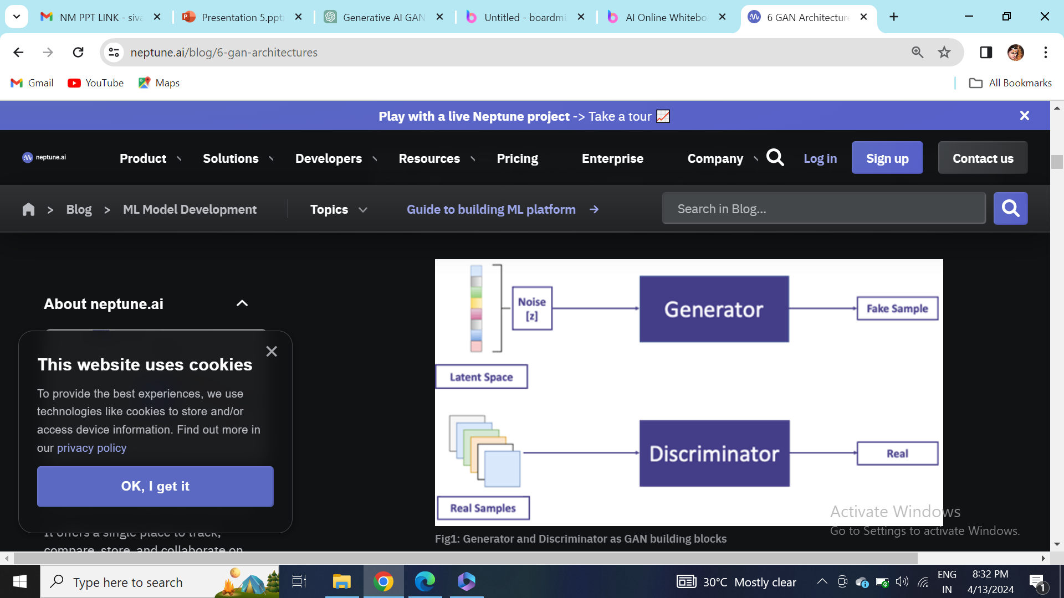
2)MODEL ARCHITECTURE DESIGN:

Slide 14
3) TRAINING SET UP:
Define hyperparameters such as learning rate, batch size, number of epochs, and optimizer settings.
Split the dataset into training and validation sets, ensuring that both sets contain a diverse range of square images.
4) MODEL TRAINING:
Train the discriminator on batches of real and fake square images, optimizing its binary classification performance.
Train the generator to generate realistic square images that can fool the discriminator, optimizing its ability to generate convincing outputs.

Slide 15
5) EVALUATION:
It starts with generating sample images using the trained generator.
The generated images are then visually inspected to assess their quality and realism.
4) DEPLOYMENT AND UTILISATION:
The deployment and utilization of the trained GAN model for generating square images.
The generated images can be utilized for various applications, such as art generation or research experiments.

Slide 16
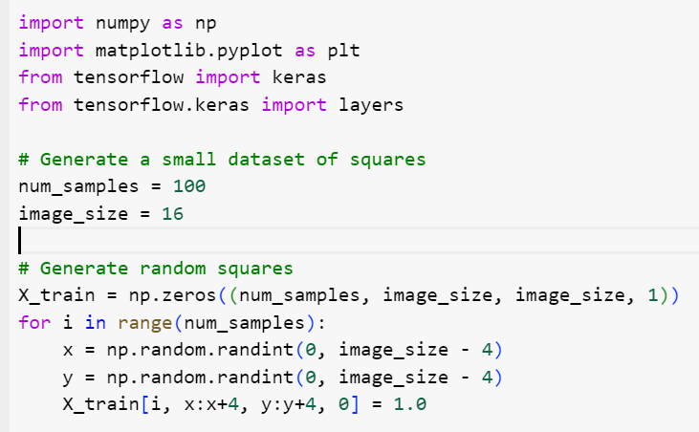
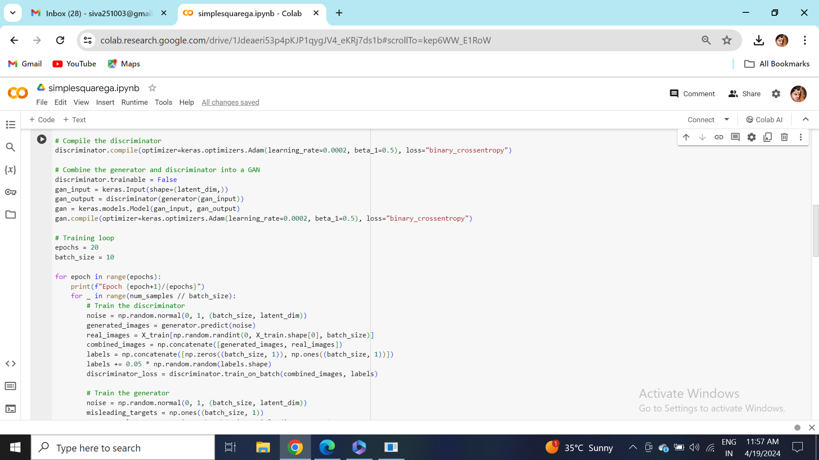
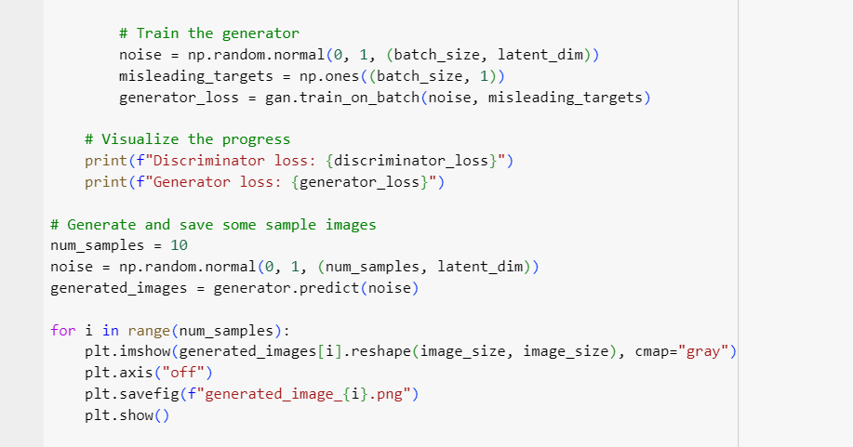
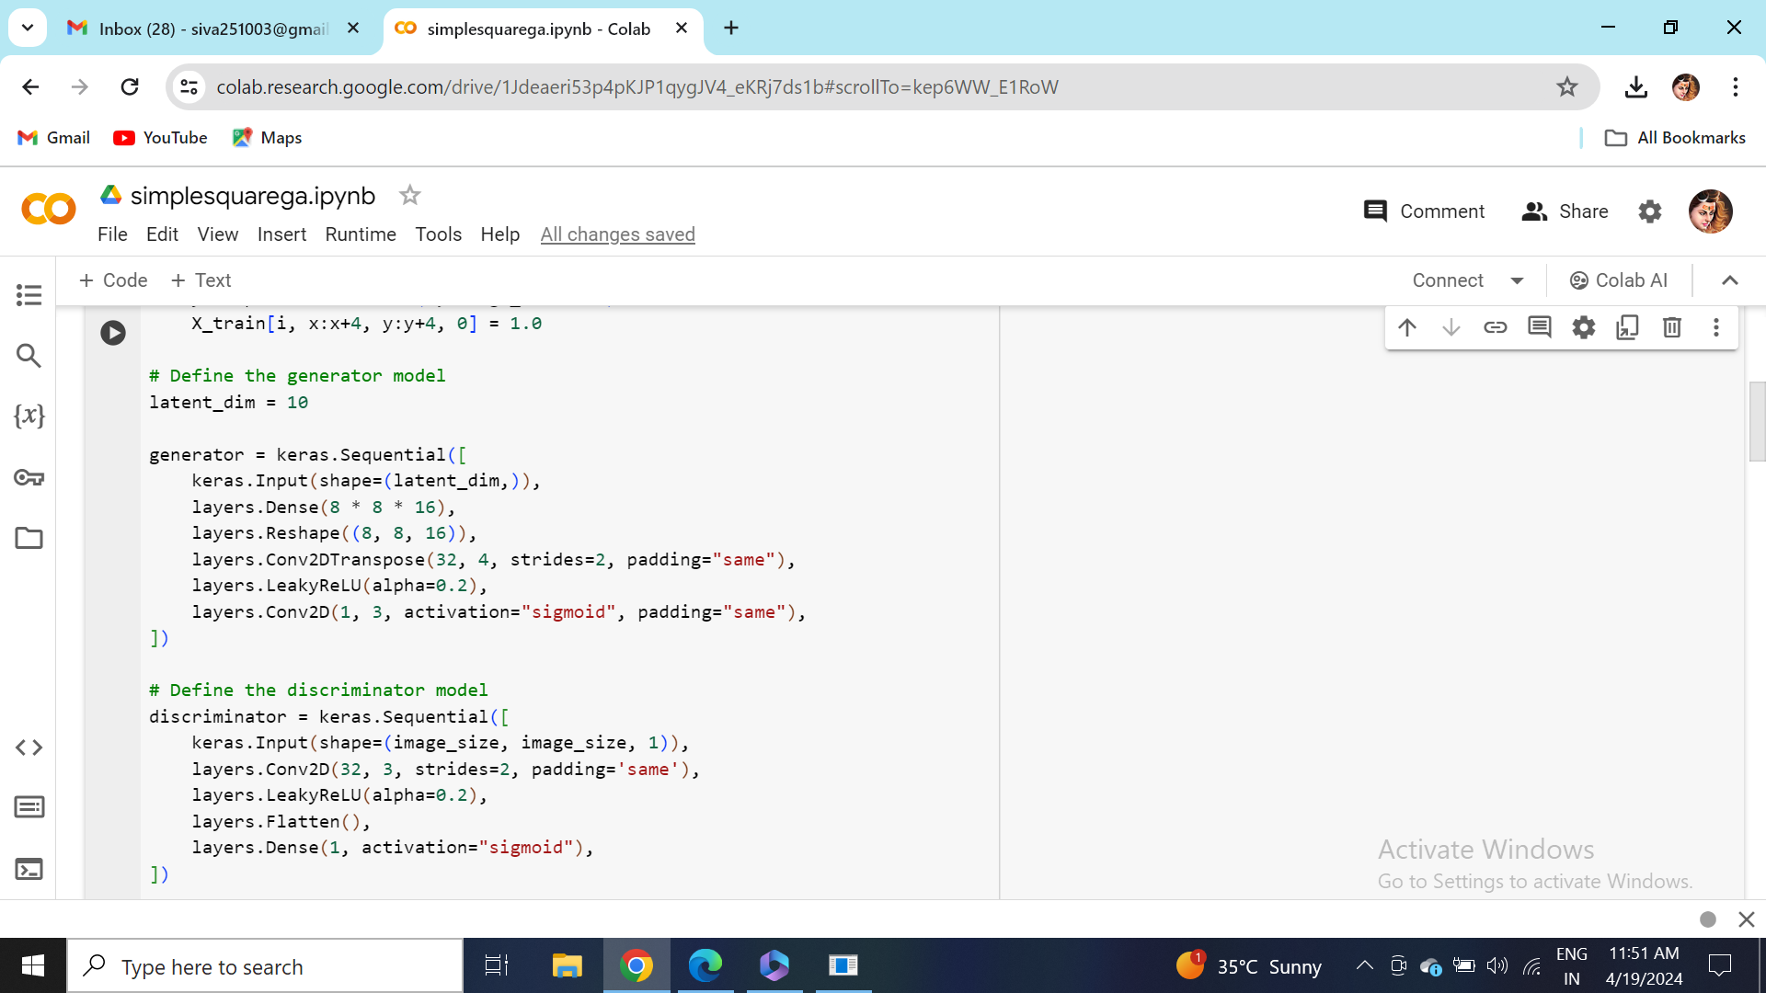
CODE IMPLEMENTATION

Slide 17
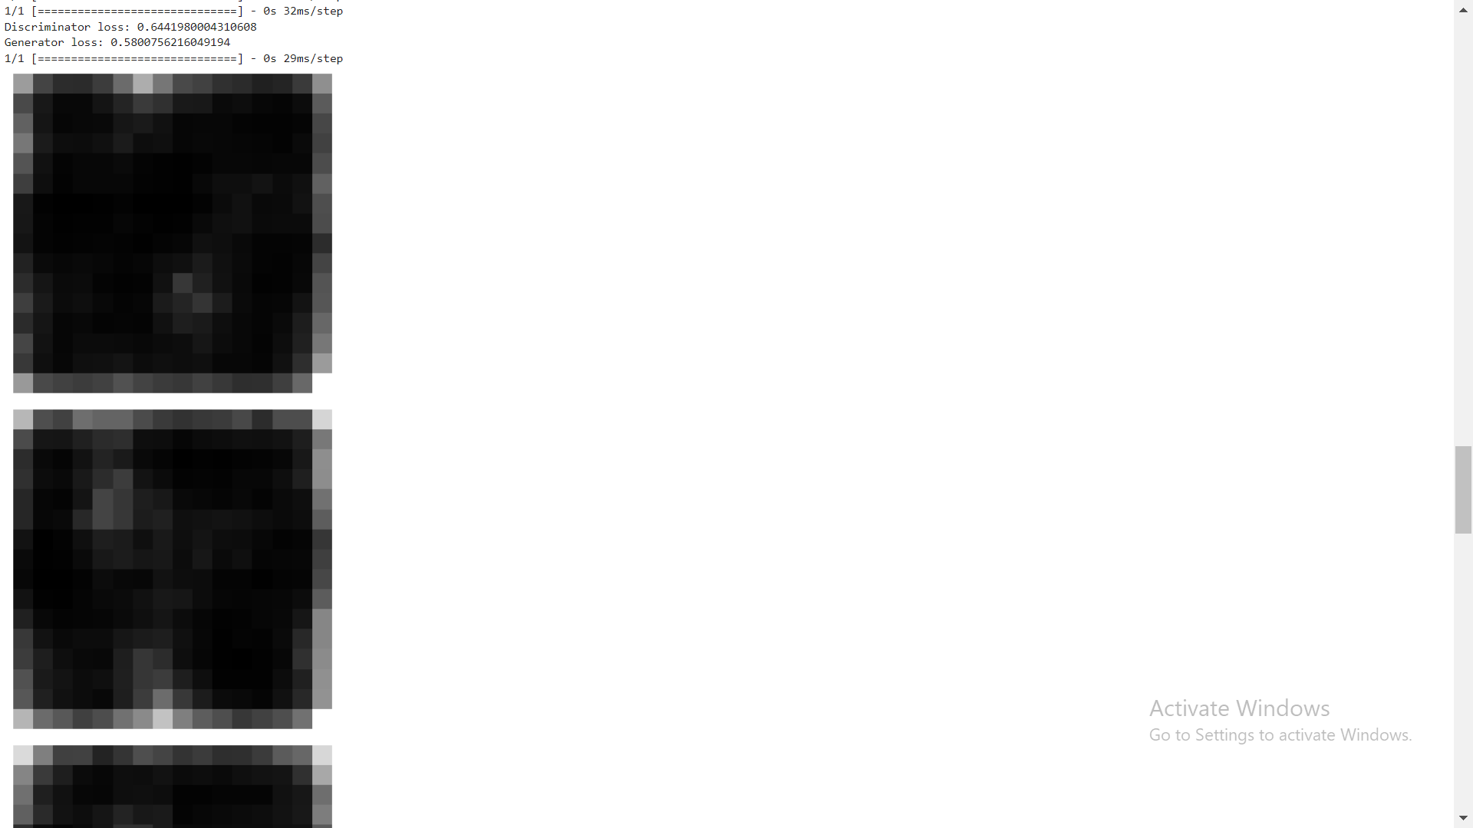
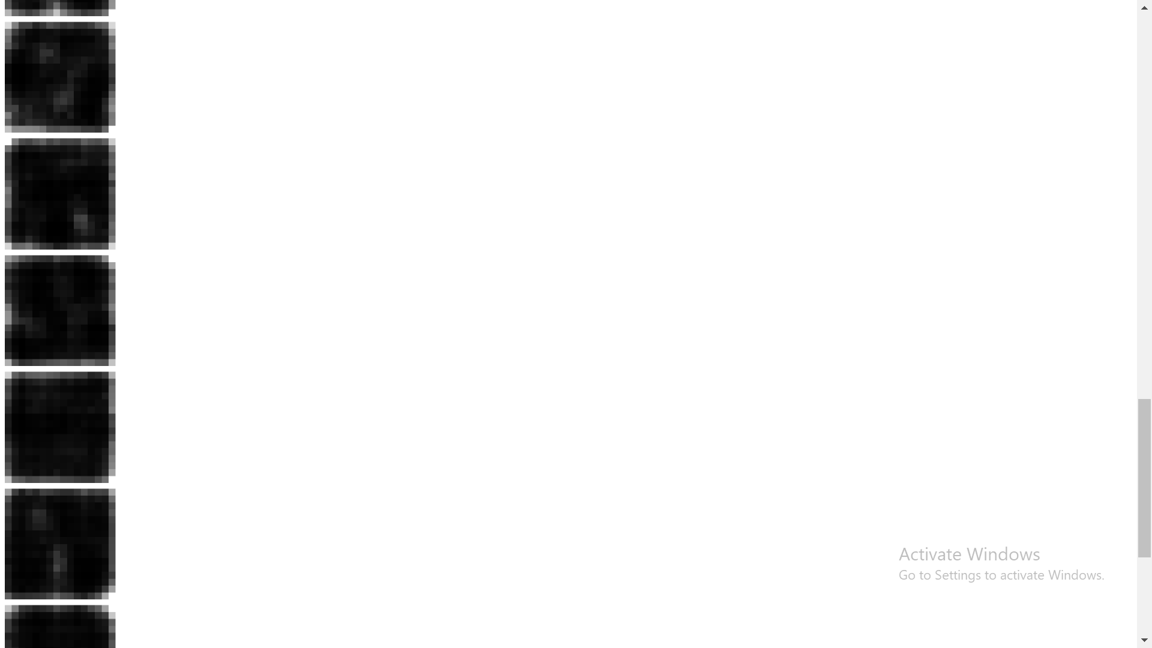
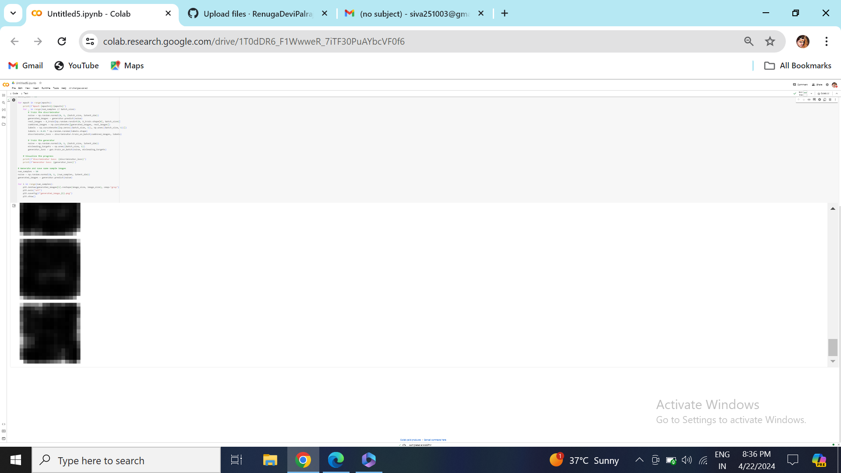
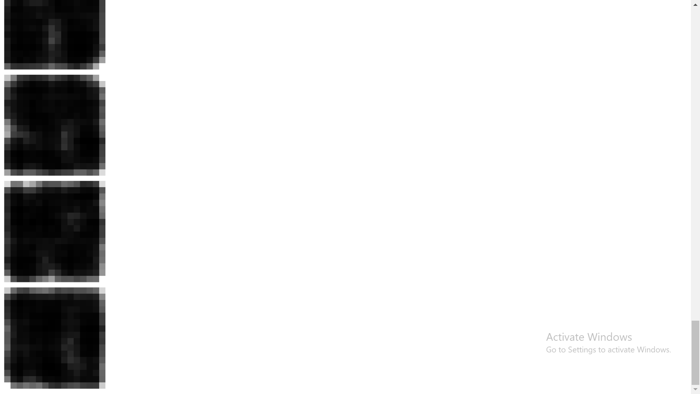
RESULT

Slide 18
SUMMARY OF RESULT
This code implements a Generative Adversarial Network (GAN) to generate square images. The generator learns to create square images resembling the ones in the training set, while the discriminator learns to distinguish between real and fake images. After training for 20 epochs, the generator becomes capable of producing square images similar to those in the dataset. However, since the dataset consists only of simple squares, the generated images will likely resemble squares as well.

