Slide 1


R.M.D Engineering college
Chennai - 601206.
Department of Computer Science and Engineering
Third Review
Content-based Movie Recommendation System
Batch Members: Guided by,
RENUGADEVI C S (111521102123) Mrs. G. MANISHA
SV ANUSHA (111521102137) Assistant Professor

Slide 2
Abstract
This project presents a content-based movie recommendation system leveraging TF-IDF vectorization and cosine similarity to suggest movies tailored to user preferences.
By analyzing attributes like genres, keywords, tagline, cast, and director, the system ensures precise and relevant recommendations. The project strives to bridge the gap between user preferences and movie discovery, ensuring an engaging and innovative experience.
Future scalability includes incorporating machine learning models and deploying the application online to reach a wider audience.
Addresses cold start problem, scalability issues, typo sensitivity.
DEPT OF CSE
Dept of CSE

Slide 3
Introduction
Recommender systems play a critical role in providing personalized suggestions for users in various domains.
The project focuses on creating a content-based movie recommendation system.
The system suggests movies based on user input, considering metadata like genre, cast, director, and keywords.
It employs TF-IDF vectorization to analyze textual data and cosine similarity to calculate closeness between movies.
Enhancements include dynamic poster fetching and a favorites management feature for better user interaction.
DEPT OF CSE

Slide 4
Literature Survey
Title of The paper | Description | Publication details
Movie Recommendation System using Cosine Similarity and KNN | Uses cosine similarity and KNN for recommendations, solving cold-start and scalability challenges. | IJEAT, June 2020
Machine Learning Model for Movie Recommendation System | Proposes a machine learning-based recommendation system using collaborative filtering and content-based filtering approaches. | International Journal of Advanced Research in Engineering and Technology, April 2020
DEPT OF CSE

Slide 5
Literature Survey
Title of The paper | Description | Publication details
Movie Recommendation System Using Content-Based Filtering and Cosine Similarity | Implements content-based filtering with cosine similarity and Euclidean distance for genre-based suggestions. | NCECA Proceedings, 2022
The Movie Recommendation System using Content-Based Filtering with TF-IDF Vectorization and Levenshtein Distance | Combines content-based filtering, TF-IDF, and Levenshtein distance to address the cold-start problem. | IJARSCT, May 2022​
DEPT OF CSE

Slide 6
Objectives
Build a content-based movie recommendation system for
personalized suggestions.
Use TF-IDF Vectorization and Cosine Similarity to measure
movie similarity.
Develop an interactive web application for seamless user
experience.
Ensure scalability and efficiency for handling large movie
datasets.
DEPT OF CSE

Slide 7
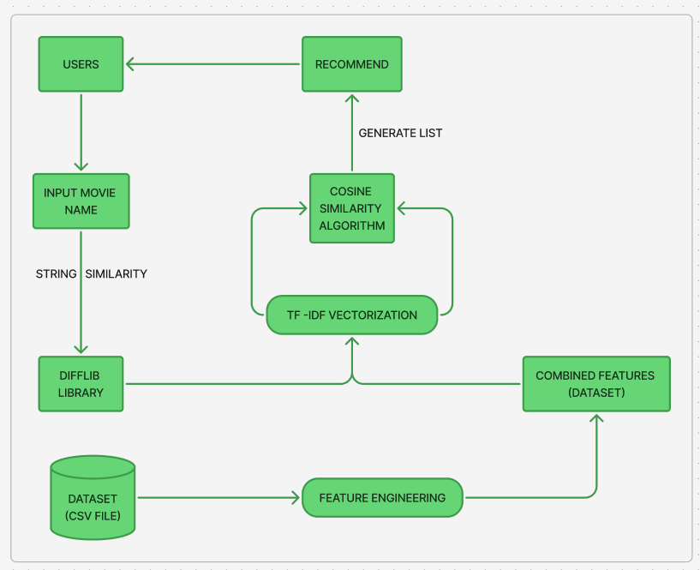
Block Diagram
DEPT OF CSE

Slide 8
Existing System
Many existing systems use collaborative filtering, requiring user interaction data like ratings or watch history and heavy reliance on datasets with user-specific preferences, making them less adaptable for diverse users.
Limitations:
Cold start problem and scalability issues.
Typo sensitivity in user inputs.
Limited personalization due to reliance on user data.
Static recommendations and lack of real-time adaptation.
DEPT OF CSE

Slide 9
Proposed System
A content-based movie recommendation system analyzing movie metadata using TF-IDF and cosine similarity.
Resolves the "cold start" problem by focusing on movie attributes rather than user history.
Dynamically fetches movie posters using TMDB API for better user engagement.
Provides a search suggestion feature for enhanced user experience.
Allows users to manage favorites and explore genres interactively.
DEPT OF CSE

Slide 10
Methodology
Step 1: Data Preprocessing
Source: Movie dataset (movies.csv).
Features Used: Genres, keywords, tagline, cast, and director.
Processing: Handled missing values and combined selected features into a single field for better analysis.
--- Progress Status: Completed
DEPT OF CSE

Slide 11
Methodology
Step 2: Feature Extraction
Technique Used: TF-IDF Vectorization.
Purpose: Converts movie metadata into numerical vectors for similarity computation.
Advantage: Captures important textual relationships for content-based recommendations.
--- Progress Status: Completed
DEPT OF CSE

Slide 12
Methodology
Step 3: Computation & Recommendation Engine
Similarity Measure: Cosine Similarity.
Computation: Calculates similarity scores between movies based on extracted features.
Recommendation Generation: Identifies and ranks top similar movies for user input.
--- Progress Status: Completed
DEPT OF CSE

Slide 13
Methodology
Step 4: Web Application Development & Deployment
Backend: Streamlit for UI & interactivity.
API Integration: TMDB API for fetching posters, trailers, and ratings.
Additional Features:
Favorites management system.
Dynamic movie search with typo handling.
Hosting: Deployable on Streamlit Cloud for accessibility.
--- Progress Status: Ongoing
DEPT OF CSE

Slide 14
Algorithm/Techniques/Tools Used
Algorithms
TF-IDF Vectorization: Converts text to numerical vectors for relevance.
Cosine Similarity: Calculates movie similarity for recommendations.
Tools
Streamlit: Framework for building the web application.
pandas & Python: Dataset preprocessing and API integration.
TMDB API: Fetches movie posters and metadata.
HTML, CSS, JavaScript: For interactive front-end design.
Techniques
Content-Based Filtering: Matches movies by features
Session Management: Tracks user-specific data like favorites.
DEPT OF CSE

Slide 15
Hardware/Software Requirements
Hardware Requirements:
Processor: Intel Core i3 or higher
RAM: Minimum 4GB
Storage: 4-8GB free space (min)
Operating System: Windows 10/11, Linux (Ubuntu), macOS
Internet: Required for API integration (TMDB API)
Software Requirements:
Programming Language: Python 3.8+
Libraries: pandas, NumPy, scikit-learn, Streamlit, requests, difflib
Web Technologies: Streamlit, HTML, CSS, JavaScript
Development Tools: VS Code/PyCharm/ Jupyter Notebook
DEPT OF CSE

Slide 16
Implementation Flow
The project is implemented using Python and Streamlit for backend development.
The dataset is preprocessed to handle missing values and merge metadata fields into a unified format.
TF-IDF vectorization is applied to analyze textual movie attributes numerically.
A web interface is created to display recommendations, allowing users to explore genres and manage favorites.
API integration is implemented to fetch dynamic movie posters for better visualization.
DEPT OF CSE

Slide 17
Expected Outcomes
Deliver a fully functional content-based movie recommendation system accessible through a web interface.
Provide accurate movie suggestions based on metadata similarity using TF-IDF and cosine similarity.
Enable dynamic poster fetching through TMDB API for an engaging user experience.
Offer advanced features like search suggestions, genre-based filtering, and a favorites management system.
Improve user experience by overcoming limitations like the cold start problem and lack of textual metadata analysis.
DEPT OF CSE

Slide 18
References
https://en.wikipedia.org/wiki/Cosine_similarity
https://Streamlit.palletsprojects.com/en/latest/
https://github.com/richardwarepam16/movie-recommender-system-content-based
https://scikit-learn.org/stable/modules/feature_extraction.html#tfidf-term-weighting
DEPT OF CSE

Slide 19
Future Enhancements
Dynamic Search Suggestions: Implement Levenshtein Distance to handle typos and provide real-time movie suggestions during searches.
Enhanced Filtering Options: Add advanced filters for genres, year, language, and runtime to refine recommendations and improve user experience.
Hybrid Recommendation System: Combine content-based and collaborative filtering techniques for more accurate and personalized suggestions.
User Ratings & Popular Movies: Introduce user ratings to enhance collaborative filtering and display trending or top-rated movies using APIs.
Global Accessibility: Deploy the system online, ensuring it is accessible to users worldwide.
DEPT OF CSE

Slide 20
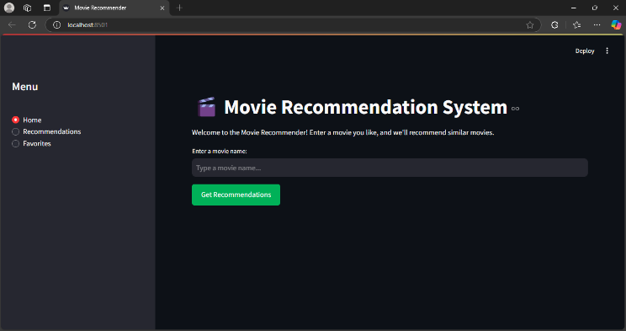
Sample output

Slide 21
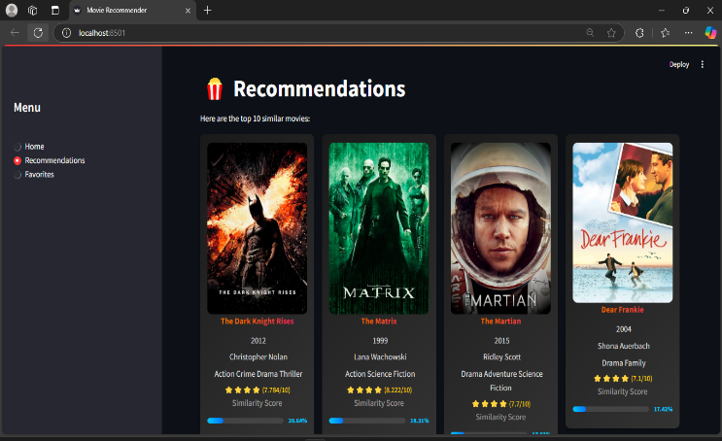

Slide 22
THANK YOU

