Slide 1
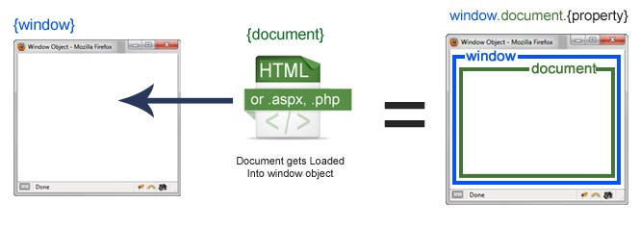
WINDOW
Window is the main JavaScript object root.
also can be treated as the root of the document object model.
Well, the window is the first thing that gets loaded into the browser. This window object has the majority of the properties like length, innerWidth, innerHeight, name, if it has been closed, its parents, and more.

Slide 2
DOCUMENT
What about the document object then? The Document object(DOM) is your html, aspx, php, or other document that will be loaded into the browser. The document actually gets loaded inside the window object and has properties available to it like title, URL, cookie, etc. What does this really mean? That means if you want to access a property for the window it is window.property, if it is document it is window.document.property which is also available in short as document.property.
window object:
window.document.bgColor = "aqua";
const height = document.getElementById('innerheight');
const width = document.getElementById('innerwidth');
window.document.querySelector('h1').textContent =
"Welcome to window object";
height.textContent = "innerheight - " +
window.innerHeight;
width.textContent = "innerwidth - " +
window.innerWidth;

Slide 3
Object Document
document.bgColor = "rgb(89, 135, 235)";
const text = prompt('enter the text to appear on screen');
const h1 = document.querySelector('h1');
h1.textContent = text;
const p = document.getElementsByClassName('details');
p[0].textContent = "document type:" +
document.contentType;
p[1].textContent = "url :" + document.bgColor;
p[2].textContent = "title :" + document.title;

Slide 4
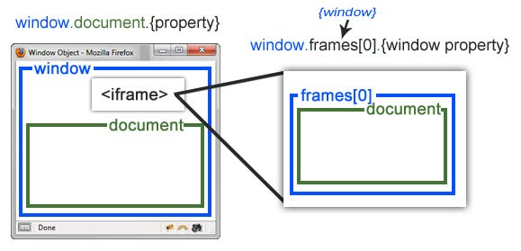
SCREEN
The Window object also has a screen object with properties describing the physical display:
screen properties width and height are the full screen
screen properties availWidth and availHeight omit the toolbar

