Slide 1
Thread In Java

Slide 2
Multitasking
Multitasking is a process of executing multiple tasks simultaneously. We use multitasking to utilize the CPU.
Multitasking can be achieved in two ways:
Process-based Multitasking (Multiprocessing)
Thread-based Multitasking (Multithreading)

Slide 3
1) Process-based Multitasking (Multiprocessing)
Each process has an address in memory. In other words, each process allocates a separate memory area.
A process is heavyweight.
Cost of communication between the process is high.
Switching from one process to another requires some time for saving and loading registers, memory maps, updating lists, etc.

Slide 4
2) Thread-based Multitasking (Multithreading)
Threads share the same address space.
A thread is lightweight.
Cost of communication between the thread is low.

Slide 5
What is Thread in java
A thread is a lightweight subprocess, the smallest unit of processing.
It is a separate path of execution.

Slide 6
Creating a Thread
In Java Thread can be created two ways
Using Thread class
Create a user-defined class which will have java.lang.Thread as super class.
public class HelloThread extends Thread
Using Runnable interface
Create a user-defined class which will implement java.lang.Runnable interface.
public class HelloRunnable implements Runnable

Slide 7
Java Thread class
Java provides Thread class to achieve thread programming.
Thread class provides constructors and methods to create and perform operations on a thread.
Thread class extends Object class and implements Runnable interface.

Slide 8
Life cycle of a Thread (Thread States)
In Java, a thread always exists in any one of the following states. These states are:
New
Active
Blocked / Waiting
Timed Waiting
Terminated

Slide 9
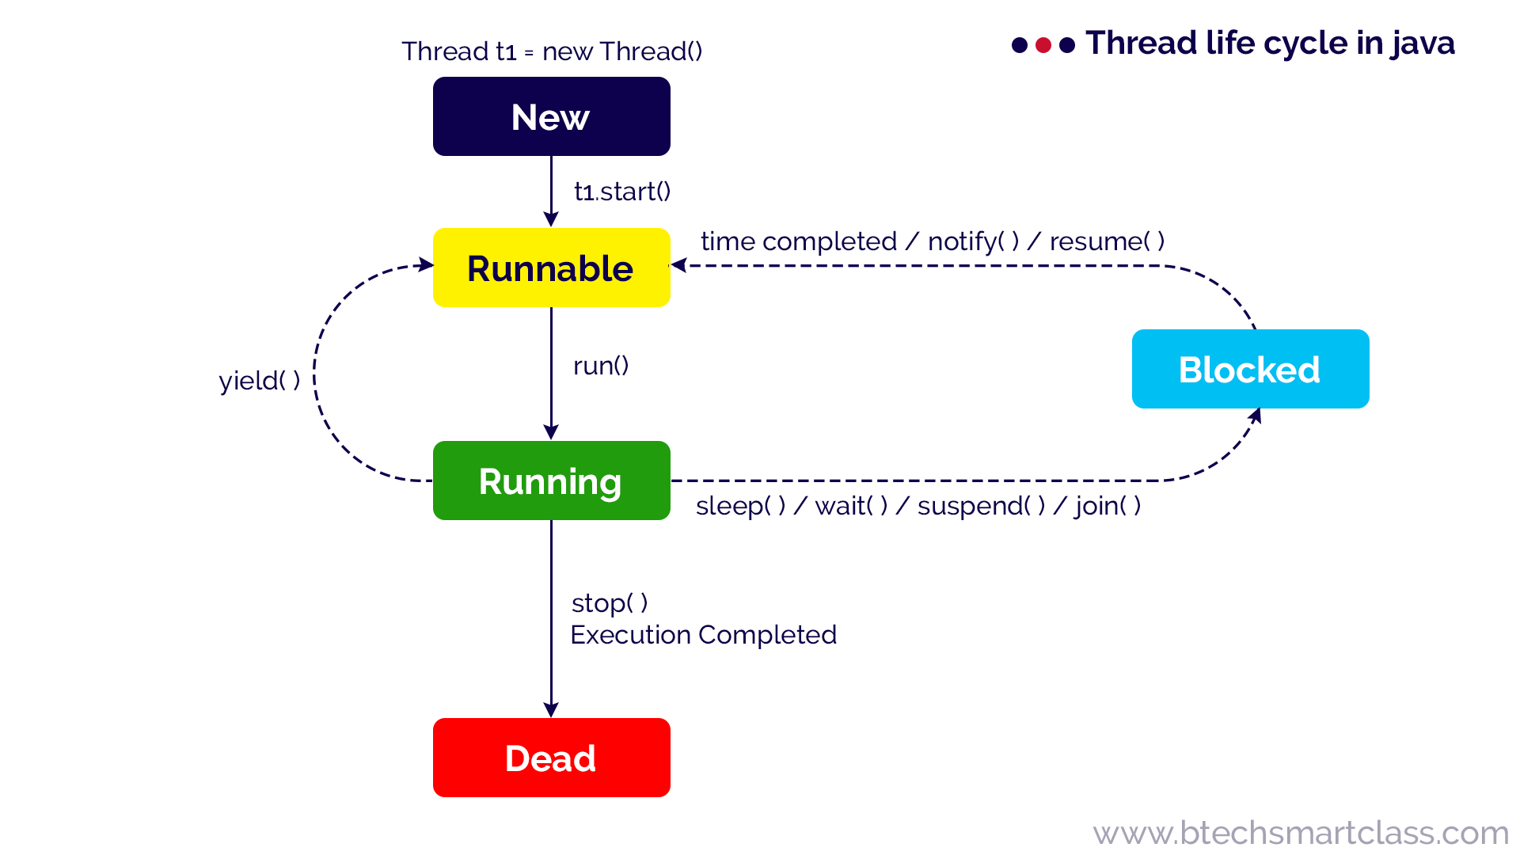

Slide 10
Thread methods
start()
sleep(long millisecond)
join()
yield()
interrupt()
interrupted()
isAlive()
currentThread()

Slide 11
Join()
When the join() method is invoked, the current thread stops its execution and the thread goes into the wait state.
The current thread remains in the wait state until the thread on which the join() method is invoked has achieved its dead state.
If interruption of the thread occurs, then it throws the InterruptedException.

Slide 12
Thread Synchronization
It refers to the concept where only one thread is executed at a time while other threads are in the waiting state.
This process is called thread synchronization.
There are two types of thread synchronization mutual exclusive and inter-thread communication.
1:Mutual Exclusive
Synchronized method.
Synchronized block.
Static synchronization.
2:Cooperation (Inter-thread communication in java)

Slide 13
Java Synchronized Method
If you declare any method as synchronized, it is known as synchronized method.
Synchronized method is used to lock an object for any shared resource.
When a thread invokes a synchronized method, it automatically acquires the lock for that object and releases it when the thread completes its task.
synchronized void printTable(int n){
//some code here
}

Slide 14
Synchronized Block in Java
Synchronized block can be used to perform synchronization on any specific resource of the method.
Suppose we have 50 lines of code in our method, but we want to synchronize only 5 lines, in such cases, we can use synchronized block.

