Slide 1

Project Title - Seasonal Agriculture Performance Analysis
[Student Name -Renuka K R
College Name-Sree Saraswathi Thyagaraja collage]
AICTE STU ID : (STU6a5ef250a2f181784607312)

Slide 2

PROBLEM STATEMENT
Agricultural activities are influenced by seasonal variations in environmental conditions, farming practices, resource availability and market conditions. As a result, agricultural performance may differ from one season to another. However, raw agricultural data does not clearly explain how agricultural performance changes across seasons or what patterns can be observed in different seasonal conditions. The problem is to analyze the given agricultural dataset and investigate seasonal differences in agricultural performance by identifying meaningful patterns, trends, relationships and variations within the available data.

Slide 3
Project Description [write detail description about your project ]
This project analyzes seasonal agricultural performance using a dataset of 4,000 farm records spanning 8 Indian states, 8 major crops, and three cropping seasons — Kharif, Rabi, and Zaid. The dataset captures environmental conditions (rainfall, temperature, humidity, soil health), resource usage (fertilizer, pesticide, irrigation, water consumption), and economic outcomes (yield, production, cost, revenue, and profit) for each farm. Using Python in Google Colab, the data was cleaned, explored, and visualized to uncover how agricultural performance varies across seasons, identify significant patterns using statistical testing (ANOVA), and understand the relationships between seasonal conditions and farming outcomes. The analysis concludes with data-driven insights and recommendations to support better seasonal agricultural planning.

Slide 4
Dataset: 4,000 farm records | 8 states | 8 crops | 3 seasons (Kharif, Rabi, Zaid)
Scope: Environmental factors, resource usage, and economic performance across seasons
Approach: Data cleaning → Exploratory analysis → Statistical testing → Visualization → Insights
Tools: Python (Pandas, Matplotlib, Seaborn, SciPy) on Google Colab
Goal: Identify seasonal patterns, trends, and relationships to support evidence-based agricultural planning
Outcome: Season-wise, crop-wise, and state-wise insights with actionable recommendations

Slide 5
WHO ARE THE END USERS?
Farmers — choose crops/irrigation methods suited to the season
Agricultural Officers & Extension Workers — give season-specific advisories
State Agriculture Departments & Policy Makers — design seasonal subsidy schemes
Agri-Input Companies — plan seasonal demand for seeds, fertilizer, pesticides
Banks & Crop Insurance Providers — assess seasonal risk for loans and insurance
Agricultural Researchers & Analysts — study trends, build predictive models
NGOs & Rural Development Organizations — target support to loss-making regions

Slide 6

Technology Used
Category | Technology / Tool | Purpose
Language | Python | Core language for the analysis
Platform | Google Colab | Cloud notebook environment
Library | Pandas | Data loading, cleaning, manipulation
Library | NumPy | Numerical computations
Library | Matplotlib | Charts and plots
Library | Seaborn | Statistical visualizations
Library | SciPy | ANOVA hypothesis testing
Library | Statsmodels | Tukey HSD post-hoc testing
File Format | CSV / .ipynb | Dataset input & notebook documentation

Slide 7
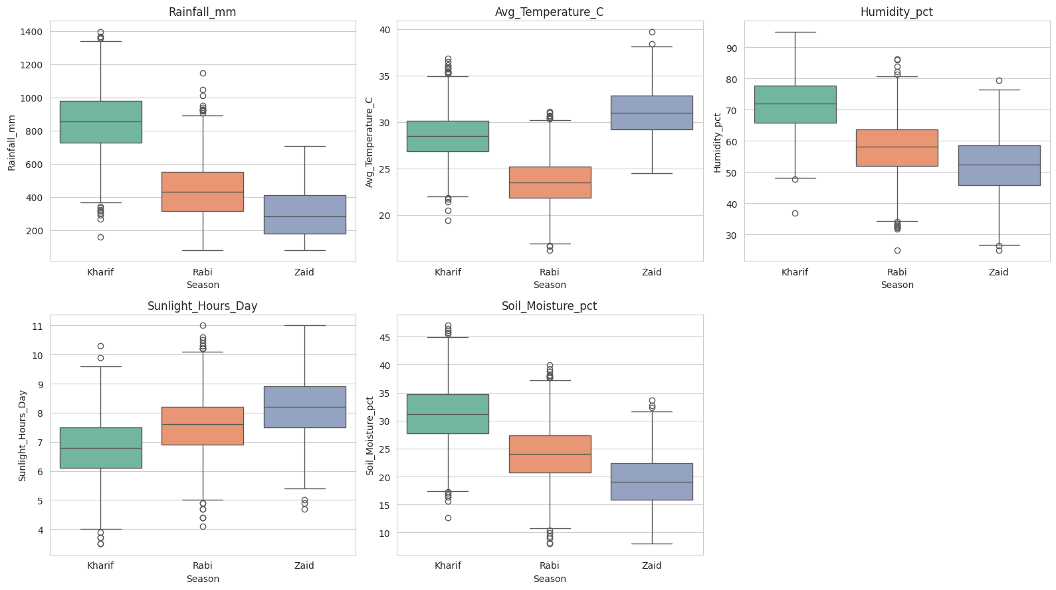
RESULTS
[Environmental Conditions by Season — Rainfall, Temperature, Humidity, Sunlight, Soil Moisture ]

Slide 8
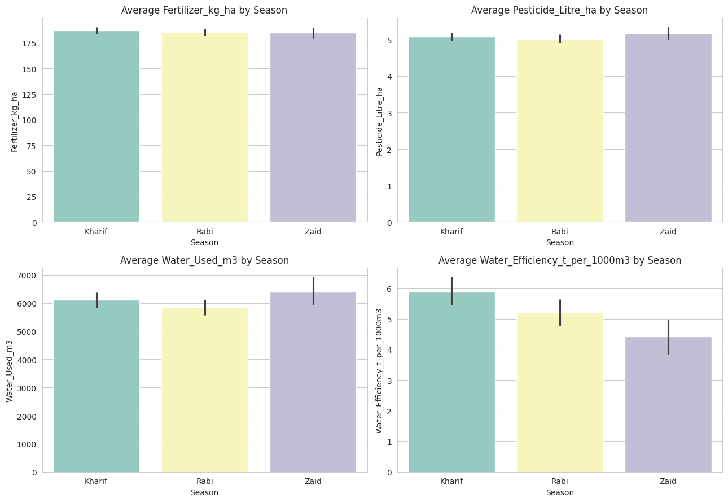
RESULTS
[Resource Usage by Season — Fertilizer, Pesticide, Water Used, Water Efficiency ]

Slide 9
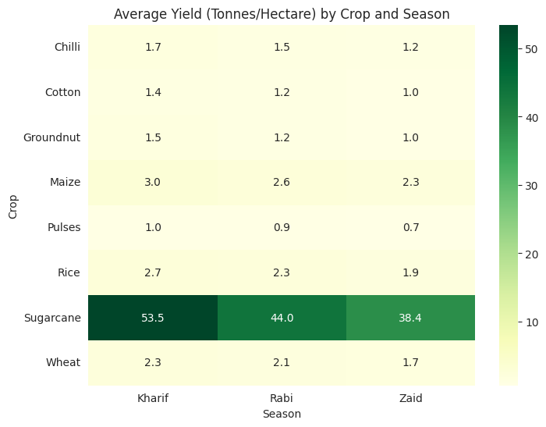
RESULTS
[Average Yield (Tonnes/Hectare) by Crop and Season]

Slide 10
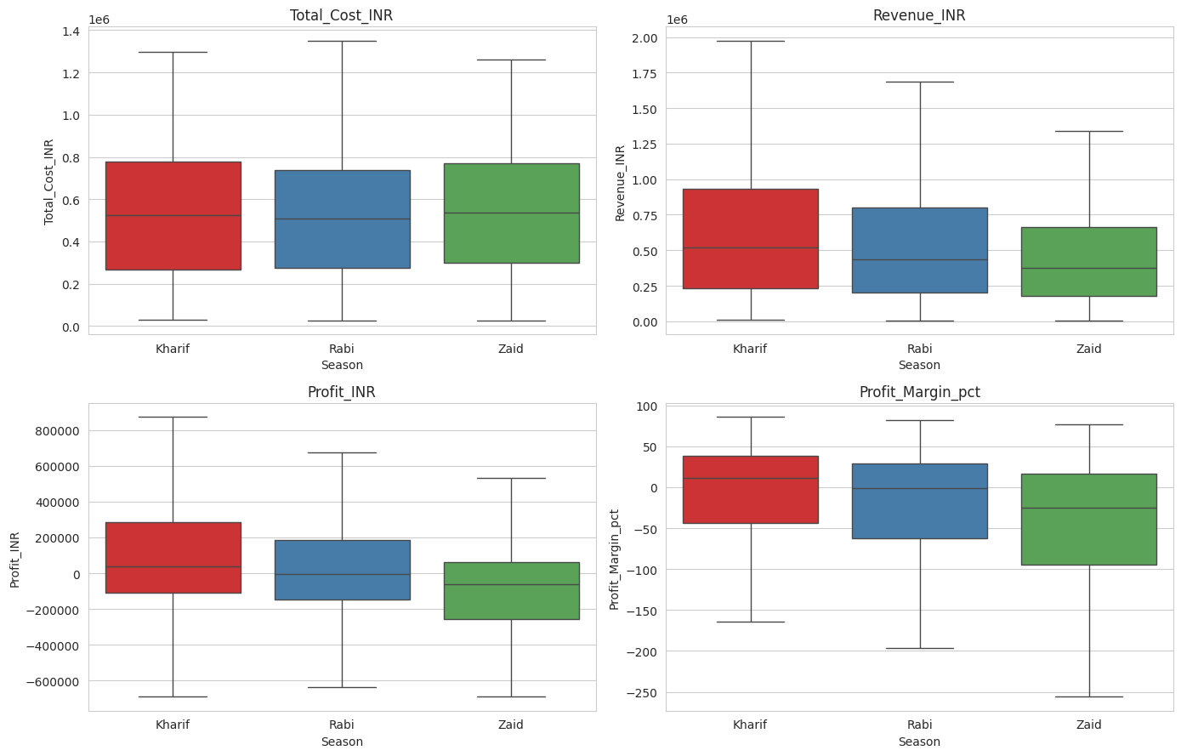
RESULTS
[Economic Performance by Season — Cost, Revenue, Profit, Profit Margin ]

Slide 11
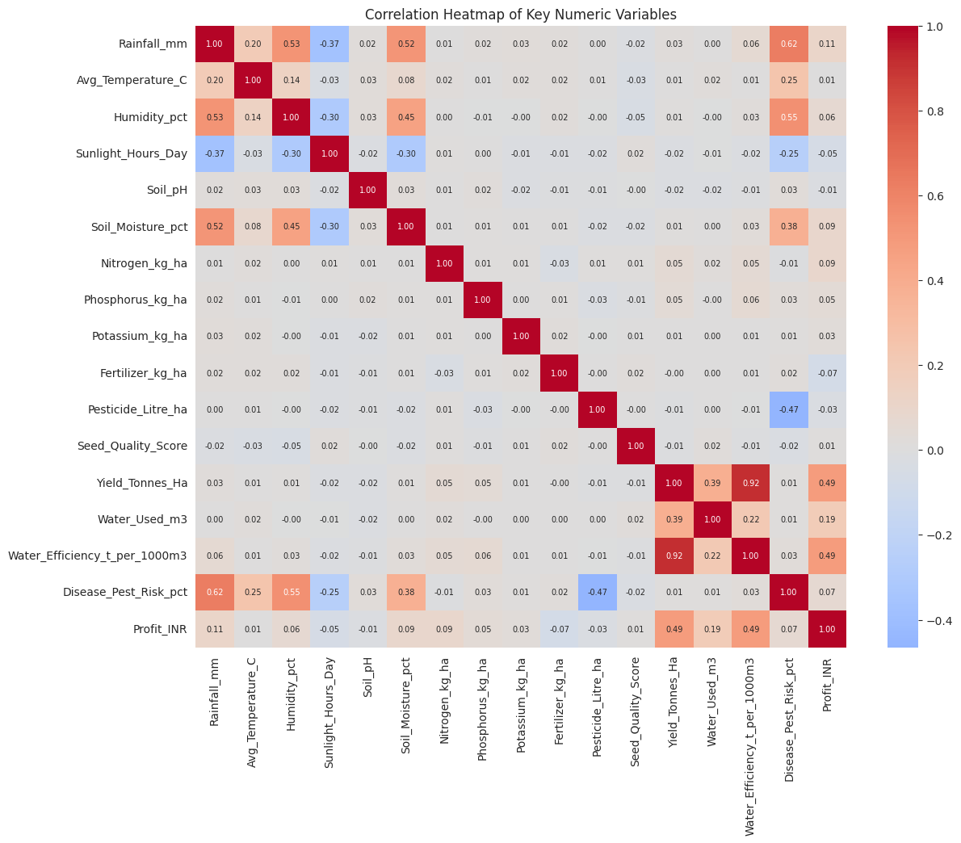
RESULTS
[Correlation Heatmap of Key Numeric Variables ]

Slide 12
Future scope
Predictive Modeling — ML models (Random Forest, XGBoost) to forecast yield/profit
Real-Time Weather Integration — live weather APIs for season-specific irrigation alerts
Larger, Multi-Year Dataset — validate patterns across more states, crops & years
District-Level Drill-Down — more localized recommendations than state-level
Cost Optimization Model — pinpoint which input costs drive farmer losses
Interactive Dashboard — Streamlit/Power BI version for self-service exploration
Crop Recommendation System — suggest best crop-season match per region
Climate Change Impact Study — track shifting rainfall/temperature vs cropping calendars

Slide 13
GitHub Link
https://github.com/Renuka515/Seasonal_Agriculture_Performance_Analysis.git

Slide 14
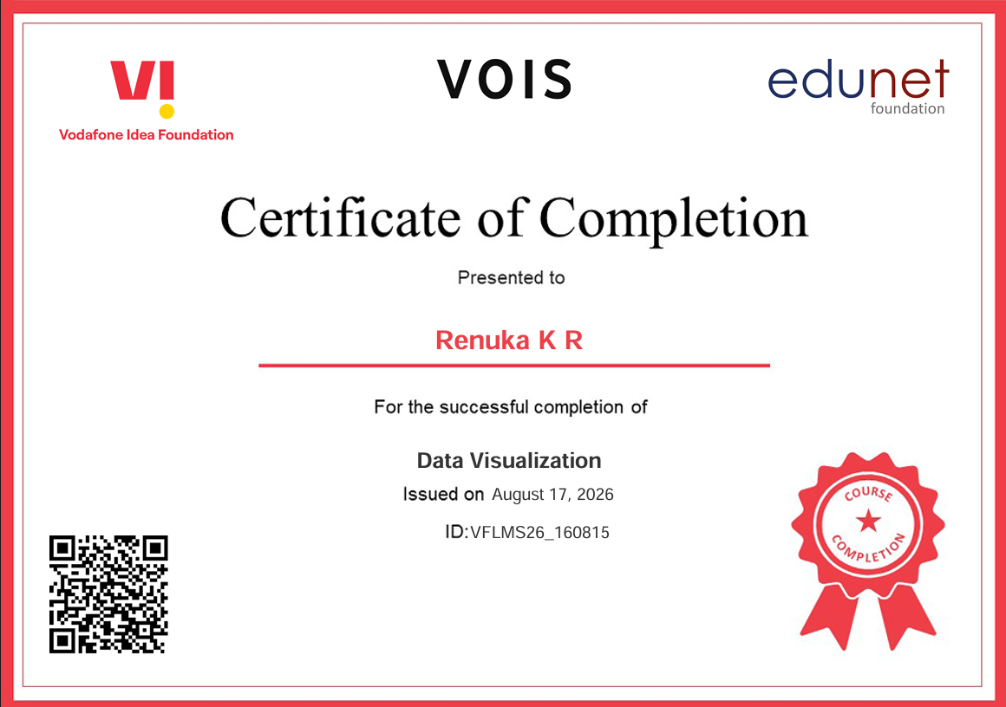
VOIS Course completion certificate - Course name- Data Visualization

Slide 15
Thank you

